Slide 1
Health Monitoring System with PPG & ECG Signal Using IoT
Course No :: EEE 426
Course Title :: Biomedical Signal, Instrument & Measurement Laboratory

Slide 2
Table of Contents
01
02
03
04
05
About the Presenters
Social Impact
Motivation
Name of all the Team Members
The project implementation process and the probable impact on society
Our motivation and driving intention about selecting this project
Milestones
Future of the Project
Description of the milestones we set up for ourselves to achieve & the timeline
Probable update of our project and the possible improvement

Slide 3
Table of Contents
06
07
08
09
10
Review of the System
Algorithm
Heart Conditions
Calculation Algorithm for all the sensor parameters
All the conditions for which alert system works
Used Components and their specifications
Alert System
Cost Breakdown
Process of Alerting patient via twitter or email
The cost of each and every component of our project making it concise and compact

Slide 4
01
About the Presenters
1. Mahfuzul – 1706045
2. Awsaf – 1706066
3. Azfer – 1706070
4. Hridoy – 1706081
5. Tahsin – 1706095
6. Sayonto – 1706103
7. Moin - 1706105

Slide 5
Social Impact
02
The health monitoring system can help people to keep track of their health condition in real time.
The iot based system can upload health data so that doctors can treat patients without even meeting them even from overseas.

Slide 6
Social Impact
02
3. The alert system can notify users of any kind of abnormalities. This can help prevent fatal consequences.4. Old generation people who need constant monitoring can use this device to keep track of their health and notify their family of it as well.

Slide 7
Motivation
03
Health monitoring and its related technologies is an attractive research area.
The Photoplethysmogram (PPG) and electrocardiogram (ECG) has always been a popular measurement scheme to assess and monitor blood volume changes in the micro vascular bed of tissue, measures heart rate and its variability for clinical diagnosis of cardiac illness and oxygen saturation level in blood and cardiovascular activity (CVDs).

Slide 8
Motivation
The number of ECG and PPG monitoring systems in the literature is expanding exponentially. Hence, it is very hard for researchers and healthcare experts to choose, compare, and evaluate systems that serve their needs and fulfil the monitoring requirements.
This accentuates the need for a verified reference guiding the design, classification, and analysis of ECG and PPG monitoring systems, serving both researchers and professionals in the field.

Slide 9
Motivation
Moreover, biomedical signal transmission through IoT cloud provides an additional benefit in health monitoring especially for ailing senior citizens who are remotely located.
In this project, we propose a comprehensive, PPG and ECG monitoring systems with IoT. It will provide real time PPG and ECG signal monitoring on cloud. Moreover, it will also provide information on Beats Per Minute (BPM) and Oxygen Saturation (SpO2).
Finally, we identify key challenges and emphasize the importance of smart monitoring systems that leverage new technologies, including Internet of Things (IoT), to provide efficient, cost-aware, and fully connected monitoring systems.

Slide 10
Milestones
04
Milestone 2
On Device updating BPM calculation and SpO2 on remote Server such as ThingSpeak
Milestone 1
On Device Heart Rate Calculation in beats per minute (BPM) & Oxygen Saturation (SpO2) calculation in percentage.
Milestone 3
Analyzing data from ThingSpeak Server and Sending alert messages to the Users Email ID & Twitter Account of one’s choice – Building an Alert System
i) Beat Per Minute (BPM) and Oxygen Saturation (SpO2) calculation from PPG Signal
ii) Beat Per Minute (BPM) calculation form ECG signal

Slide 11
Future of the Project
05
3. Deep learning models can also be used to detect motion and activities such as, sleep, workout, rest etc.
1. The alert system can be easily improved by introducing a mobile application to send notification directly to the phone.
4. The device can be modified for better consumer level use cases.
2. Deep learning models can be used on the backend of this device or with the help of mobile application. Such model can be used to predict any kind of abnormalities by analyzing user data.

Slide 12
Review of Systems
01
02
03
04
05
06
PPG Sensor
ECG Sensor
Model MAX30100 Measures Heart Rate & Oxygen Saturation percentage
Model AD8232 Measures Heart Rate for any sudden anomalies of the patient
Arduino Uno
LCD Display
Node MCU
Data received from the sensor is obtained here for calculation
The immediate heart rate and SpO2 is shown to the patient here
WiFi module ESP8266 is used to send data to ThingSpeak

Slide 13
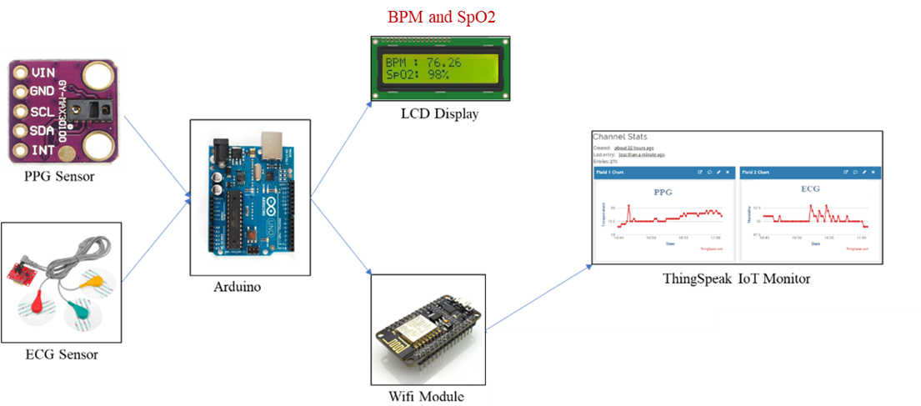


Block Diagram
Mailed to dedicated physician if anomaly detected
Alert Message sent to twitter account

Slide 14
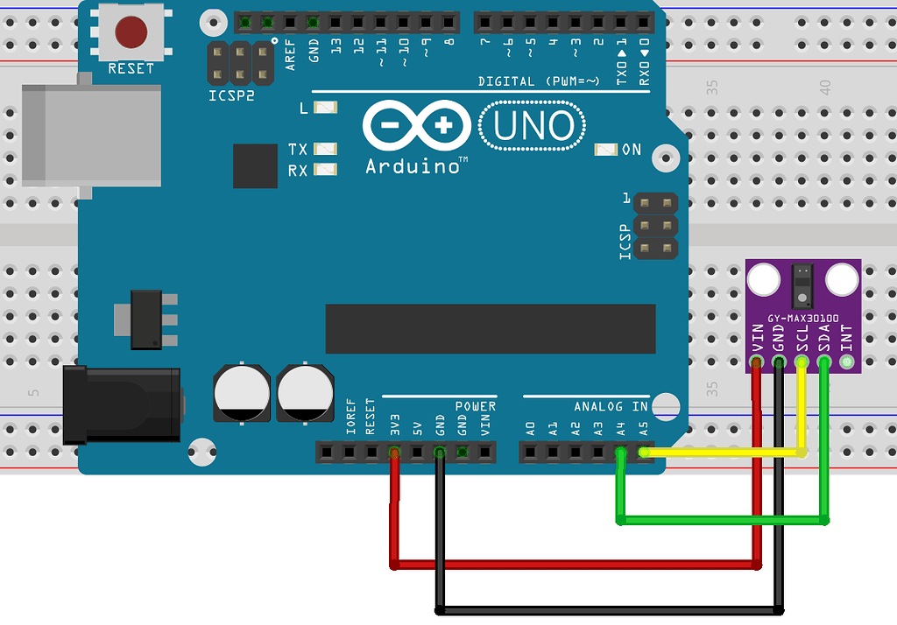
Circuit for PPG Sensor
Firstly, PPG Vin is connected to 3.3v from Arduino and Ground Connected to Arduino GND
Secondly, The SCL port is connected to Analog input A5 of Arduino to synchronously clock data in and out of the slave device
Thirdly, SDA port is connected to pin A4 of Arduino to transmit data between the master devices and slave devices.

Slide 15
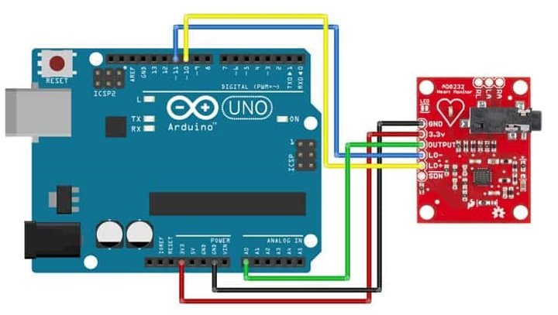
Circuit for PPG Sensor
Firstly, ECG Vin is connected to 3.3v from Arduino and Ground Connected to Arduino GND
Secondly, The Output port is connected to Analog input A0 of Arduino to send ECG data to master device.
Thirdly, LO+ and LO- port is connected to pin 10 & 11 of Arduino to compare data obtained from electrodes.

Slide 16
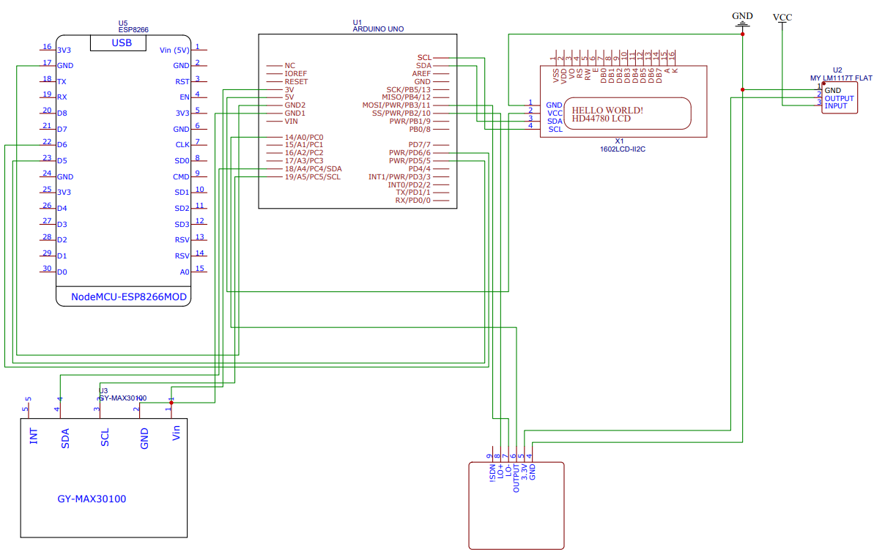
Circuit as a whole

Slide 17
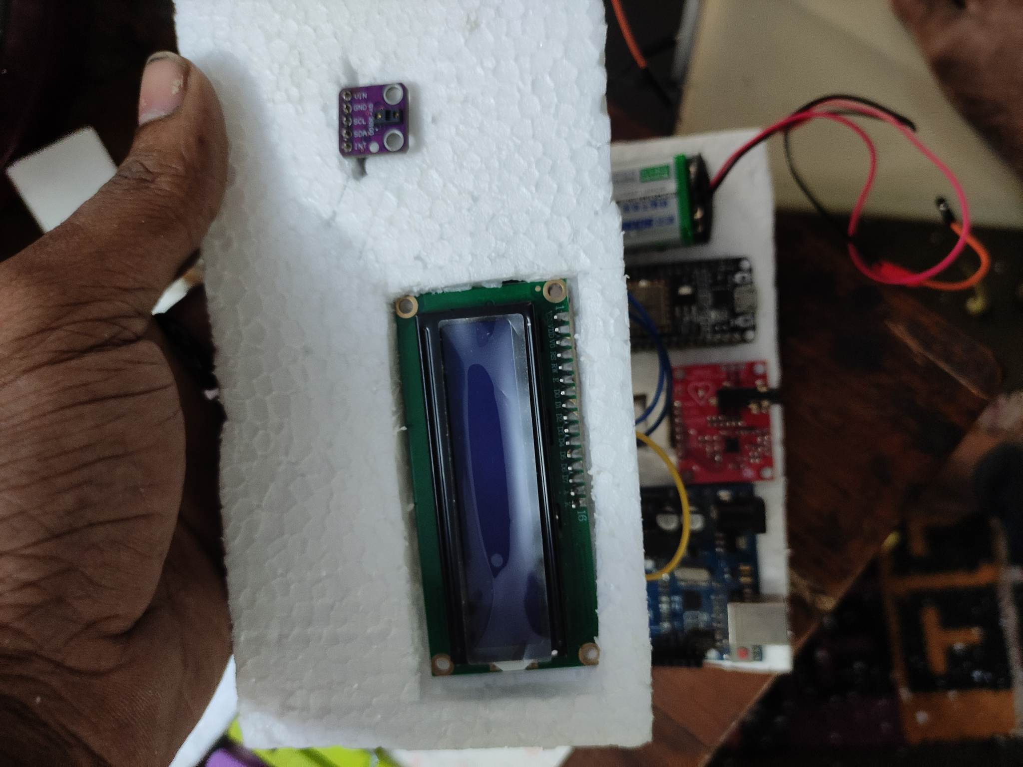
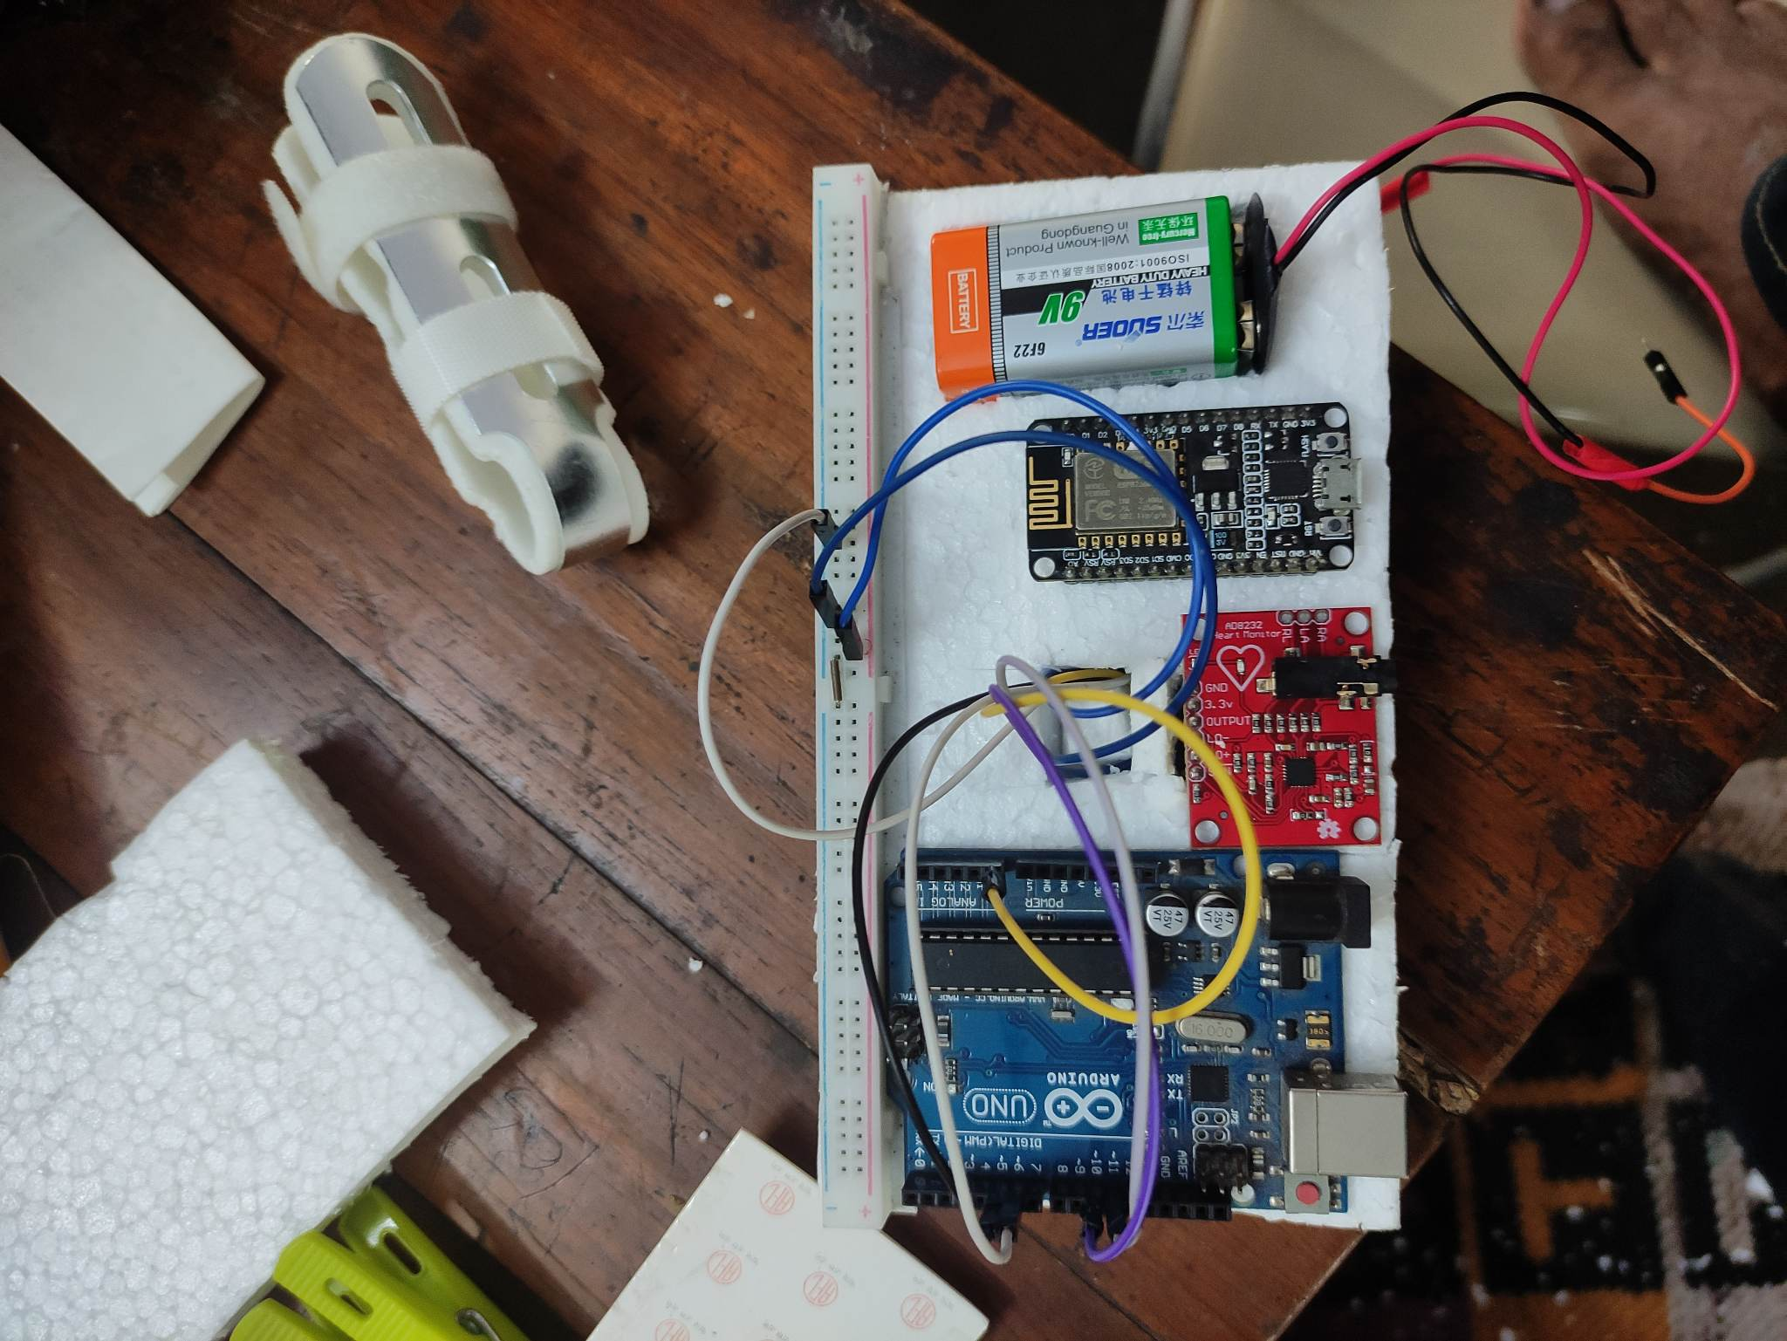
Project Setup

Slide 18
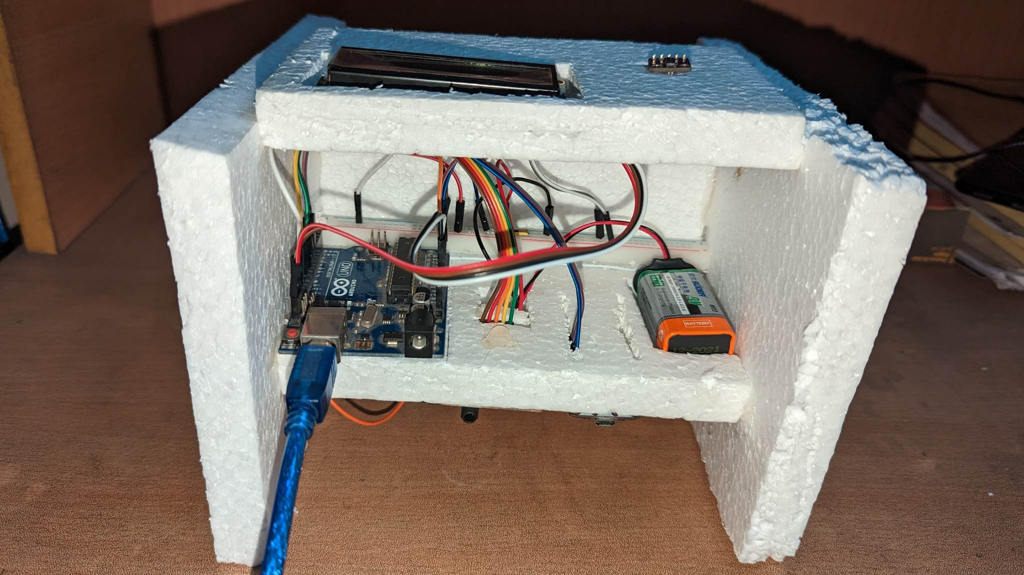
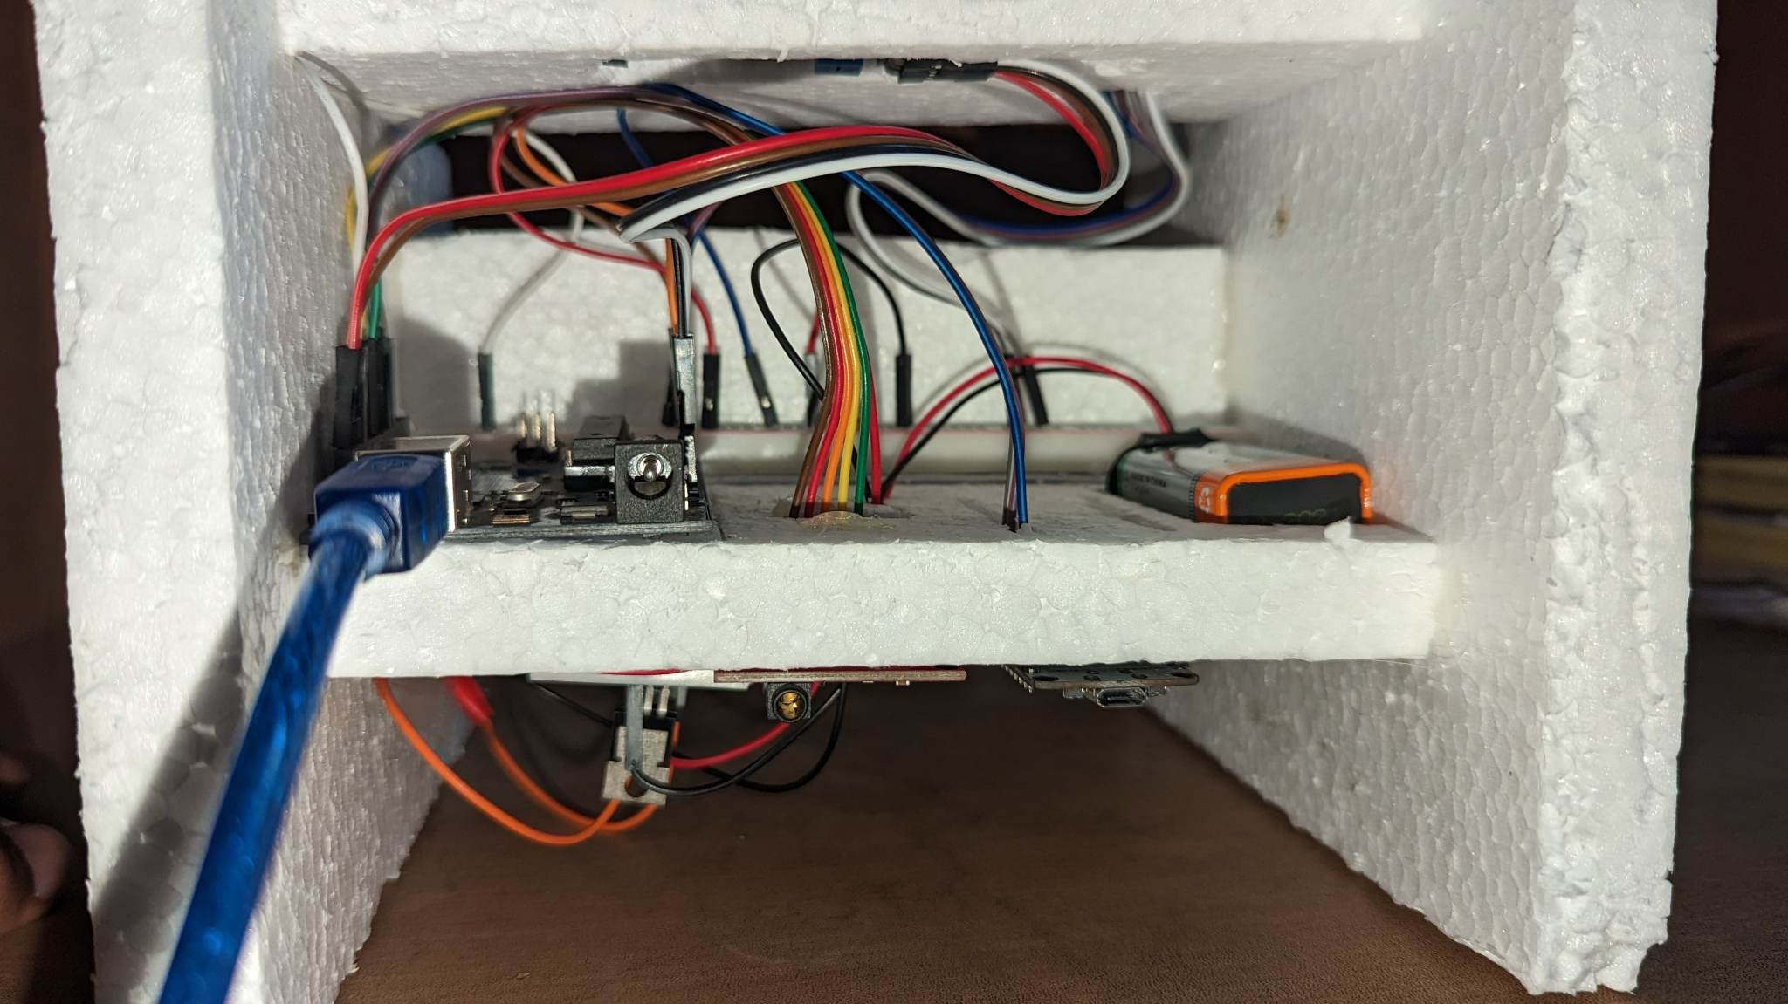
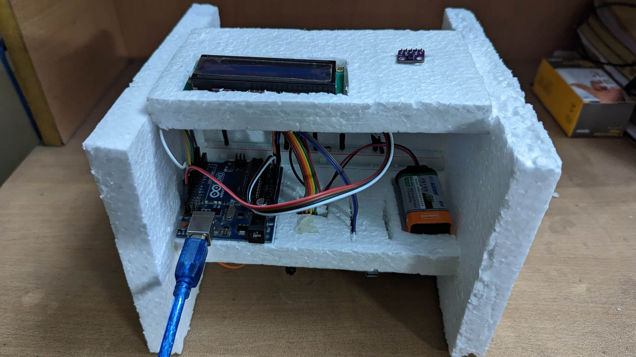
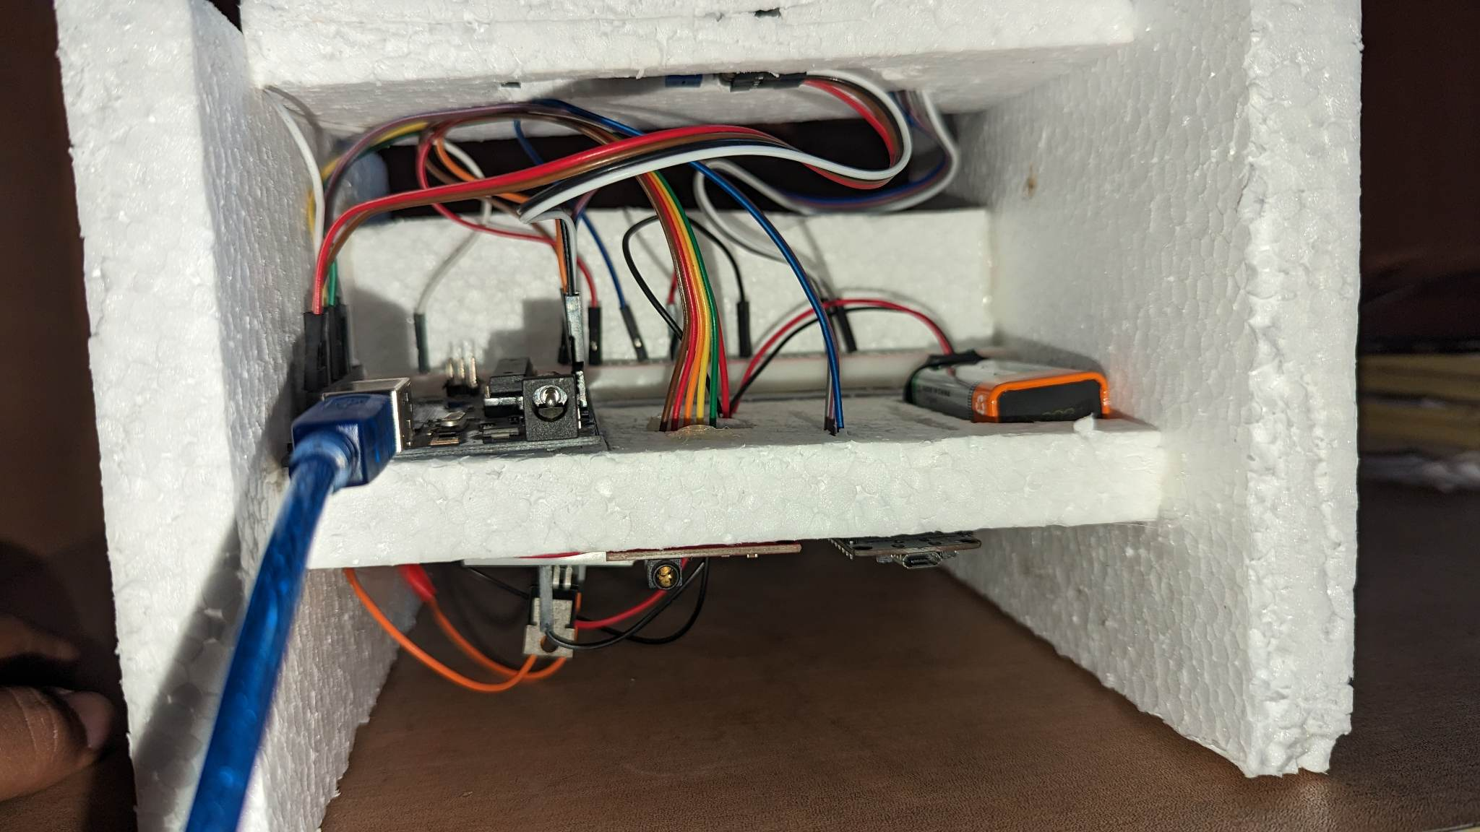
Project Setup

Slide 19
07
Algorithm for BPM and SpO2 Calculation

Slide 20
How is it calculated
BPM from PPG
SpO2 from PPG
BPM from ECG
Alert System
The Heart rate is measured by counting Number of samples in 3 beats
The Laser from PPG sensor measures the saturation of oxygen in patient blood to find haemoglobinated blood.
Peak of heart beat measured with precision from AD8232
Data is then sent to ThingSpeak server, which calculates the Heart Condition and provides the Update to Twitter Account & Email ID

Slide 21
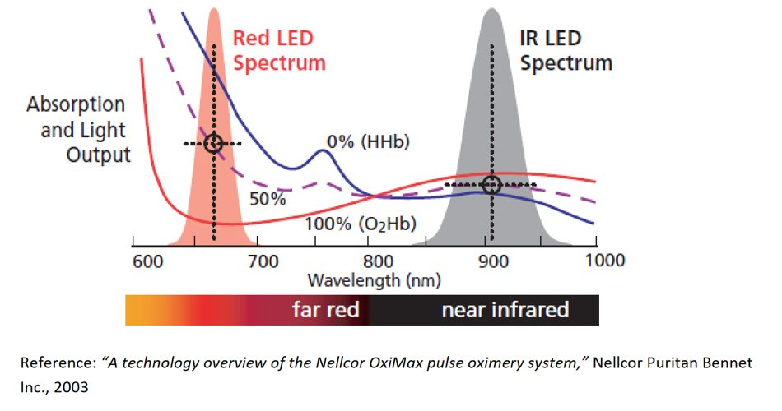
The PPG Sensor Wavelengths here are
Lambda 1 = 660 nm
Lambda 2 = 940 nm

Slide 22
The algorithm
The Oxygenated haemoglobin absorbs less red light and absorbs more IR light. So, the blood volume at high saturation has less impact on detected red signal than on the IR signal. That is, the AC component of Red signal is smaller than that of IR signal.
Deoxygenated haemoglobin absorbs less IR light than red light so the blood volume at low saturation has less impact on the detected IR signal than on the red signal. That is, the AC component of IR signal is smaller than that of red signal.

Slide 23
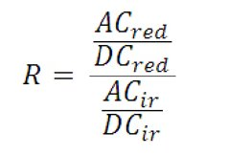
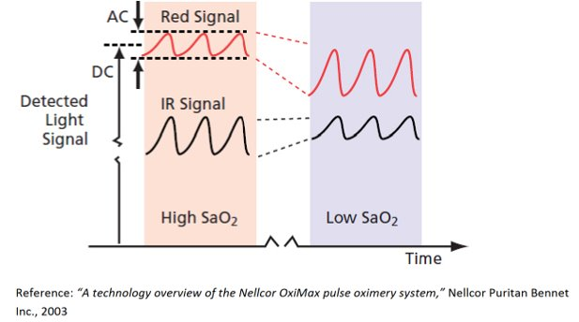
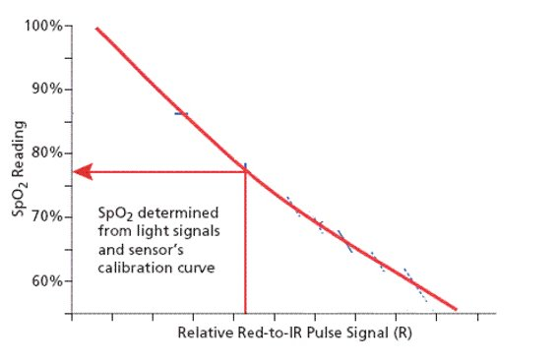
The algorithm
Ratio of Ratio,

Slide 24
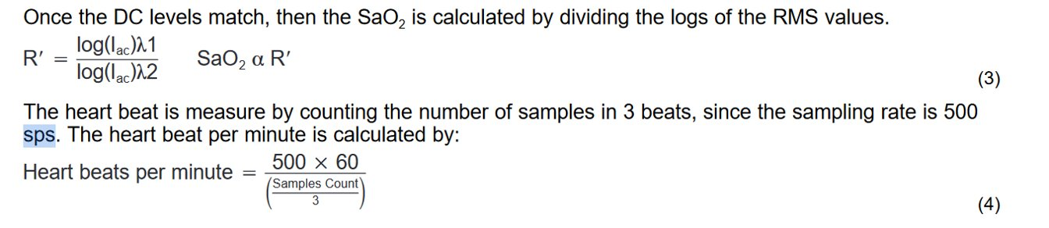
The algorithm
The PPG Sensor Wavelengths here are
Lambda 1 = 660 nm
Lambda 2 = 940 nm

Slide 25
Heart Conditions
08
The Heart Rate less than 60 BPM is known as Bradycardia
If the heart rate is greater than 100 BPM it is known as Tachycardia
If the SpO2 is less than 85% it is known as Severe Hypoxia
If SpO2 is less than 90% it is known as Moderate Hypoxia
If SpO2 is less than 95% it is known as Mild Hypoxia

Slide 26
09 Alert System
Twitter
Email
Twitter account can be of any choice of the user. The account can be updated every 5 minutes. Thus, if any anomaly occurs the Twitter account gets a tweet for patient’s relatives or physician. This doesn’t necessarily mean updating every 5 minute, but it can be changed.
The Email ID has a constraint of sending an email twice in every 30 minute. The Email ID cannot be updated less than this time limit. Thus the threshold is set between Bradycardia and Tachycardia

Slide 27
10 Cost Breakdown
Component Name | Price (TK) | Quantity | Reference
PPG Sensor GY-Max30100 | 297 | 1 | Link
AD8232 ECG Sensor | 790 | 1 | Link
Arduino Uno | 1050 | 1 | Link
ESP8266 Wi-Fi Module | 420 | 1 | Link
16 x 2 LCD Display | 240 | 1 | Link
LM1117 IC | 49 | 1 | Link
Wire | 100 | 1 | Link
Battery | 100 | 1 | Link
Total | 3046 | 8

Slide 28

Thanks to everyone for your kind patience
Do you have any questions?

