Slide 1
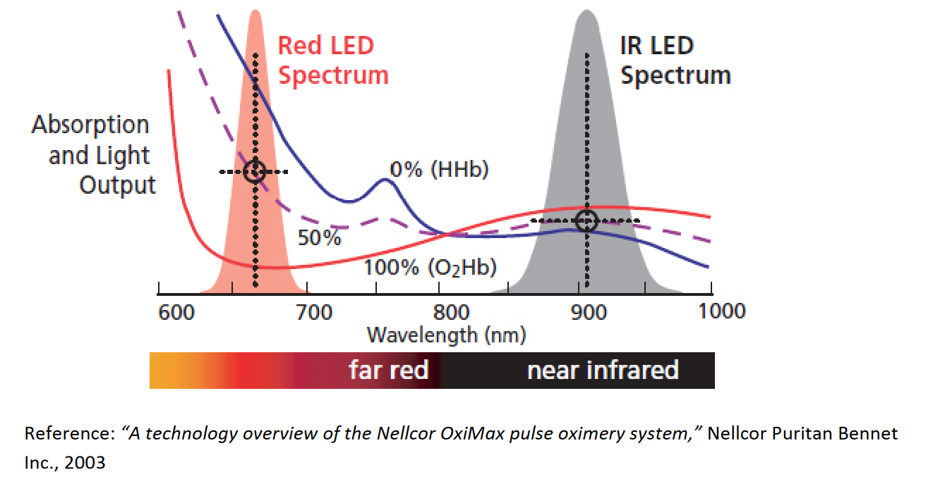
SpO2 Calculation From PPG Signal
HHb: Deoxyhemoglobin
O2Hb: Oxyhemoglobin

Slide 2
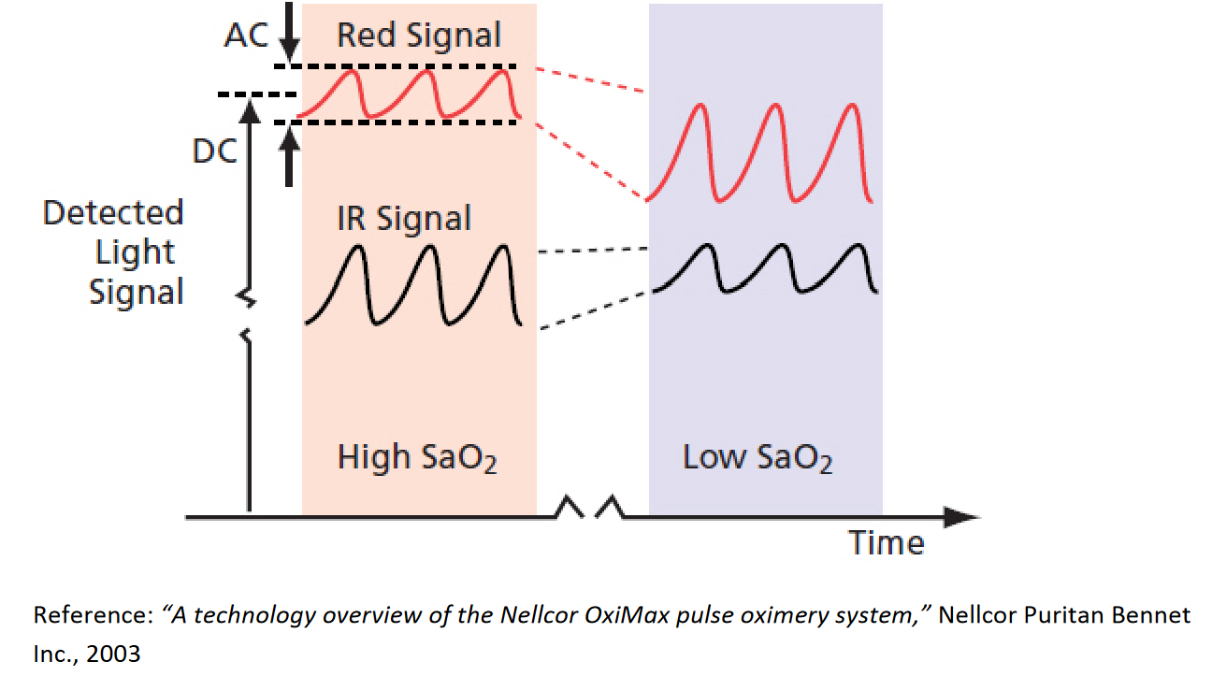
SpO2 Calculation From PPG Signal
Oxygenated Haemoglobin absorbs less red light than infrared (IR) light and so the blood volume at high saturation has less impact on the detected red signal than on the IR signal. That is, the AC component of the Red Signal is smaller than that of the IR signal.
Deoxygenated Haemoglobin absorbs less IR light than red light and so the blood volume at low saturation has less impact on the detected IR signal than on the red signal. That is, the AC component of the IR signal is smaller than that of the red signal.

Slide 3
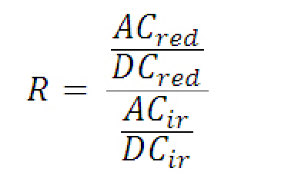
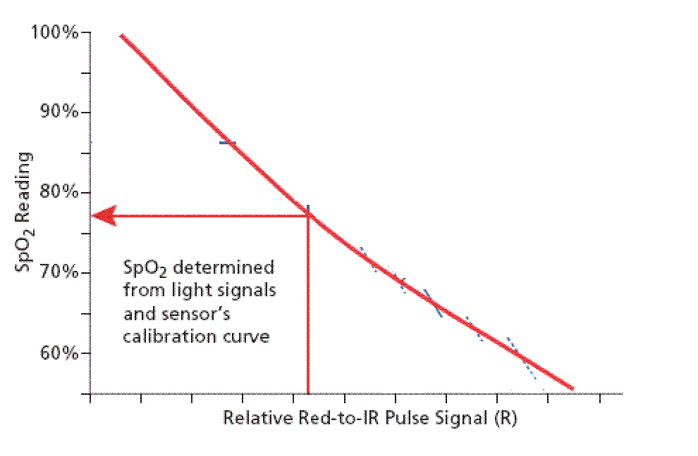
SpO2 Calculation From PPG Signal
Ratio of Ratio
or
Pulse Modulation
y ~= - mx + c

Slide 4
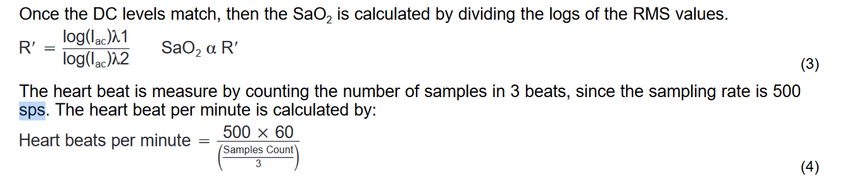
SpO2 Calculation From PPG Signal
Lambda1 = 660 nm (red)
Lambda2 = 940 nm (ir)

