Slide 1

2026 | October 3
Sponsor Deck

Slide 2
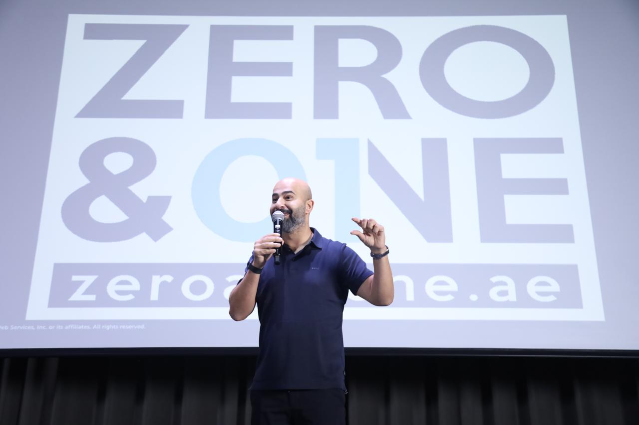
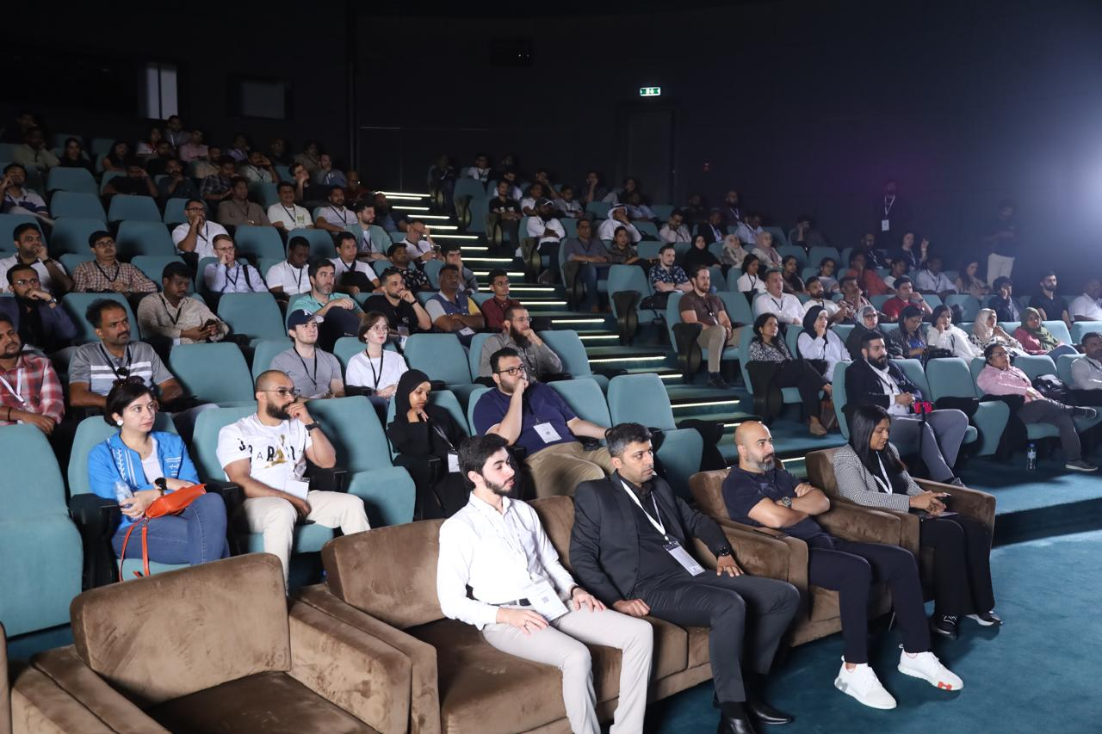

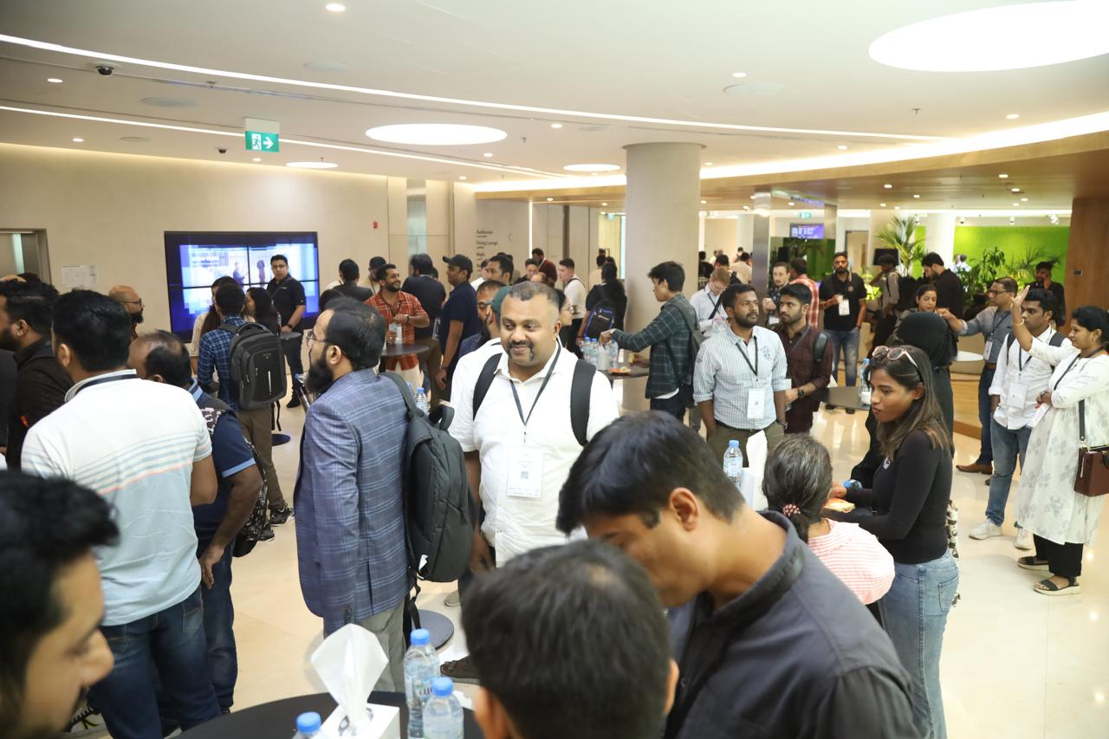
Why Partner with AWS Community Day UAE 2026?
Amplify your brand • Hire top talent • Grow lasting connections
Boost Brand Visibility
Showcase your logo and stories to 600+ cloud professionals and decision‑makers.
Demonstrate Thought Leadership
Share success stories, demos, or lightning talks that underline your expertise.
Recruit AWS Talent
Position your company as an employer of choice for certified engineers & architects.
Expand Your Network
Build long‑term relationships with customers, partners, and AWS staff.

Slide 3
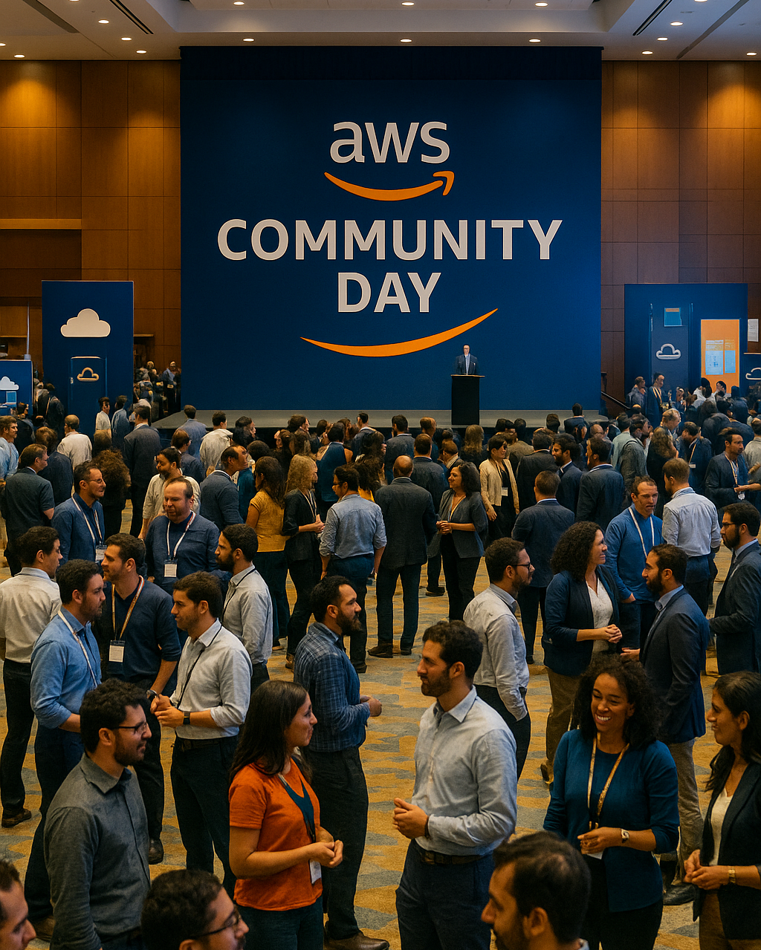
What is AWS Community Day?
Global, community‑led AWS conferences built by builders, for builders
Community‑Driven
Planned & executed by local AWS User Group leaders; AWS participates only as a sponsor.
Rich Multi‑Track Content
Up to 40 sessions, keynotes & hands‑on workshops per event (e.g., DACH 2024 featured 4 tracks & 32 speakers).
High‑Energy Crowd
500‑650+ passionate builders and decision‑makers per city — UAE editions have consistently drawn 600–700+ attendees.
Free Entry
Accessible pricing drives big turn‑out, giving sponsors a wider lead pool.
Sponsor Visibility
Booth/demo table, logo placement, and conference passes included in most packages.
First‑Come Packages
Limited tiers per city—early commitment secures prime exposure.

Slide 4

AWS User Groups at a Glance
Builder‑run communities that make learning AWS social, local, and fun
Local & Volunteer‑Led.
Hands‑On Learning
Add
Community Photo
Grass‑roots groups in 400+ cities, powered by passionate builders
Lightning talks, code labs, and demos dive deep into real AWS use cases.
Contents
Peer Knowledge Exchange
Career & Networking Boost
Members openly share architectures, cost tips, and lessons learned.
Meet AWS Heroes, hiring managers, and fellow cloud enthusiasts.

Slide 5
AWS User Group, Dubai
AWS User Group, Abu Dhabi
AWS Community
User Groups, UAE
AWS Women’s User Group, UAE
AWS User Group Cloud & Security

Slide 6
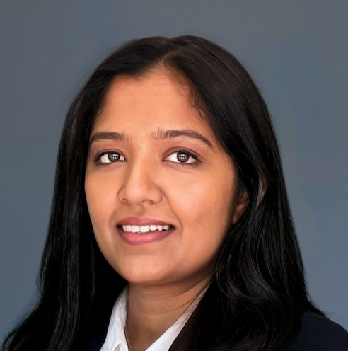
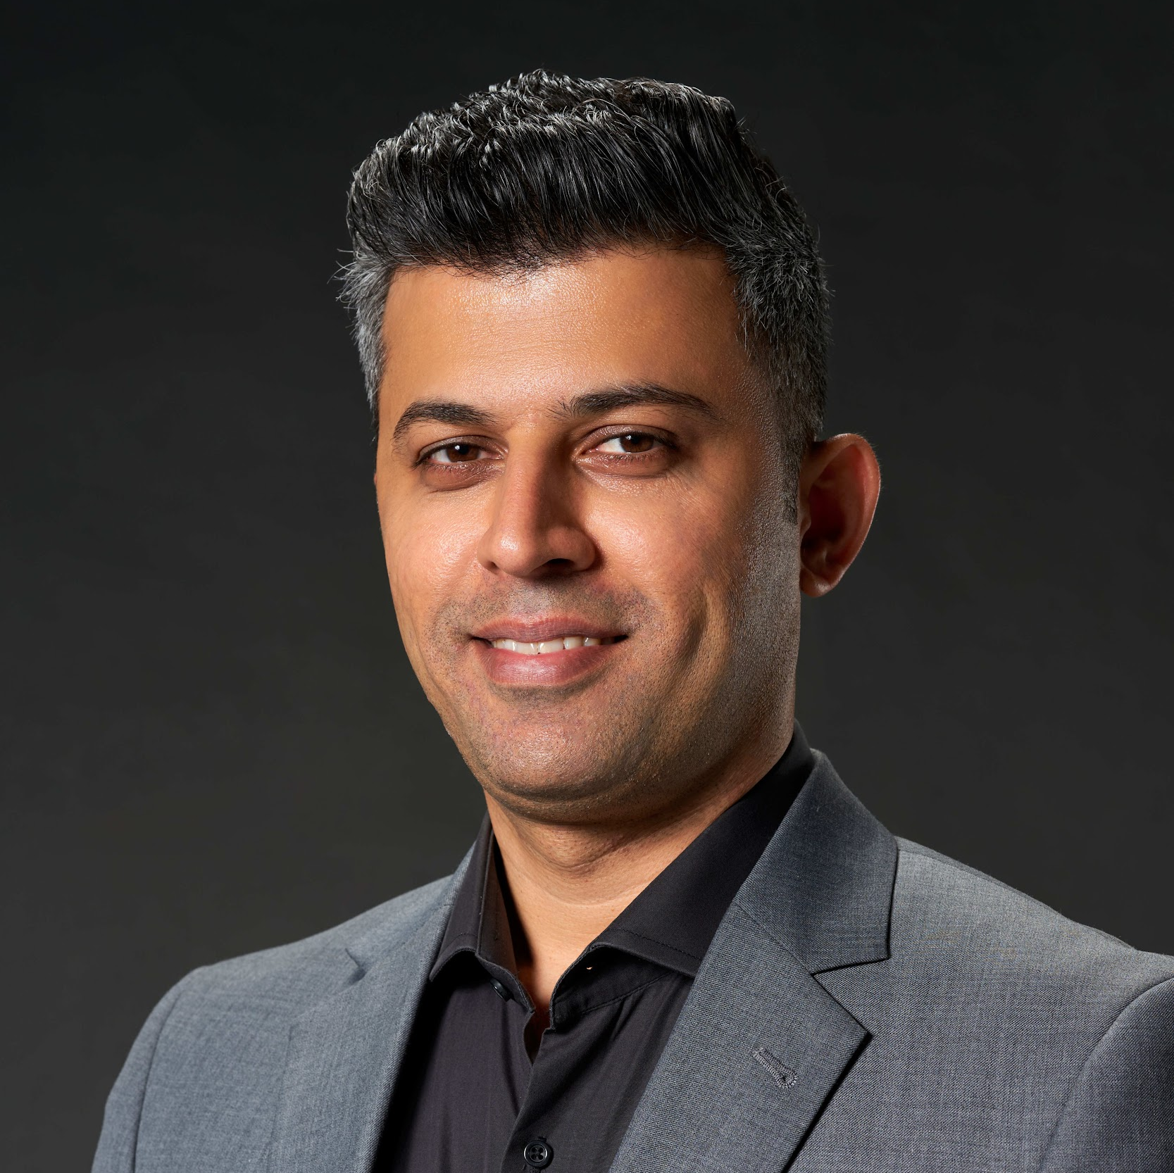
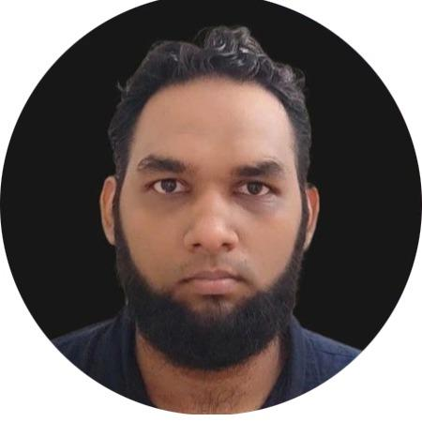
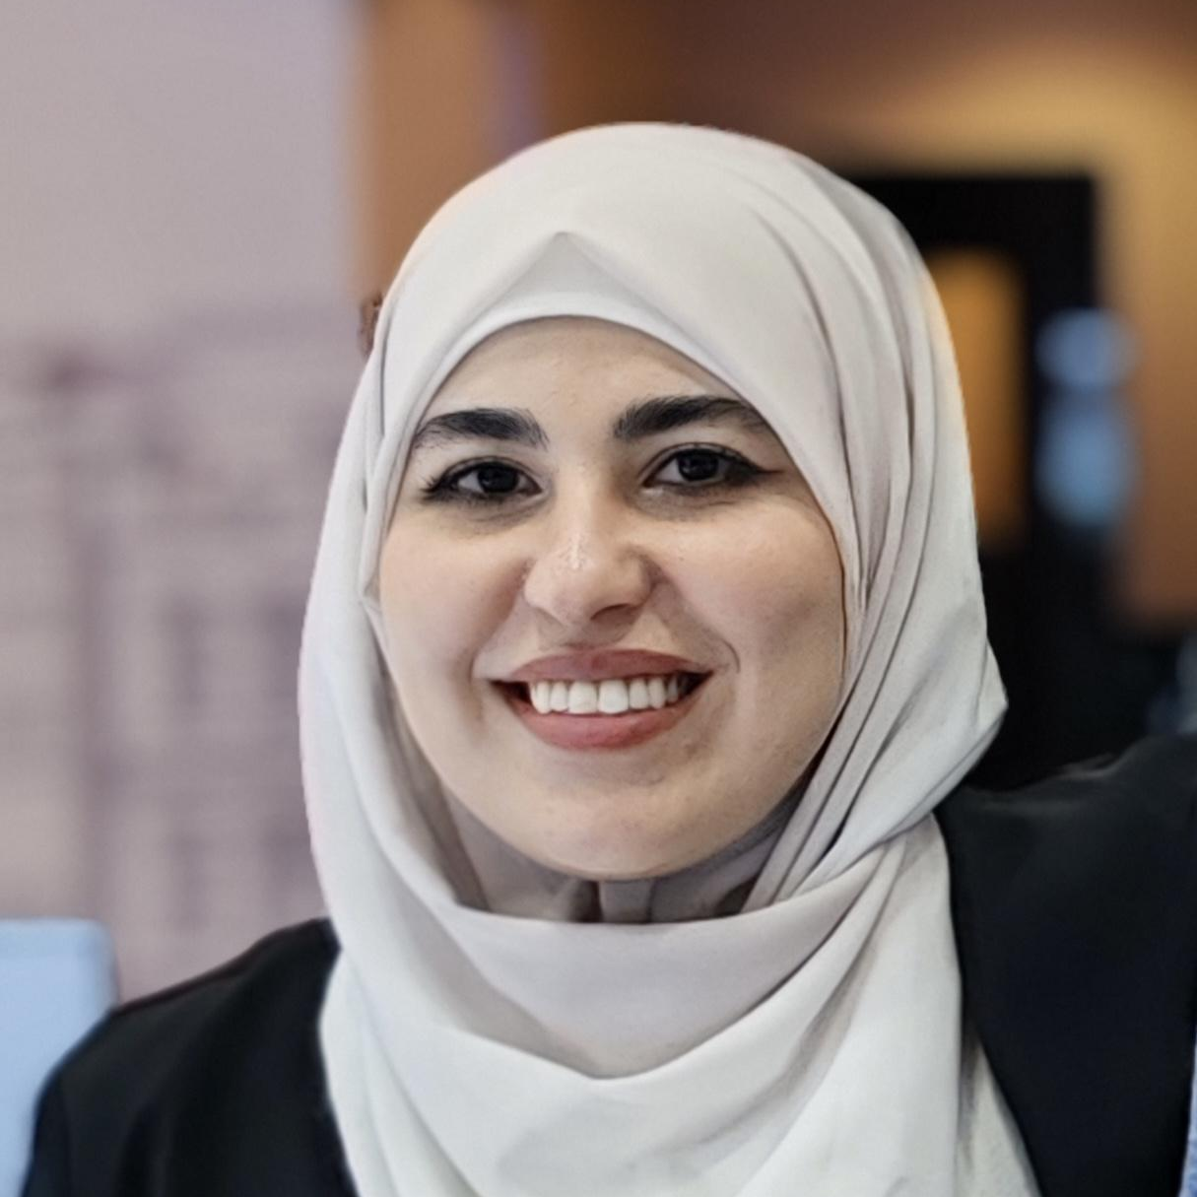
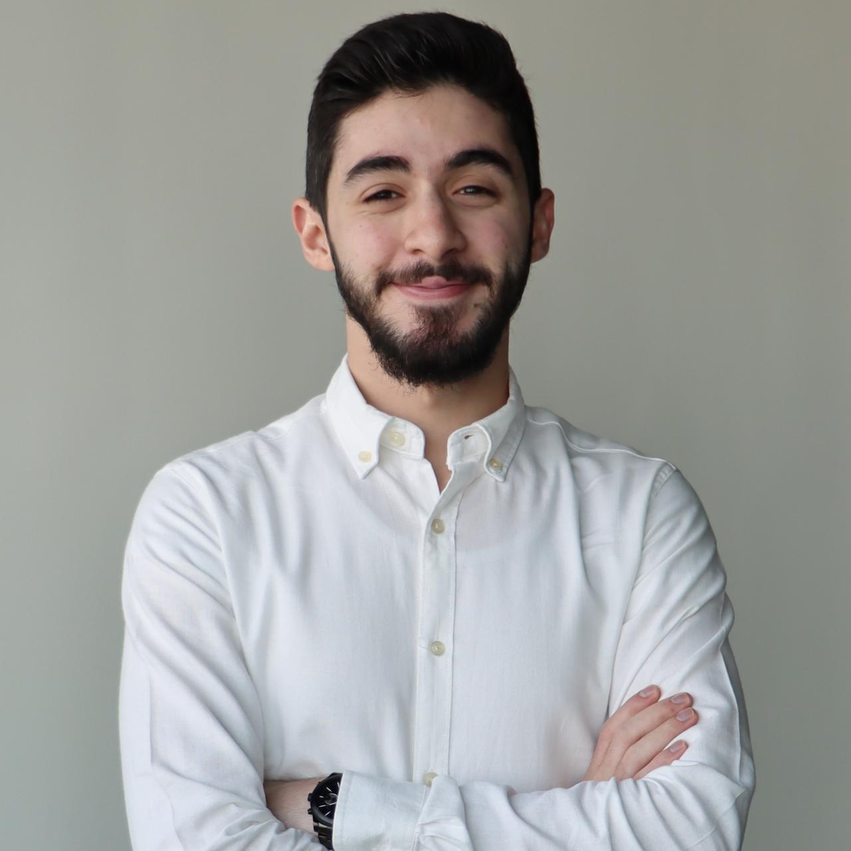
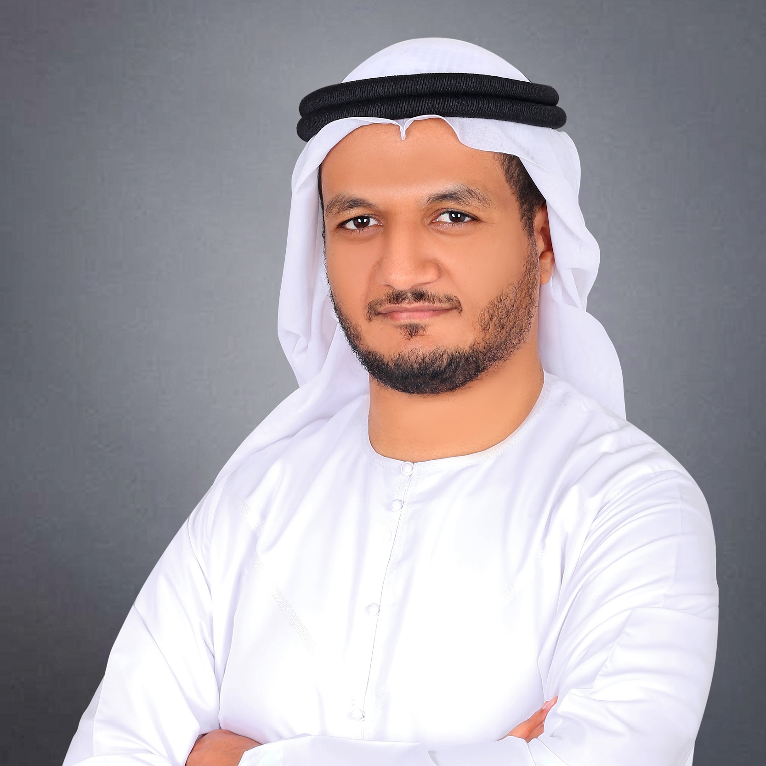
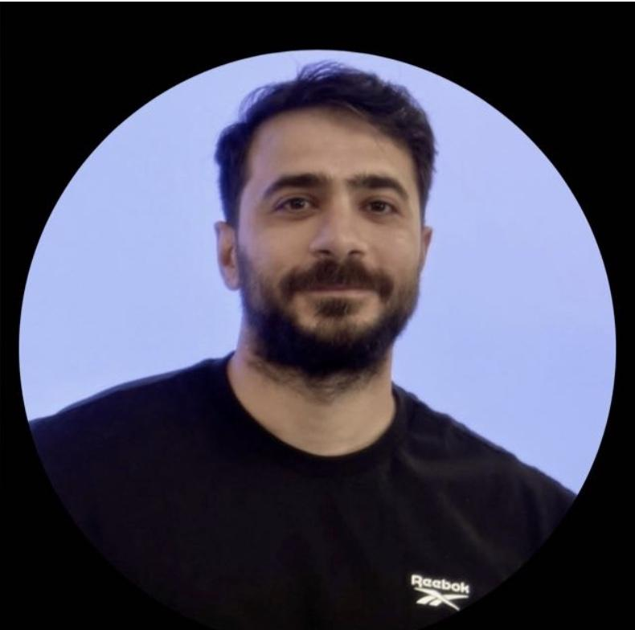
UAE AWS User Groups Leaders
Sabiha Ali
Hameedullah Khan
Saad Zaman
Graphic Designer
Programmer
Graphic Designer
Graphic Designer
Rahaf Al-Najjar
Mahmoud Abdelrahman
Ahmed Hussein
Mahmoud
Graphic Designer
Programmer
Graphic Designer
Graphic Designer

Slide 7
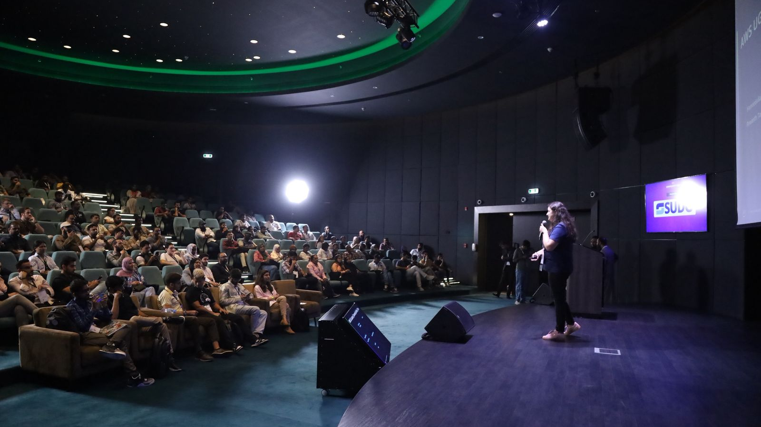
AWS Community Day 2026

Slide 8
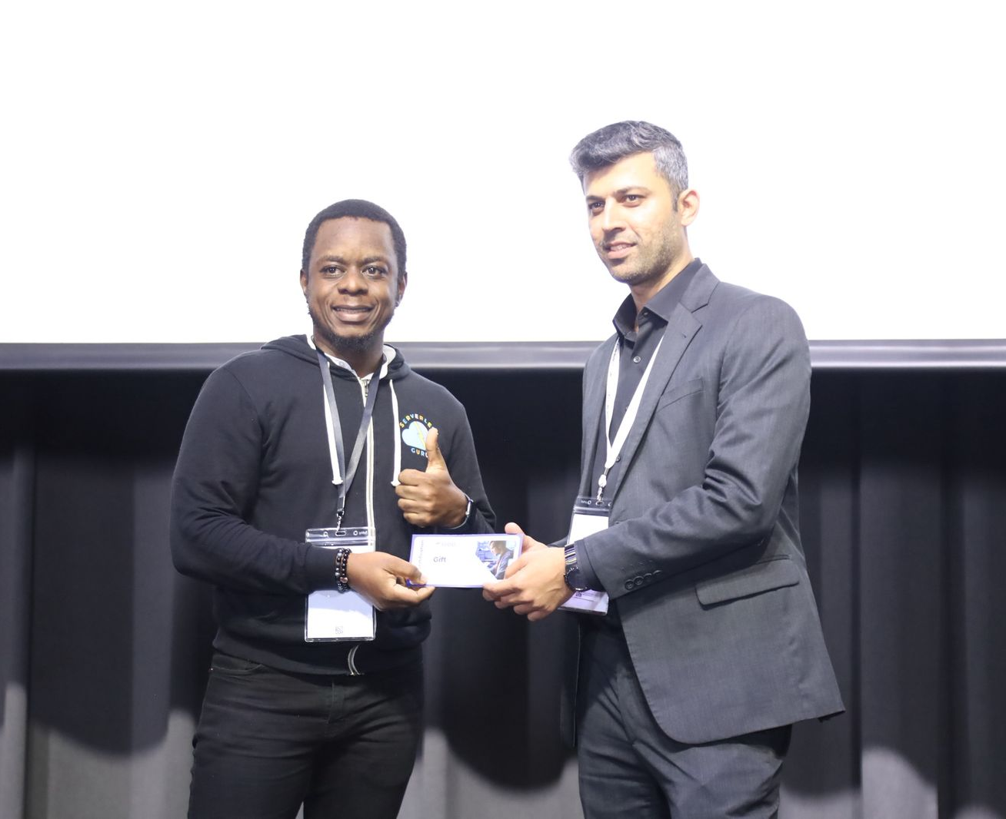
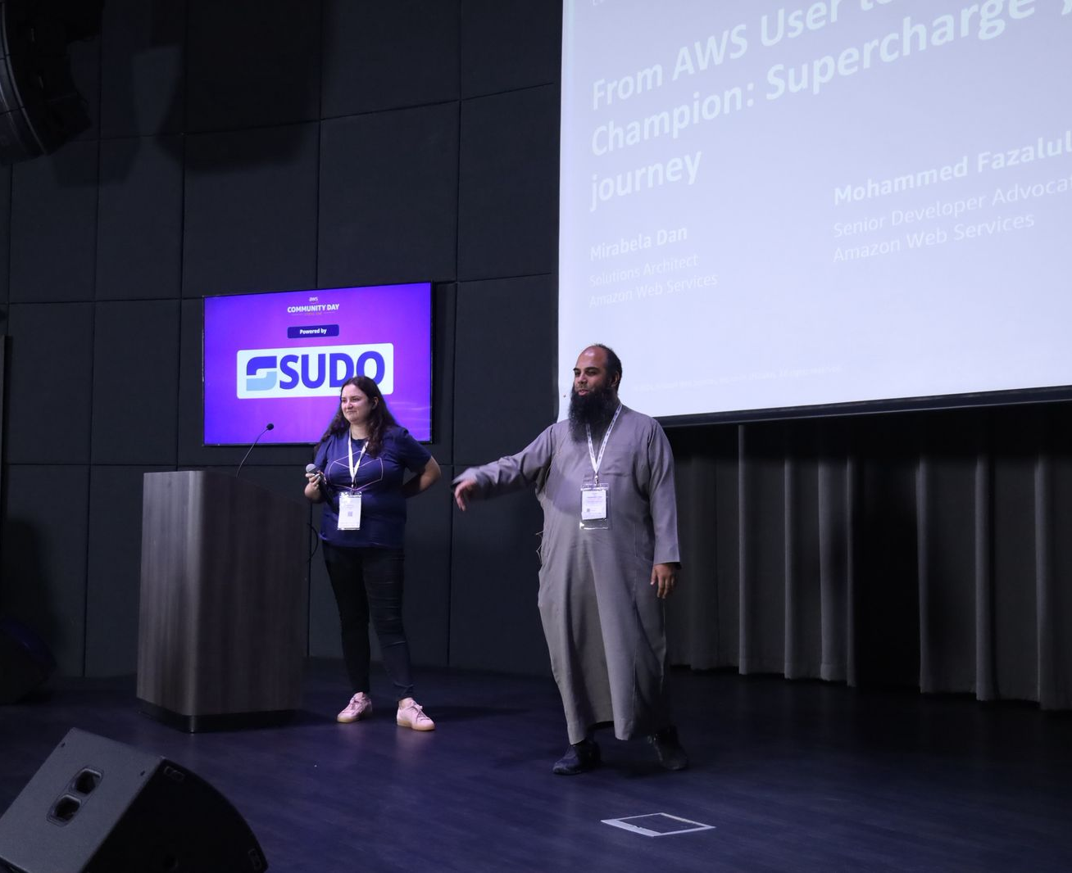
A Glimpse of past events

Slide 9
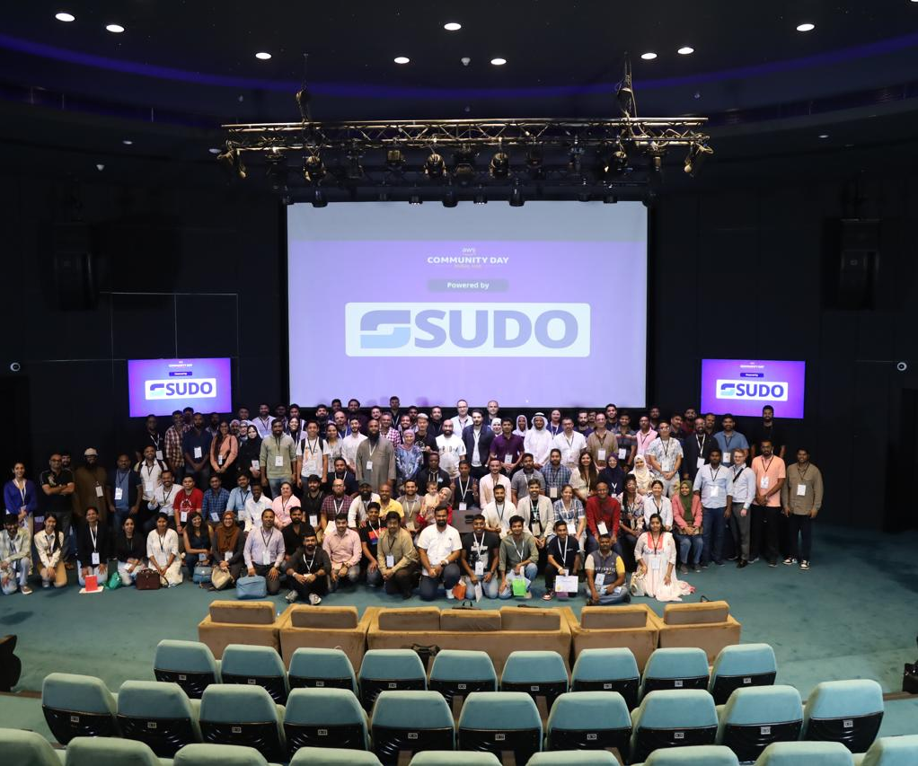
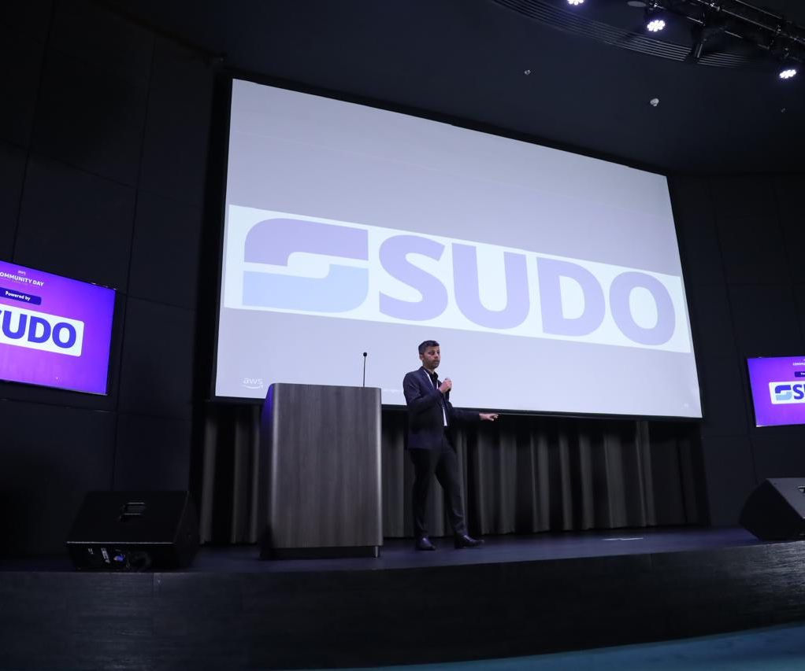

Slide 10
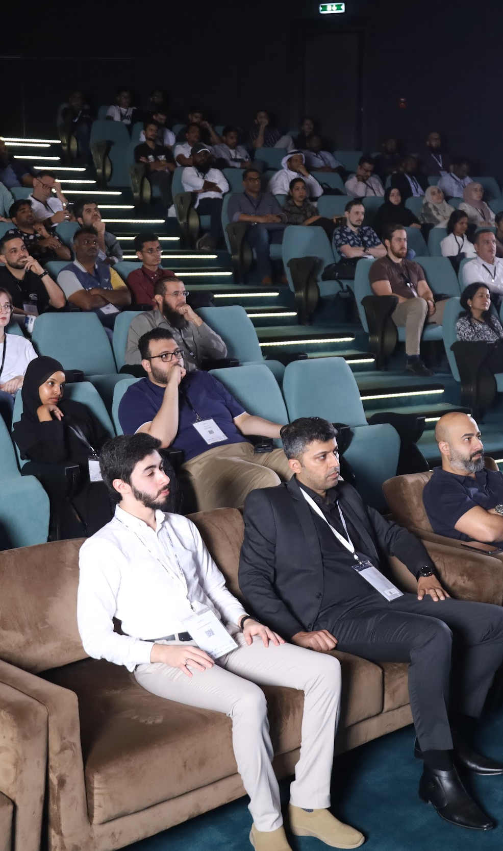
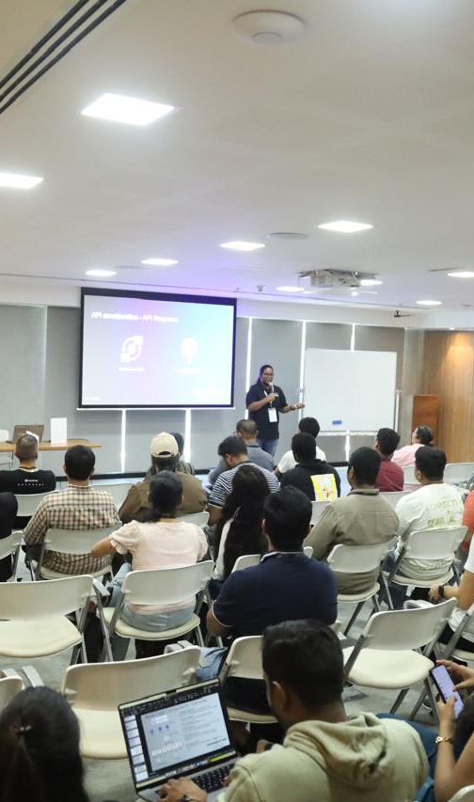
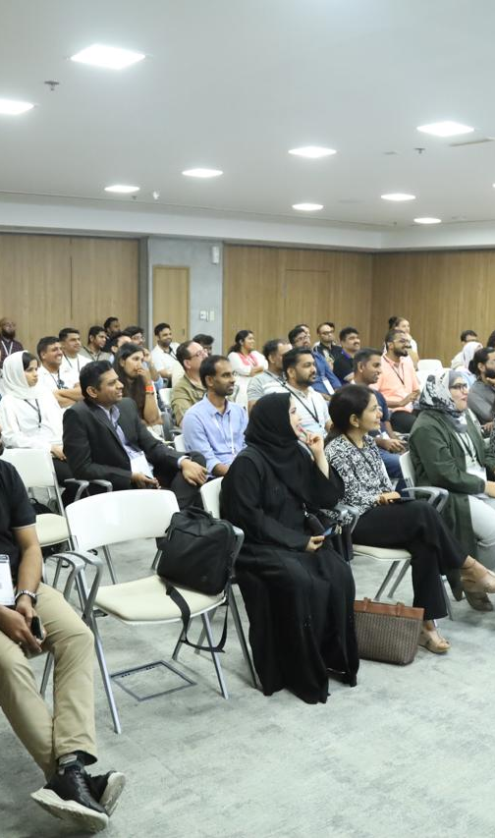

Slide 11
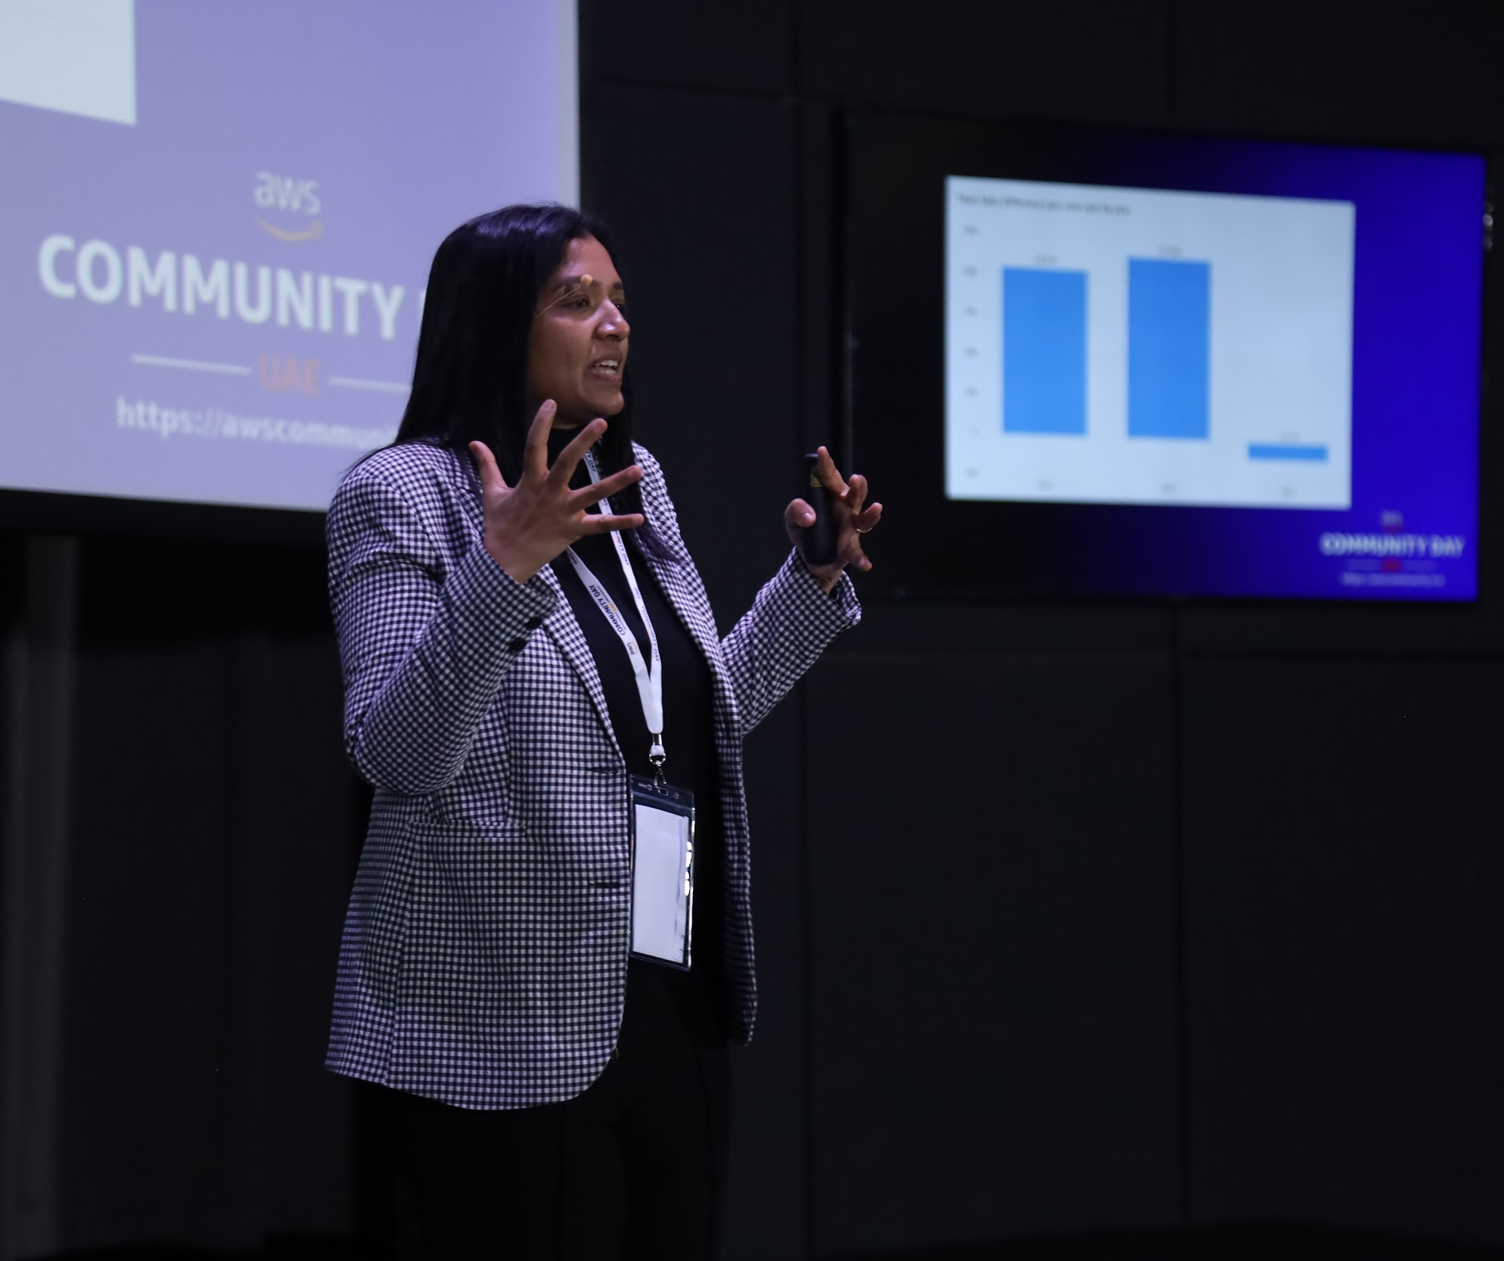
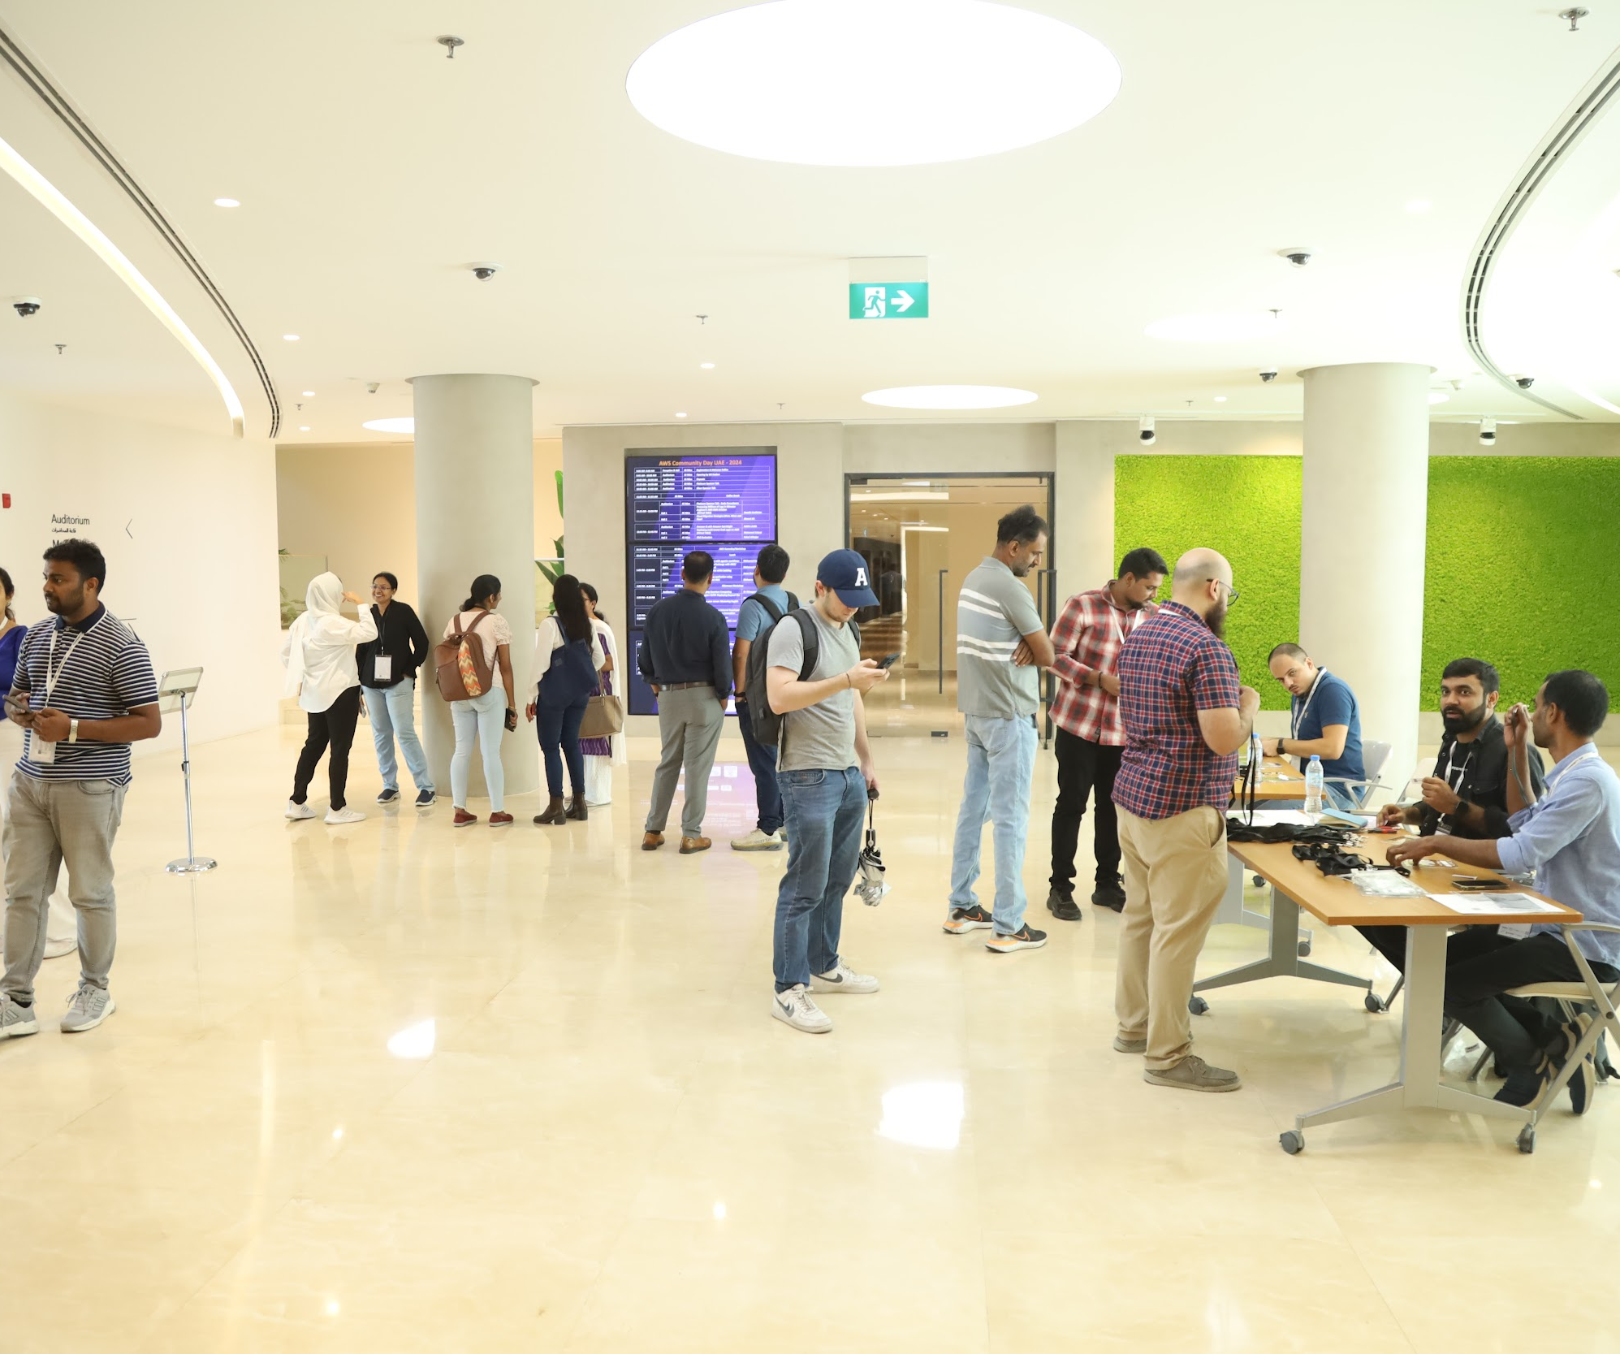
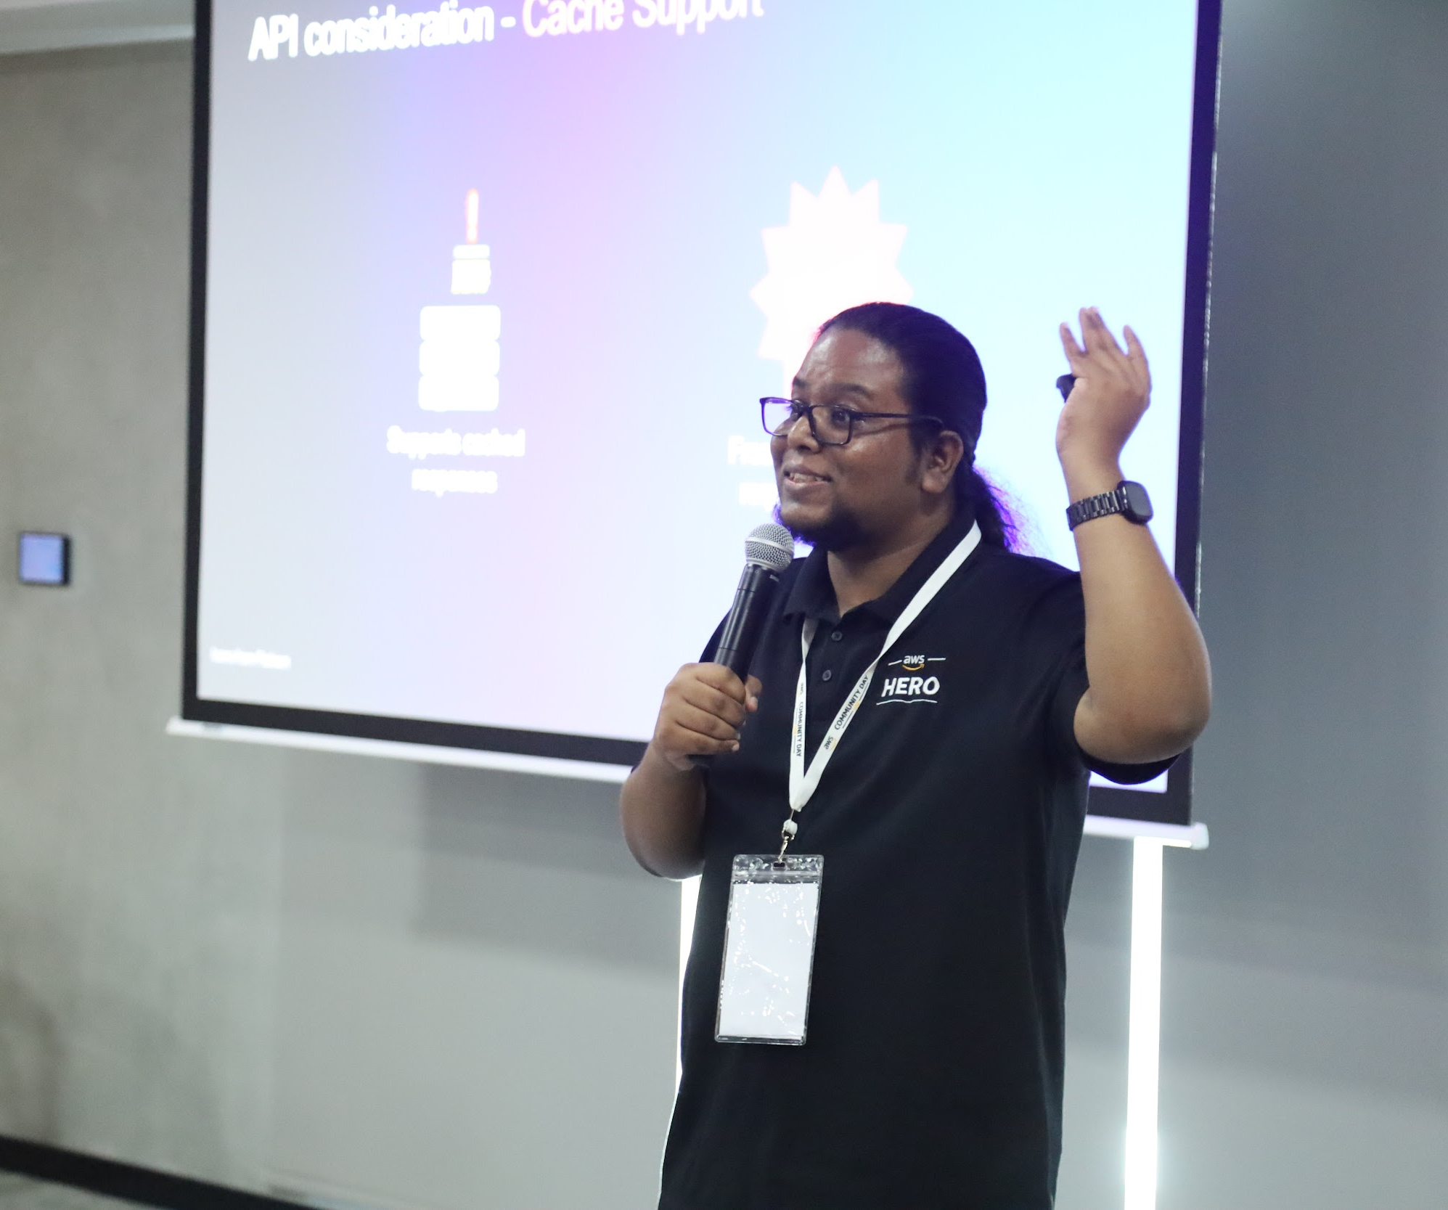
Tech sessions, Networking and Interaction with companies

Slide 12
Why We Need Sponsors
• Local volunteers run the event — your support directly elevates the attendee experience.
• Sponsorship offsets venue, A/V, and catering so tickets stay free or low‑cost, boosting attendance.
• High‑value visibility via stage shout‑outs, booths, and social media puts your brand in front of 400‑650 AWS builders.
Where Your Sponsorship Funds Go
What Your Sponsorship Enables | Allocation | Impact on the Event
Professional Venue & A/V | 35 % | Modern auditorium, HD streaming, rock‑solid Wi‑Fi
Catering & Networking Breaks | 30 % | Meals & coffee stations that fuel conversations
Stage, Branding & Expo Booths | 25 % | Sponsor logos prominent on stage & in photos
Swag & Prize Giveaways | 10 % | Eco‑friendly merch and raffles driving booth traffic
Learn more: awscommunity.me

Slide 13
The Bottom Line for Sponsors
• Support the UAE’s fastest‑growing cloud community and gain prime brand exposure.
• Reach hundreds of AWS decision‑makers actively seeking innovative solutions.
• Your investment funds a top‑tier experience that attendees — and sponsors — remember.
Sponsorship Opportunity Tiers - Community Day 2026
Platinum Sponsor ( with Naming rights ) – AED 50,000
Gold Sponsor – AED 30,000
Silver Sponsor – AED 10,000
Learn more: awscommunity.me

Slide 14
Benefits (Tangible) | Platinum AED 50,000 | Gold AED 30,000 | Silver AED 10,000
AWS Community Day Powered/Enabled By …. You company’s name will be mentioned with the event name through out event + on digital & print. | ✔
Logo inclusion on AWS Community Day conference kit, goes with every participant | Large & Prominent location | Medium | Small
Booth / Desk at the Venue | Large & Prominent location | ✔ | ✔
Logo featured within event venue (banners/standees/posters/session intros/agenda) | X Large & Prominent location | Large & Prominent location
Speaking session soon after Opening Keynote | ✔ | ✔
Workshop or Speaking Slot around the sponsors product | ✔
Branding around all stages ( Either as backdrop or as standee ) | Large & Prominent location | Medium | Small
*negotiable

Slide 15
Benefits (Tangible) | Platinum AED 50,000 | Gold AED 30,000 | Silver AED 10,000
Free to distribute goodies from respective booth | ✔ | ✔ | ✔
Logo on participant's badge. | ✔ | ✔ | ✔
Branded Photo Booth ( *Must have Community Day or AWS Logo ) | ✔
Access to contact & designation details of all opt-in conference participants | ✔
30 second video reel before sponsor presentation | ✔
1 Speaker Slot in upcoming Meetup | ✔
Logo and Material inclusion for next 3 months (~ 6 - 8 Meetups across UAE ) | ✔
Speaking session soon at the Closing Keynote | ✔
*negotiable

Slide 16
Benefits (Tangible) | Platinum AED 50,000 | Gold AED 30,000 | Silver AED 10,000
Logo inclusion in AWS Community Day Event Invitation (Email) | ✔ | ✔ | ✔
Logo inclusion in meetup page and post event email to participants | ✔ | ✔ | ✔
Community Day Website presence (logo + link and 150 word write-up) (to be provided by sponsor) | ✔ | ✔
Shout out on Social Media by Official User Group Pages & Groups on LinkedIn, Whatsapp & Facebook ( 10000+ Combined Organic Reach ) | ✔ | ✔
Sponsored Post by User Group Leaders, AWS Experts and Community Members ( Organic Word of Mouth ) | ✔
Sponsored Post by AWS Experts & Members in AWS UAE Community ( Organic Word of Mouth ) | ✔
Branding with Meetup Invite Emails & Meetup page to all participants | ✔
*negotiable

Slide 17
Booth / Table Sponsor – AED 5000
Continuous engagement with the audience.
Seating arrangement for two people at the table/booth.
Place two standees near your setup.
Hand out complimentary goodies.
2 Social Media promotional posts on LinkedIn, Facebook & Whatsapp
Logo placement on main backdrop & footer.

Slide 18
get in touch

