Slide 2
Docker
- sudeep

Slide 3
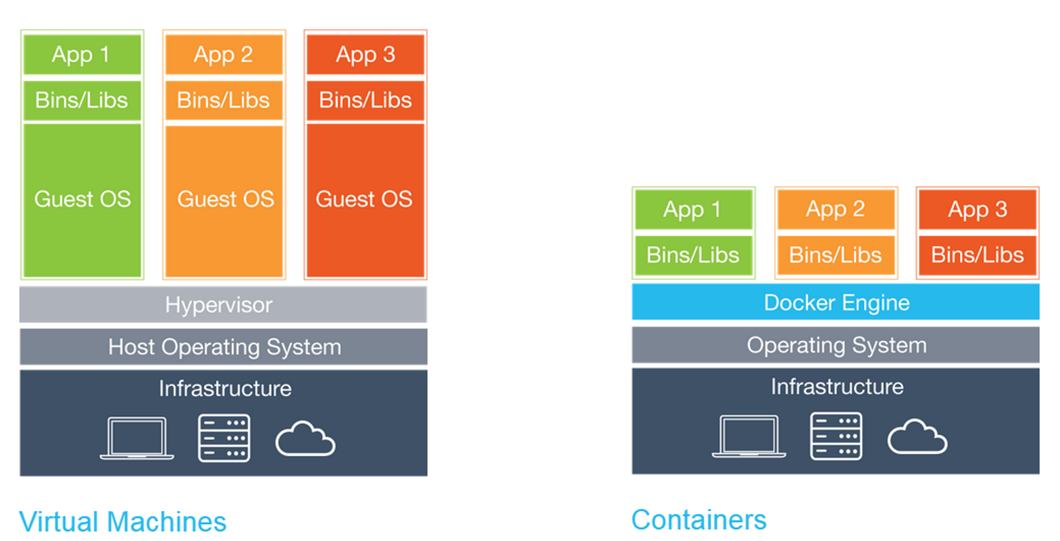
What is Docker
Docker is a platform for developing, shipping and running applications using container virtualization technology
Lightweight
No need to install guest OS
Less CPU, RAM, storage space required
More containers per machine than VMs
Better portability
Notes:
We can have multiple VM, each one has different OS and each one has different applications, on the same physical machine. Each VM still needs a entire operation system which consumes the resources. The more VMs you run, the more resources you need.

Slide 4
Introducing Containers
Container based virtualization uses the kernel on the hosts’ operating system to run multiple guest instances
Docker origins from LXC and libcontainer.
Docker is built upon AuFS
Each guest instance is called a container and has its own
Root filesystem
Process
Memory
Devices
Network ports
Notes:
LXC, libcontainer is 2nd generation of LXC, is a concept of namespace and control group. Each namespace separate resources in an operation system. It has its own process id 1, processor, memory and devices. Process in a namespace cannot access resources in another namespaces. In such a way, application is encapsulated into containers instead of running upon operation systems.
AuFS is a union file system, or a nested file system. It is a layered virtual file system and consists of one or more sub directories. Each directories is mounted with sub-file system. This sub-file system can be configured as Read Only, or Read Write. The write operation on Read-Write file system is incremental only and it is “Copy-on-first-write”

Slide 5
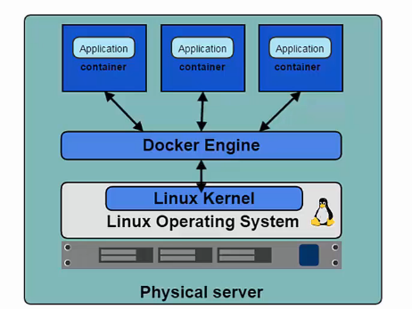
Docker and Linux Kernel
Docker Engine is the program that enables containers to be built, shipped and run.
Docker Engine uses Linux Kernel namespaces and control groups to create and manager containers
Namespaces give us the isolated workspace
Notes:
There are a few namespaces. IP namespace isolates IP address. IPC and mnt namespace isolates mountpoint. Memory namespace isolates RAM.

Slide 6
Docker Containers and Images
Docker Image
Read only template used to create docker container
Created by you or other docker users
Store in docker hub or you local docker registry
Docker Container
Isolated application platform
Contains everything you need for your application
Created from one or more images
Notes:
Within the image, there is a set of instructions to create containers, such like what program to install, which volume to mount, which folder to create and what port number to expose, etc.
Docker container is isolated applications. We create container from the images and it contains all the necessary resources for your applications, for example, library and binaries.

Slide 7
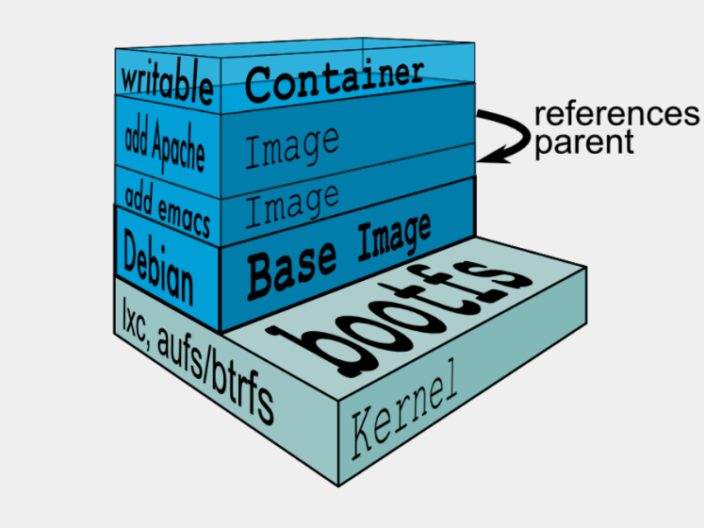
Docker Architecture
Layered read-only images
Read-write container
Shared images for containers
Notes:
Once kernel and bootfs is loaded, a base image is built upon bootfs. The base image is very similar like OS image but very small. Another read-only image with application is built upon base image, for example, emacs. And then a second and a third image with applications can be built, such like Nginux or MySQL. In the end, a read-write layer is created, that is the container. All base image, application images and containers are grouped into one file system. All the images are visible for container but container cannot make any change to the read-only images. The change of container is copy-on-first-write and it is saved to a delta space.

Slide 8
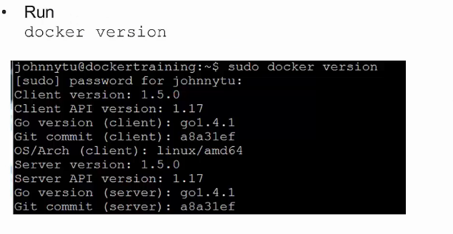
Docker Client and Daemon
Client/Server architecture
Client sends user inputs to the daemon
Daemon builds, runs and distributes containers
Client and daemon can be on the same host or different
CLI mode and GUI mode
Notes:
When we run docker run, we are using docker client in CLI mode. In most cases. Docker client and daemon are in the same host.
With the help to docker version cmd, we can easily check the version of docker client and docker daemon. You can see from the output that the version of client in this example is 1.5 and so does docker daemon

Slide 9
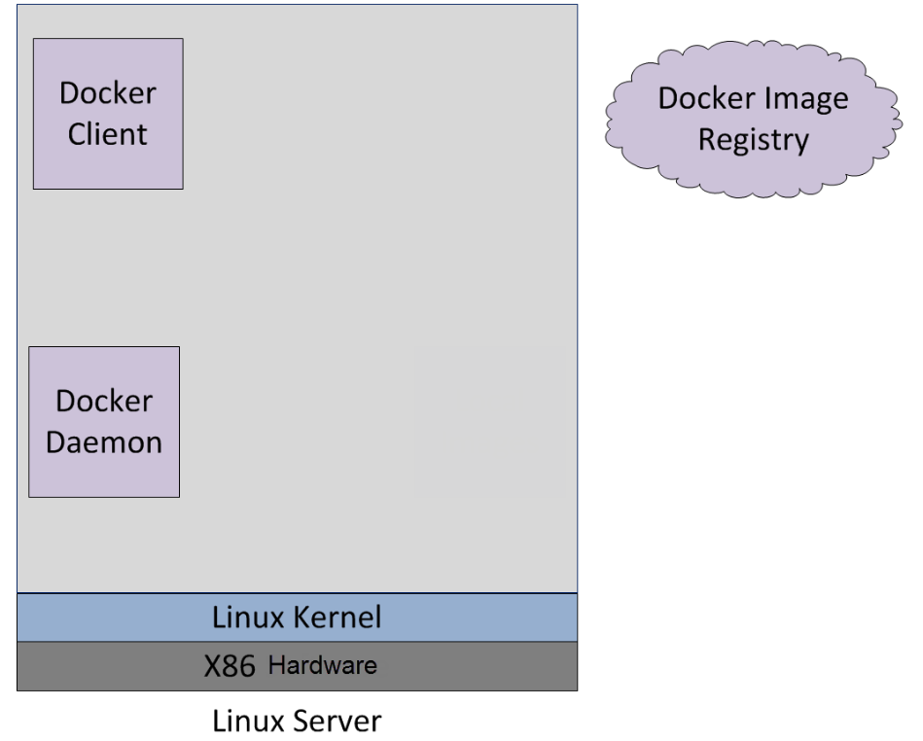
Create a docker container

Slide 10
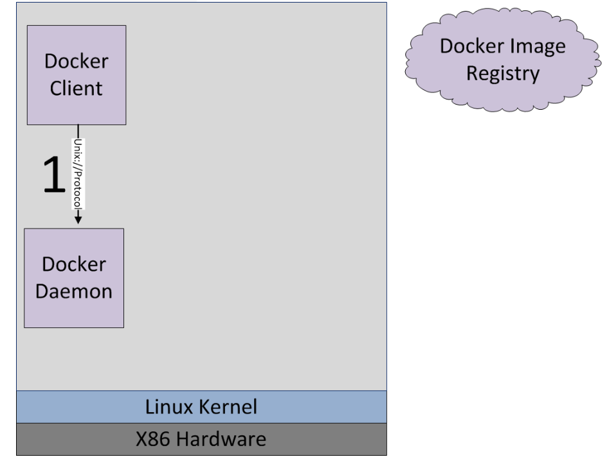
Create a docker container
Notes:
When creating a new container, docker client calls docker daemon via unix://var/run/docker.sock

Slide 11
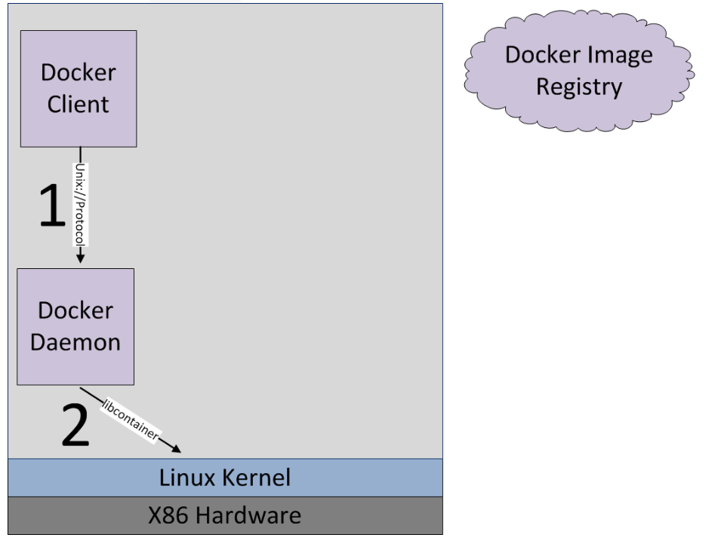
Create a docker container
Notes:
Docker daemon calls Linux Kernel to create a new container via libcontainer

Slide 12
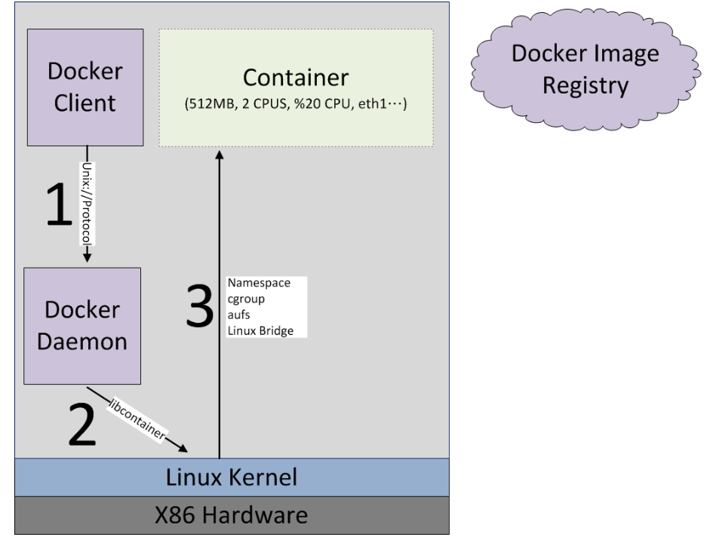
Create a docker container
Notes:
After Linux kernel gets the request, it creates a independent namespace with PID, network, mount, etc. The resource is assigned to container according to the parameter from docker client. At this point, the container is still empty

Slide 13
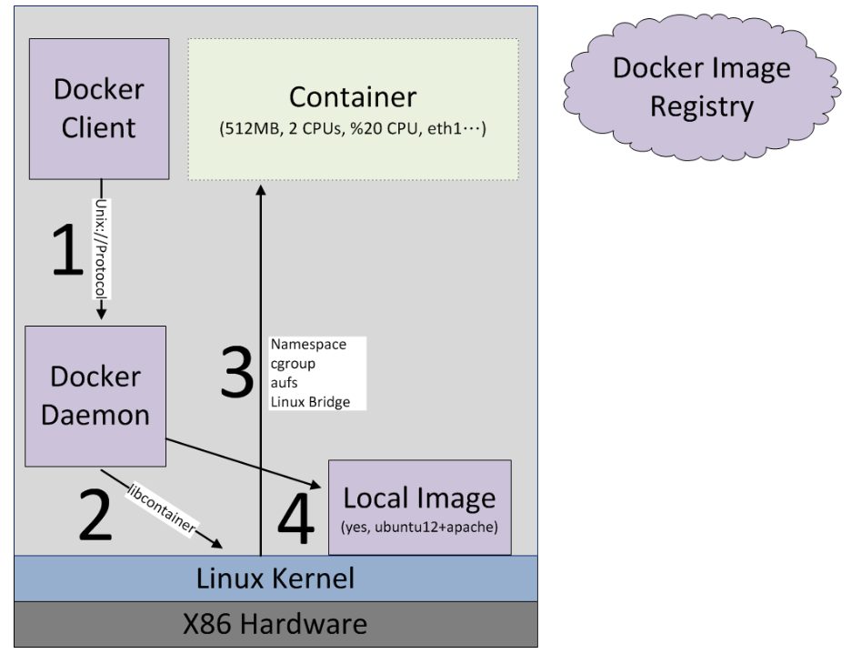
Create a docker container
Notes:
Docker daemon checks local images.

Slide 14
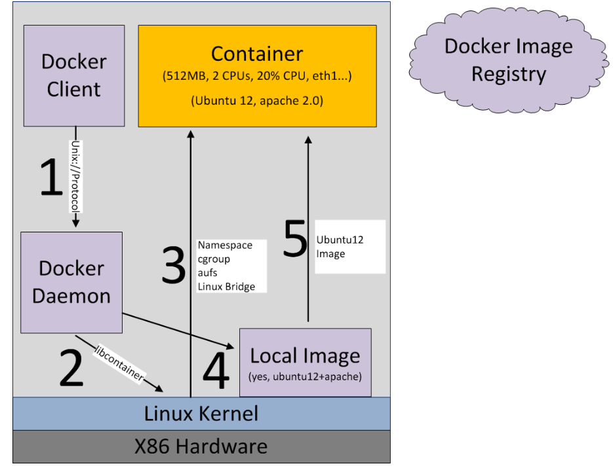
Create a docker container
Notes:
If local images contains the required images, it will be loaded to container and then container is created succesfully

Slide 15
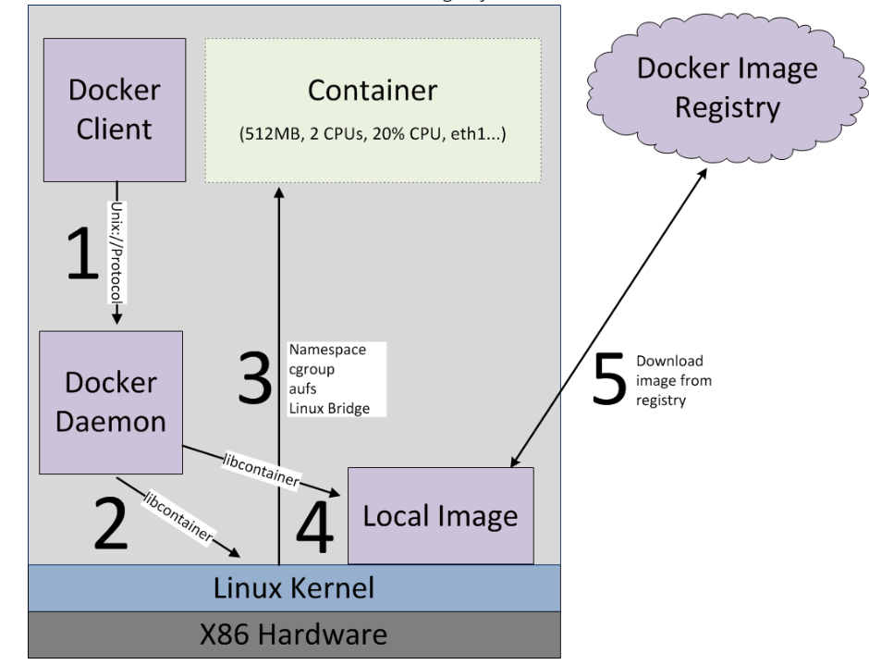
Create a docker container
Notes:
If local image does not contain the required image, it will pull the image from docker image repository.

Slide 16
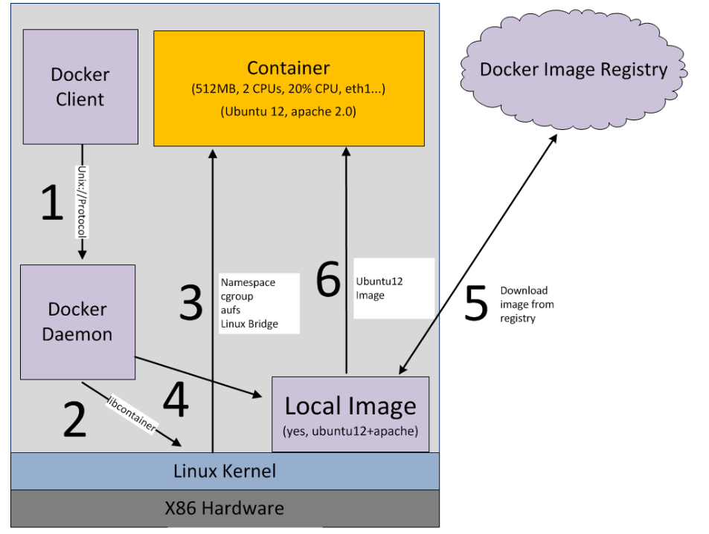
Create a docker container
Notes:
Once the image is pulled, it will be loaded to container. Container is booted up.

Slide 17
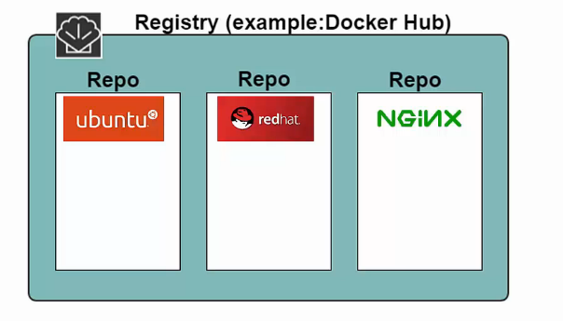
Registry and Repository
Notes:
Registry is where we store our images. You can run your own registry and using docker public registry (docker hub). Inside the registry, your images are stored in repositories. In this pic, you can see an example of this structure. We have three repositories in registry, Ubuntu, redhat and nginx, each repository has a lot of images. Each image can be a different version of Ubuntu, red hat and nginx.

Slide 18
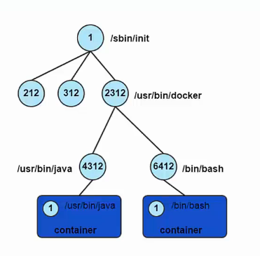
Container Process
A container only runs as long as the process from your specified docker run command is running
Your command’s process is always PID 1 inside the container

Slide 19
Container ID
Container can be specified using their ID or name
Long ID and short ID
Short ID and name can be obtained using docker ps
Long ID obtained by inspecting a container

Slide 20
Docker Orchestration
Orchestrating distributed applications with Docker
Docker Machine
Tool that provisions Docker hosts and installs the Docker Engine on them
Docker SWARM, DC/OS
Tool that clusters many engines and schedules containers
Docker Compose
- Tool to create and manage multiple-container applications

Slide 21
Benefits of Docker
Better application portability
Faster development cycle
Easy and Fast scalability
Resources saving and run more apps on one host machine
Notes:
1. Built on one platform and ship to others. You can build a container on your PC or Mac and run it on a physical server. 2. easy and quick to delete and re-deploy.

