Slide 1


Slide 2
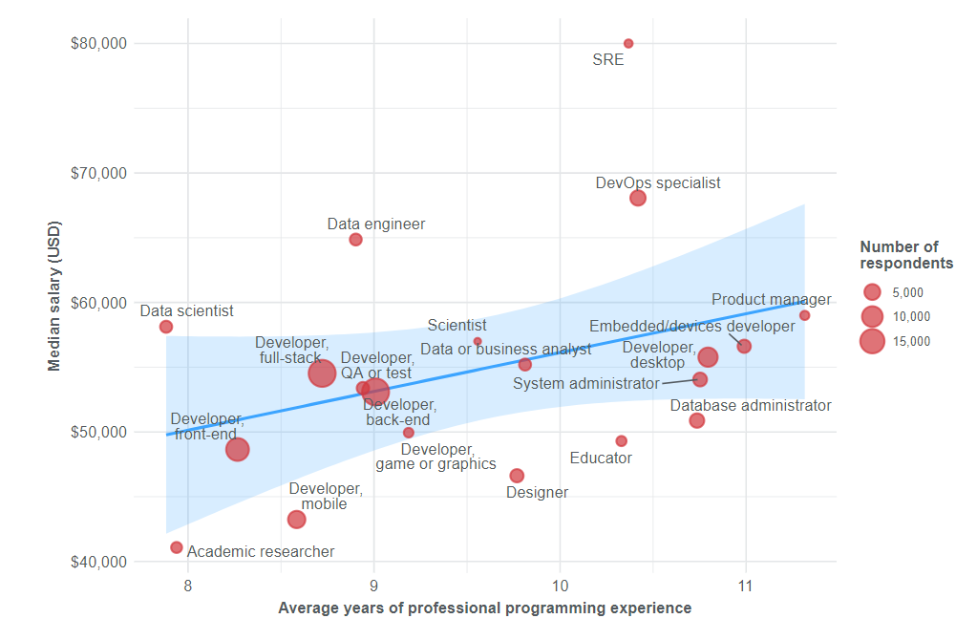

Slide 3

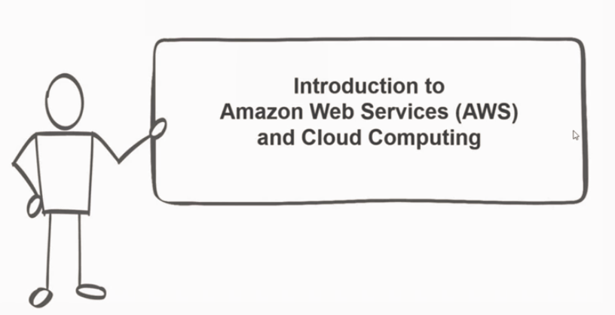

Slide 4
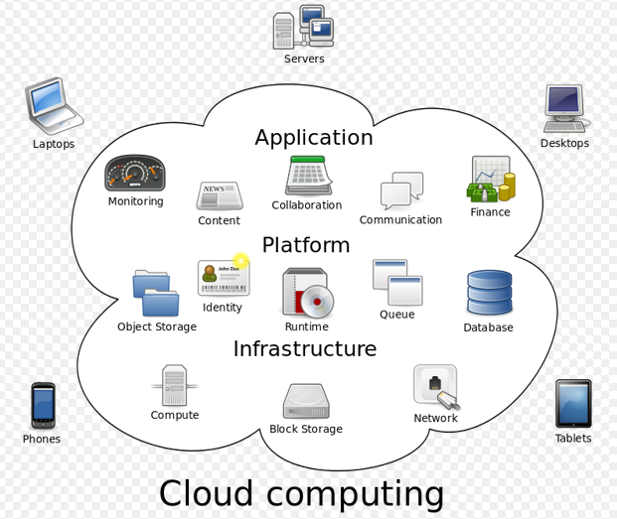
Cloud computing
Cloud computing is the on-demand delivery of compute power, database storage, applications, and other IT resources through a cloud services platform via the internet with pay-as-you-go pricing.

Slide 5






Benefits of Cloud Computing
Trade capital expense for variable expense
Benefit from massive economies of scale
Stop guessing capacity
Increase speed and agility
Stop spending money on running and maintaining data centers
Go global in minutes

Slide 6
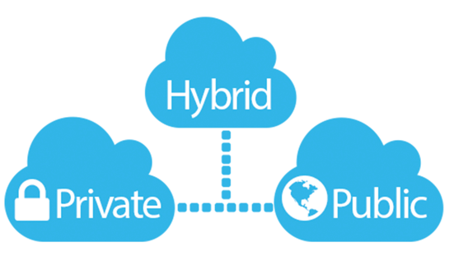
Type of Cloud
Notes:
https://aws.amazon.com/types-of-cloud-computing/

Slide 7
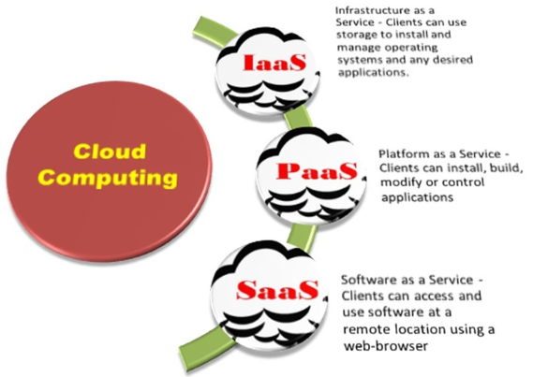
Cloud Service Models

Slide 8
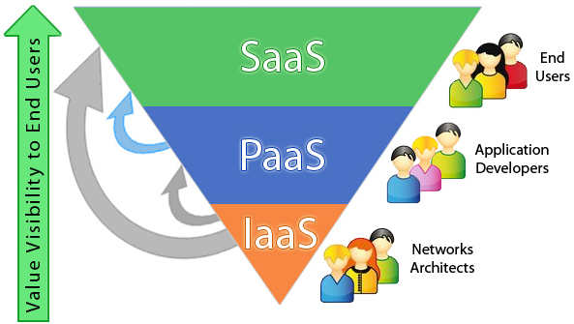
Cloud Service Models
Notes:
Ubber or Ola

Slide 9
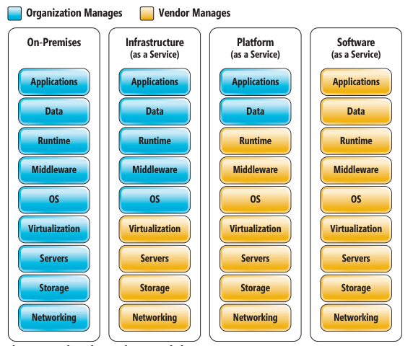
Shared Responsibility

Slide 10
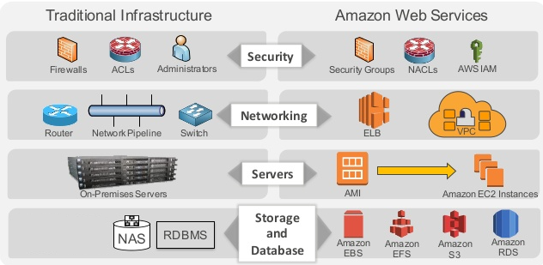
core infrastructure and services
Notes:
https://aws.amazon.com/solutions/case-studies/

Slide 11
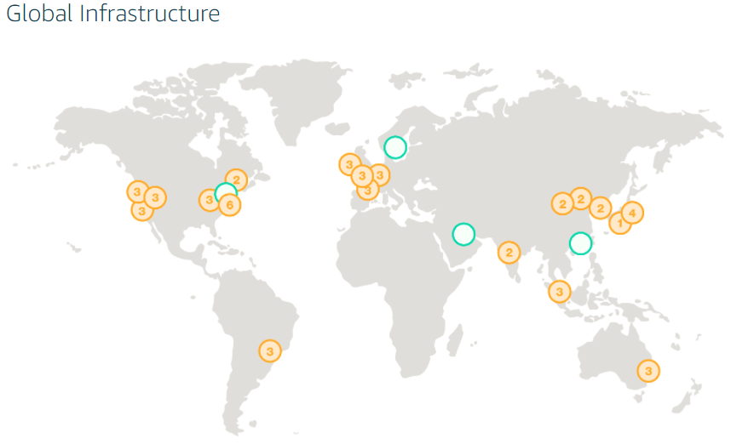
AWS region and Az’s
The AWS Cloud spans 54 Availability Zones within 18 geographic Regions and 1 Local Region around the world, with announced plans for 12 more Availability Zones and four more Regions in Bahrain, Hong Kong SAR, Sweden, and a second AWS GovCloud Region in the US.

Slide 12
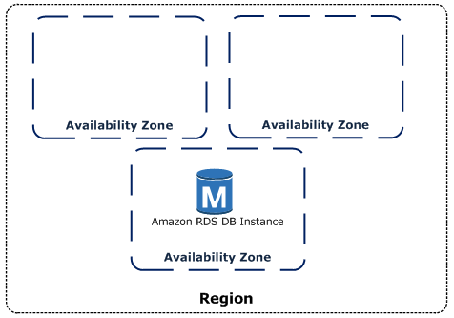
AWS Region

Slide 13
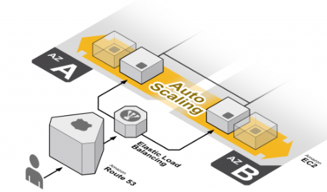
EC2 Auto Scaling

Slide 14
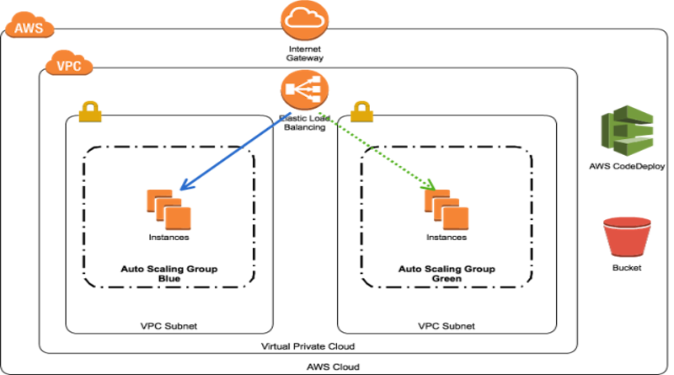
Elastic Load Balancing
Notes:
Achieve fault tolerance for any application by ensuring scalability, performance, and security.

Slide 15
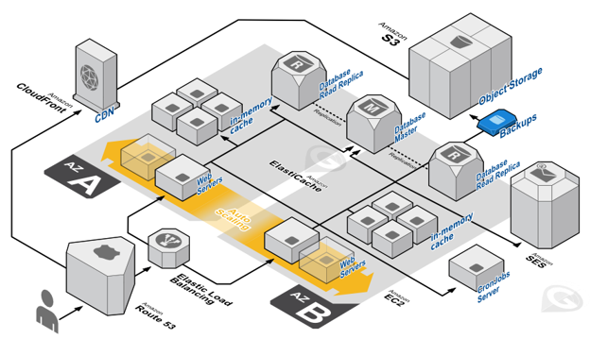
AWS AZ’s

Slide 16
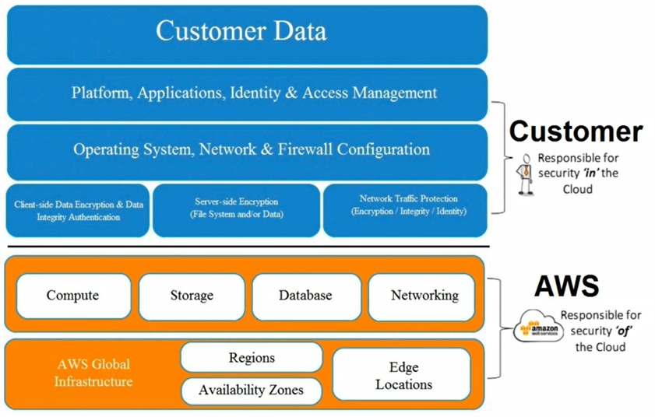
Shared Responsibility

Slide 17
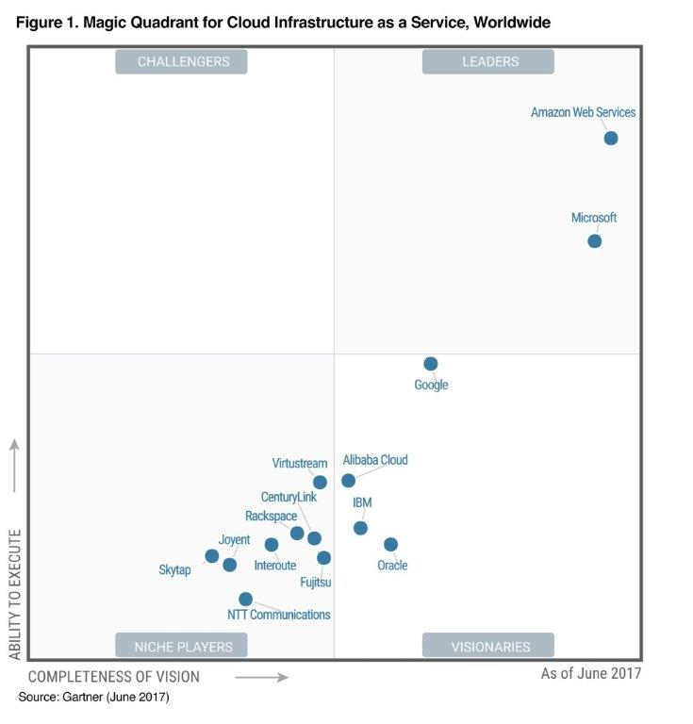
AWS in Leaders board
https://aws.amazon.com/blogs/aws/aws-named-as-a-leader-in-gartners-infrastructure-as-a-service-iaas-magic-quadrant-for-7th-consecutive-year/

Slide 18
Five Pillars
Security
Reliability
Performance Efficiency
Cost Optimization
Operational Excellence
Data protection
Privilege
management
Infrastructure protection
Detective controls
Foundations
Change management
Failure management
Compute
Storage
Database
Space-Time Trade-Off
Matched supply and demand
Cost-effective resources (AWS Trusted Advisor)
Expenditure awareness
Optimizing over time
Preparation (CloudFormation, Auto Scaling, AWS Config, Tagging)
Operation (Agile, CI/CD, Release Management, Monitoring)
Response (Event, notification)
AWS
Notes:
https://d1.awsstatic.com/whitepapers/architecture/AWS_Well-Architected_Framework.pdf
Security
Data protection > Encryption data at rest/transit (SSL)
Privilege management > IAM
Infrastructure protection > VPC, Network, EC2
Detective controls > CloudTrial, Config, AWS logs.
Reliability > Scale Horizontally
Foundations > IAM, VPC
Change management > CloudWatch, CloudTrail
Failure management > AWS CloudFormation / Terraform / Ansible
Performance Efficiency
Compute > EC2, Autoscaling
Storage > EBS, EFS, S3
Database > RDS
Space-Time Trade-Off > CloudFront, ElastiCache, Direct Connect, RDS Read Replicas.
Cost Optimization
Matched supply and demand > Autoscaling, Lambada
Cost-effective resources > correct instance type can be key to cost savings, AWS Trusted Advisor.
Expenditure awareness > consolidated billing, tags, billing alerts, stop resources no logger need, decommission infrastructure, dev/test 9-5 hrs.
Optimizing over time > adoption of new services, AWS Blogs and AWS Trusted Advisor.
Operational Excellence
Preparation > CloudFormation, Auto Scaling, AWS Config, Tagging.
Operation > like agile process, small, incremental and agreed with process.
Response > unexpected failure and notification, escalation to hierarchal level

Slide 19
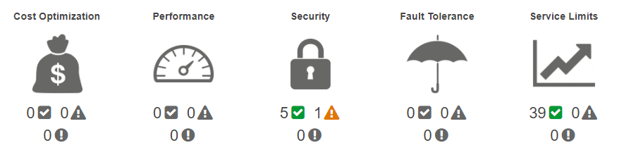
AWS trusted advisor

Slide 20
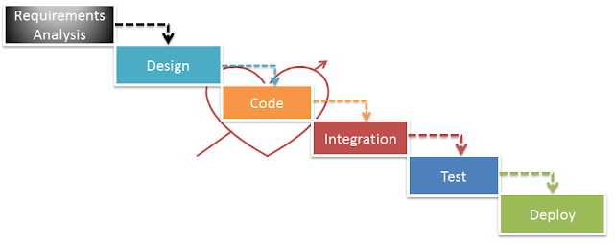

Slide 21
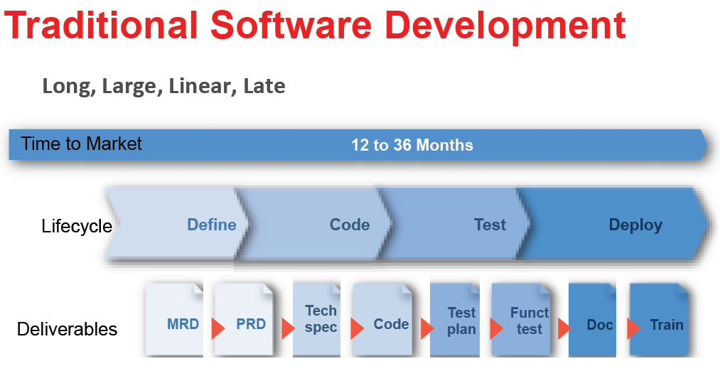

Slide 22
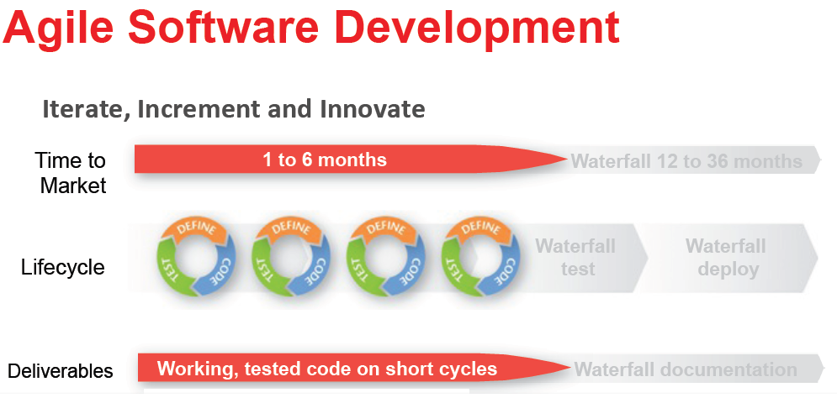

Slide 23
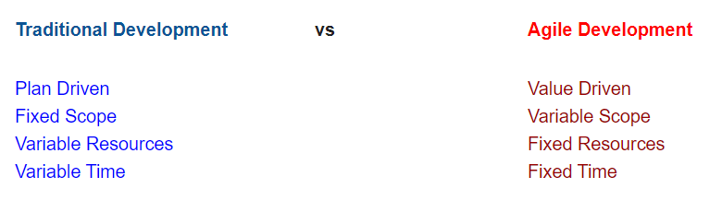

Slide 24
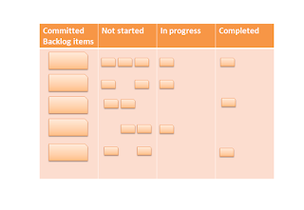

Slide 25
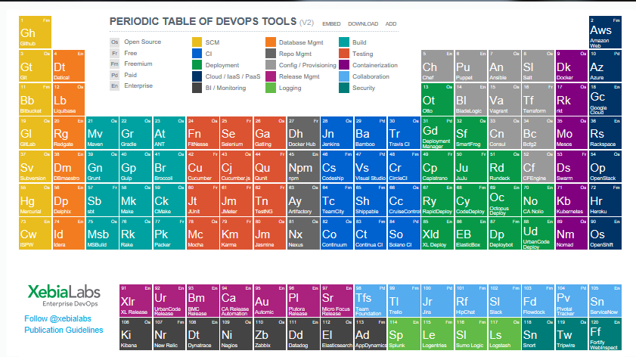
AWS in Leaders

Slide 26
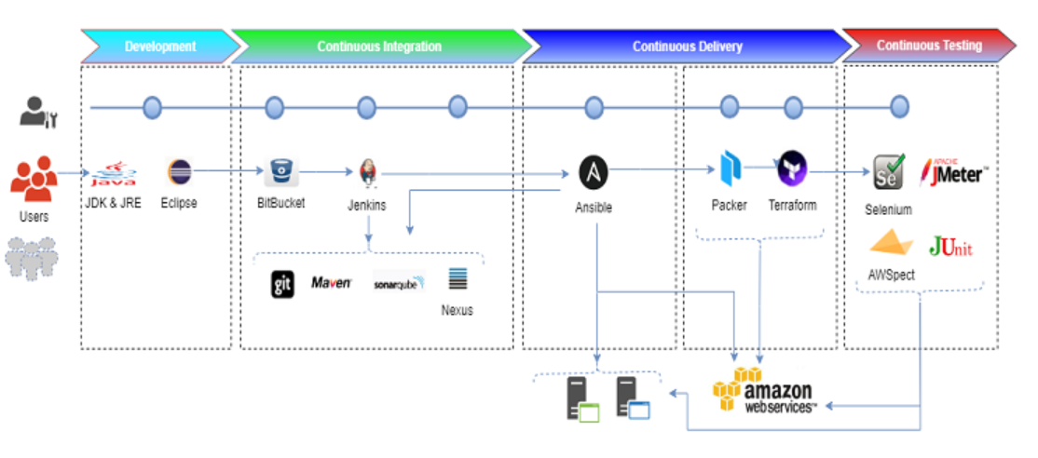

Slide 27





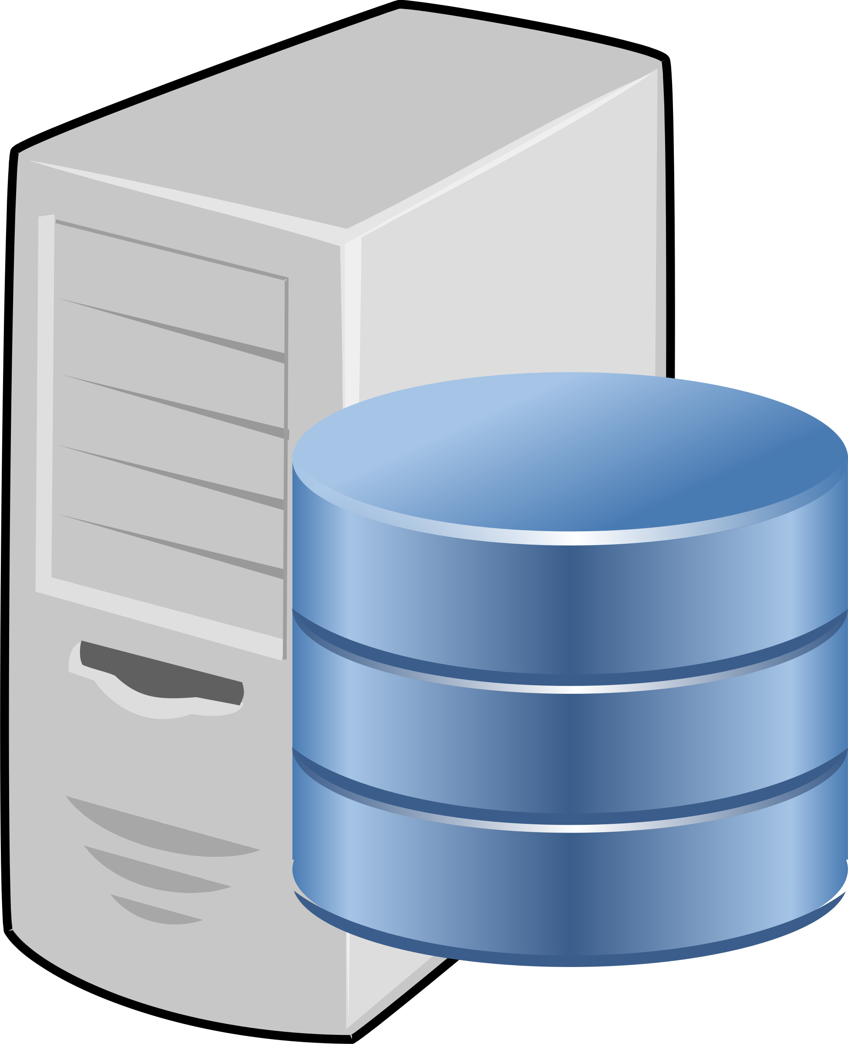
Jenkins
Java Developer 3
Dev Server
Java Developer 2
Code Repository
Test Server
Jenkins CI
Build Server
Java Developer 1
Prod Server

Slide 28
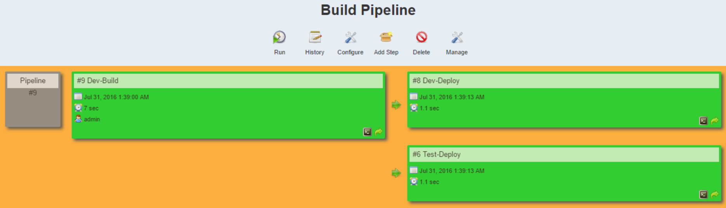
Jenkins

Slide 29

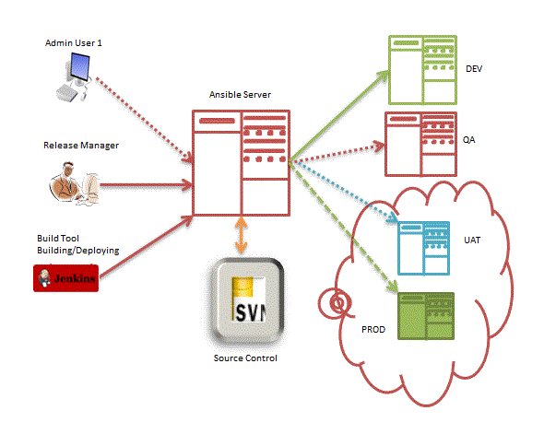
Ansible Architecture Envs
SSH

Slide 30
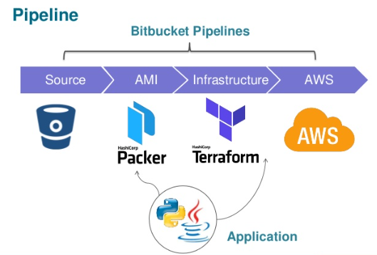
Terraform will paly vital roles for infra. provisioning

Slide 31

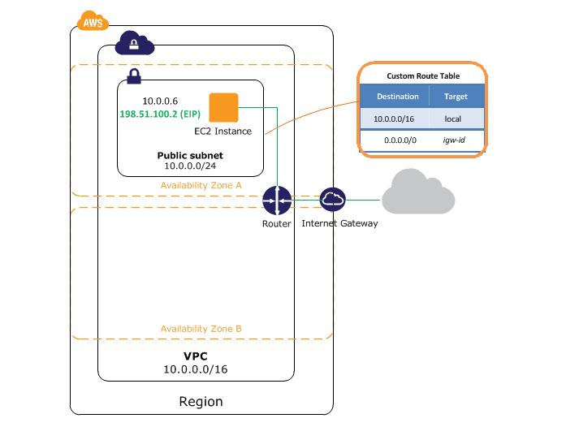


Terraform Architecture
Modules
*.tf
*.tfvar
AWS Cloud Provider
Plugins

Slide 32
Demo & qa
?????
C:\TerraformDemo\Terraform 701 VPC SubNet SG IG NGW and Instance
Notes:
Demo:
#!/bin/bash
yum install -y httpd
echo "<html><body><h1>Welcome! </h1></body></html>" > /var/www/html/index.html
service httpd start
chkconfig httpd on

