Slide 1
TELCO Customer Churn
DATS211
Andrew Whiteside (SEPTEMBER 2024)

Slide 2
Introduction
Purpose & Agenda
TelCo, a telecommunications company is experiencing high customer churn rates.
An in-depth analysis will be conducted to evaluate the predictive model for customer churn.
Data Overview​
Data Preprocessing​
EDA​
Model Building​
Model Evaluation​
Business Insights​
Conclusion

Slide 3
Data Overview
Dataset Description
The dataset contains information on customer demographics, which is crucial for analyzing customer behavior and predicting churn
Variables are Age, Gender, Annual Income, Account Length, Monthly Charge, Data Usage, and Churn Status
The dataset consists of 981 customer records after being cleaned
Average age is 49 years
Average annual income is $50,000
Gender is evenly split
Approximately 49% of customers have churned

Slide 4
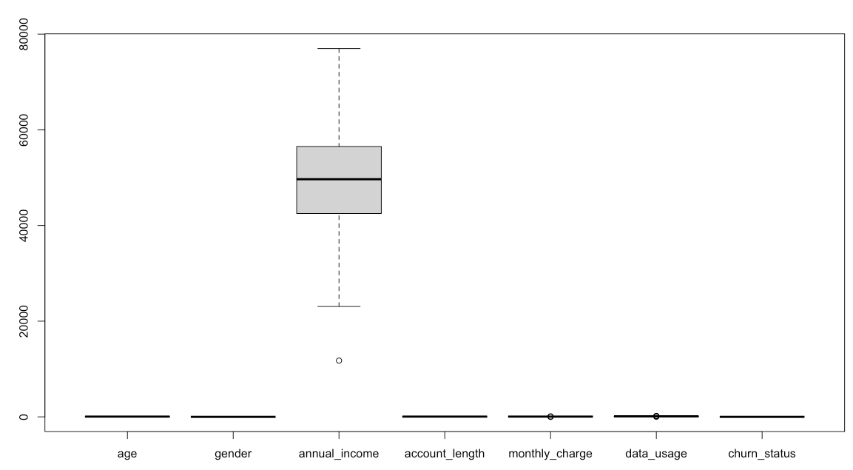
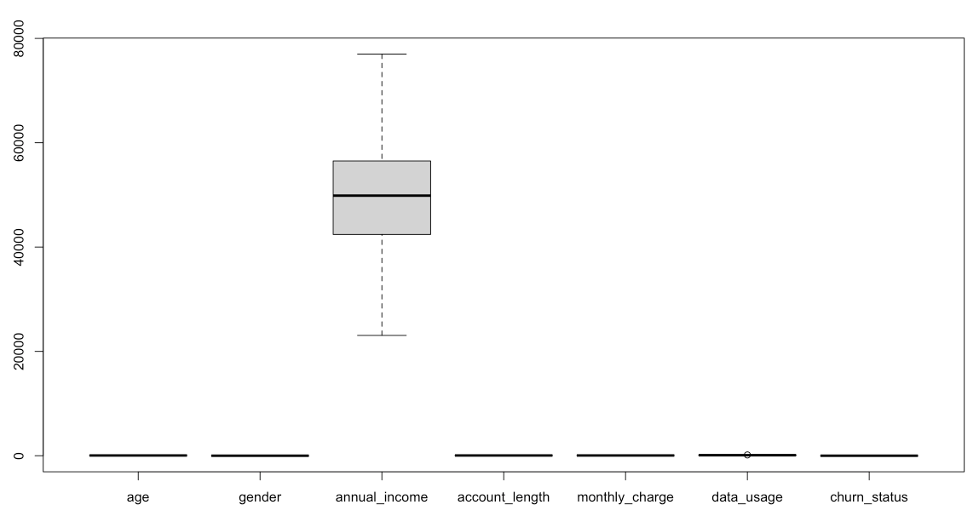
Data Preprocessing
Cleaning and Transformation
BEFORE
Column names were cleaned and standardized using the janitor package to improve readability and consistency
The two categorical variables were converted to binary format to simplify the modeling process
Outlier detection and removal was used based on the IQR method; reducing the influence of extreme values that could skew results
AFTER

Slide 5
Exploratory Data Analysis (EDA)
Key Findings
Age Distribution
Annual Income
Churn Rate by Age Group
The age distribution reveals that there are noticeable spikes in certain age groups.
There is a wide variation in annual income among the customers, with a slight uptrend as they age.
The churn rate analysis shows that customers aged 40-60 have a higher tendency to churn compared to other age groups.

Slide 6
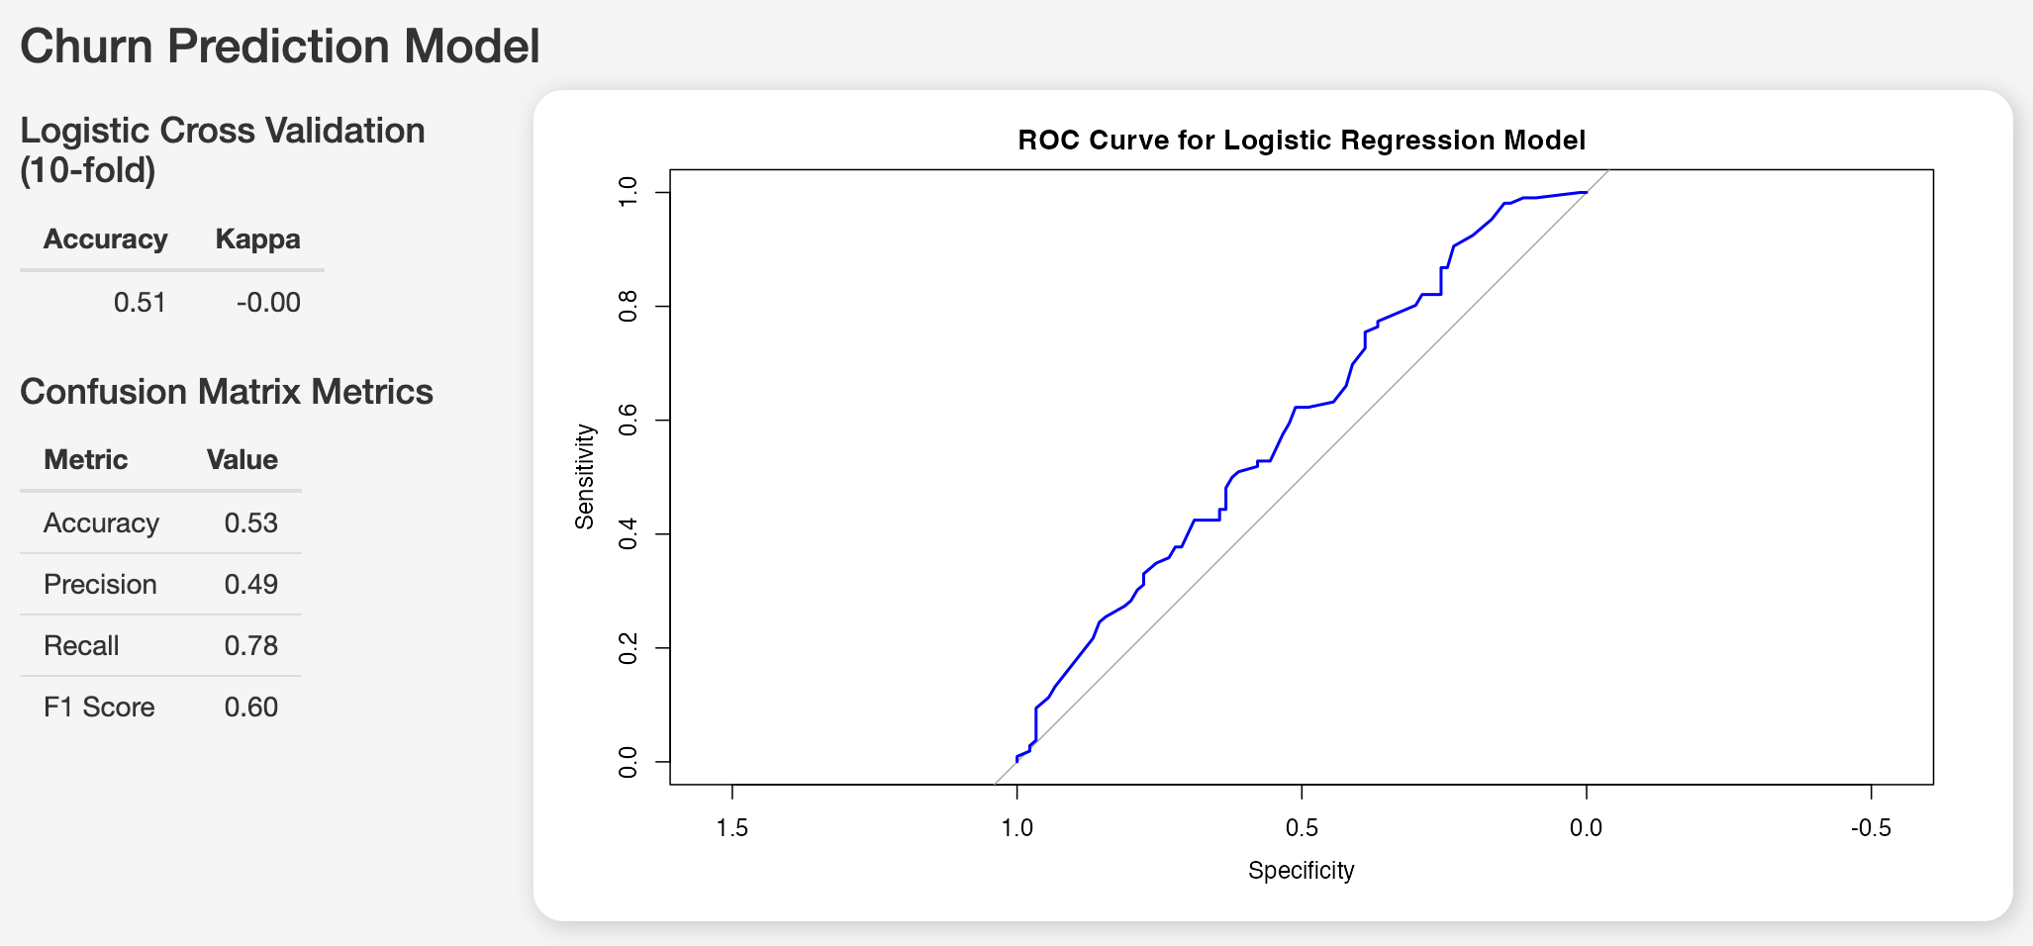
Predictive Model Building
Logistic Regression Model

Slide 7
Model Evaluation
Assessing Performance and Identifying Areas for Improvement
The model is using age as its only predictor for customer churn status. This lends the model to be highly interpretable
The model is effective at identifying customers who are likely to churn with a high recall score (0.78)
With a low precision score (0.49), the model will predict a number of false positives leading to unnecessary retention efforts
The overall accuracy (0.53) indicates that the model’s predictions are only slightly better than random guessing.
The ROC (Receiver Operating Characteristic) curve has some discriminative power as the bow curves towards the top-left corner, seen in the recall score

Slide 8
Business Insights
Recommendations
The churn rate is highest among customers aged 40-60. This demographic may face specific challenges or have unmet needs that lead them to discontinue the service. It’s important to understand these challenges to devise effective retention strategies.
Develop retention programs that cater specifically to the needs of the 40-60 and above 60 age groups. For instance, offering discounted rates for long-term contracts, or adding value through bundled services that address their specific needs, could help lower churn rates.
By reducing churn among the higher-risk age groups, the company can maintain a more stable revenue stream and avoid the costs associated with acquiring new customers to replace those who leave.

Slide 9
Conclusion
Key Takeaways and Strategic Path Forward
The Exploratory Data Analysis (EDA) revealed that customers aged 40-60 and above 60 are at a higher risk of churn, which indicates a need for targeted retention strategies
The logistic regression model provided insights into the likelihood of churn, with a recall rate of 78%, indicating the model’s strength in identifying customers at risk of leaving
Implement targeted retention strategies for high-risk age groups, such as personalized offers, better customer support, and loyalty programs

