Slide 1


Slide 2
Terraform :
It is an open-source infrastructure as code software tool created by HashiCorp. It enables users to define and provision a datacenter infrastructure using a high-level configuration language known as Hashicorp Configuration Language (HCL), or optionally JSON, Terraform supports a number of cloud infrastructure providers such as Amazon Web Services, IBM Cloud (formerly Bluemix), Google Cloud Platform, Linode, Microsoft Azure, Oracle Cloud Infrastructure, or VMware vSphere as well as OpenStack
Terraform is a tool for building, changing, and versioning infrastructure safely and efficiently.
Terraform can manage existing and popular service providers as well as custom in-house solutions.

Slide 3
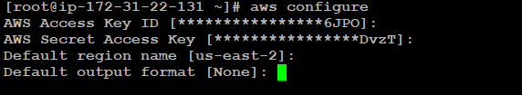
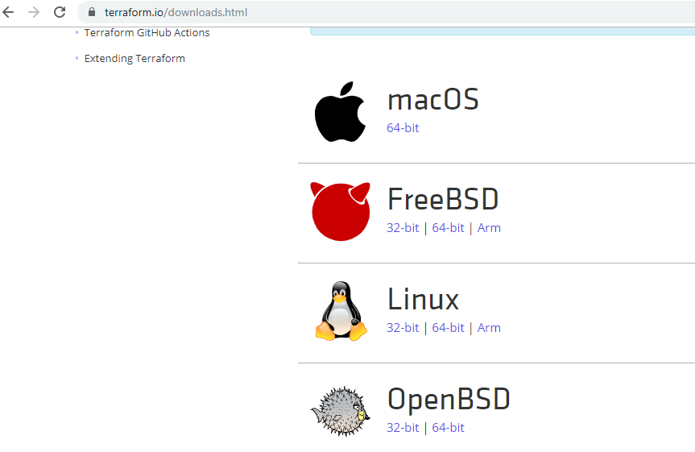
Terraform Setup on Linux
Step 1 : Create user with Full admin access in AWS
Step 2 : Configure Access key and Secret Key
Step 3 : Download Terraform → https://www.terraform.io/downloads.html
Copy the Link for the OS and download into the machine and unzip the file

Slide 4
AmazonLinux::
sudo yum install -y yum-utils
sudo yum-config-manager --add-repo https://rpm.releases.hashicorp.com/AmazonLinux/hashicorp.repo
sudo yum -y install terraform

Slide 5
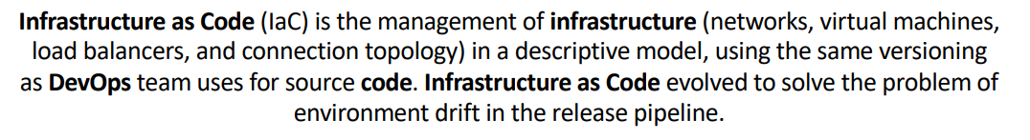
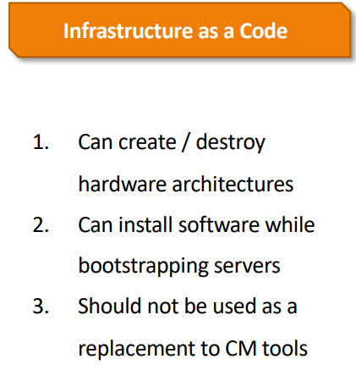
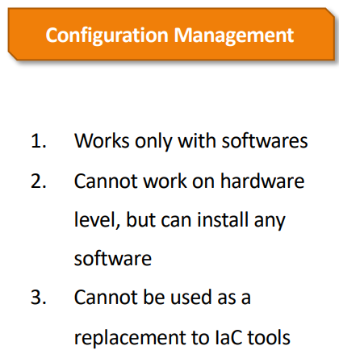

Slide 6
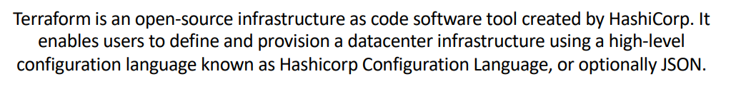
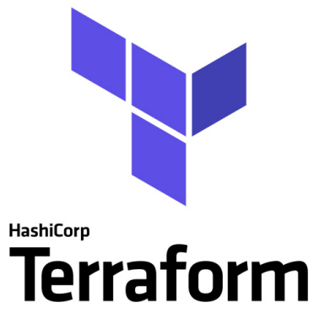
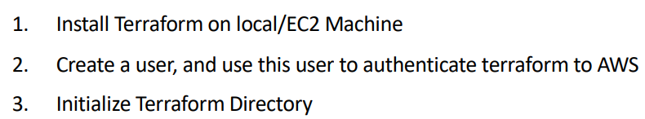

Slide 7





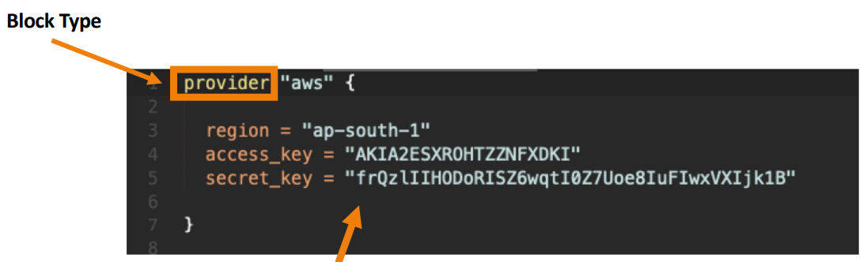


Slide 8
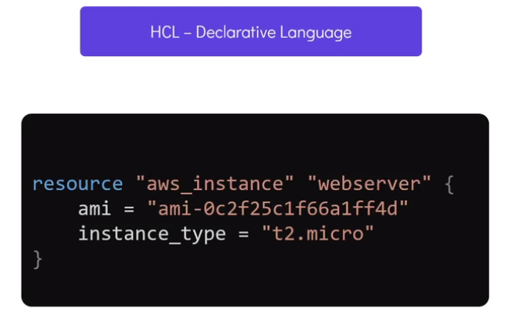

Slide 9

