Slide 1


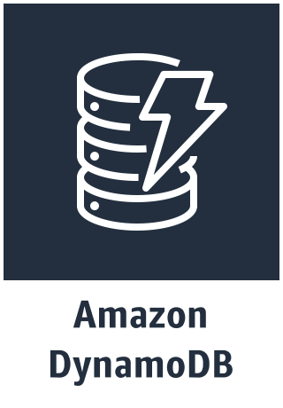
aws-serverless-twitter-event-source app
TwitterSearchPoller
triggers
Polling Schedule (CloudWatch Events Rule)
TweetProcessor
Twitter
Search API
SearchCheckpoint

