Slide 1

Notes:
Talk deck (for DB experts, English). Render with Marp / reveal-md, or just read as Markdown. Slides split on a horizontal rule (three hyphens); speaker notes are HTML comment blocks. Timing (20-min talk + 5-min demo): intro 2 · architecture 4 · Evaluation/Schema 3 · Full Load 4 · CDC 5 · Validation/AI 2 · closing (hot partition) 1 (+buffer). - (verbal) Internal tech share · 20-min talk + 5-min demo · audience: DB experts. - This tool is a web app that migrates RDS/Aurora MySQL to Aurora DSQL (PostgreSQL-16 compatible, distributed). - Today is about "how it works," not "what it does" — especially the internals of the architecture, Full Load, and CDC. - DSQL is distributed, so it intentionally omits features that don't scale horizontally (FKs, triggers, synchronous indexes) → this is a "heterogeneous migration," not an "upgrade."

Slide 2
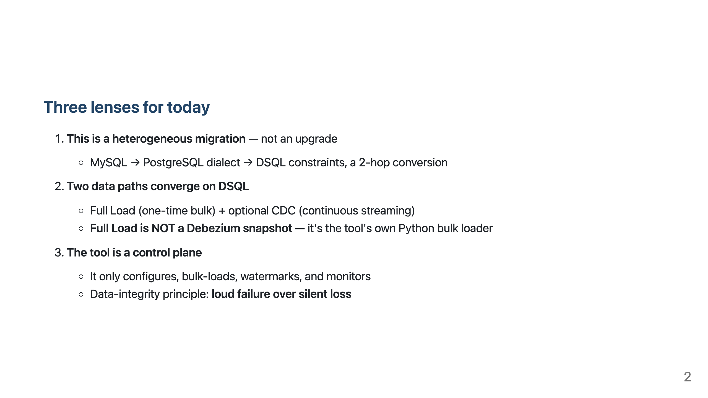
Notes:
- These three lenses run through the whole talk. Especially remember (2) "Full Load ≠ Debezium snapshot" and (3) "loud fail over silent loss." - The goal is NOT fully-automated zero-downtime: assess feasibility → automate what's deterministic → clearly surface where human work is required.

Slide 3
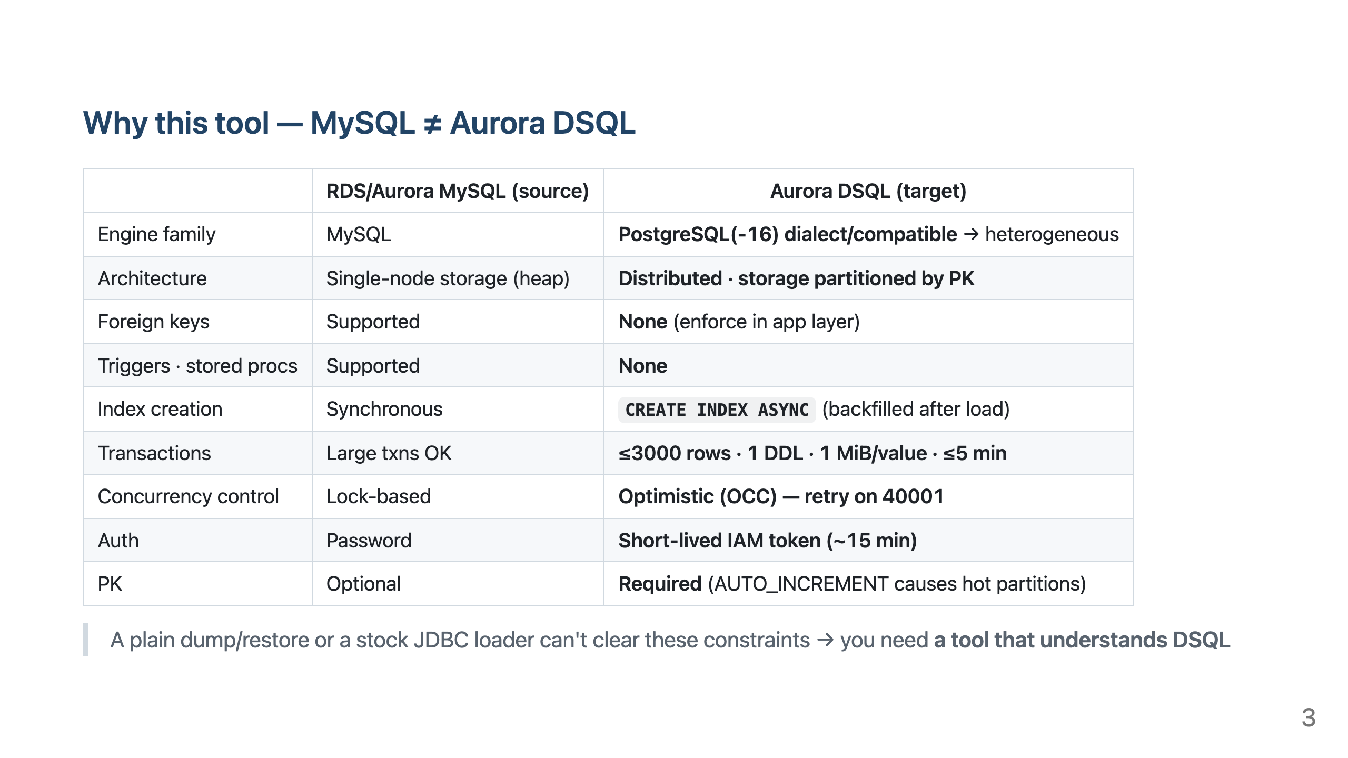
Notes:
- This slide answers "why this tool." Each row is the rationale for a later slide: distributed + PK partitioning → hot partition / PK strategy, ≤3000 rows → batched loader, OCC 40001 → statement-level retry, IAM token → custom sink, no FK → preserve-in-report. - One-liner: mysqldump or a generic tool's "full load" does not handle DSQL's batch limit, OCC, IAM token, or type differences.

Slide 4
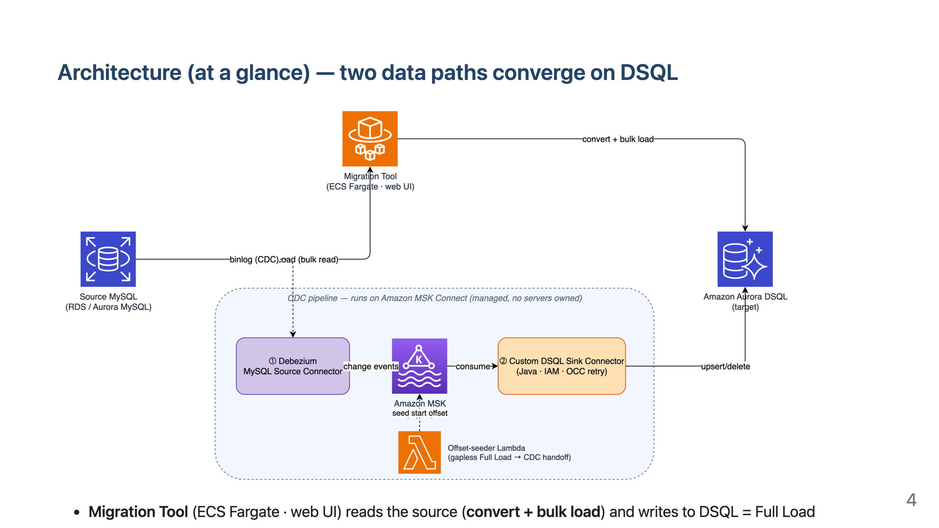
Notes:
- Big picture first. Top path = Full Load (convert + bulk load), bottom box = optional CDC. - Emphasize the "CDC pipeline runs on managed MSK Connect — no servers owned" label: we don't operate compute. - Next slide zooms into the full production architecture (networking/IAM/security).

Slide 5
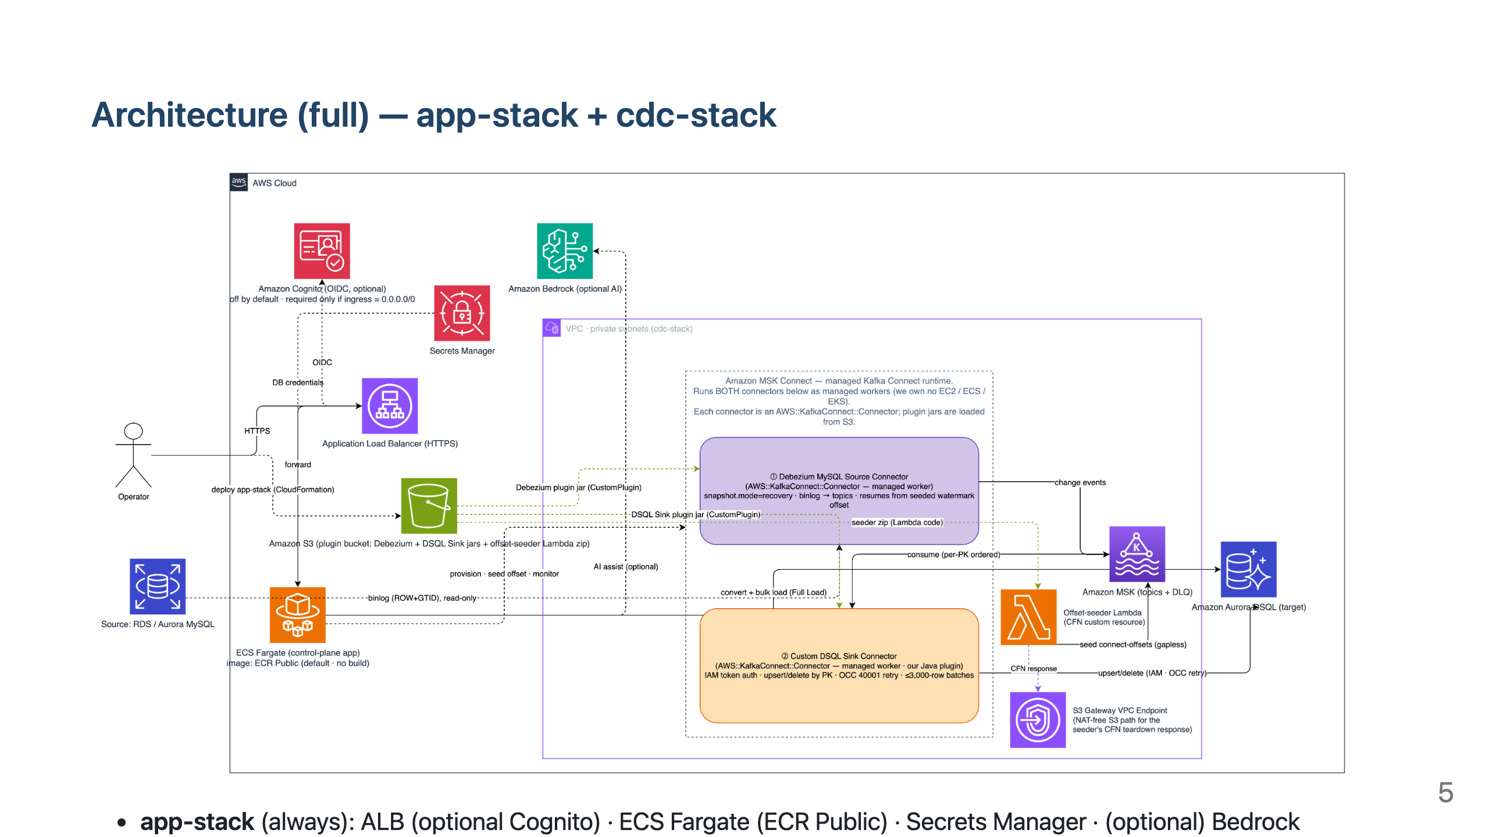
Notes:
- Why single task (desiredCount=1)? It's a control plane, no state to shard (no-bloat). Rolling image replacement means brief downtime → managed via the next state-layers slide. - Source MySQL is customer-owned, outside both stacks. The browser only renders the UI (not on the data path). - Security: Cognito is off by default; the template forcibly blocks the "internet-exposed (0.0.0.0/0)" combo. Least-privilege IAM (task/execution role split). - If short on time, cover this slide in two lines: "left = app-stack always, right VPC box = cdc-stack optional."

Slide 6
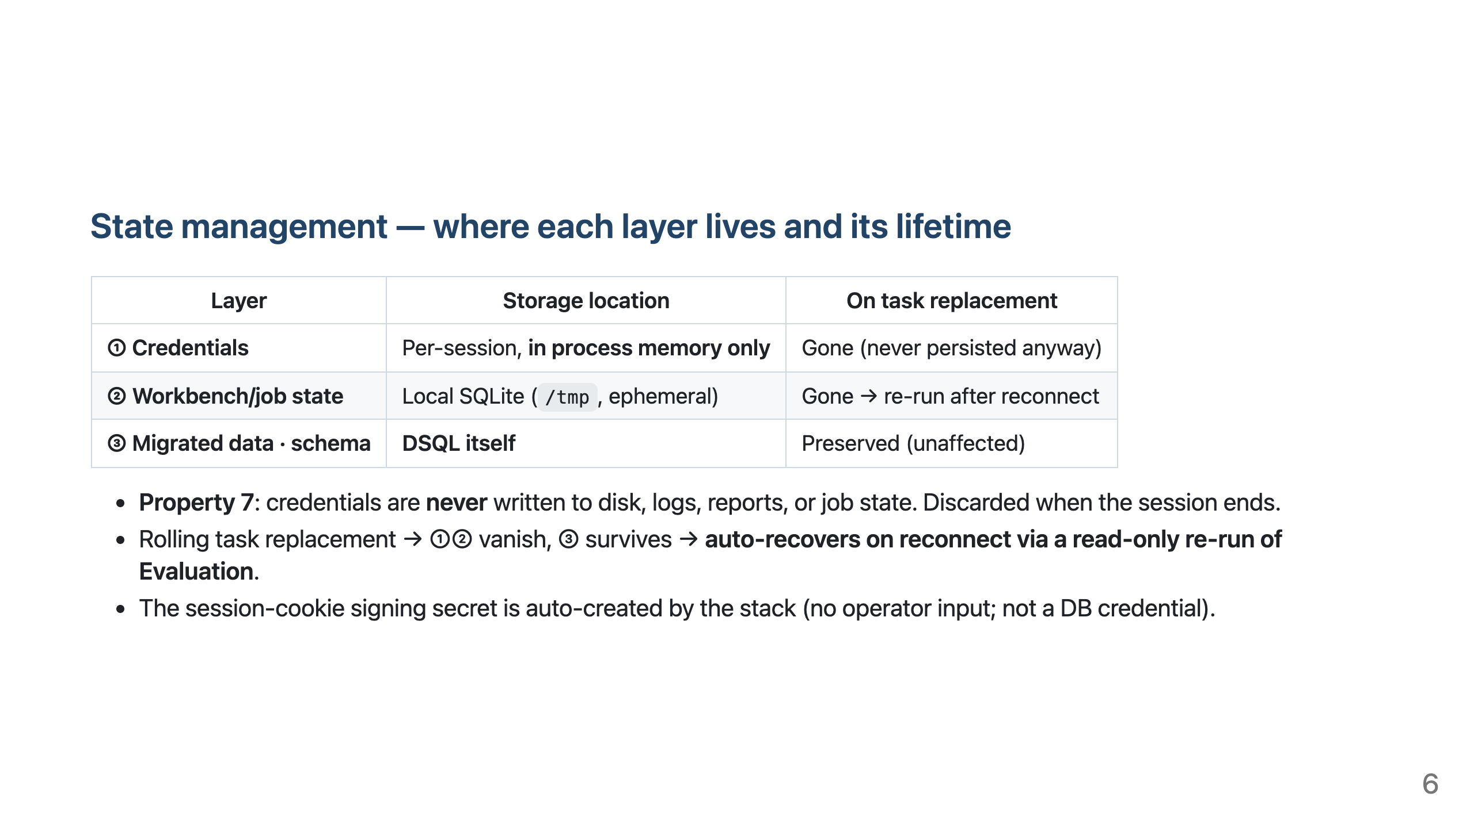
Notes:
- Appeal point for DB experts: "credentials never touch disk" is an enforced rule (code-review gate). - Since ③ is DSQL, data/schema stay safe even if the task dies. On reconnect, the tool introspects the target to restore state.

Slide 7
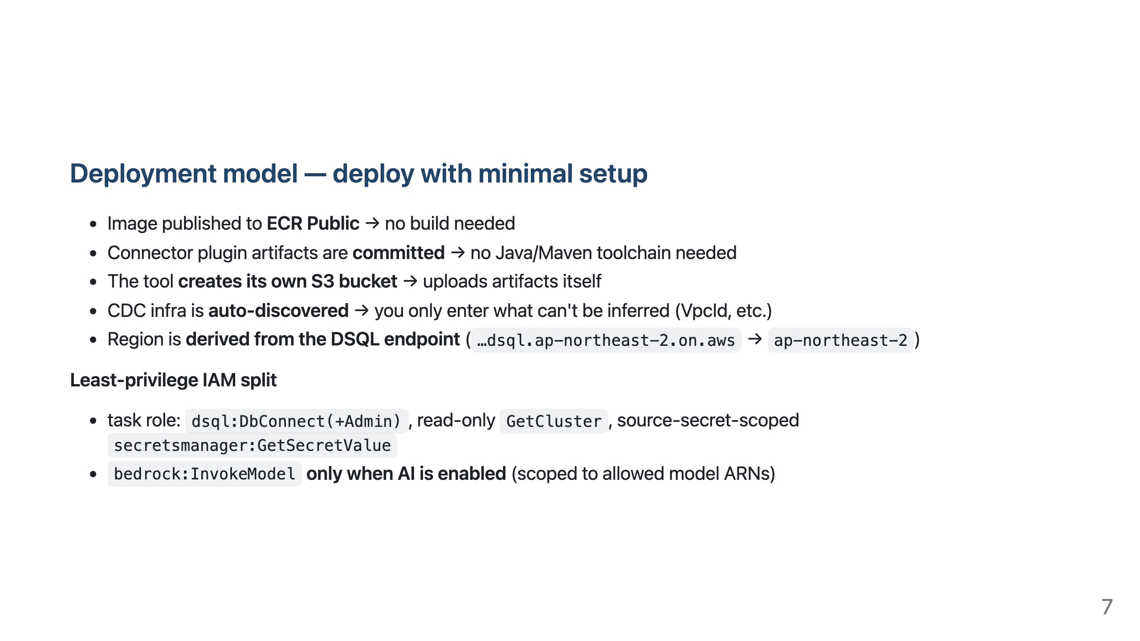
Notes:
- Deployment convenience is the top design principle. Goal: "fresh clone + minimal setup." - Cross-region migration is unsupported — the CDC data plane must reach the source privately from inside the DSQL region's VPC. Single-region assumption.

Slide 8
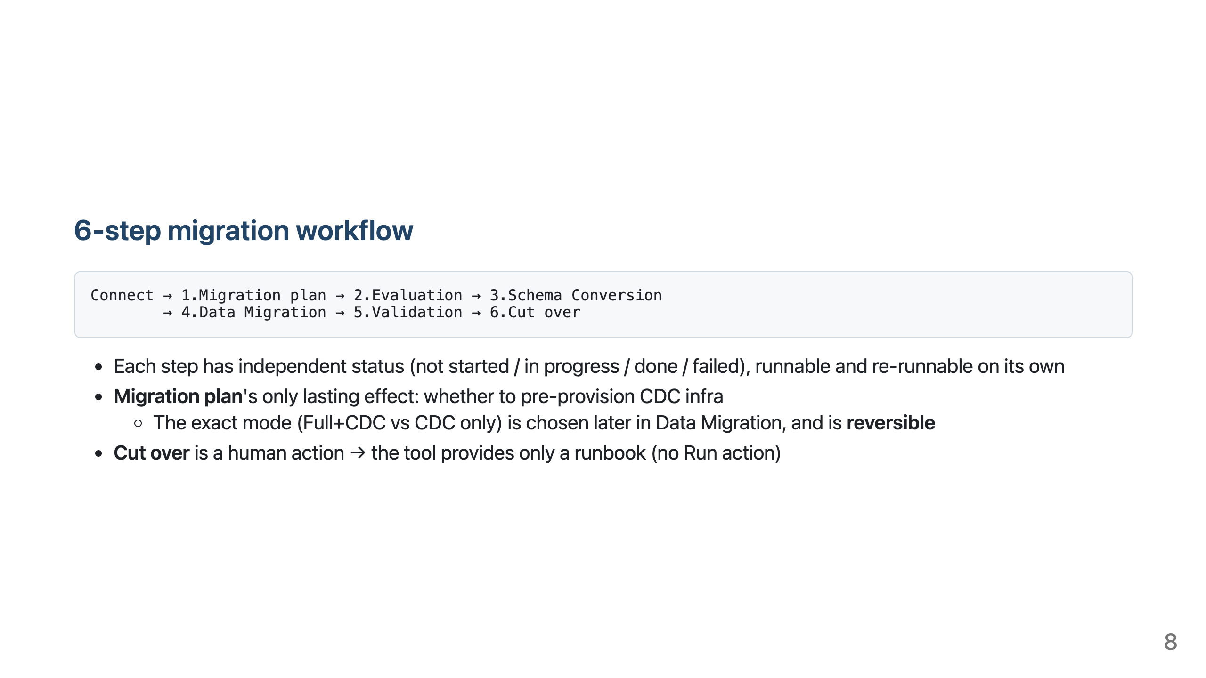
Notes:
- A guided flow, not a forced wizard. If a prior step is incomplete, the UI only advises. - Today's deep dive covers 2·3 (Evaluation/Schema), 4 (Full Load/CDC), and 5 (Validation).

Slide 9
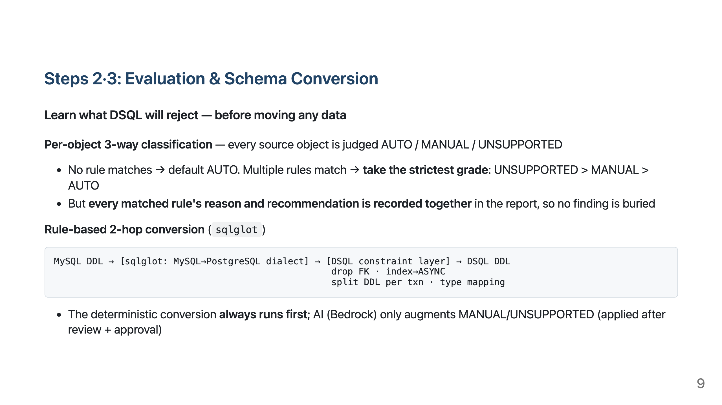
Notes:
- Core message: a "deterministic gate" between connecting and moving data — predictable conversion, not trial and error. - For an Aurora MySQL user, this step is where you learn "what DSQL won't accept" — before a single row moves, read-only and cheap. - AI does not replace the deterministic path, only augments it (off by default), and must pass review-only + an explicit approval gate to reach the target.

Slide 10
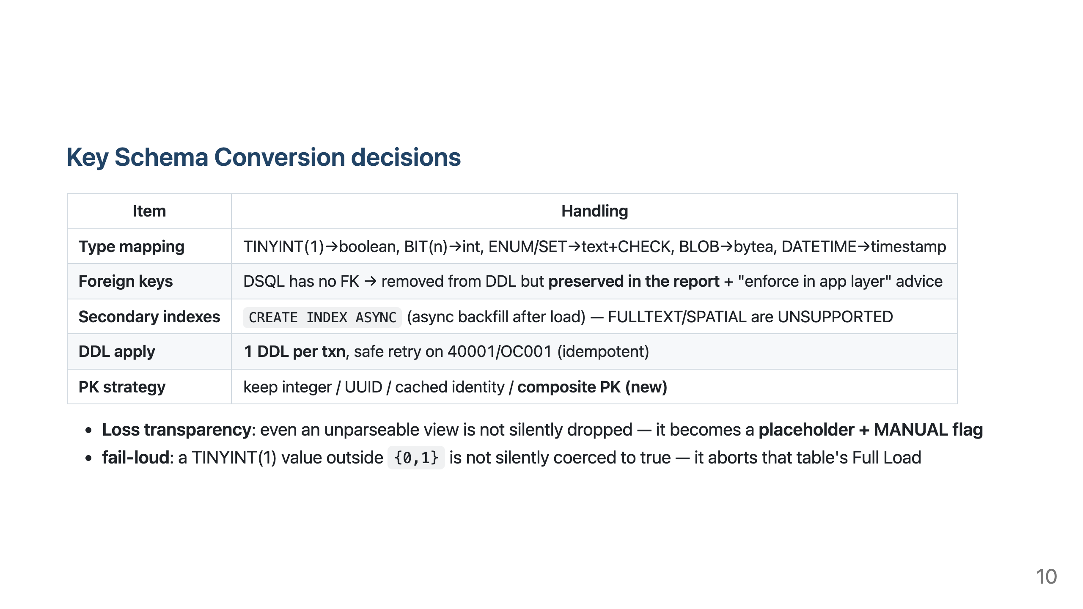
Notes:
- FK "preserve-in-report" is the emblem of loss transparency: it's surfaced, not vanished. - The reason for PK strategy (hot partition) is detailed in the Full Load deep dive; here it's just "you have choices." - DSQL hard limits: ≤255 columns/table, ≤1000 tables/DB, 1 DB/cluster, DECIMAL ≤38, 1 MiB/value.

Slide 11
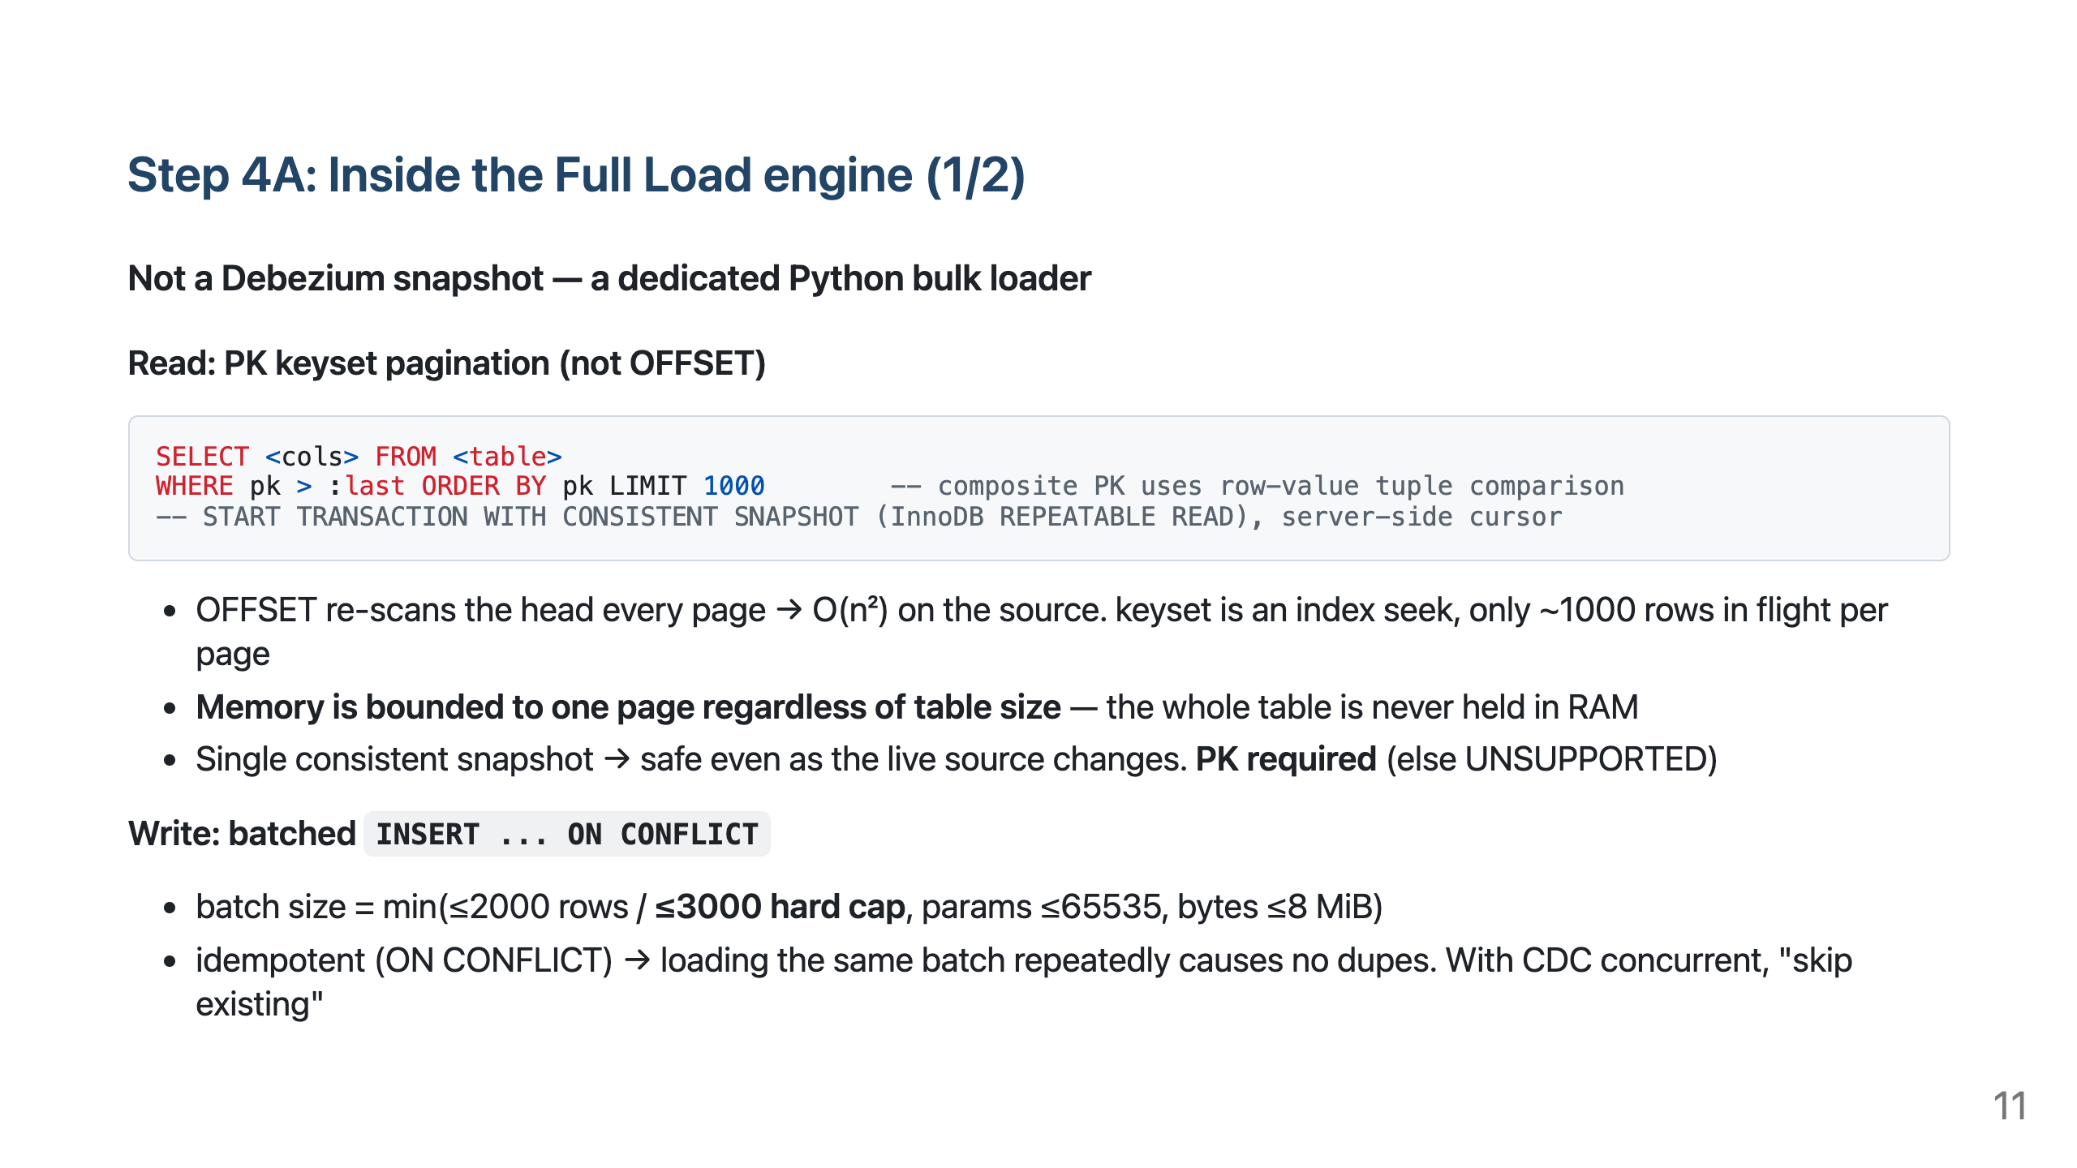
Notes:
- Why a dedicated loader: a generic tool's full load is internally JDBC INSERTs with no DSQL-specific OCC handling. - Inside the consistent snapshot, the watermark is captured in the same transaction → the snapshot point and binlog coordinates align exactly (the basis for the later CDC handoff). - Caveat: the REPEATABLE READ snapshot stays open for the whole table read, so on a write-heavy source it can block InnoDB undo purge (History List Length).

Slide 12
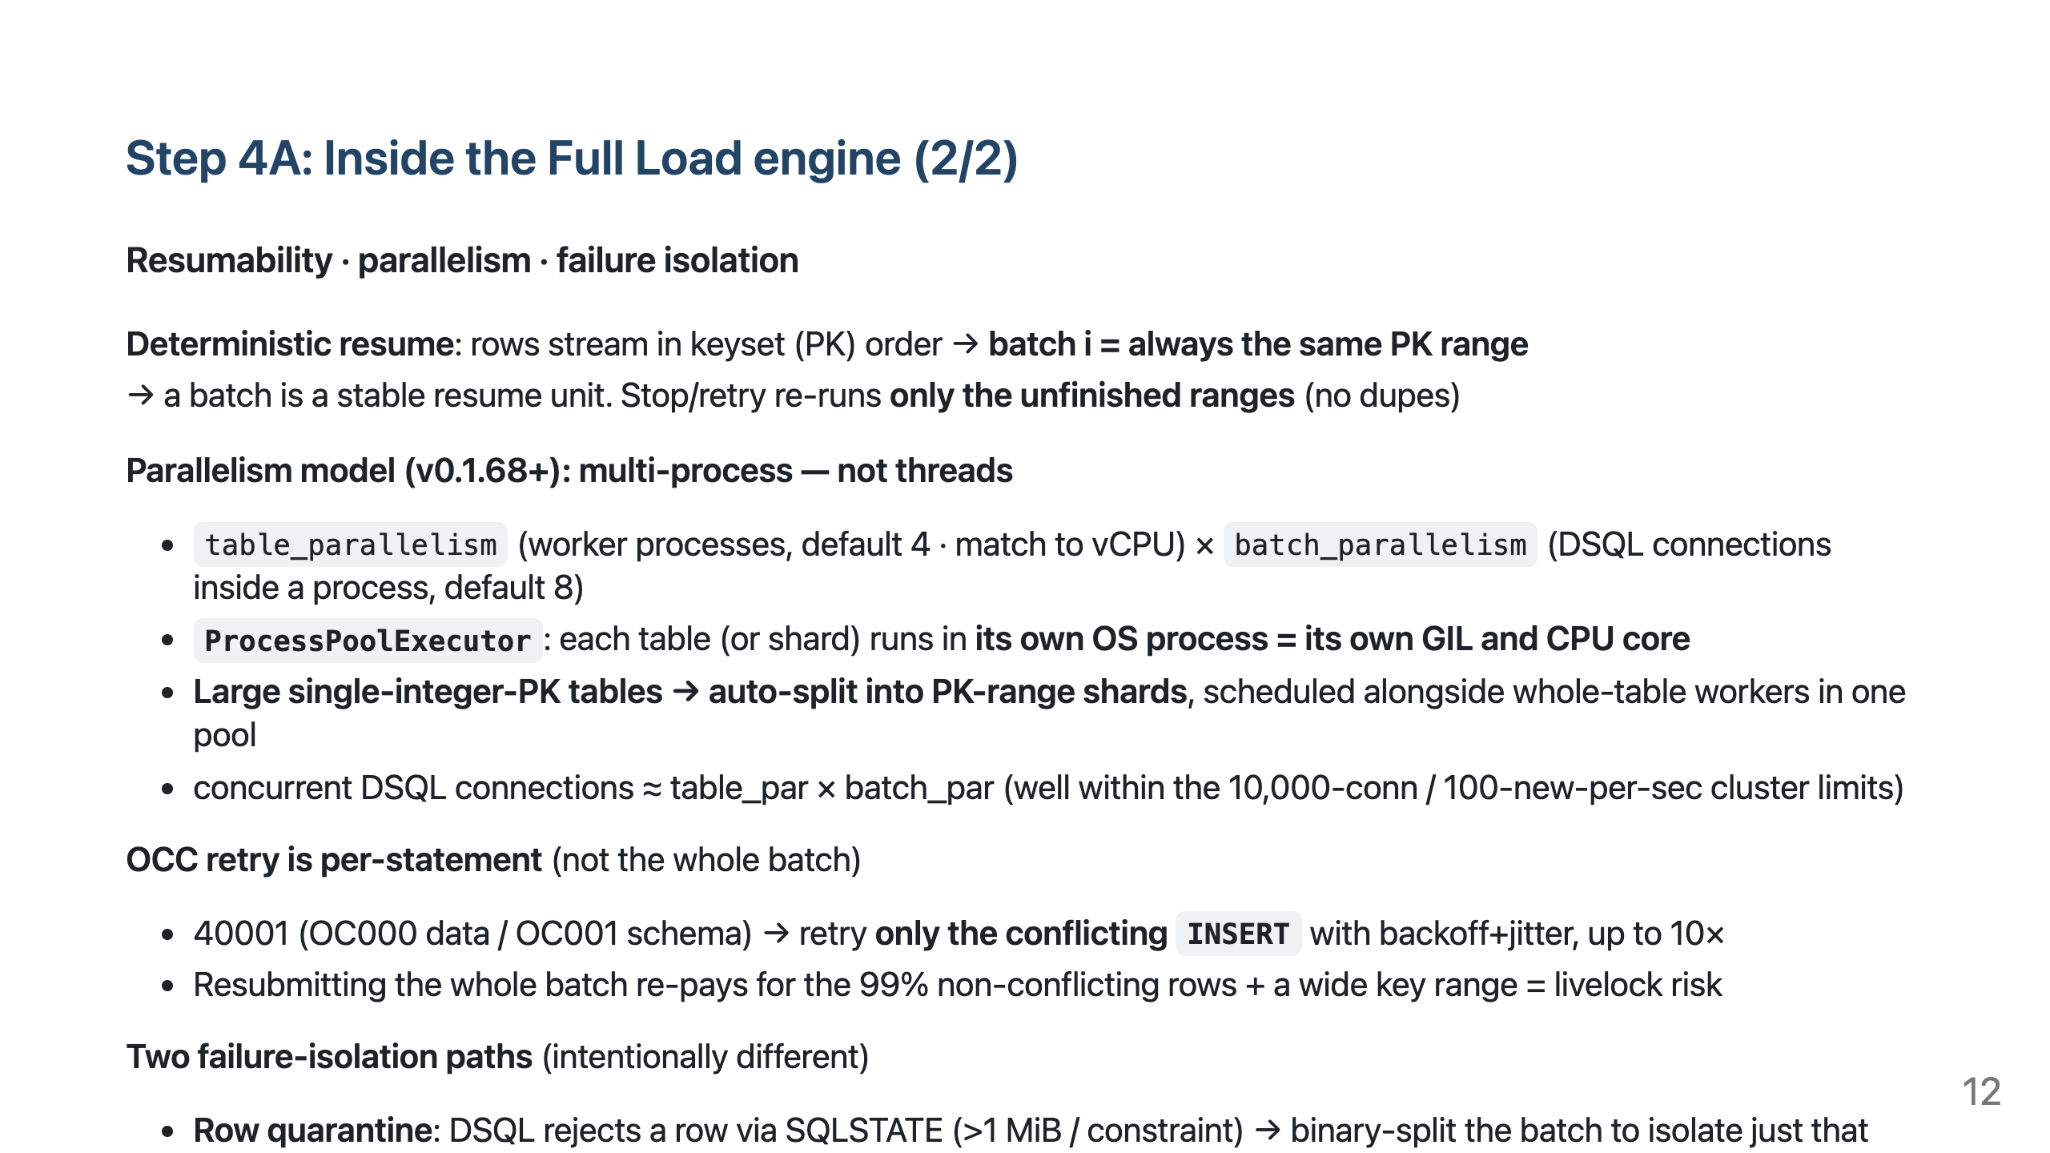
Notes:
- Per-statement retry is this tool's signature. The custom CDC sink mirrors it later. - Row-quarantine vs table-fatal: the former is DSQL rejecting (has SQLSTATE), the latter happens during read/convert before asking DSQL (no SQLSTATE). Neither is passed over silently. - Indexes are created last, after load, as CREATE INDEX ASYNC (building during load makes every INSERT pay index-maintenance cost).

Slide 13
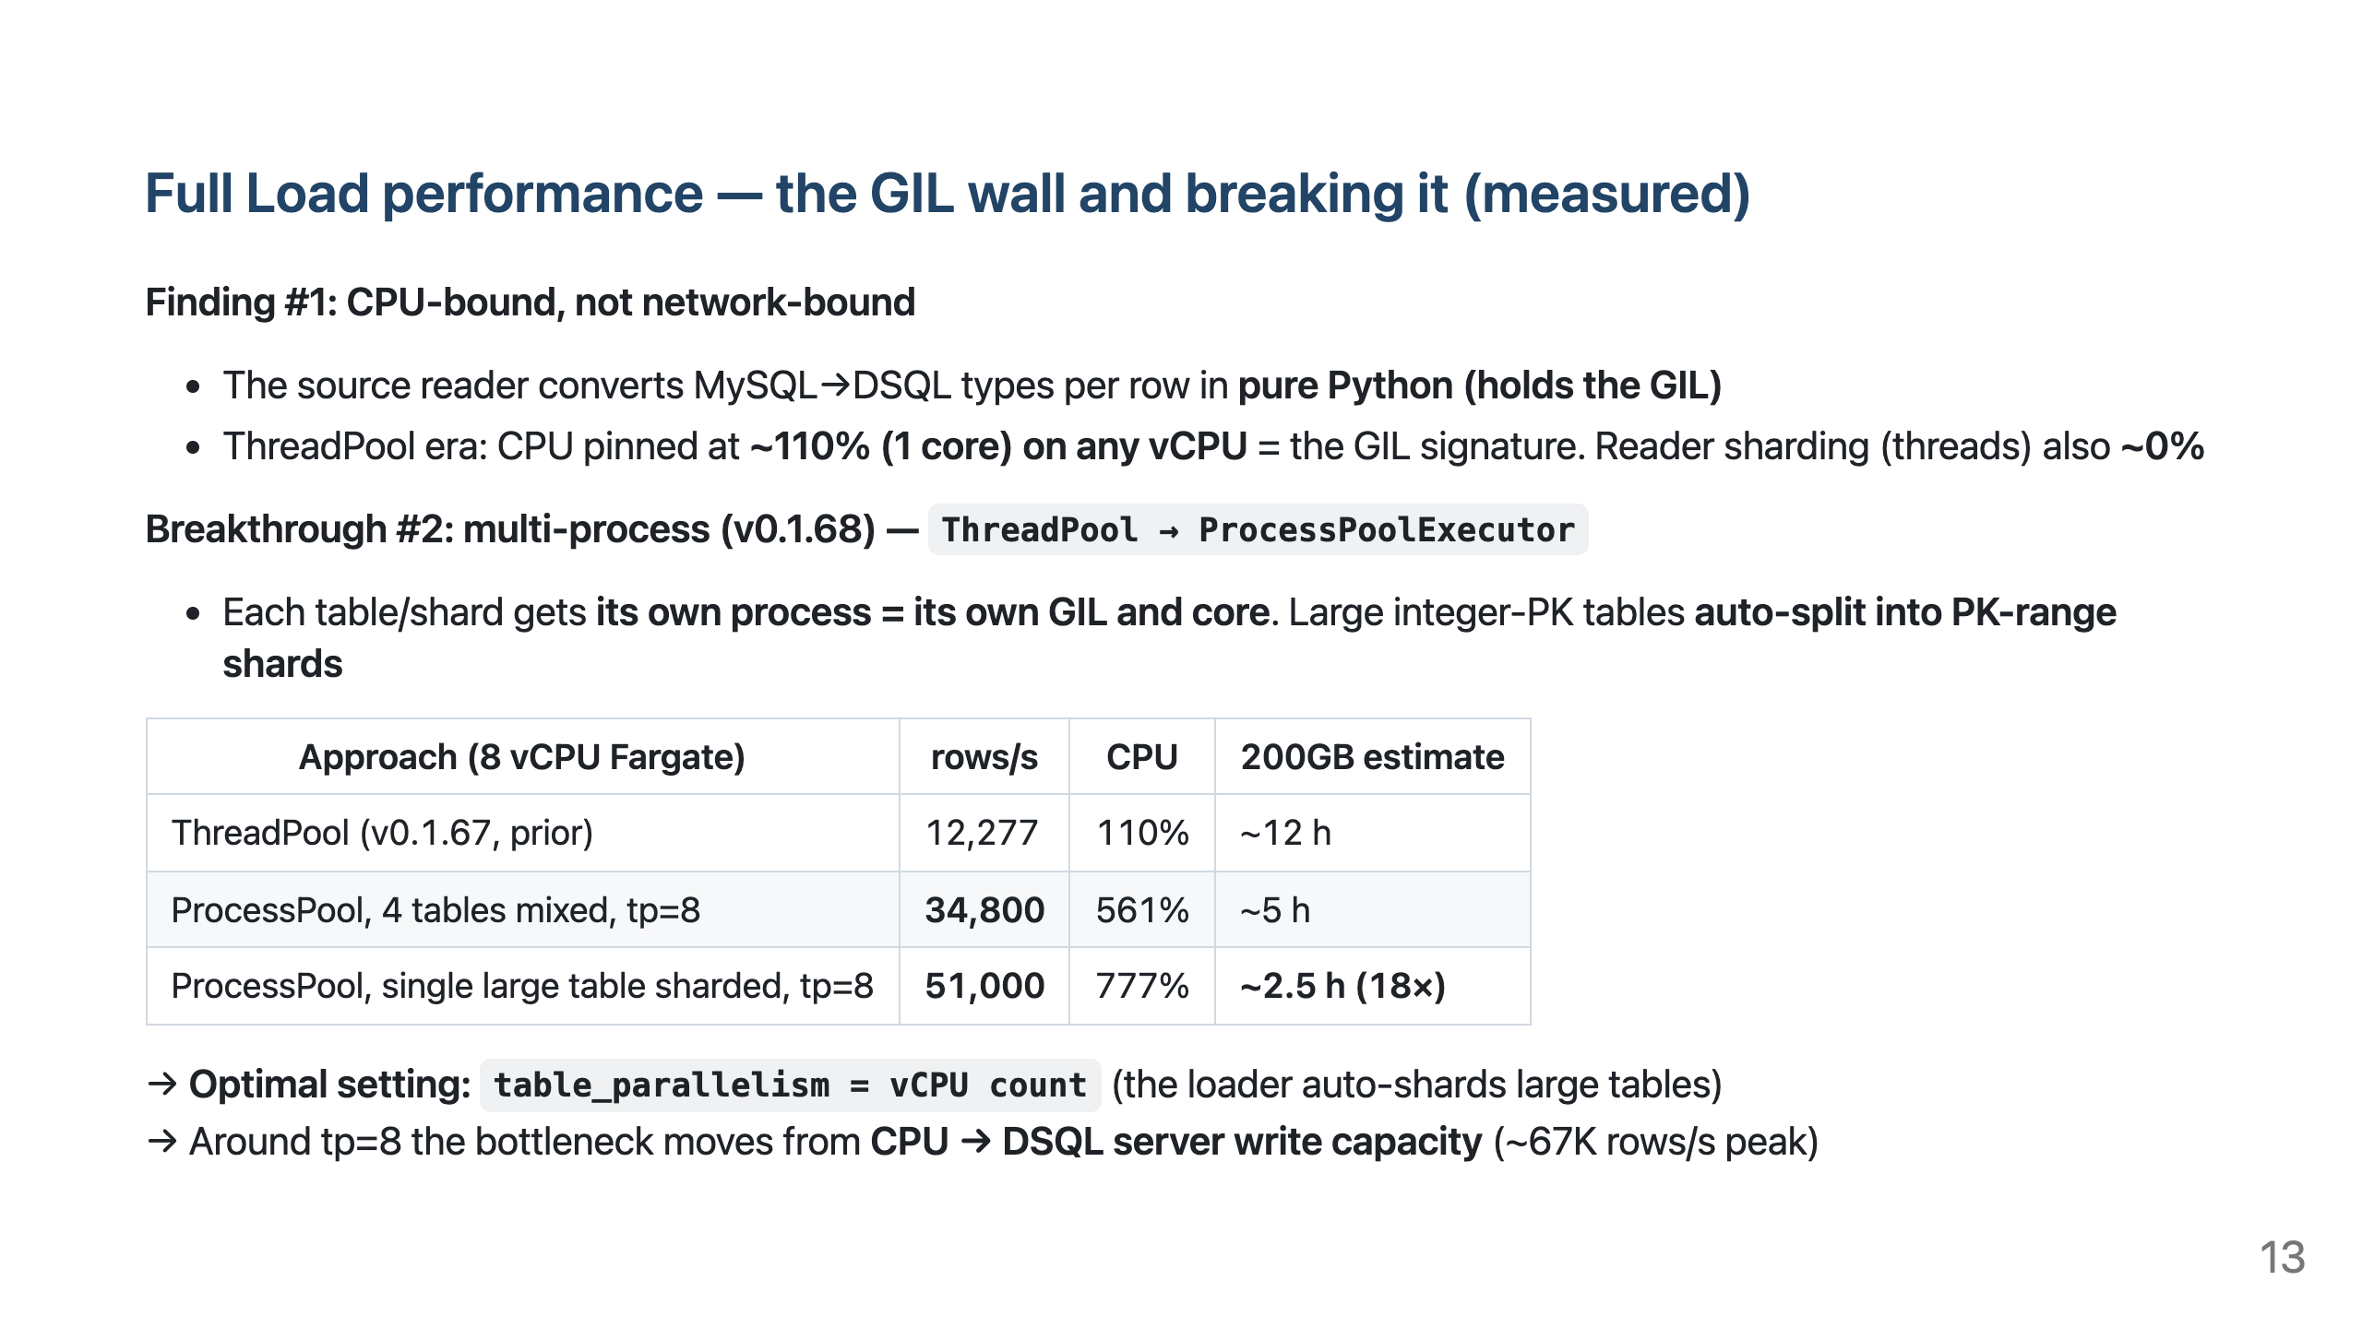
Notes:
- This is the biggest update since the last tech-talk. It used to end at "the GIL is the wall, just add CPU" — now multi-process breaks that wall. - Core narrative: threads can't use the vCPUs because of the GIL → each process has its own GIL so cores are actually used → 18× (200GB 46h→2.5h). - Uses the spawn context; each worker builds its own MySQL engine + DSQL connection pool (no inter-process row transfer). Test doubles auto-use the thread fallback (backward-compatible). - Replace path: for an empty table, plain INSERT (no ON CONFLICT) removes OCC contention → 41K–51K sustained, 67K peak.

Slide 14
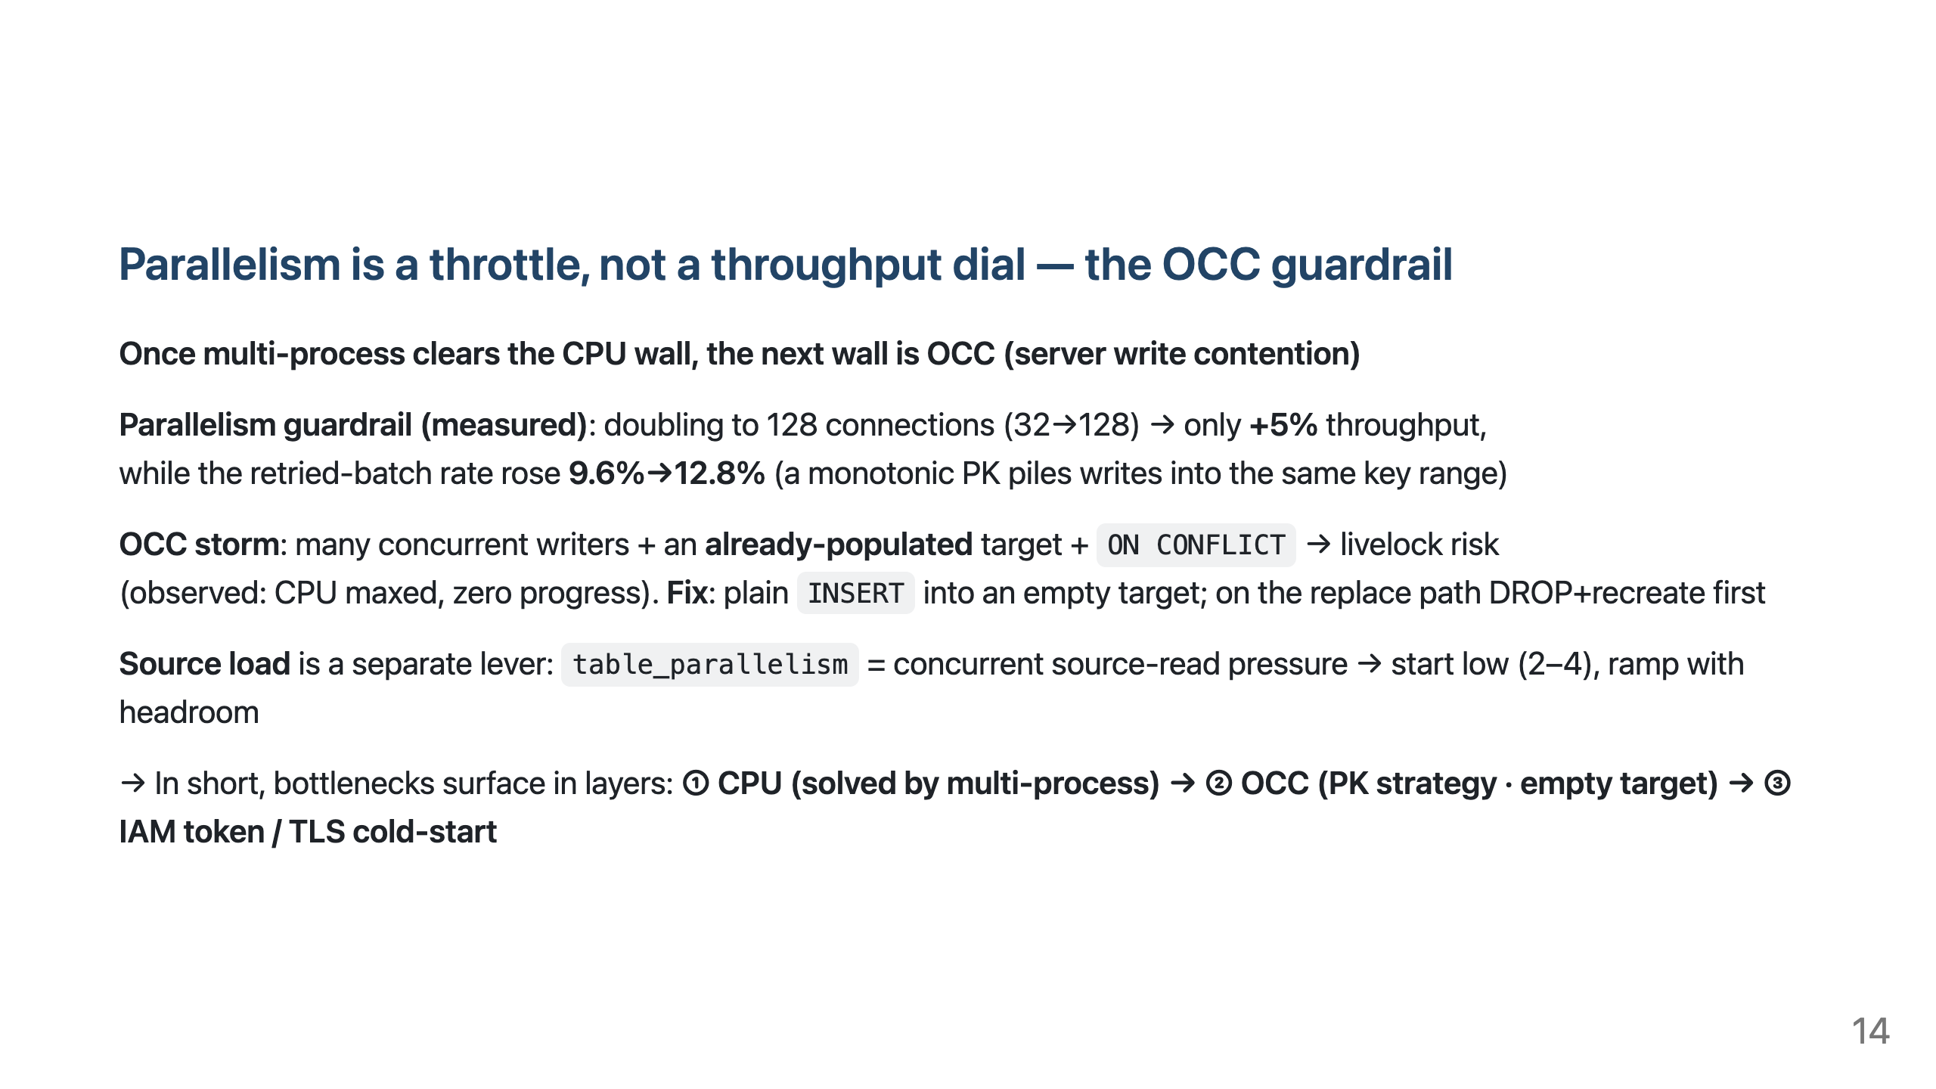
Notes:
- The old "parallelism +5%, retries 9.6→12.8%" measurement still holds — it's now repositioned as the story *after* clearing the CPU wall. - The OCC storm is a real landmine we hit when adding multi-process: 32 writers ON CONFLICT into a populated target → 8+ min at 0 rows. Fixed by plain INSERT into an empty target. - Memory ≈ table_par × batch_par × ~8 MiB (independent of table size). The Fargate CPU/memory pairing (8 vCPU→16 GiB) already covers it.

Slide 15
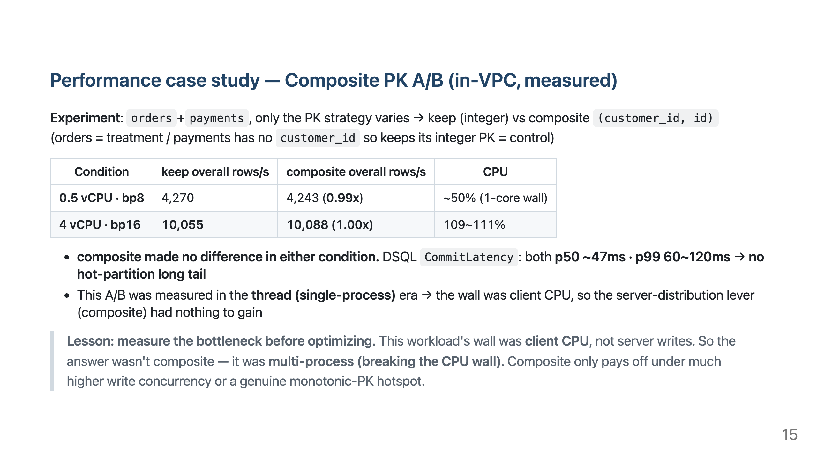
Notes:
- Make clear this A/B predates multi-process (thread era) — that's why CPU was the wall, and the real fix for that wall was the later multi-process work. - The control (payments) moved identically to the treatment (orders) → not environment noise, a genuine no-effect. - Where composite shines: (a) after first removing the client CPU bottleneck (via multi-process), (b) at much higher write concurrency where a monotonic PK heats one partition.

Slide 16
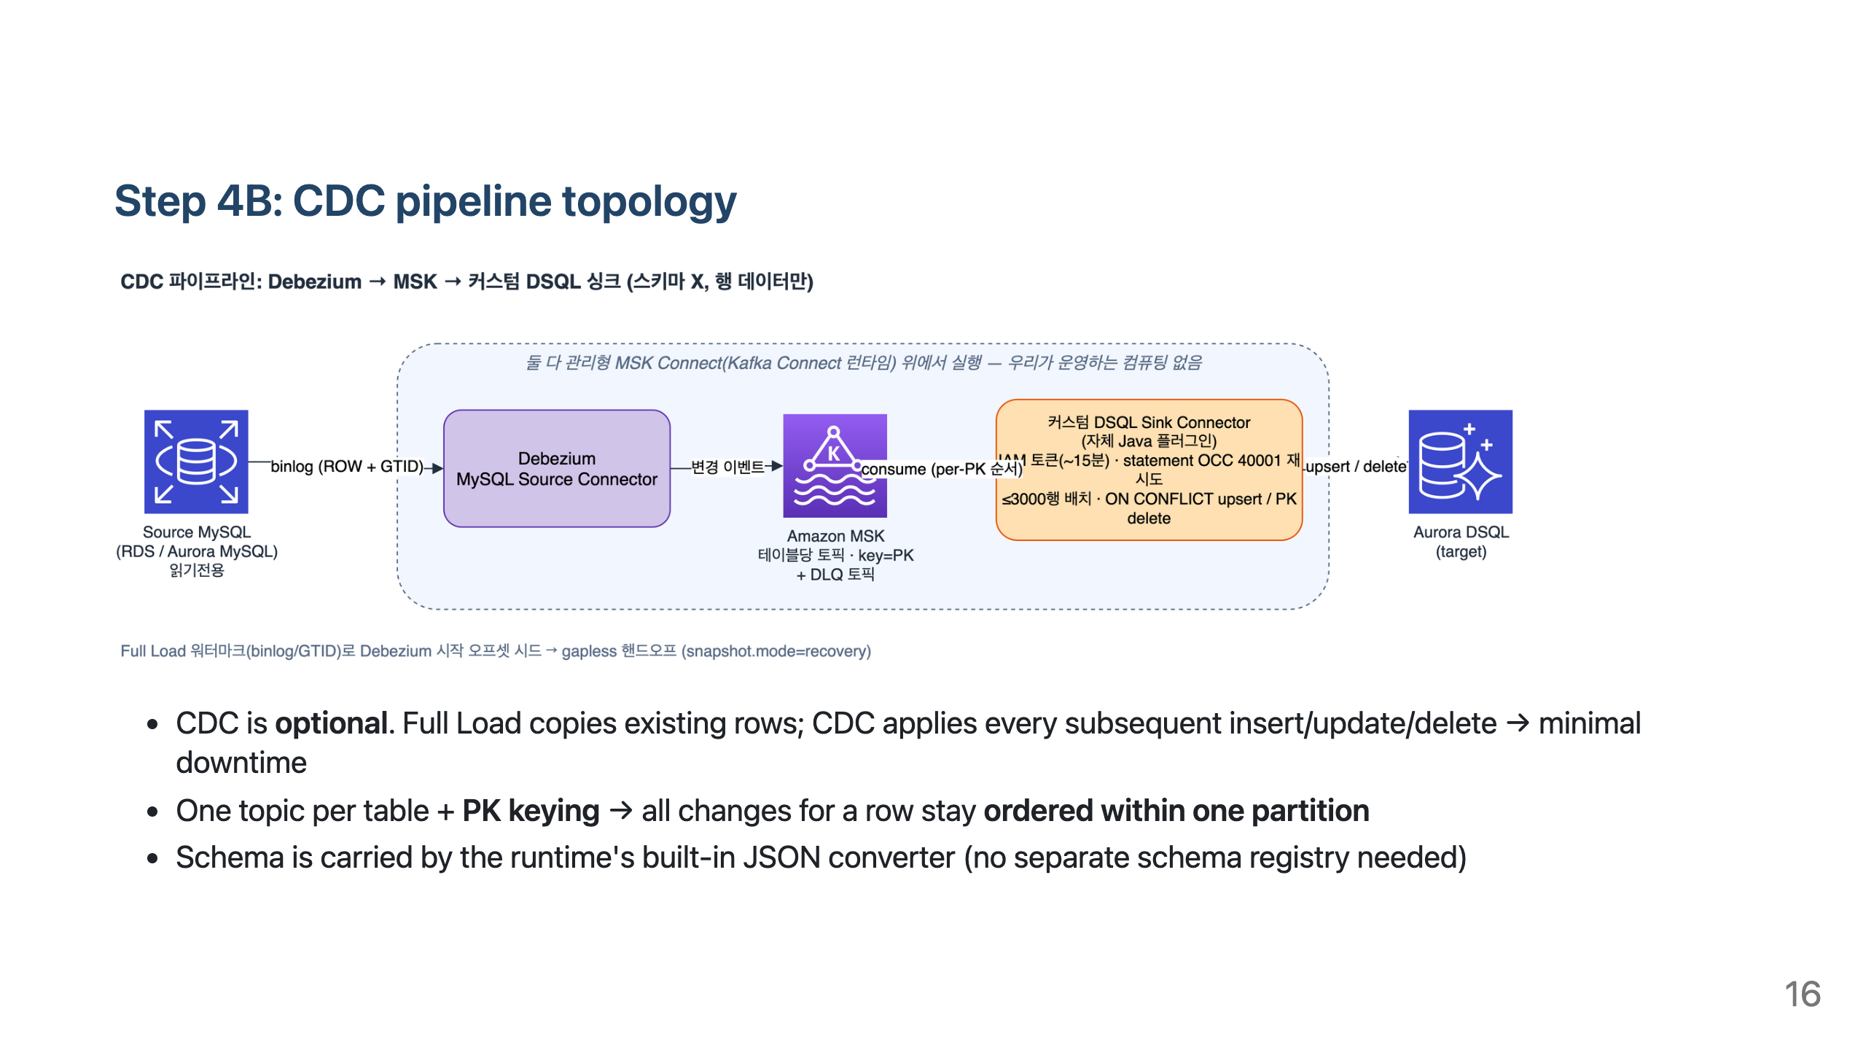
Notes:
- If a short freeze is acceptable, Full Load alone suffices. CDC is for large/continuous migrations. - The tool does not run this pipeline in-process → it's just a control plane (see two slides ahead).

Slide 17
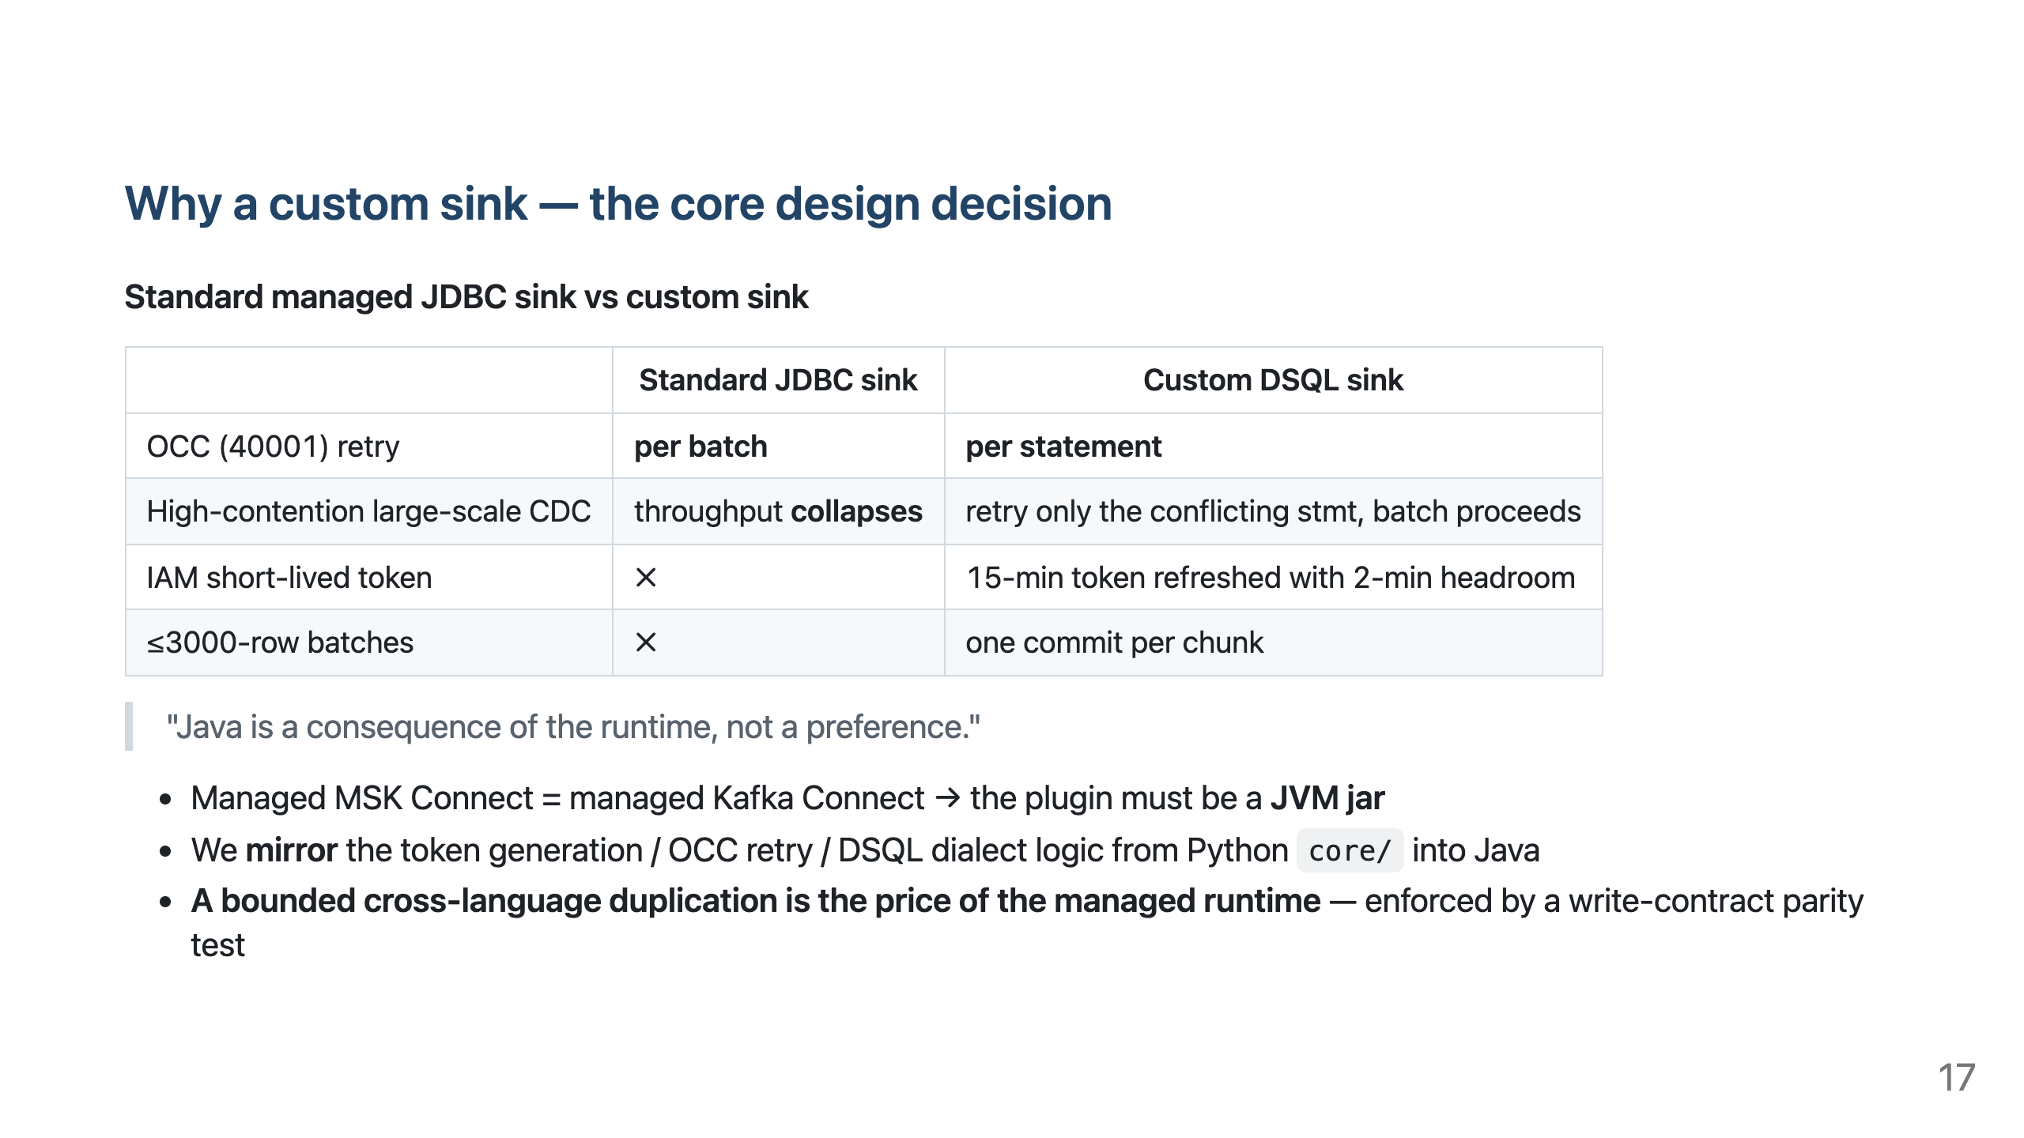
Notes:
- The basis is "Decision Change 8." A standard JDBC sink retries 40001 per batch → replays all 3000 rows → wide key range → livelock. - A shared parity test forces Full Load (Python) and the CDC sink (Java) to follow the same type mapping → the same source row lands identically via either path. - CDC specifics: BIGINT UNSIGNED needs precise mode, JSON is wrapped as a PGobject, GEOMETRY extracts .wkb.

Slide 18
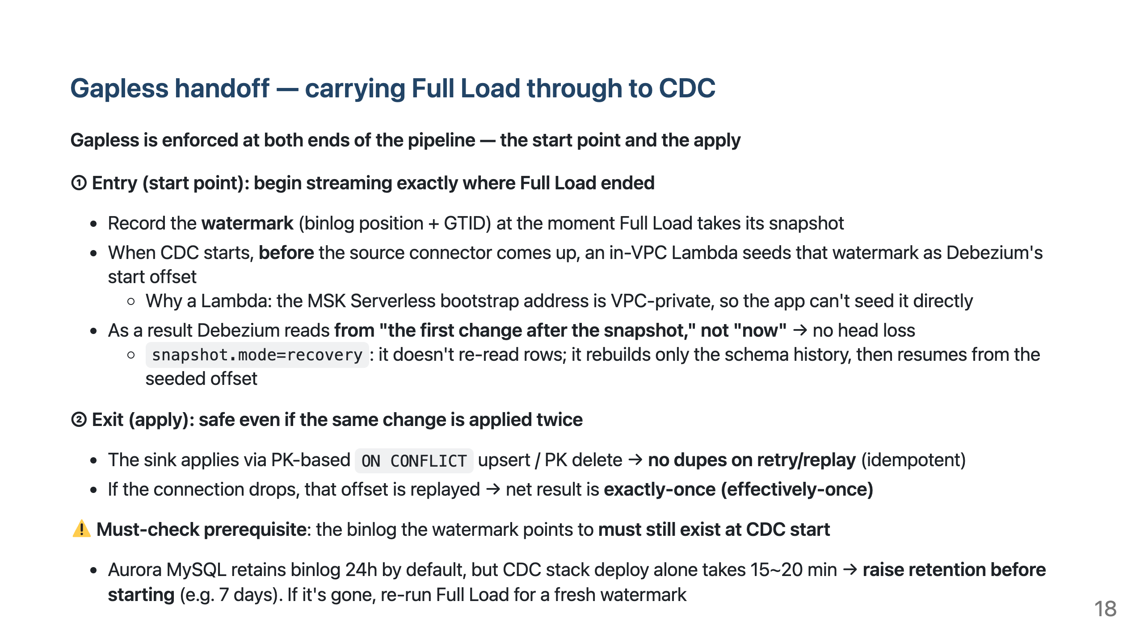
Notes:
- Core framing: gapless is enforced not at one point but at two layers — Lambda (entry) prevents head loss, sink idempotency (exit) prevents mid-stream loss. - The actual loss we hit was an "exit" bug: misclassifying a connection drop as poison advanced the offset past unapplied rows → fixed by reclassifying in isTransient (retry). The Lambda (entry) was fine all along. - The prerequisite (binlog retention) is the most commonly missed thing in the field. binlog_format=ROW and binlog_row_image=FULL are also required.

Slide 19
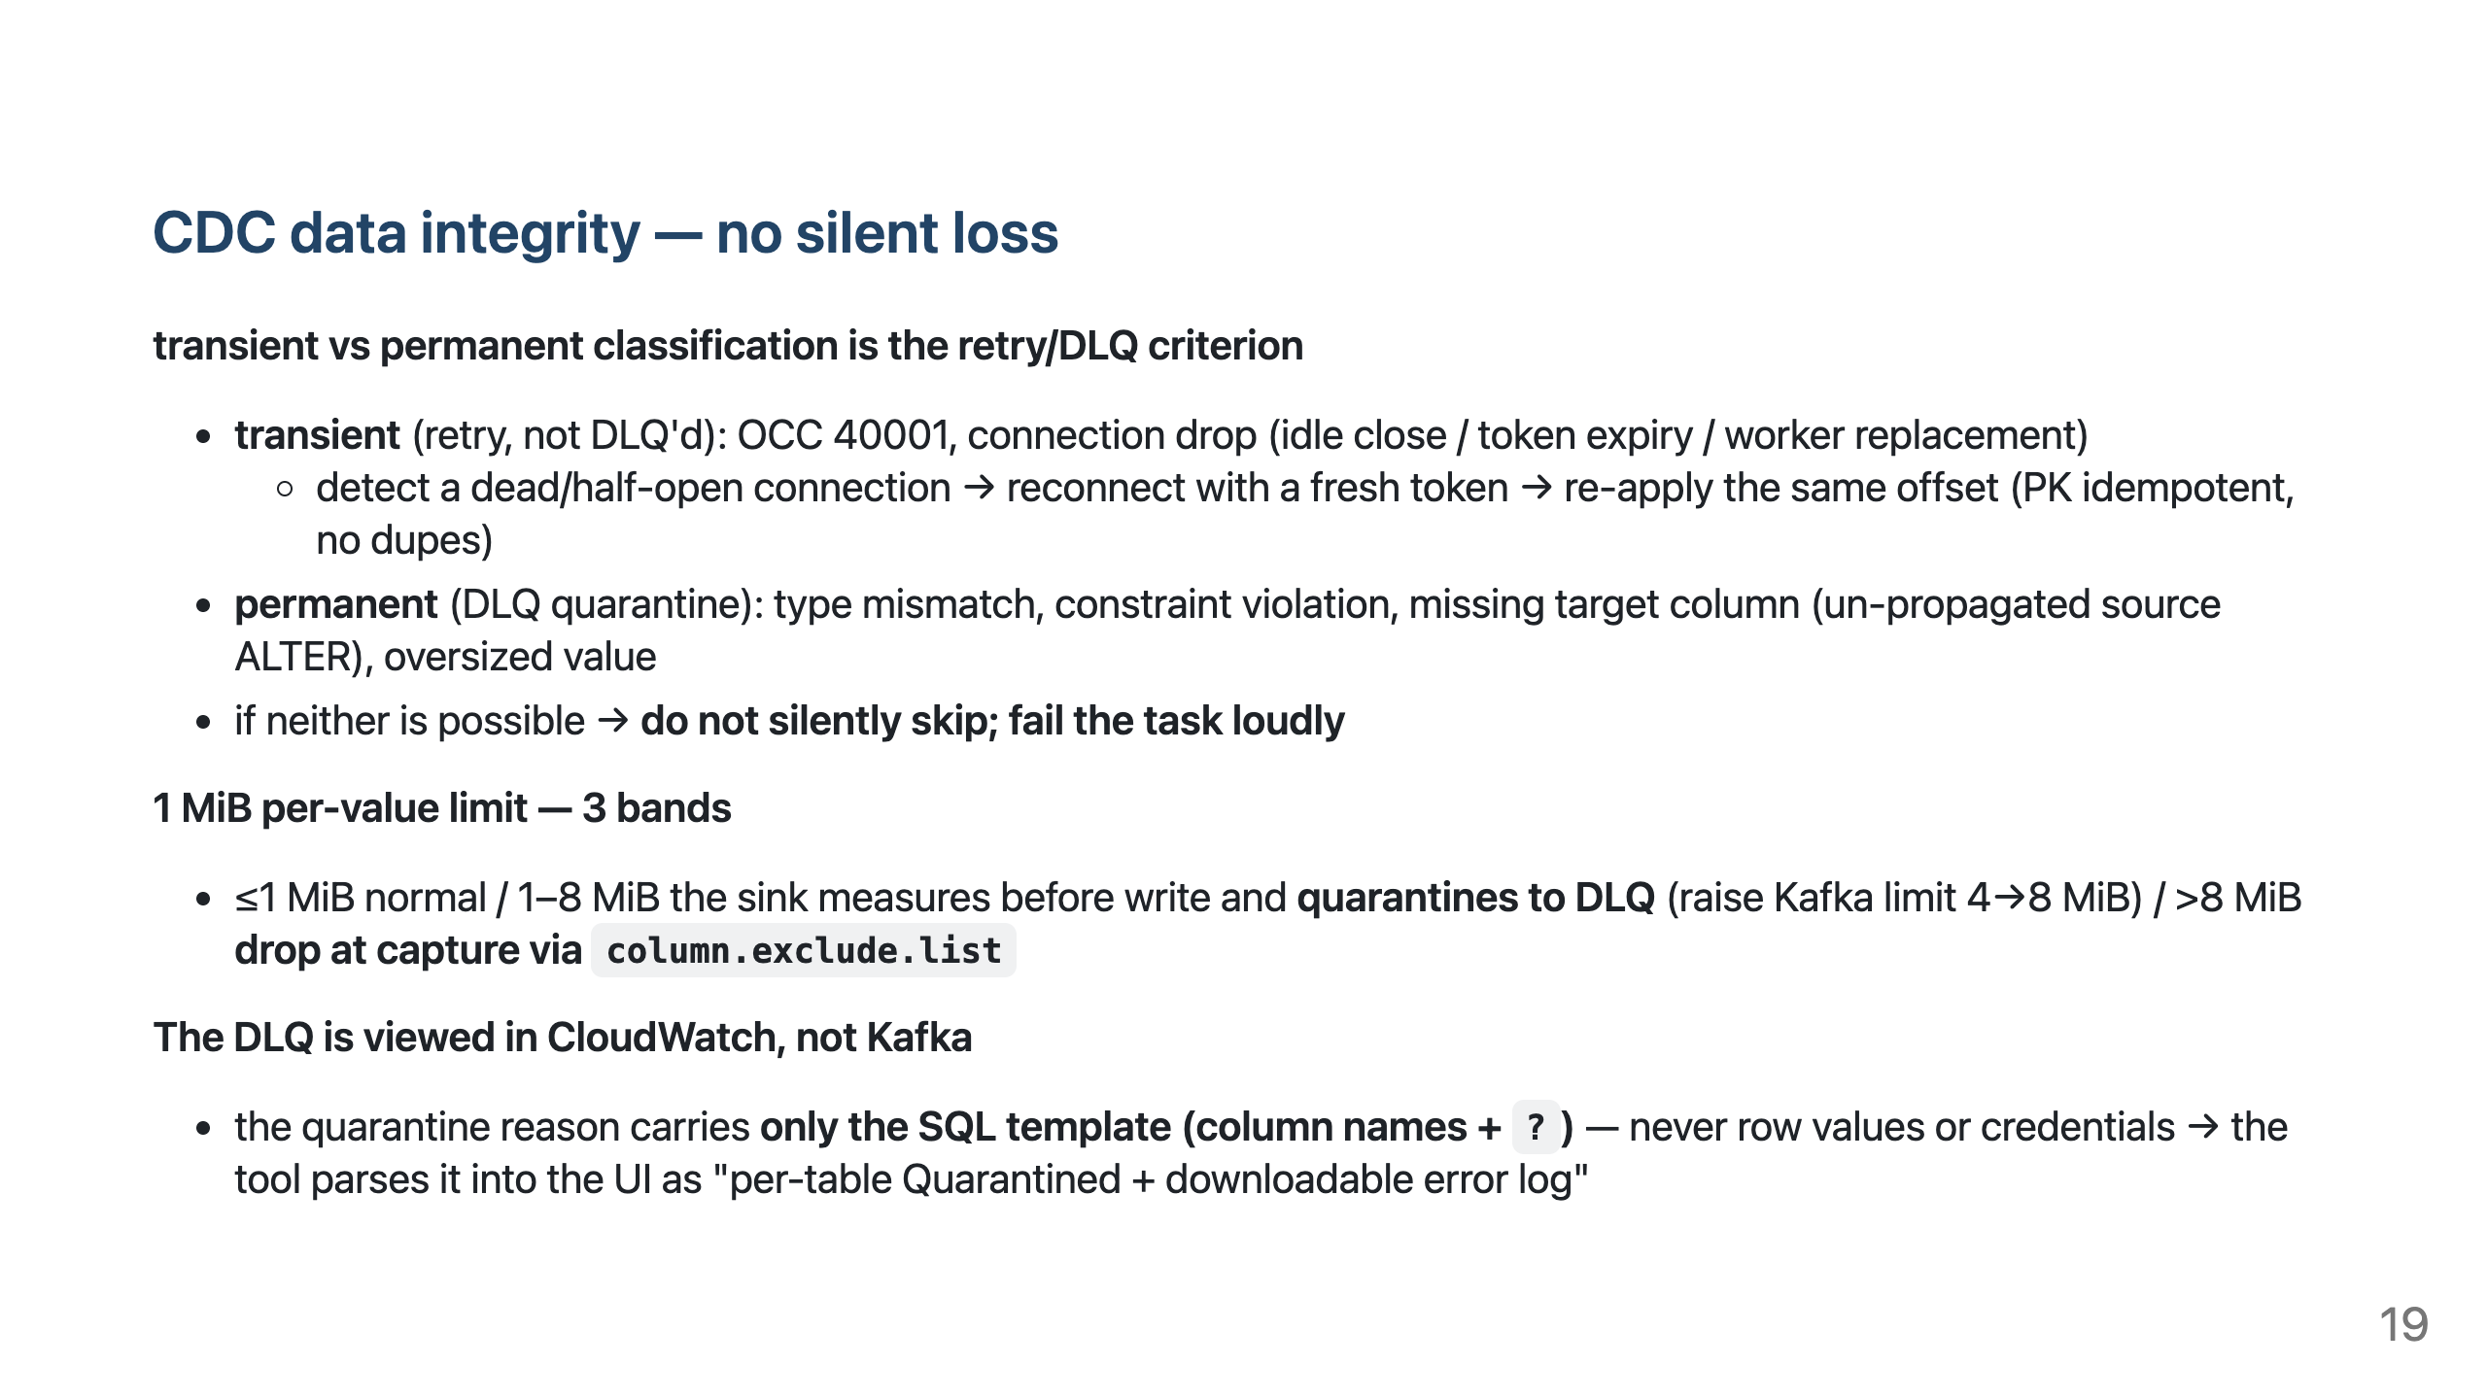
Notes:
- "CDC replicates data, not schema" (include.schema.changes=false). Source DDL changes don't propagate → re-apply them directly to DSQL first. Until then, non-matching rows are DLQ-quarantined (not silently gone). - Not mistaking a connection drop for a poison row is the key — that was the earlier data-loss mode. - Composite PK: re-keyed at the source via message.key.columns → a row's changes stay ordered in one partition, and the sink builds ON CONFLICT(pk...)/DELETE WHERE correctly.

Slide 20
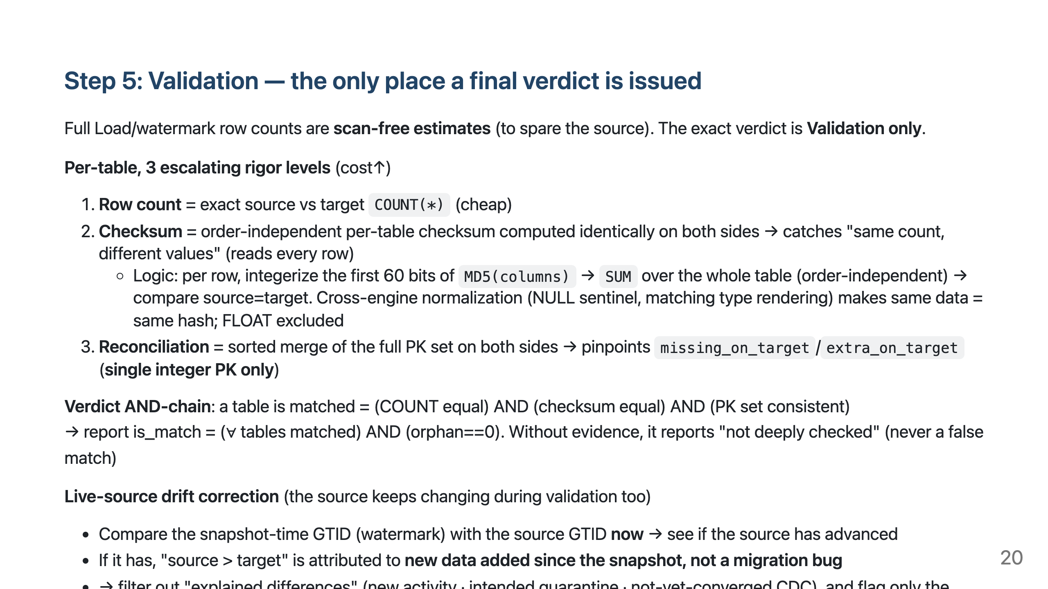
Notes:
- Target-short diagnosis: (a) drift, (b) intended quarantine (>1 MiB), (c) not-yet-converged CDC delete → if explained by these three, it's healthy. Unexplained missing/extra PKs are the real targets. - Diff samples show only PK + checksum tokens, never row values. There are also read-only CLIs (compare_rows.py / cdc_consistency_check.py, exit-0 for shell gating).

Slide 21
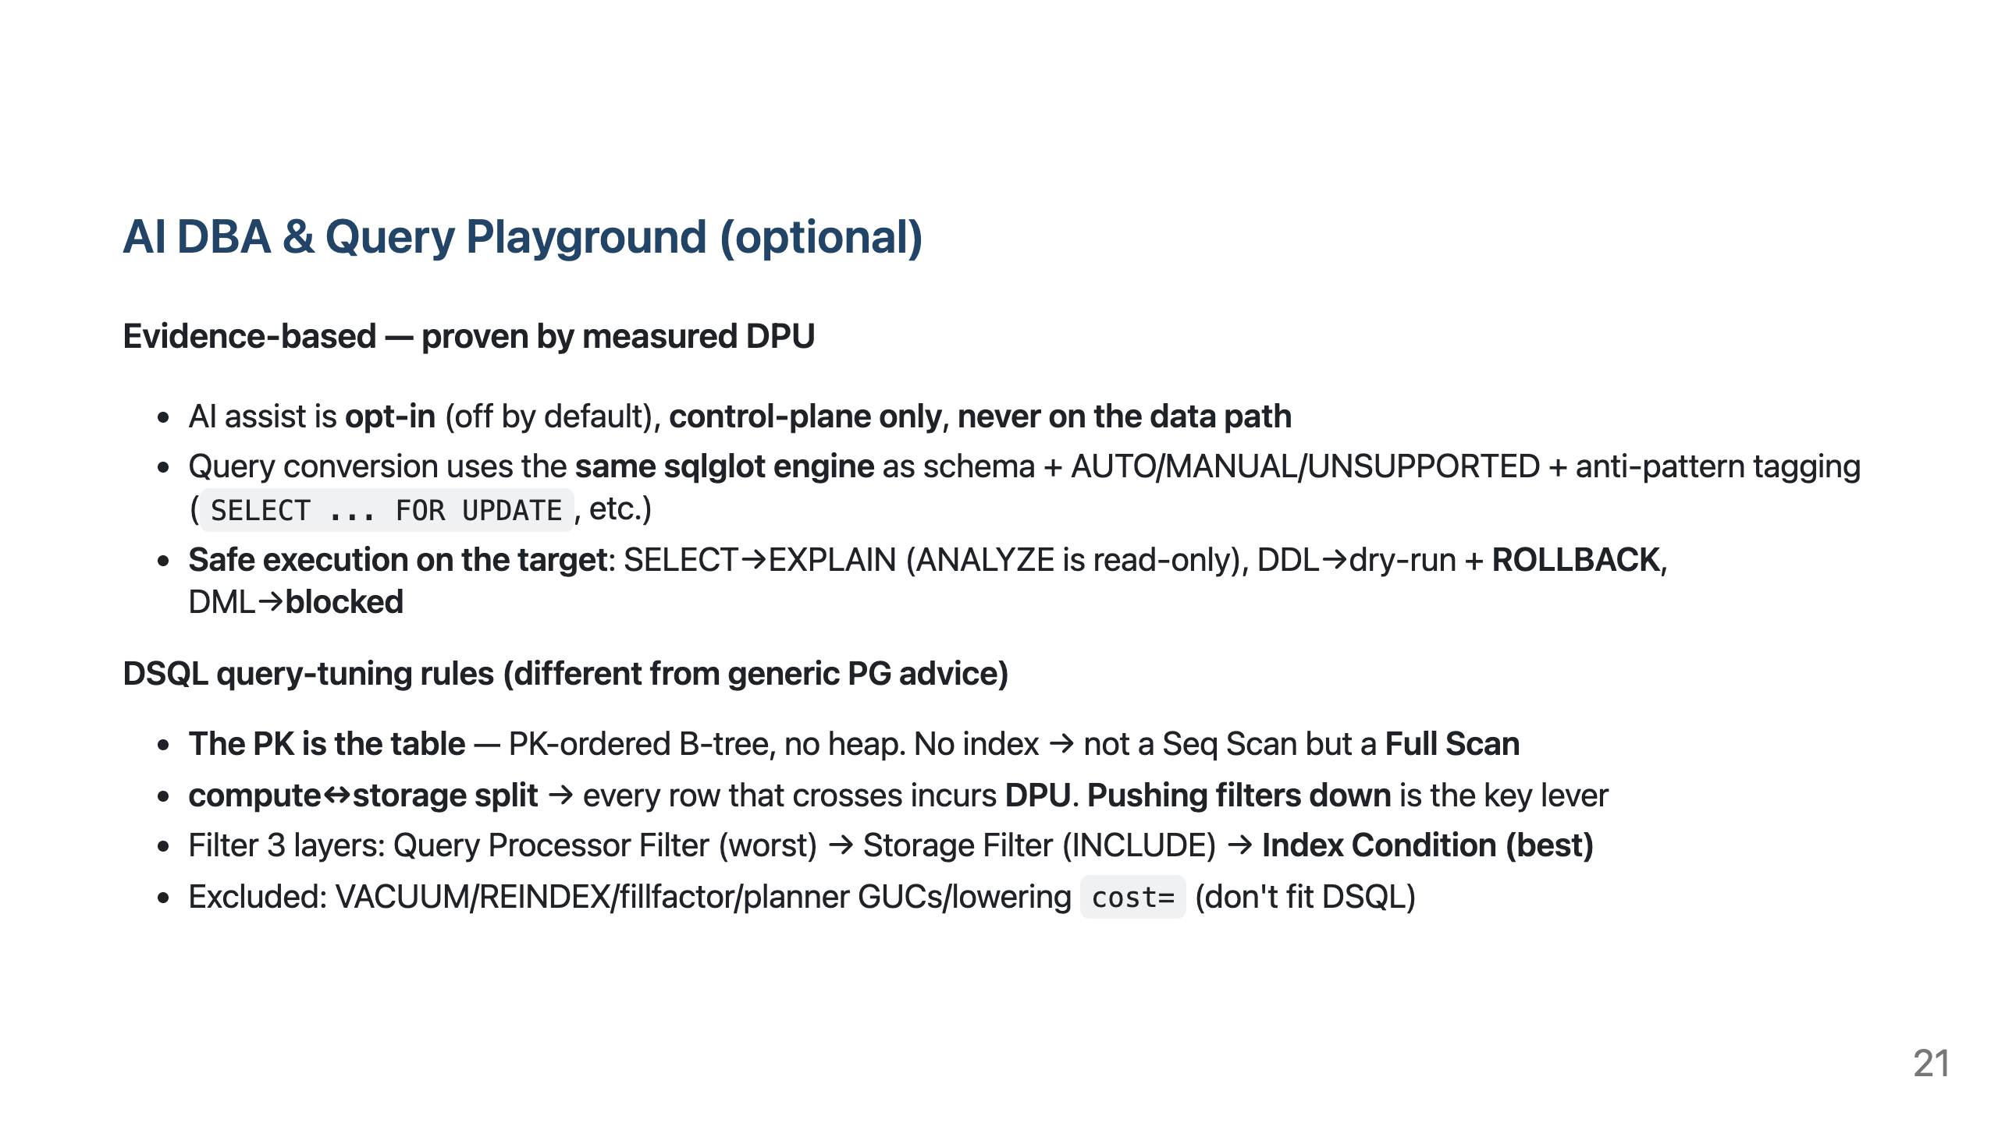
Notes:
- The "Tune with AI DBA" button appears only after the converted SELECT passes Test on target — so the AI grounds on the real plan, not a guess. - Proof loop: EXPLAIN ANALYZE feeds the before/after DPU delta back into the chat → the measurement, not the model's claim, is the evidence. If there's no improvement it says so. Not auto-applied (human-review gate).

Slide 22
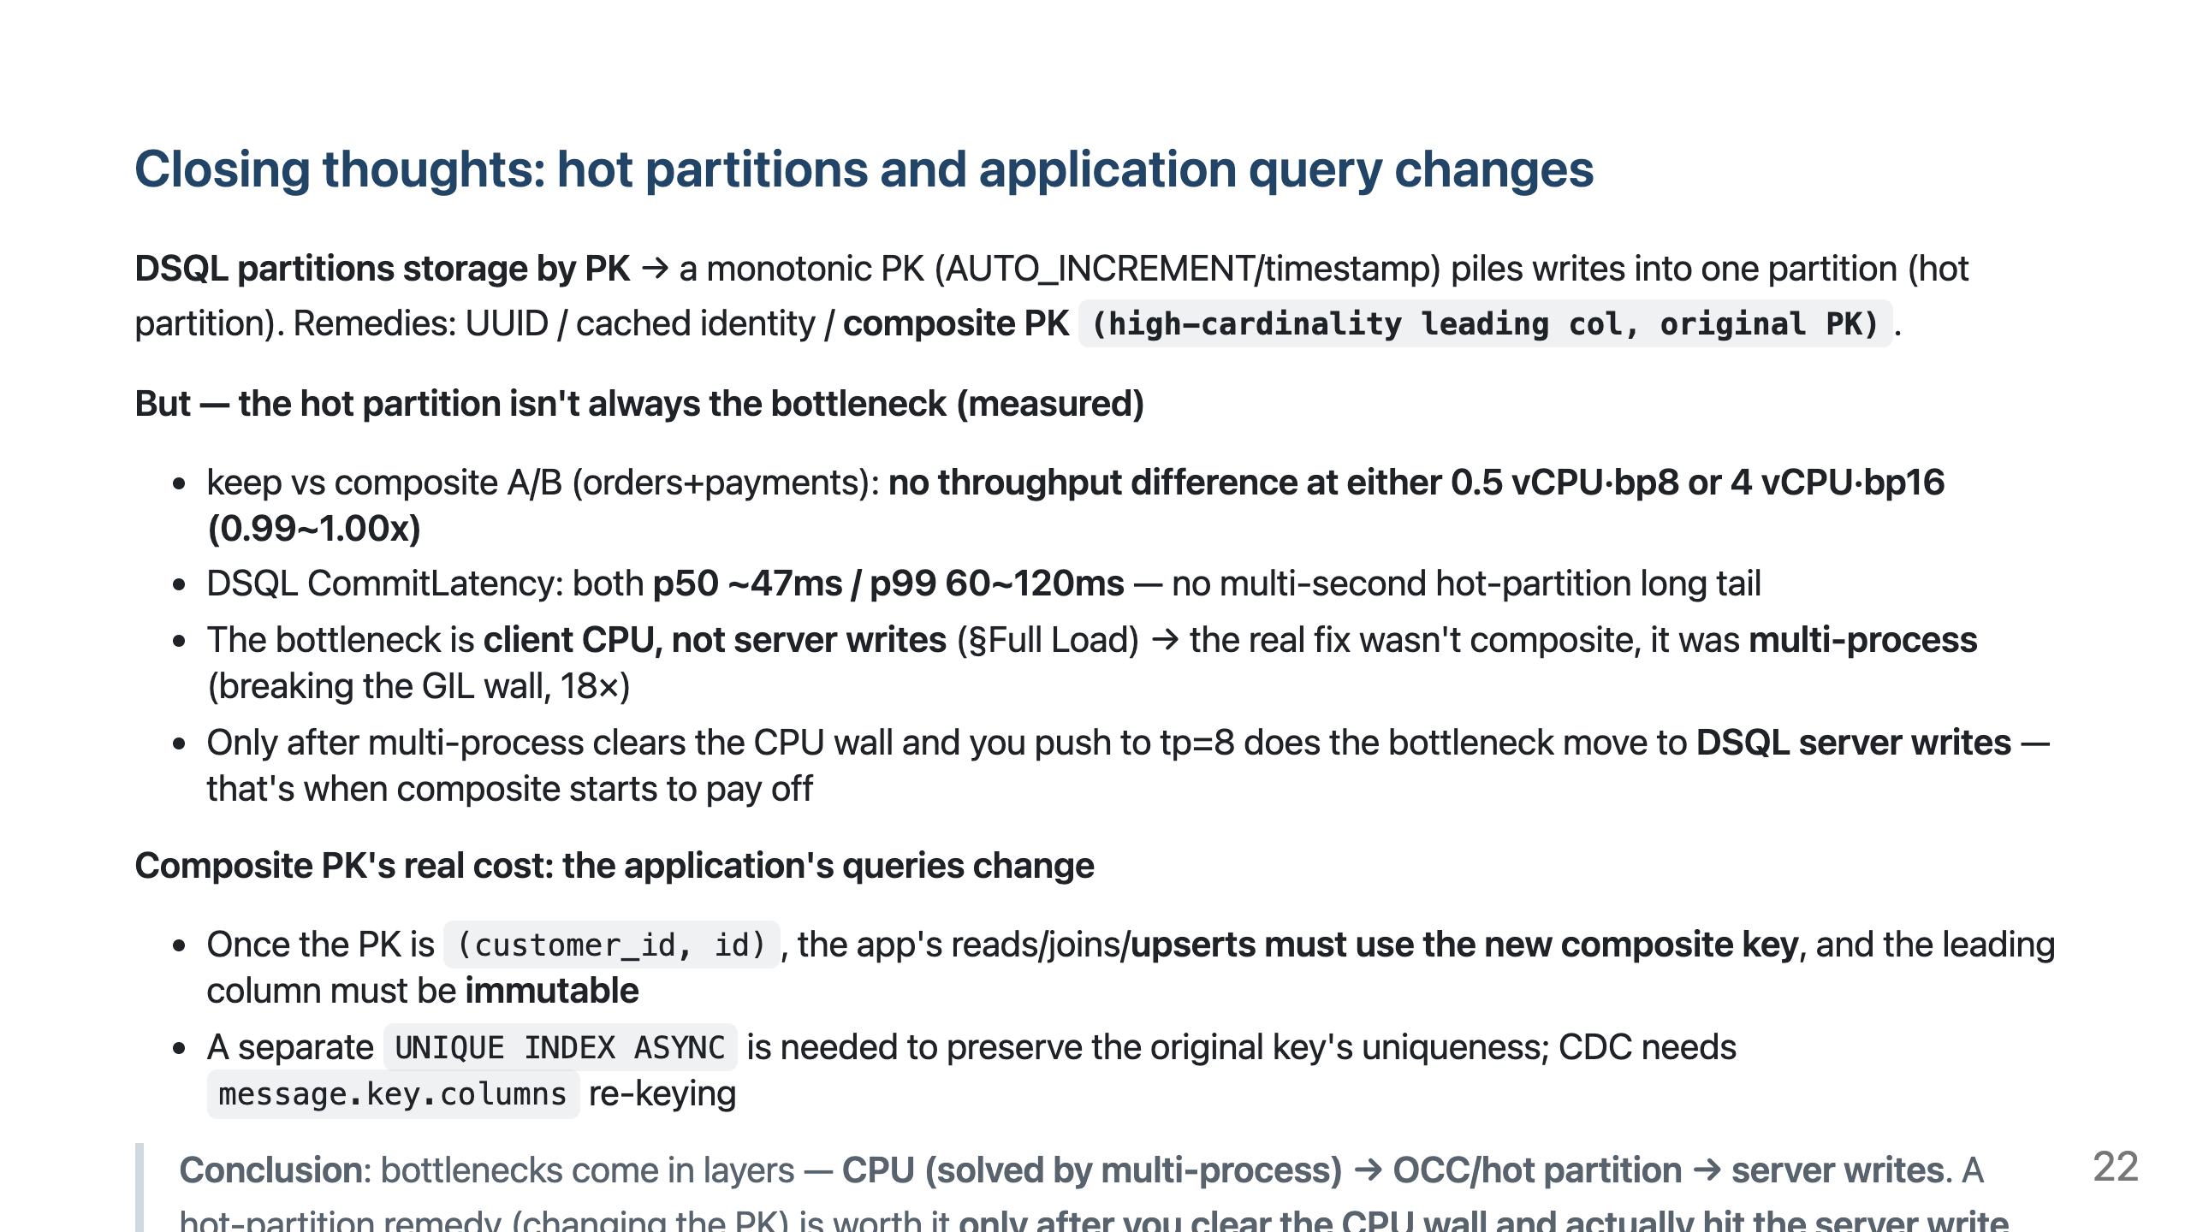
Notes:
- Honest diagnosis: the composite PK feature works correctly but gained 0 in this workload — because the bottleneck was client CPU, not the server. The real fix for that GIL wall was multi-process (18×). - Message: "hot partitions are real, but measure before applying a remedy. Bottlenecks layer as CPU→OCC→server writes. And composite PK isn't free — app queries change." - Where composite shines: (a) after removing the client CPU bottleneck via multi-process, (b) at much higher write concurrency where a monotonic PK heats a partition.

Slide 23
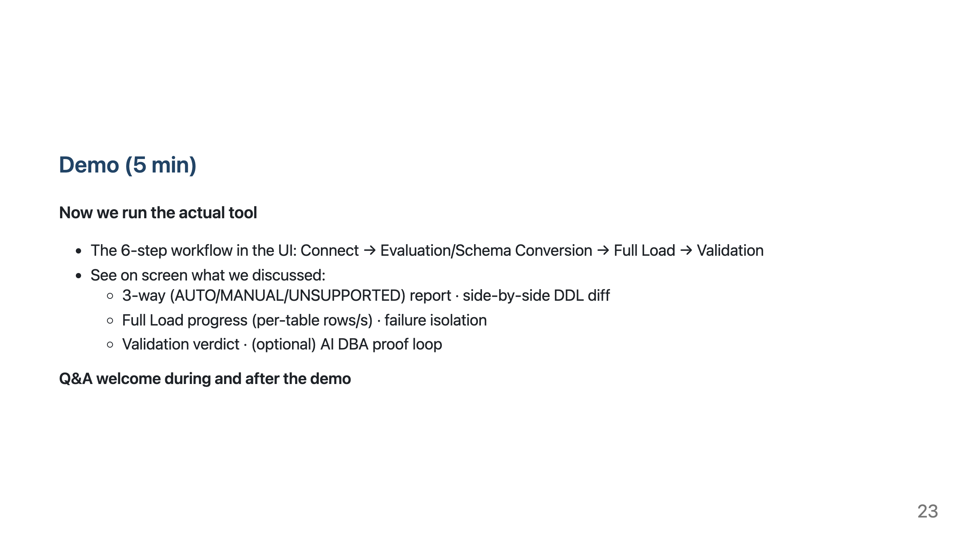
Notes:
- Start the demo. (Run in an internal test environment — the launch method is intentionally not in the deck.) - If short on time, just showing the Full Load progress screen + Validation verdict conveys the core.

Slide 24
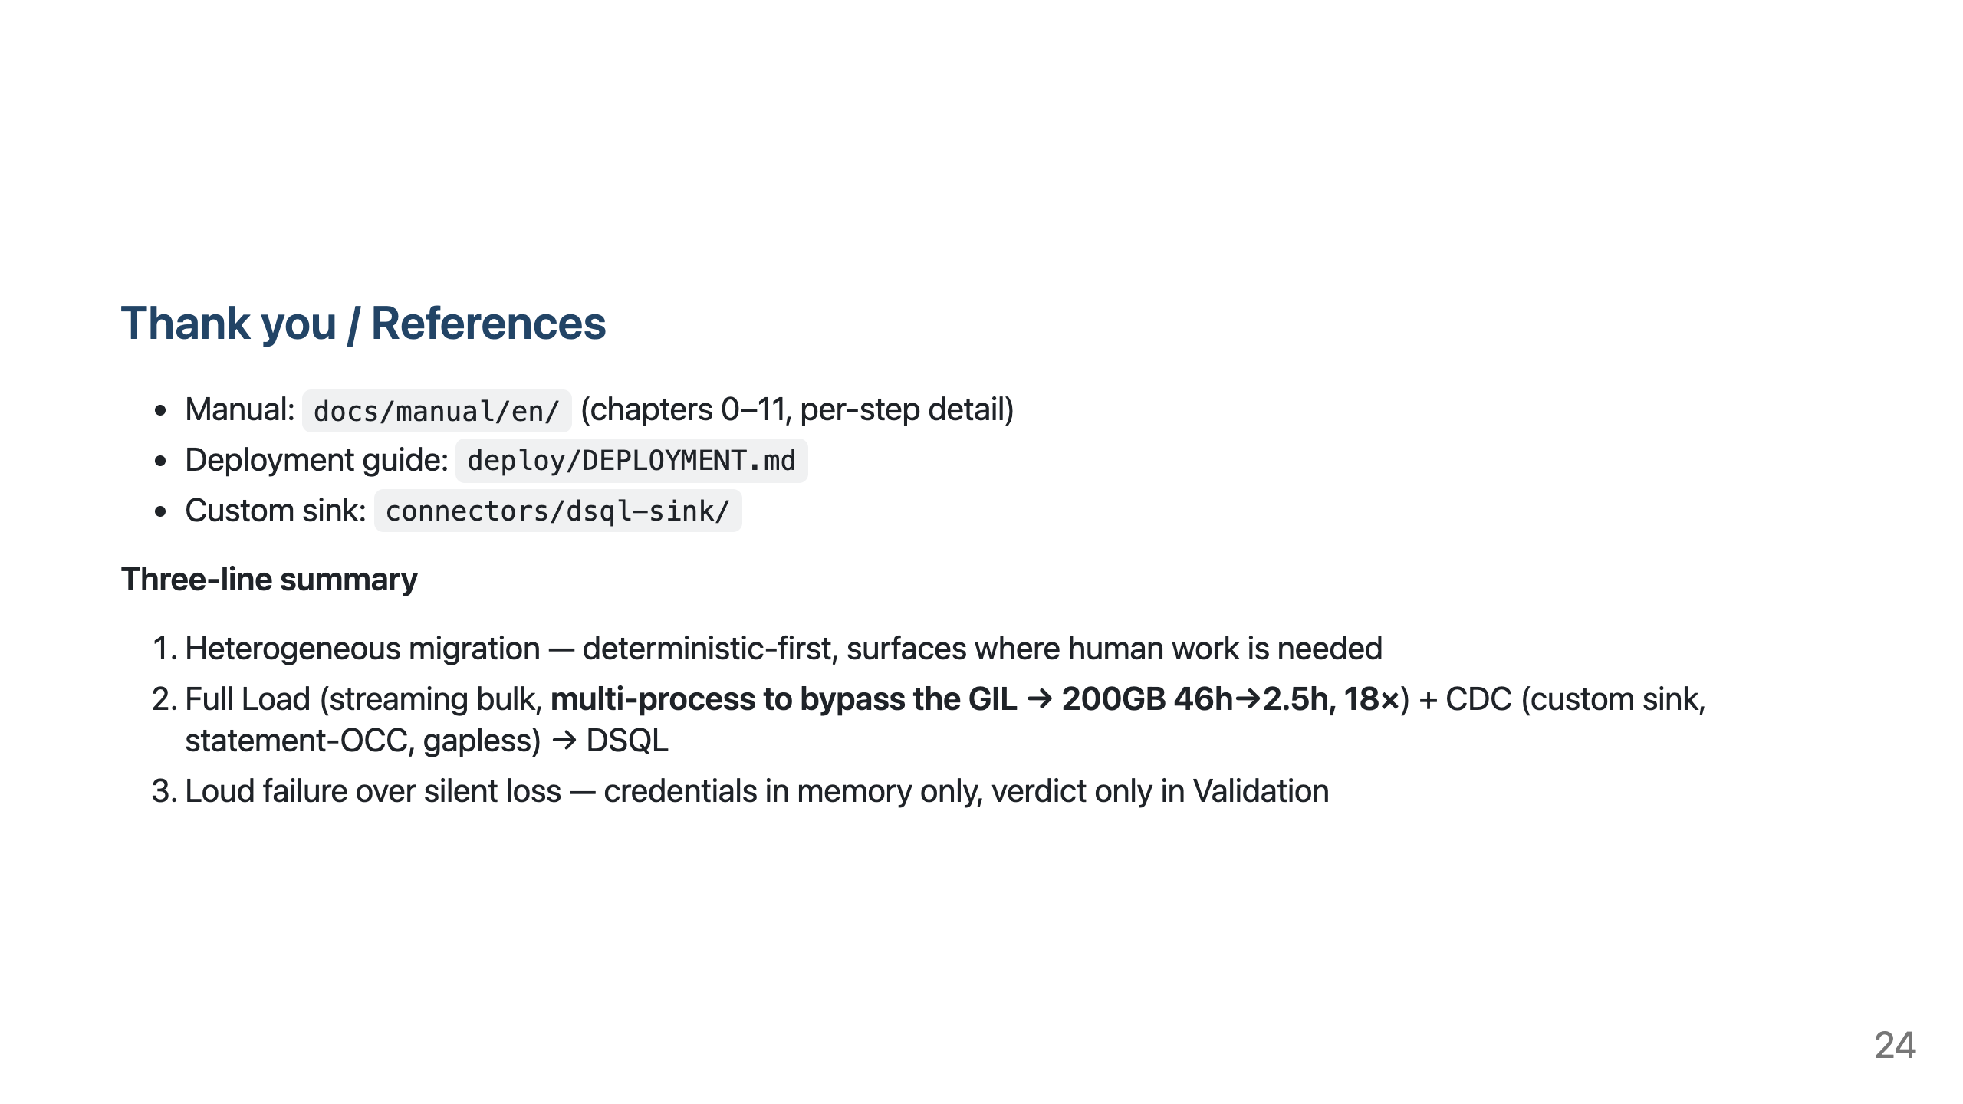
Notes:
- Wrap up. Invite questions.

