Slide 1

INTRODUCTION TO GITHUB

Slide 2

What is GIT?
Git is an example of version control
Version control is a system that records changes to a file or set of files and helps us recall specific versions later if needed. E.g. Subversion (SVN), CVS etc
It allows you to :
Revert files or the whole project to an earlier state
Compare changes over time
See who modified what?
Control modifications by collaborators with the permission of admin/owners

Slide 3

What is GITHUB?
GitHub is a repository hosting service for Git
While Git is a command line tool, GitHub provides a web-based graphical interface that works on top of GIT. It can also be treated as a social platform to share knowledge and work
It also provides access control and several collaboration features, such as wikis and basic task management tools

Slide 4
What can done with GitHub Account?
CREATE A REPO
Creating a repository for multiple people to work together
MASTER IN A REPOSITORY
This is the final version that is considered ready to use by anybody in the team or outside if repository is public.
CREATING A BRANCH
Create a branch in your project, for an environment where you can try out new ideas.
Changes you make on a branch don't affect the master unless pull request is accepted.
Changes committed to branch reflects for you to keep track of different versions

Slide 5
What can done with GitHub Account?
ADDING COMMITS
Keeps track of your progress as you work on a branch or master.
Creates a transparent history that others can follow to understand what you've done and why.
FORKING A REPOSITORY
It creates a copy for you to work on independently without any changes to theirs.
Submit a pull request to owner so that the owner can incorporate changes.

Slide 6
GitHub Concepts
PULL REQUESTS
Pull Requests initiates discussion about your commits or changes made to a code.
See exactly what changes would be merged if pull request is accepted.
Use GitHub's @mention system in your Pull Request message to ask for feedback from specific people or teams, or for someone to review your work
ISSUES
Highlight bugs or issues with codes that need rectification.
Issues remain open unless resolved.
Can be filtered, Can be labeled as bug/enancement/ question/help wanted etc
@mention can be used to notify someone

Slide 7
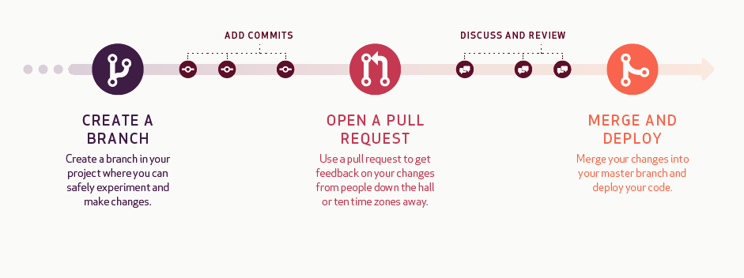
Understanding Github Workflow
*Deploying the code is
for development projects
Commit
Comment on
Pull request
Close Pull request
Compare
Sync or Push to branch
Add Issues/ Resolve Issues
Mention Individuals

