Slide 1
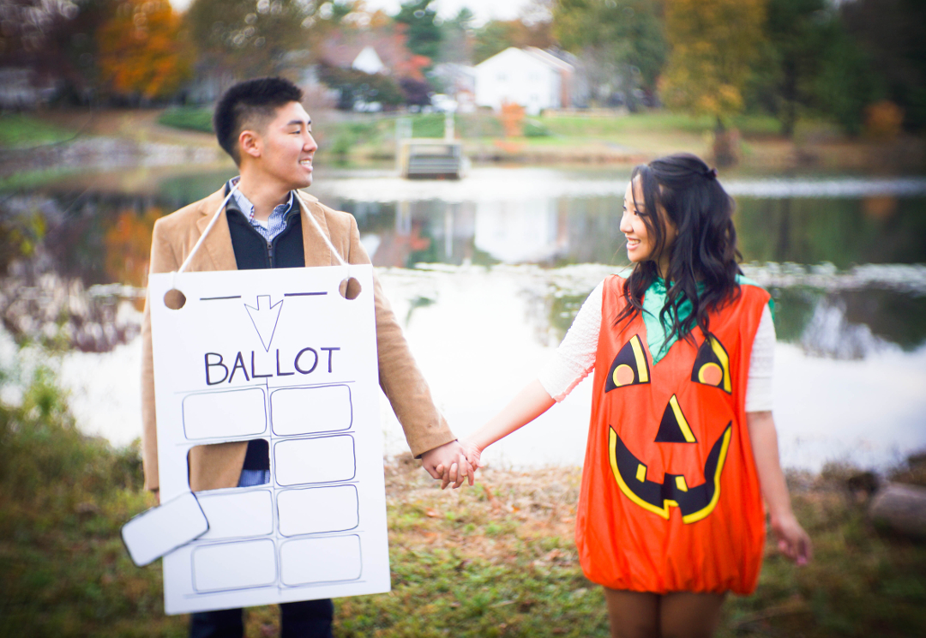


CLICK HERE

Slide 2


Slide 3
DAVID
MINA
June 27th, 2015

Slide 4
Carnegie Institute of Science
CLICK HERE!

Slide 5


Slide 6
DAVID
CLICK
HERE!
MINA
June 27th, 2015
CLICK HERE!
SAVE THE DATE!
WE’RE GETTING MARRIED!

