Slide 1
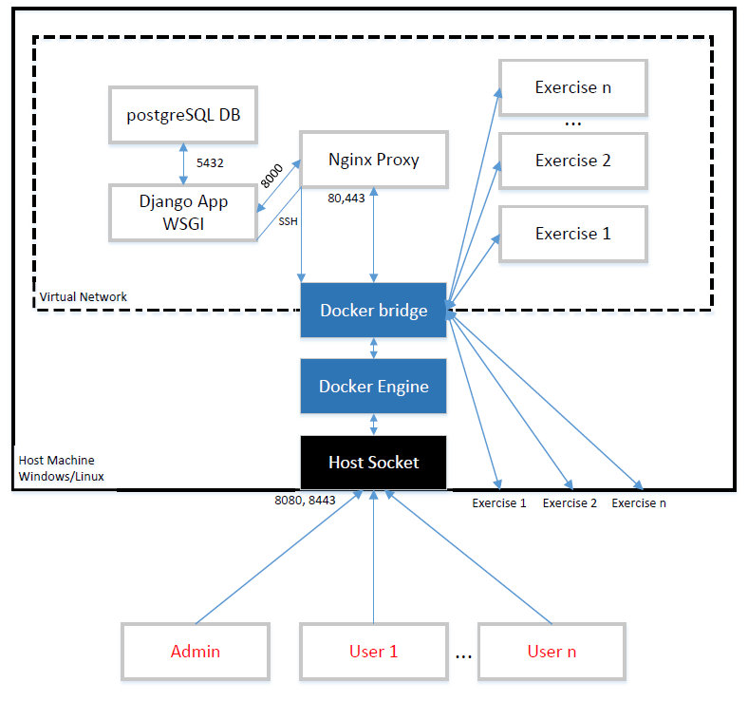
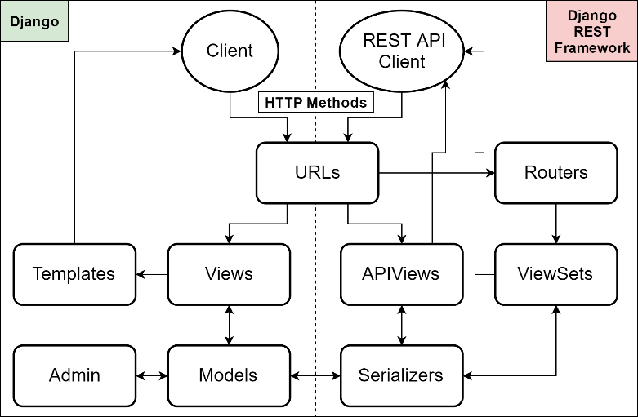
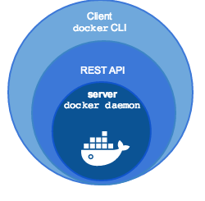
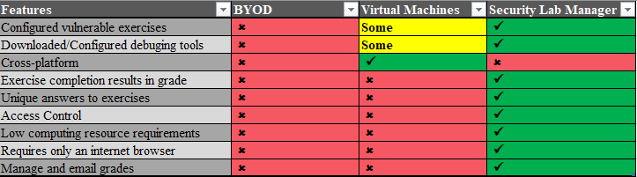
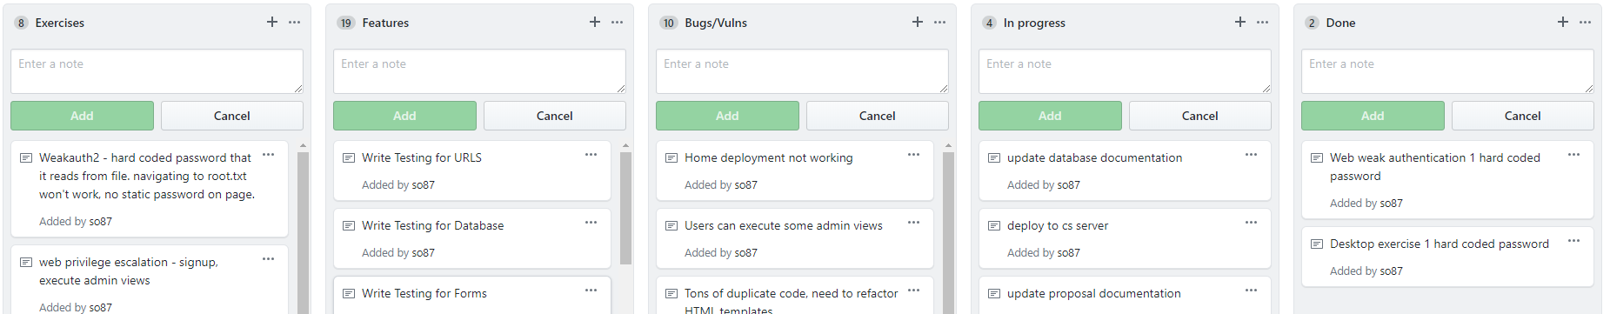
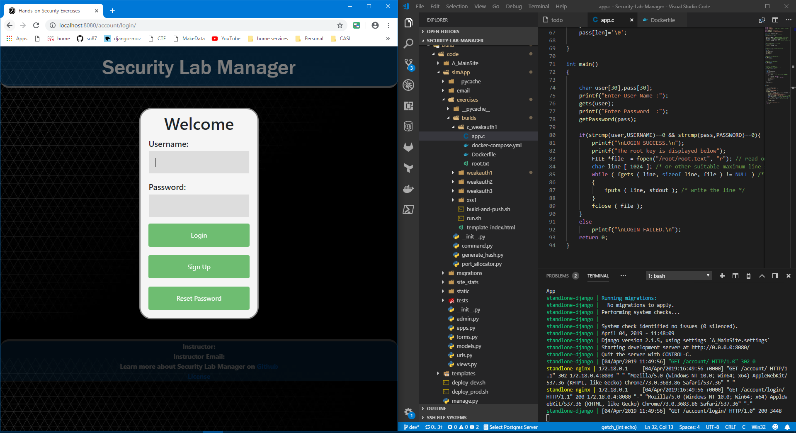
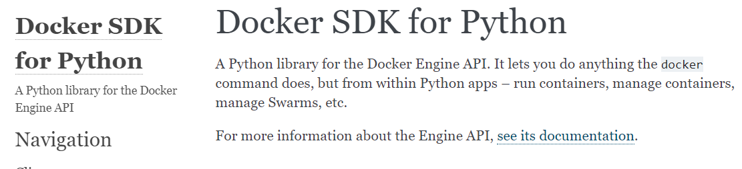
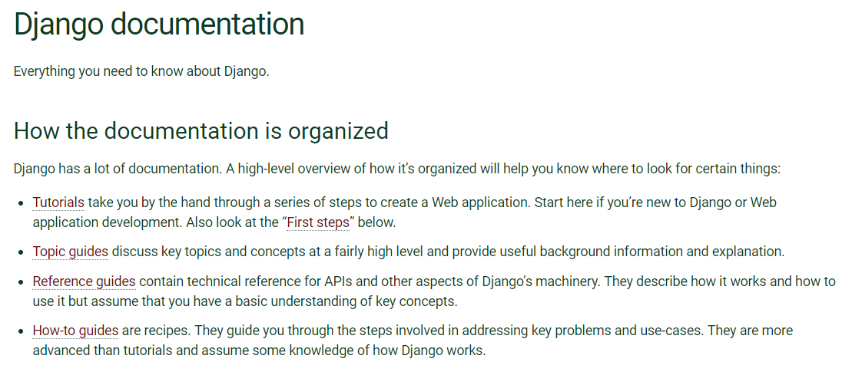
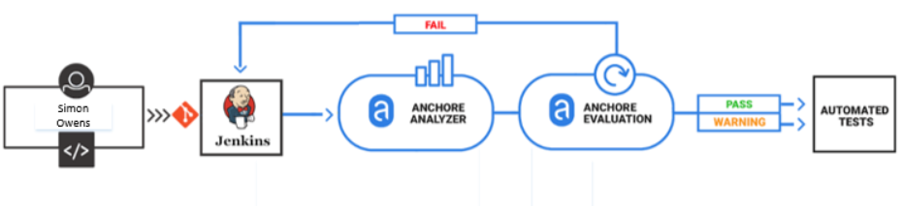
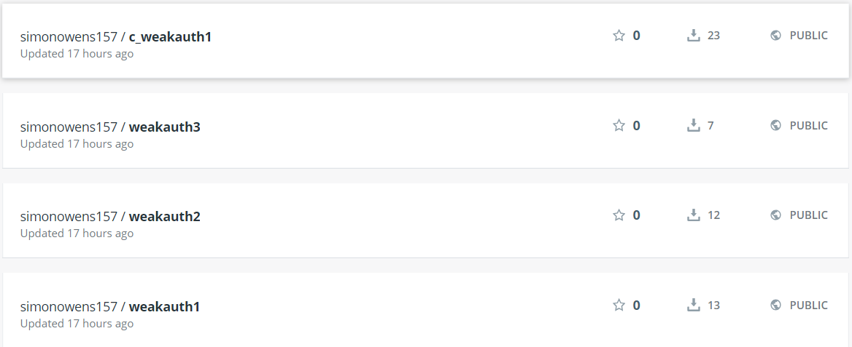
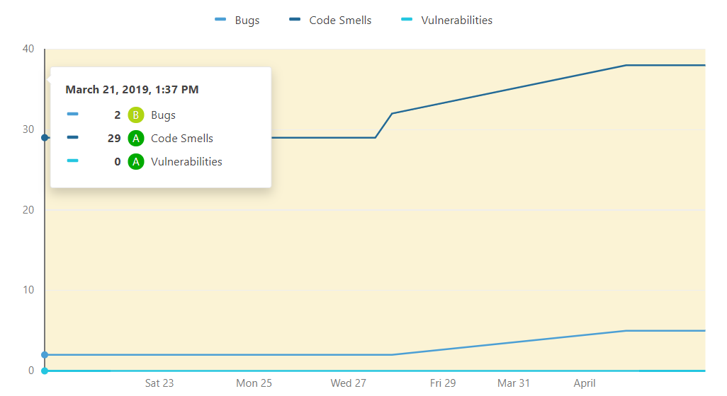
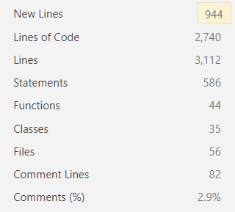





Security Lab Manager
Developed by Simon Owens Advisor/Sponsor: Mr. Mark Randall
Security Engineer University of Evansville
ABSTRACT
REQUIREMENTS
The Security Lab Manager is a web application that manages vulnerable virtualization machines for users to practice hacking on. Users can start hacking in their own virtual environment. Administrators can view completed exercises and send grades to users.
Features
Software
❏ Front End – JavaScript, JQuery, HTML5, CSS
❏ Back End – Django Framework, Python, Docker SDK, Bash, PostgreSQL
❏ Platform – Docker Linux Containers: Can run and develop on Windows or Linux if Docker is installed
❏ Student interface for starting, stopping, and restarting exercises. There should also be a place to submit answers for exercises
❏ Instructor interface for creating, editing, deleting: classes, exercises, students, and managing application performance
❏ Instructors should be able to easily check and email grades
❏ Must contain one web security exercise
❏ Must contain one desktop security exercise
❏ Must be developed securely – scan for vulnerabilities and fix them
❏ Must be easily installed and enhanced by other developers
❏ Launch exercises via GUI
❏ Automatic grading/emailing
❏ Configure all data via GUI
❏ Secure web portal
❏ Four full virtual exercises
❏ Scales to performance needs
Secure
Efficient
Functional
There are zero vulnerabilities in Anchore, Sonarqube, and ZAP
The Docker Software Development Kit allows virtual machines to be built, started, and stopped in under 20seconds
Student and instructor tasks can be easily done in seconds through the GUI
PROBLEM
DESIGN
Components
Security training is desired in all parts of industry: secure coding for developers, Q/A Testers, and Security Engineers. There are several virtual machines to practice security, but none have a student-teacher model. Students can now easily begin learning security with just this application. The table below compares current options for learning security, bring your own device(BYOD), using VMware virtual machines, or this application.
Internals
REST Framework
Docker SDK
Database
❏ Classes
❏ Exercises
❏ Submissions
❏ Users
❏ Settings
DEVELOPMENT
Kanban boards for project Management
RESULT
VSCODE, Docker, and Chrome for development
Jenkins runs Anchore, Sonarqube, and ZAP scans
Store Security reports, push code and Docker images to source control, deploy to production
Findings over Development
Codebase Size
Summary
The application met all requirements, is much more efficient than using virtual machines, and helps students learn security in a hands on way.

