Slide 1
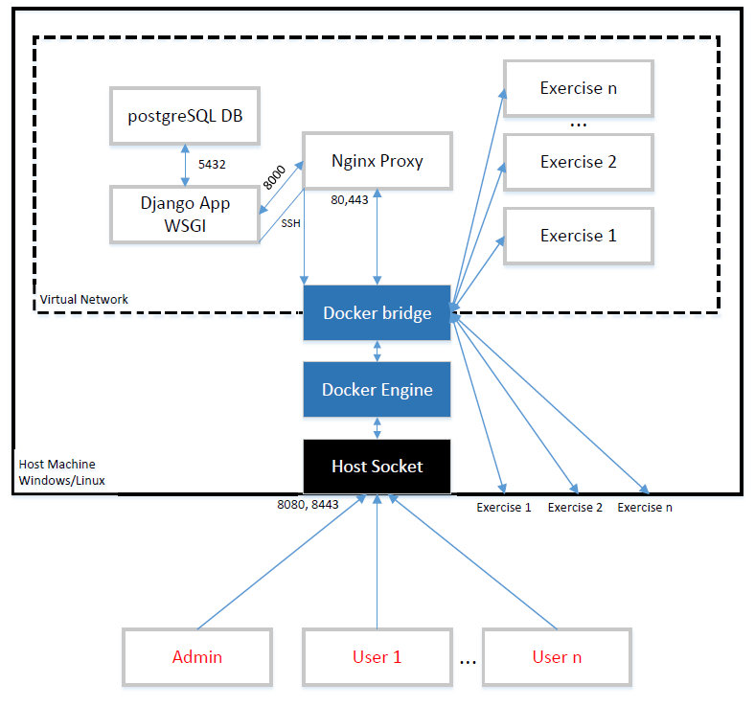
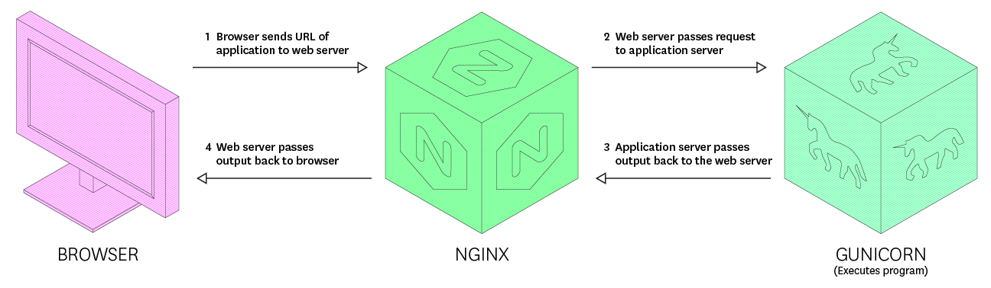
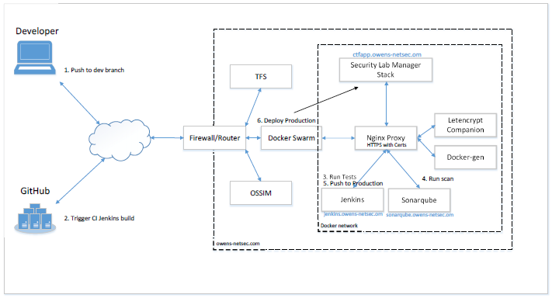
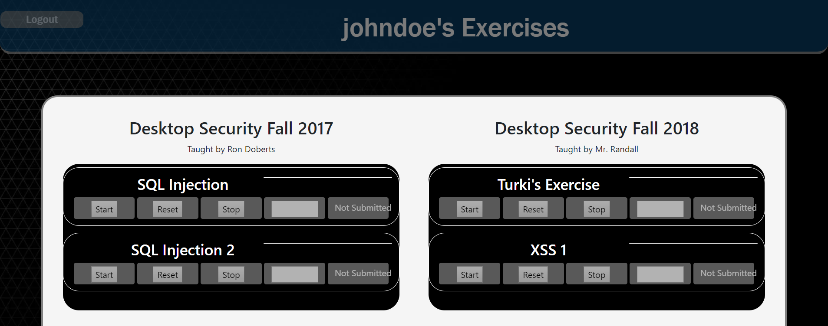
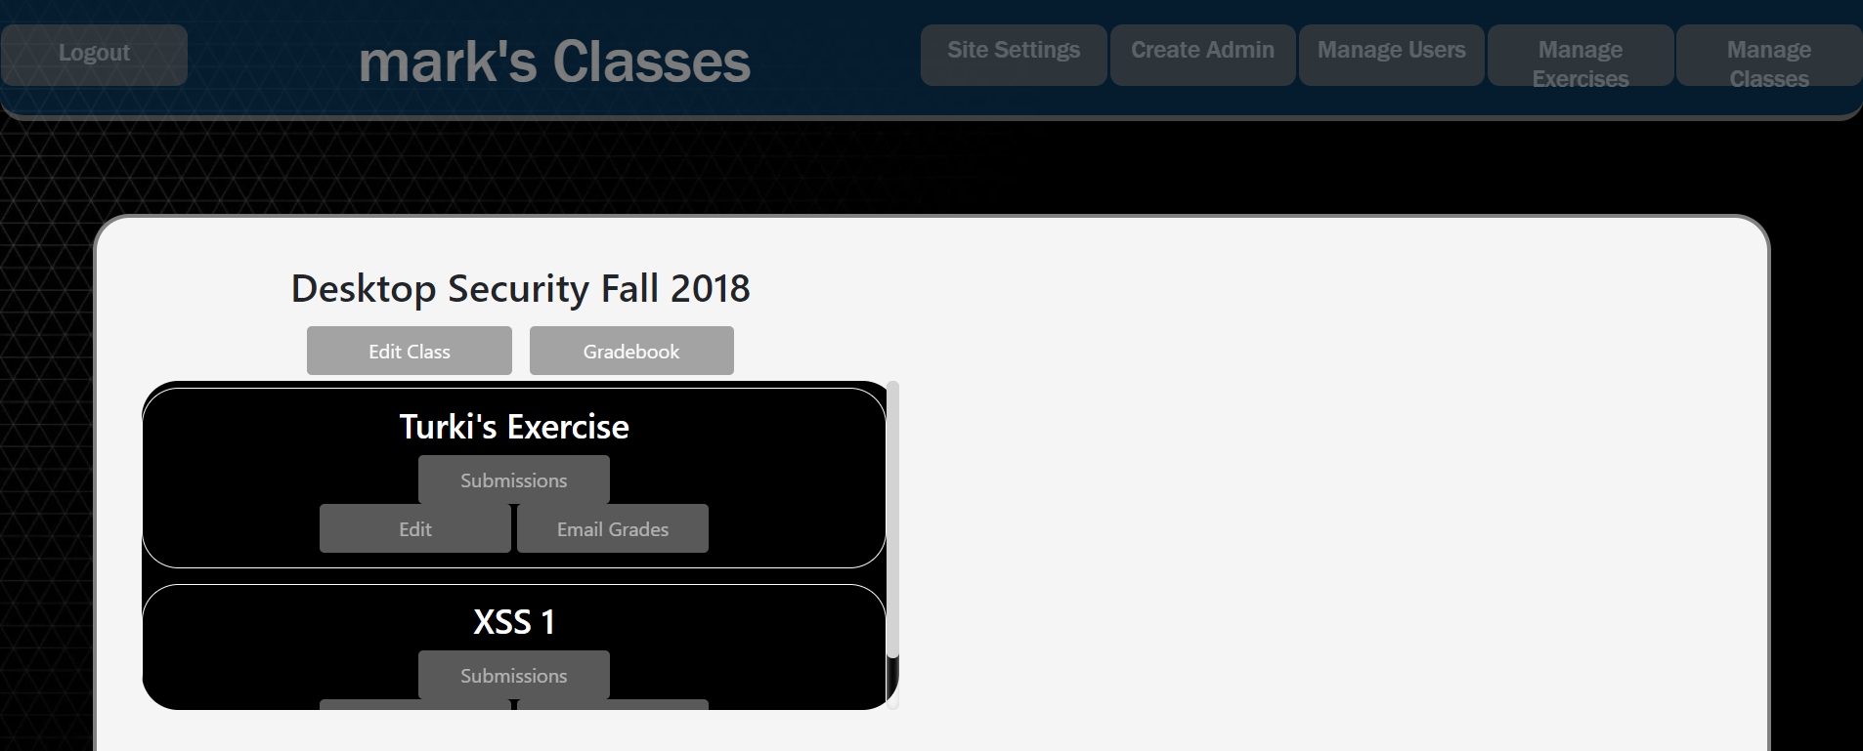




Security Lab Manager
Developed by Simon Owens Advisor/Sponsor: Mr. Mark Randall
Security Engineer University of Evansville
ABSTRACT
DEVELOPMENT
The Security Lab Manager is a web application that manages vulnerable virtualization machines for users to practice hacking on. Users can start hacking in their own virtual environment. Administrators can view completed exercises and send grades to users.
This application was planned and developed using the Agile framework. DevOps principles of tested driven development, automated test, continuous integration, and continuous deployment were used. The CI/CD pipeline utilized code and web scanners to ensure code is lean and secure.
PROBLEM
DESIGN
Components
Security training is desired in all parts of industry: secure coding for developers, Q/A Testers, and Security Engineers. There are several virtual machines to practice security, but none have a student-teacher model. Students can now easily begin learning security with just this application.
Internals
Gunicorn - Browser
Network Setup
Database
Classes
Exercises
Submissions
Users
Settings
REQUIREMENTS
1 – Student interface for starting, stopping, and restarting exercises. There should also be a place to submit answers for exercises
2 – Instructor interface for creating, editing, deleting: classes, exercises, students, and managing application performance
3 – Instructors should be able to easily check and email grades
4 – Must contain 1 web security exercise
5 – Must contain 1 desktop security exercise
6 – Must be developed securely
7 – Must be easily installed and enhanced by other developers
RESULT
Student
Instructor
Summary
The project is functional, has no static analysis findings, and scales well. Meets requirements, but this application needs to be further developed to be useful for other Universities.

