Slide 1
Simon Owens University of Evansville December 3, 2018 Project sponsor/Advisor: Mark Randall
Security Lab Manager

Slide 2
Security Engineering
High demand for cyber security jobs
Secure coding for desktop and web application required for developers
Abuse case and fuzz testing required for production software
Reverse engineers require knowledge of memory management/software flaws

Slide 3
Learning Resources
Books with short answer questions
Capture the flag competitions
Setup own virtual hacking environment

Slide 4
Hands on Learning
How do we allow students to virtualize exercises?
What is the fastest way possible to do this?
Does this require the students to have powerful computing resources?

Slide 5
Manage virtual machines
Students and Professors
Training
Any class size with little setup time

Slide 6
Requirements
Student interface for starting, stopping, and restarting exercises. There should also be a place to submit answers for exercises
Instructor interface for creating, editing, deleting: classes, exercises, students, and managing application performance
Instructors should be able to easily check and email grades

Slide 7
Requirements
Must contain 1 web security exercise
Must contain 1 desktop security exercise
Must be developed securely
Must be easily installed and enhanced

Slide 8
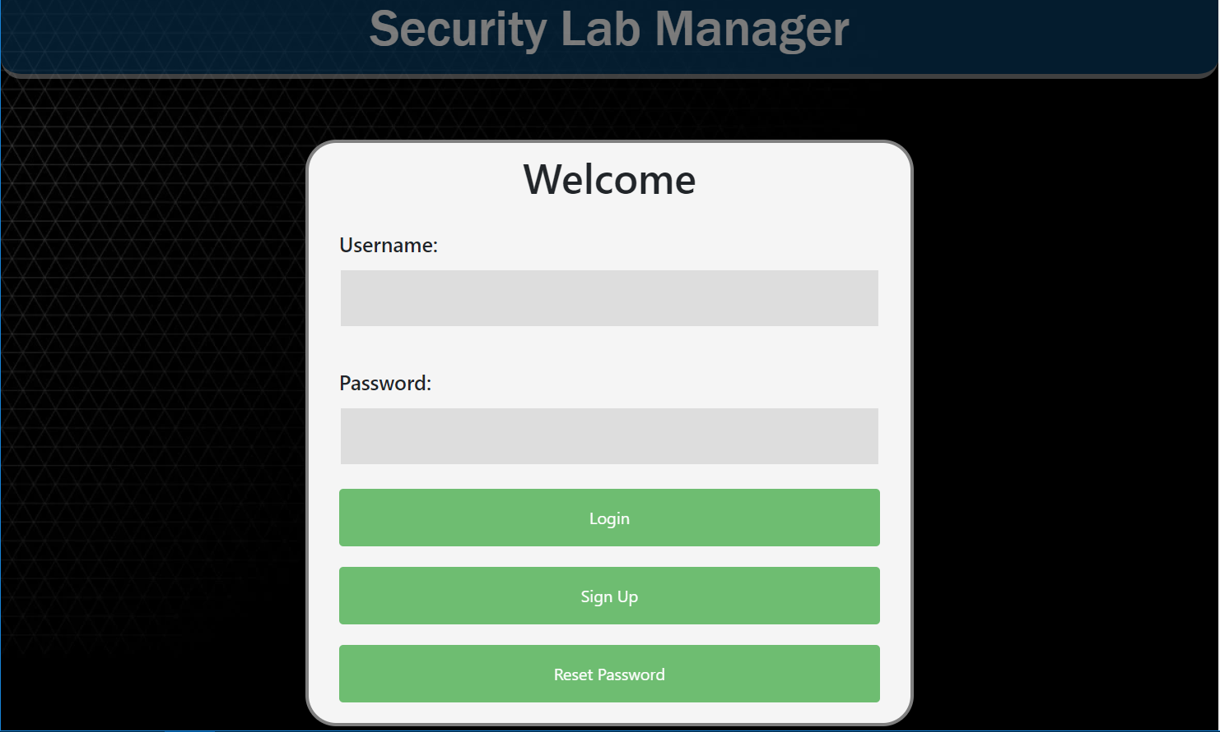

Slide 9
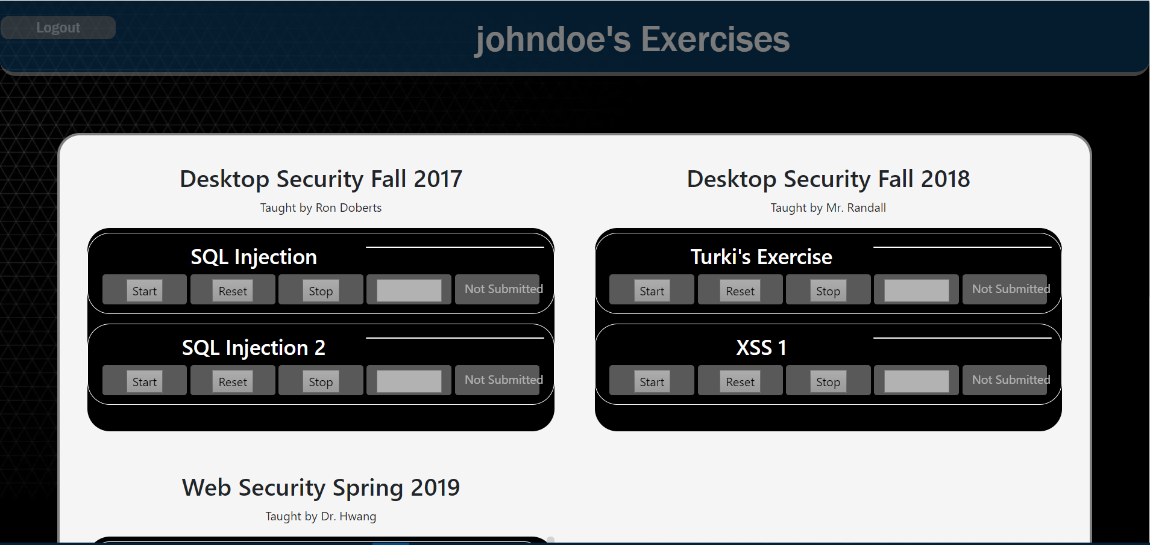

Slide 10
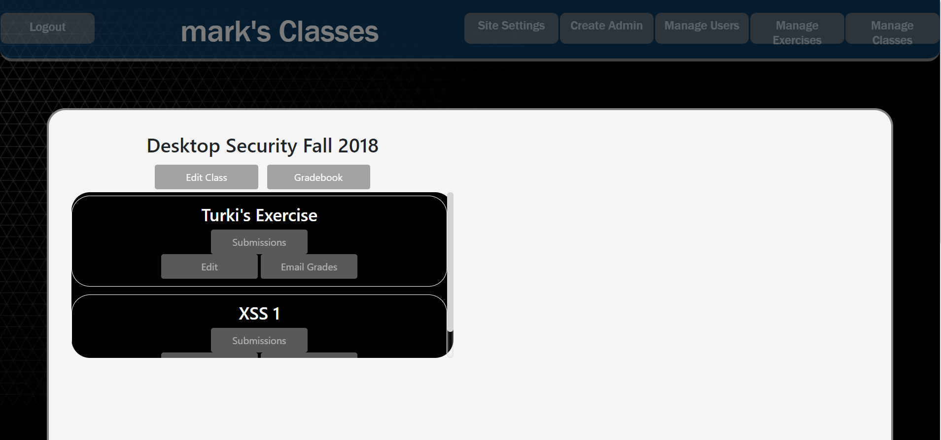

Slide 11
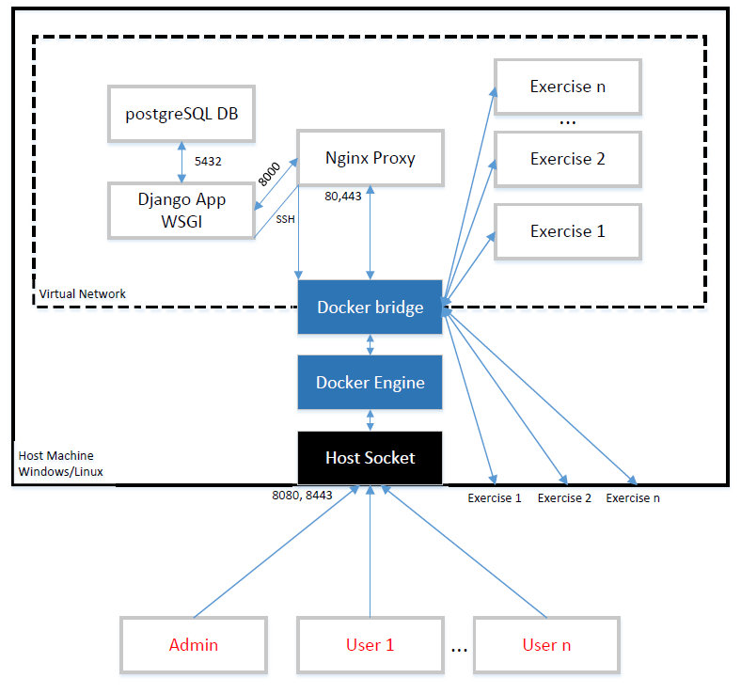
Architecture Overview
Client/Server
Web Application
Starts/Stops Docker containers

Slide 12
Database design
PostgreSQL Docker Container
Tables for
Users
Classes
Exercises
Submissions
Application Performance
Database accessed via python SQL queries

Slide 13
Database design

Slide 14
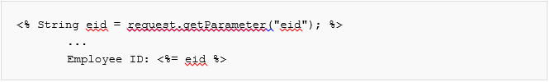
Web exercise
Ubuntu Docker container hosting JavaScript code
Cross Site Scripting
Vulnerable JavaScript
XSS code

Slide 15
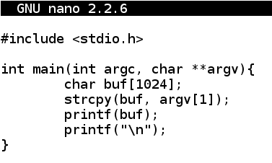
Desktop exercise
Ubuntu Docker container hosting C++ Code
Format String Vulnerability

Slide 16
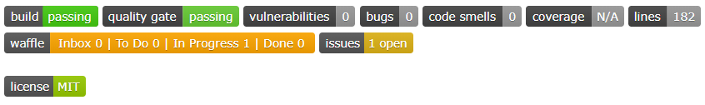
Developing Securely
Synk for dependency vulnerabilities
Sonarqube for software vulnerabilities
OWASP ZAP for continuous vulnerability scanning
Security assessment for OWASP Top 10
Reporting on Github

Slide 17
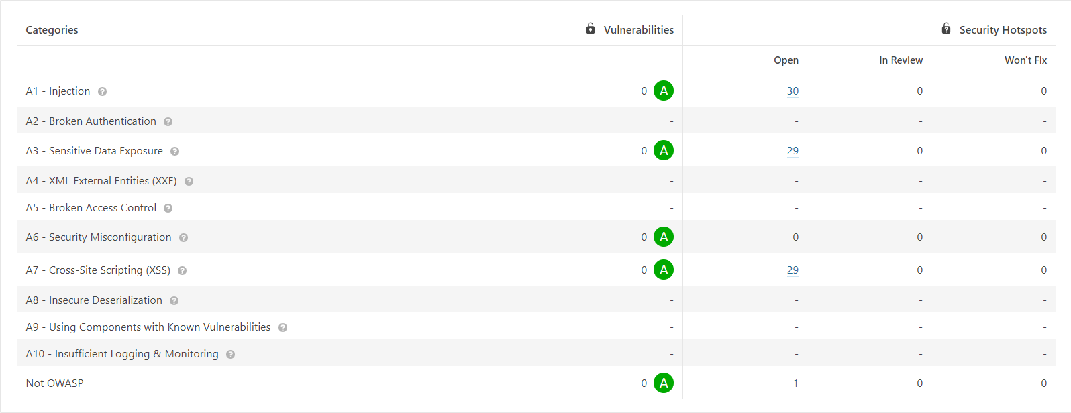
Static Analysis Results

Slide 18
Design considerations
Docker Containers – Scalability and Efficiency
Nginx – Load balancing and static file delivery
Django – Structured web framework because of python familiarity
Sonarqube & OWASP ZAP – secure development
Selenium and Mocha – simple unit and functional testing frameworks
Jenkins – continuously integration to speed up development

Slide 19
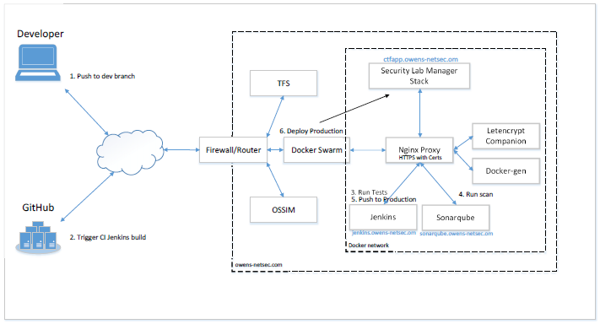
Continuous integration

Slide 20
Conclusion
This application was developed in a way to maximize satisfaction from the product owner by presenting constant demos and gathering feedback. Modern development practices like test driven development, static analysis, vulnerability scanning, and CI/CD enhanced the applications security and stability. The Security Lab Manager needs to be further developed to become a great tool for learning security in a classroom setting safely.

