Slide 1
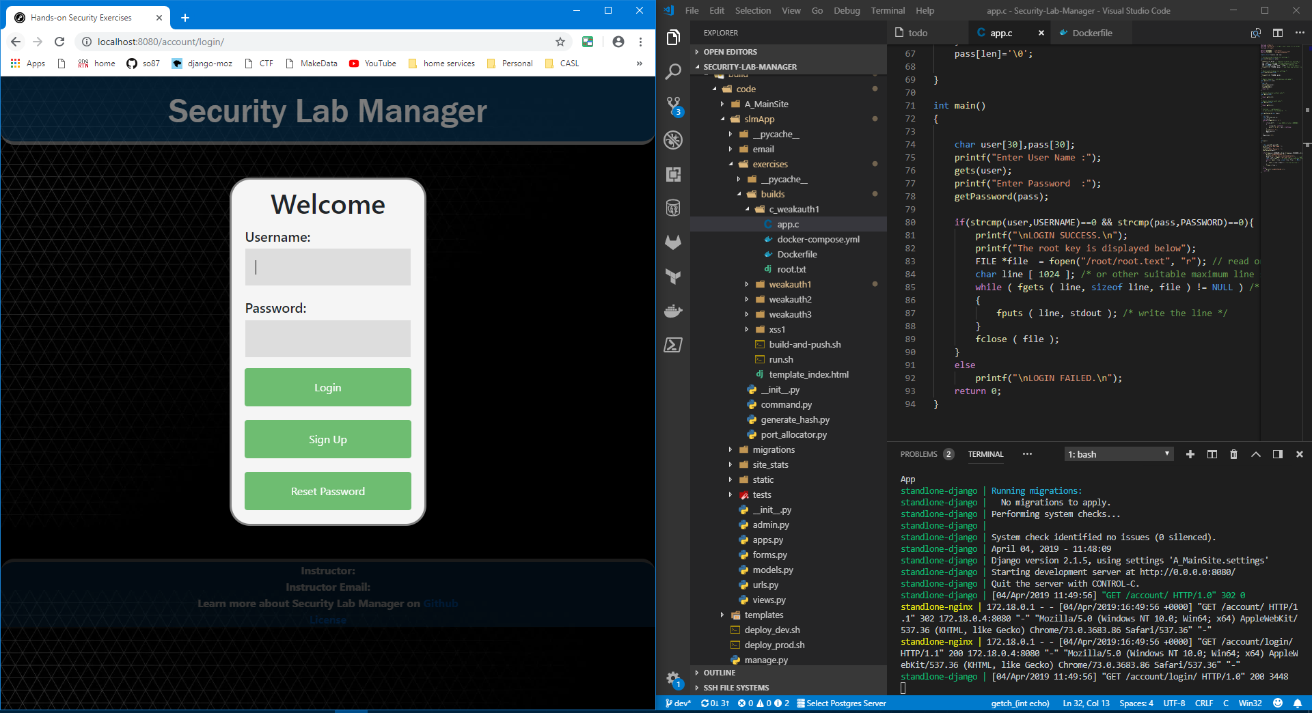
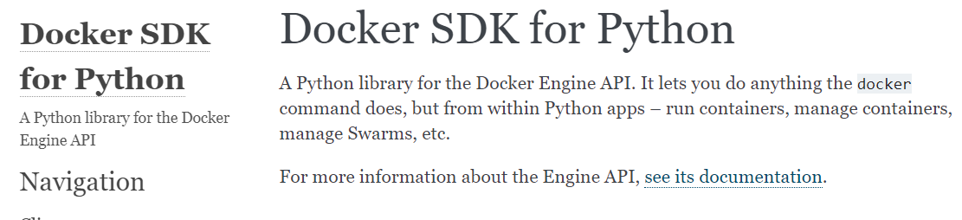
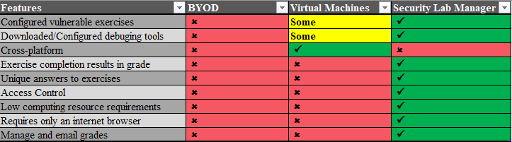
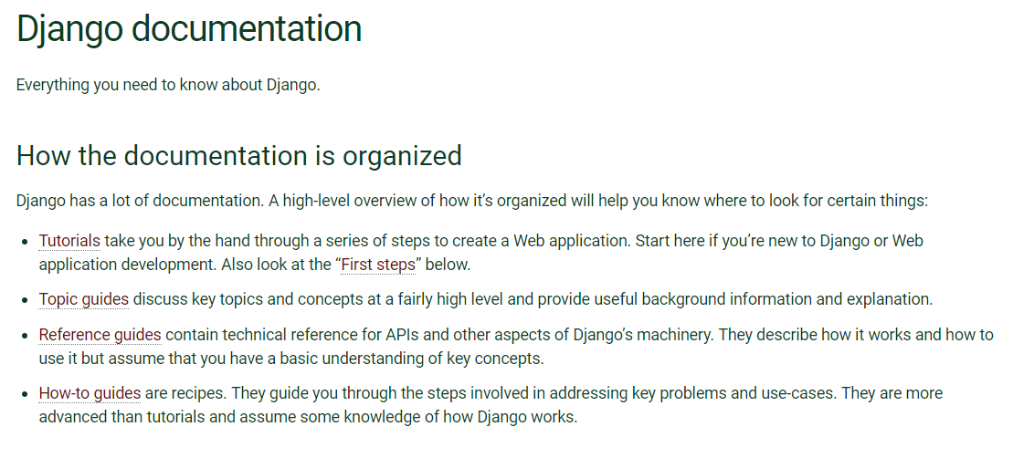
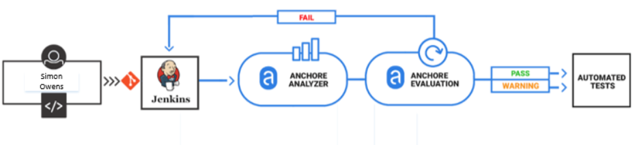
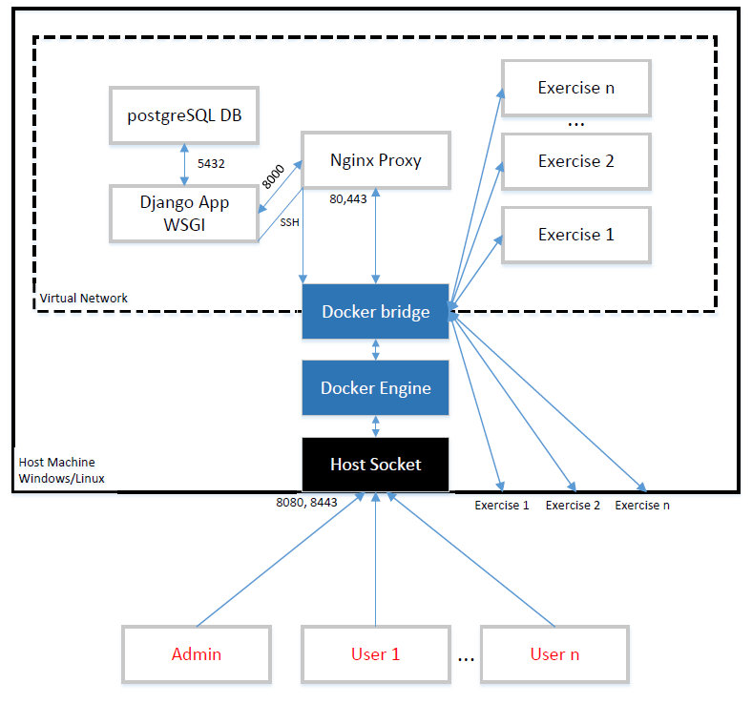
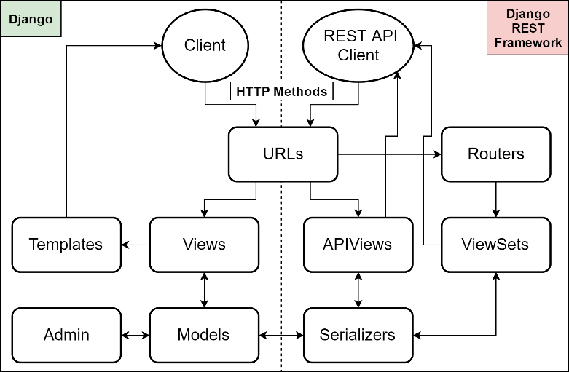
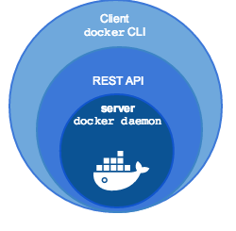

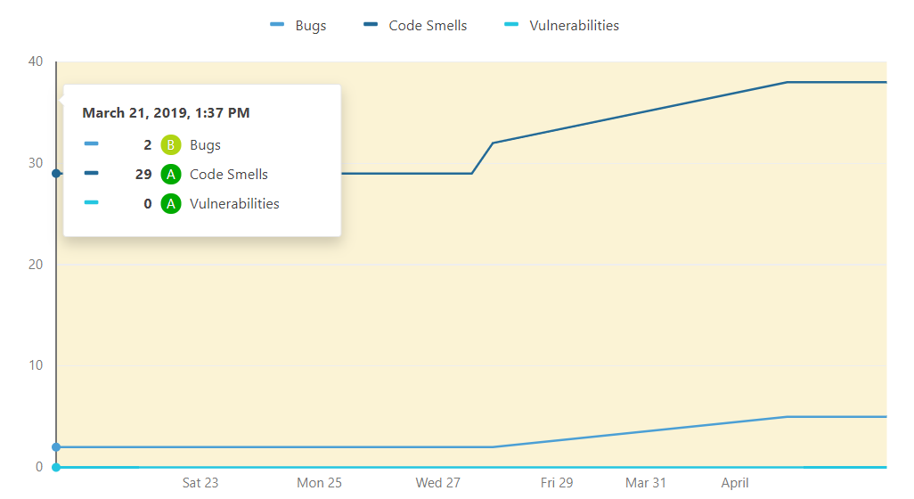




Security Lab Manager
Developed by Simon Owens Advisor/Sponsor: Mr. Mark Randall
Security Engineer University of Evansville
ABSTRACT
REQUIREMENTS
The Security Lab Manager is a web application that manages vulnerable virtual machines for users to practice cyber security on. Users only need to login to the website to get started – no setting up environments or downloading software. Each exercise has unique answers for students –
so answer sharing isn’t viable. Administrators can create, edit, and view: classes, exercises, and users. Grades can be emailed out automatically.
❏ Student interface for starting, stopping, and restarting exercises. There is a place to submit answers for exercises
❏ Instructor interface for creating, editing, deleting: classes, exercises, students, and managing application performance
❏ Instructors should be able to easily check and email grades
❏ Must contain one web security exercise
❏ Must contain one desktop security exercise
❏ Must be developed securely – scan and fix vulnerabilities
❏ Must be easily installed and enhanced by other developers
Secure Efficient Functional
There are zero vulnerabilities in Anchore, Sonarqube, and ZAP
The Docker Software Development Kit allows virtual machines to be built, started, and stopped in under 20seconds
Student and instructor tasks can be easily done in seconds through the GUI
PROBLEM
Security training is desired in all parts of industry: secure coding for developers, Q/A Testers, and Security Engineers. There are several virtual machines to practice security, but none have a student-teacher model. Students can now easily begin learning security with just this application. The table below compares current options for learning security, bring your own device(BYOD), using VMware virtual machines, or this app.
DEVELOPMENT
VSCODE, Docker, and Chrome for development
Jenkins runs Anchore, Sonarqube, and ZAP scans
DESIGN
OS Level
REST Framework
RESULTS
Docker SDK
Database
Features
❏ Launch exercises via GUI
❏ Automatic grading/emailing
❏ Configure all data via GUI
❏ Secure web portal
❏ Four full virtual exercises
❏ Scales to performance needs
Summary
Findings over Development
The application met all requirements, is much more efficient than using virtual machines, and helps students learn security in a hands-on way.

