Slide 1
Simon Owens University of Evansville April 17, 2019 Project sponsor/Advisor: Mark Randall
Security Lab Manager

Slide 2
Security Engineering
High demand for cyber security jobs
Secure coding extremely useful for all developers: web, desktop, system
Fixing vulnerabilities in dev is often 100 times cheaper than fixing in production

Slide 3
Hands on Learning
How do we allow students to virtualize exercises?
What is the fastest way possible to do this?
Does this require the students to have powerful computing resources?

Slide 4
Design considerations
Docker Containers – Scalability and Efficiency
Django – Structured web framework because of python familiarity
Nginx – Load balancing and static file delivery
Jenkins, Sonarqube, ZAP, mocha – keep quality and security high along development

Slide 5
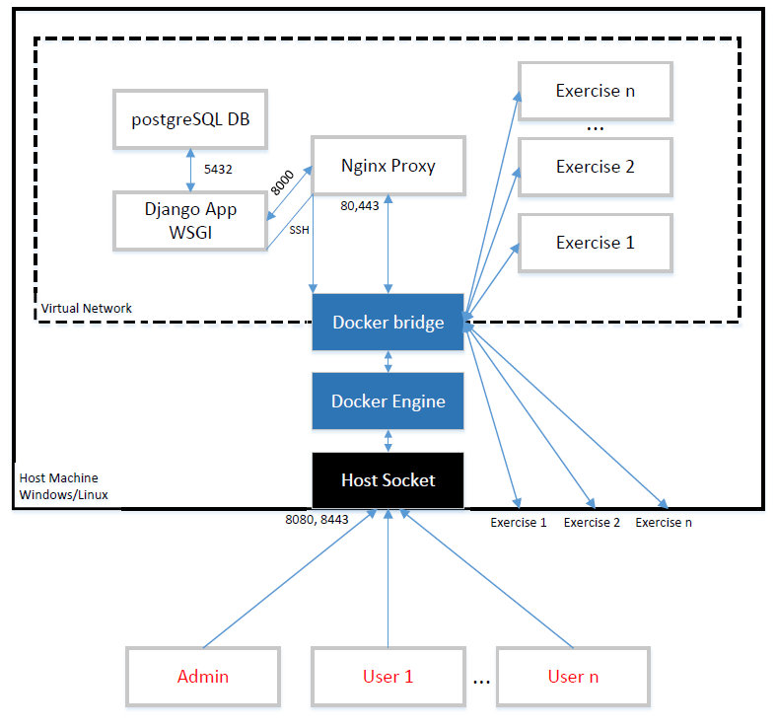
Architecture Overview
Client/Server
Web Application
Starts/Stops Docker containers

Slide 6
Database design

Slide 7
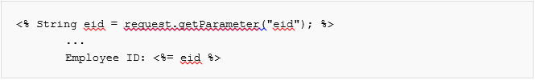
Web exercise
Ubuntu Docker container hosting JavaScript code
Cross Site Scripting
Vulnerable JavaScript
XSS code

Slide 8
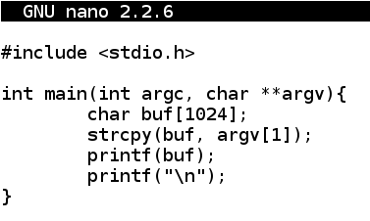
Desktop exercise
Ubuntu Docker container hosting C++ Code
Format String Vulnerability

Slide 9
Conclusion
The application is sometimes one hundred times faster than creating unique virtual machines
The application is also stable and nice to use
The application meets requirements
Needs to be further developed – UI, additional exercises, and multiple choice questions

