Slide 1
DevOps on AWS
Team
Shibu Narayanan
Arun Mohan Kuttampurambath

Slide 2
Objective
Execute a Proof of Concept to get familiarized with DEVOPS services offered by Amazon Web Services(AWS)
To utilize AWS to have an end to end (Code to Deployment) scenario.

Slide 3
AWS services utilized
IAM(Identity and Access Management) for User management
Code Commit for GIT repositories
Code Build for application build
Code Pipeline for managing build
Elastic Container Registry(ECR) for docker image repository
Elastic Kubernetes Service(EKS) - Application deployment
Lambda - for Bridge between Code Pipeline and EKS
S3 - For Storage
Cloud Watch - For logs and Event Trigger

Slide 4
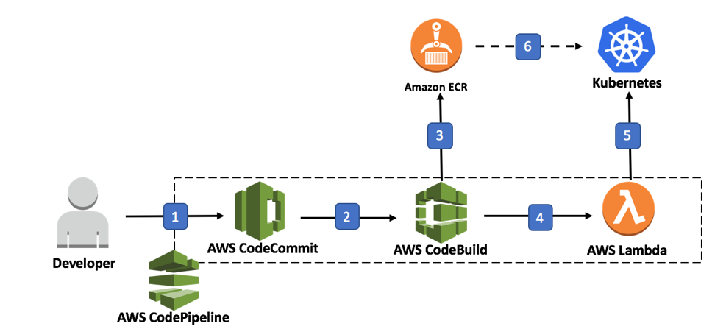
Interaction between Services

Slide 5
Interaction between Services

Slide 6
Reference Application (Docker containers)
AWS DynamoDBDatabase
Derby Database
Account Service
(Java SpringBoot)
Customer Service
(Java SpringBoot)
Loan Service
(Python)

Slide 7
IAM (Identity and Access Management)
Created userid for team members
Created Roles, Policies, Security Group, KeyPairs
Assigned IAM roles for Code Commit, Code Build, Code Pipeline full Access
Generated GIT credentials for all team members
Created all the roles and policies required for services to service interaction.

Slide 8
Code Commit
Code Commit is the AWS service which provides GIT repository
Created git repository “ss-poc-repo”
Assigned policies to users to access “ss-poc-repo”
Checked in all code into this repo

Slide 9
Code Build
Code build is AWS service which is responsible for building application code.
Source (input) to this service is Code Commit repository “ss-poc-repo”
As part of build the following main actions were performed
Java build
Perform docker build of JAR and create docker images
Perform docker build of python application and create docker image
Download and re-tag derby-db docker image
Upload docker images to Elastic Container Registry(ECR)

Slide 10
Code Deploy
Code Deploy is an AWS service which deploys the build artifacts to dev/test/prod servers.
In our POC our aim was to deploy our application to Kubernetes
In AWS Code Deploy there is no action to deploy build artifacts to Elastic Kubernetes Service(EKS)
So, the artifacts were deployed to Lambda
In Lambda, logic was embedded to deploy to EKS

Slide 11
Code Pipeline
Code pipeline is an AWS service which integrates the following
Code Commit
Code Build
Code Deploy
The Build steps can be specified using buildspec.yaml (should be present in source code root directory).

Slide 12
Elastic Container Service (ECS)
ECS is one of the services provided to deploy your application as containers.
The user/admin is responsible for administration of the services, replicas, etc
There are two possible ways we can use ECS
Deploy to Fargate(completely manages by AWS)
Deploy to EC2 (User is responsible for allocation of nodes, etc..)
We deployed to EC2

Slide 13
Elastic Kubernetes Service (EKS)
EKS is AWS’s managed kubernetes services
The user/admin is responsible for managing the deployment using kubernetes manifests(YAML)
EKS manages the cluster and nodes and all the necessary infrastructure required for running kubernetes(Control Plane)
DNS service
Scheduler
API server
State management(etcd internal database)
We deployed application images with manifests using kubectl tool
Uses Elastic Load Balancer to expose application to world
Application is accessible over the Internet

Slide 14
Lambda
Lambda is the serverless service from AWS(Function as a service)
It was used in our POC as a bridge between Code pipeline and EKS
We created a python Lambda service.
Used BOTO3 Python framework to interact with AWS within Python
Since we need to interact with EKS, we created two Lambda layers
One for AWS CLI
One for kubectl (the cli tool to interact with K8S)
Kubernetes manifest files were picked up from S3 bucket and deployed to Kubernetes using kubectl tool.

Slide 15
Cloud Watch
Cloud Watch service provides logging and monitoring services across all AWS services.
Events generated in various services are captured by Cloud Watch and results in triggering of any other configured services.
Example :- When Code is commited/merged in Code Commit, Cloud Watch is responsible for triggering a automatic build in Code Pipeline.
Also code pipeline build logs, echo statements in Lambda functions, etc.. are captured and viewable in cloudwatch portal

Slide 16
S3 - Simple Storage Service
S3 is the “persistent hard disk” service provided by AWS
S3 is explicitly and implicitly used by different services
Artifacts exchanged between different stages of code pipeline uses S3 are intermediate storage (implicit usage)
For Deployment to EKS, kubernetes manifests are stored temporarily to S3. It is then picked up by Lambda function and processed(explicit usage).

Slide 17
Automation/Scripting
AWS CLI - We created scripts for the creation/removal of aws resources
BOTO3 – Used BOTO3 SDK for Python to create all required resources for EKS
This helped us in bringing up resources at start of day and destroying resources at end of day in a consistent fashion.
Helped us in speeding up of the creation/removal process.

