Slide 1
Infrastructure Architecture and Design Concepts for Financer

Slide 2
Project Objectives
Relocate the old premises financial services to new infrastructure through AWS.
Establish high availability architecture in various availability zones.
Create a smooth scalability of the personal finance management application servers.
Implement superior security measures to protect valuable financial transactions data.
Notes:
Financr is planning to resolve its main weaknesses in its London infrastructure by transitioning monolithic applications and PostgreSQL databases to AWS. This transition is low in maintenance and long-lasting. The IT team reduces overhead administration but makes the platform secure, compliant and able to be used heavily in the future by using managed services.

Slide 3
Current Infrastructure Challenges and Pain Points
Rigid on-premises hardware causes high application failure during peak time.
The monolithic application server is the single point of failure (Bhatia, 2025).
Local postgres database is not subject to performance bottlenecks during high loads.
Active Directory administration is not as secure as the modern cloud resources.
Notes:
Existing infrastructure is no longer sufficient as there is massive growth in the number of users. The monolithic systems lack scalability hence leading to high service failures. The financial management user experience is compromised by the on-premises database latency issues.

Slide 4
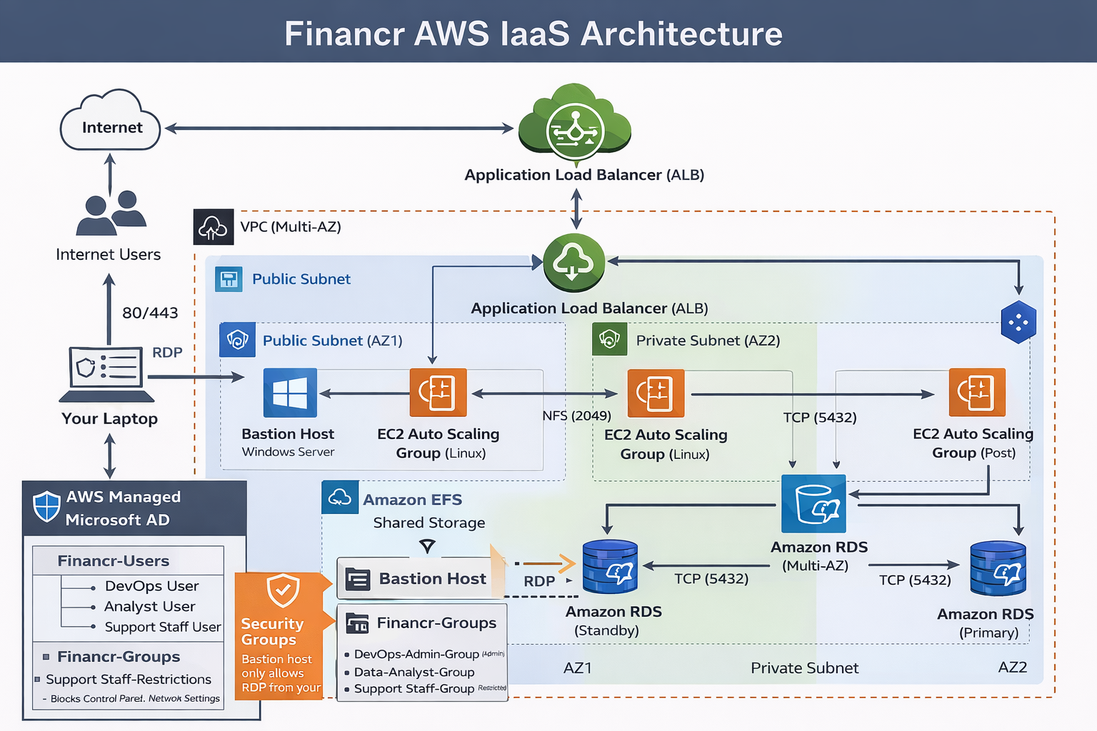
Proposed AWS Architecture Overview
Launch a custom Virtual Private Cloud in the us-east-1 region.
Use an application load balancer to process web traffic.
Install Auto Scaling Groups to control the dynamic application server fleets.
Manage a highly available postgres database with Multi-AZ Amazon RDS (Boscain, 2023).
Notes:
The architecture is multi-tier to ensure that it offers the best reliability to Financr. Custom VPC provides network-isolation. The data tier is under RDS instances and the compute layer is under an automated scaling group.

Slide 5
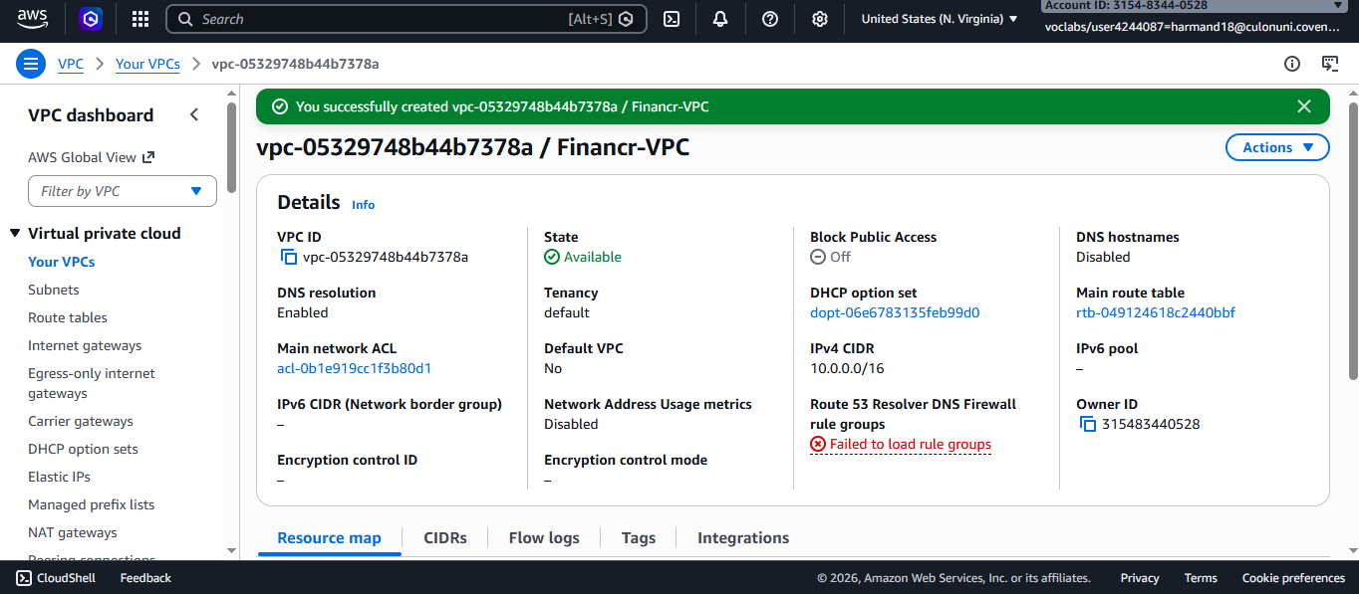
Networking Design and Multi-AZ VPC Configuration
The VPC utilizes us-east-1 region with a 10.0.0.0/16 CIDR block.
Six public and private subnets ensure maximum high availability availability.
Load balancer and bastion host are present in public subnets (Cherukuri, Chhapola and Kaushik, 2024).
The application servers and database instances are segregated in secret sub nets.
Notes:
The virtual private cloud on which the migration to the cloud is premised is custom. The platform will be resilient to local outages since the six availability zones will be used. The approach eliminates single points of failure, which puts Financr in down time.

Slide 6
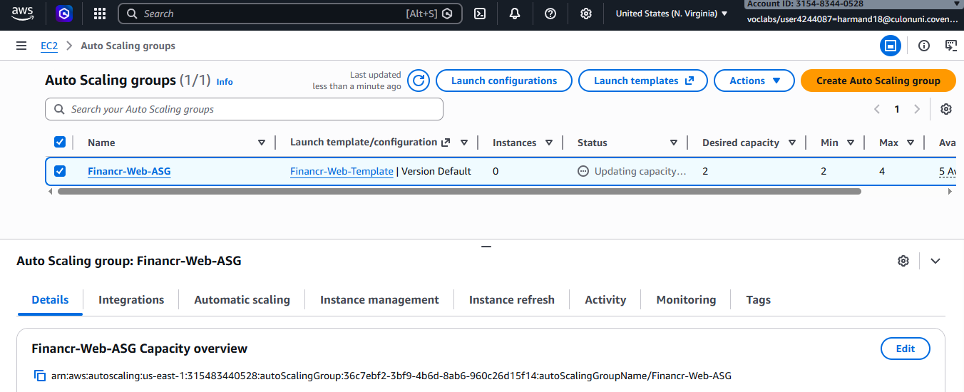
Compute Layer: Auto Scaling Group Implementation
A Launch Template is used to make Linux EC2 instances supporting PHP.
At least two examples are related to the Auto Scaling Group (Thota, 2021).
The instances are distributed to a number of private subnets to attain high redundancy.
Dynamic scaling policies are set to the changes in user demand (Nagraj, 2023).
Notes:
The compute layer utilizes Auto Scaling Group to manage a pool of Linux servers. The templates of a standardised launch ensure that the instances are configured identically with the necessary web software. The group has at least two healthy group cases.

Slide 7
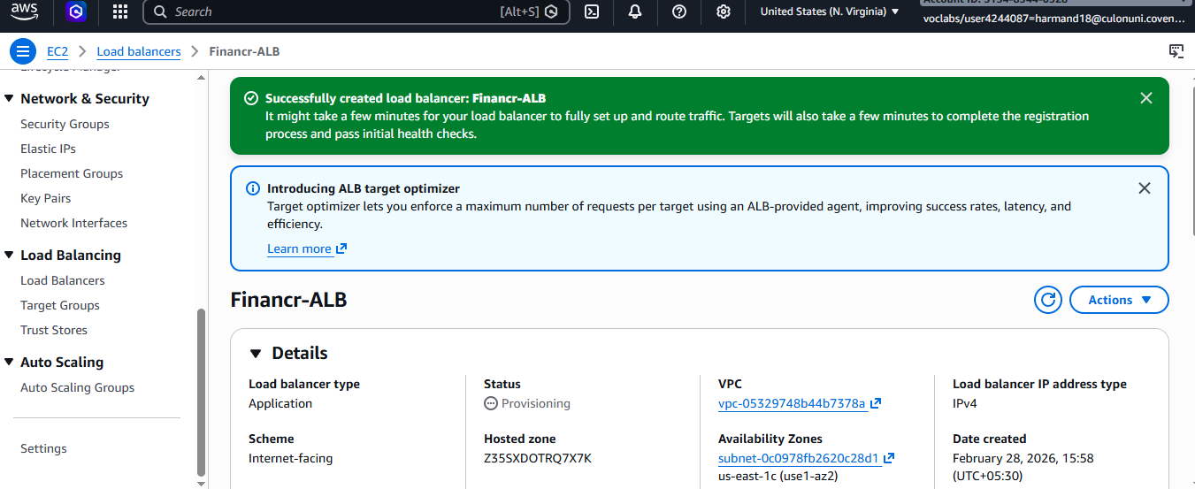
Application Load Balancer Strategy
The Load Balancer also distributes traffic to the scaling group (Rakipllari, 2025).
The ALB is found in public subnets to receive external internet traffic.
The ALB provides a single DNS entry point for users.
Security groups restrict the ALB to only accept HTTP traffic.
Notes:
Financer clients will be directed to Application Load Balancer. It is disseminated across different subnets in the public to be available. The load balancer undertakes a continuous health check of the backup instances through which traffic is automatically redirected to the non-responsive servers.

Slide 8
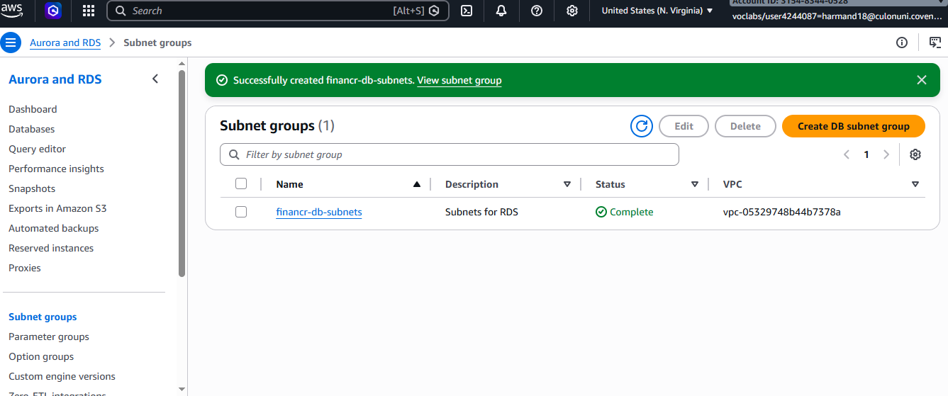
Managed Database Services: Amazon RDS
Amazon RDS will replace the current on-premises postgres database servers.
Multi-AZ deployment offers automatic failover insurance by provision of standout instance.
Security The database is restricted to the private subnets (Thorne and Valdez, 2025).
Only the application servers and bastion host can access RDS.
Notes:
The privacy of information is paramount to this FinTech start up. The migration to the Amazon RDS PostgreSQL provides multi-AZ deployment to prevent automatic failure. RDS promotes a backup instance in a different zone in case of failure of a primary database.

Slide 9
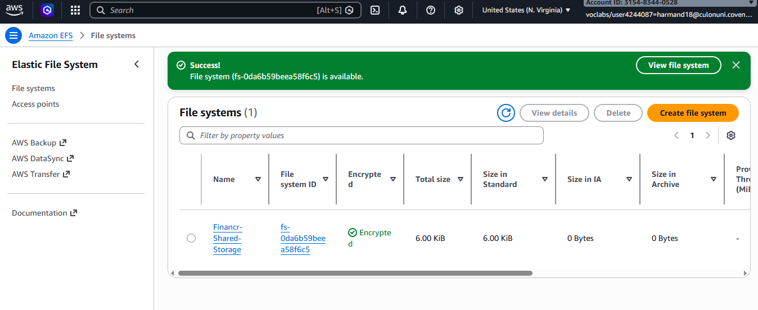
Scalable File Services: Amazon EFS
Amazon EFS provides a scalable and durable shared file system.
The file system is mounted automatically on all EC2 instances.
EFS ensures that application logs and user data remain consistent.
NFS security rules permit traffic only from the web servers (Thota, 2021).
Notes:
Amazon EFS modernizes rigid on-premise storage using a regional file system that is flexible. This shared storage is also automated and is scaled according to the size of data demands. EFS may be attached to the entire Auto Scaling Group to allow all web servers to use the same files simultaneously.

Slide 10
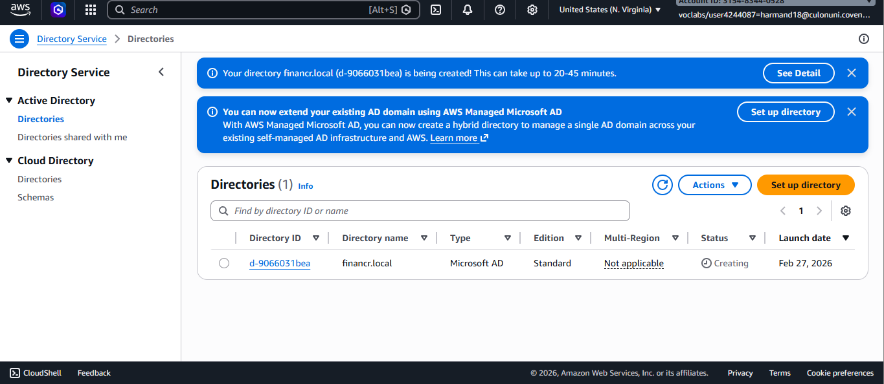
Identity Management: AWS Managed Microsoft AD
Managed Microsoft AD replaces the legacy on-premises domain controller.
Domain controllers are deployed across two availability zones for redundancy.
Organizational Units are created to manage different staff access levels (Bhatia, 2025).
The directory service facilitates seamless joining of Windows bastion hosts.
Notes:
AWS Managed Microsoft AD makes it possible to switch to a familiar directory structure with cloud reliability. The platform is deployed in a two-zone highly-available environment. Authentication and resource access control exists in this directory.

Slide 11
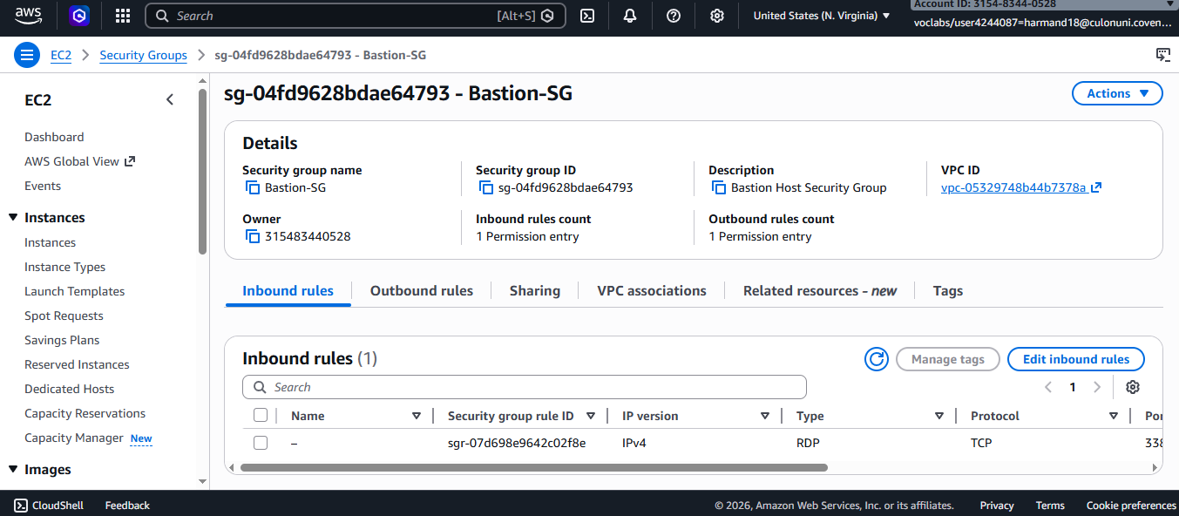
Security Implementation: Security Groups and Bastion Host
A Windows Server bastion host provides secure administrative entry points.
Strict security groups enforce stateful traffic rules between different layers.
Public RDP access is restricted to the bastion host only (Boscain, 2023).
The application servers only accept HTTP traffic from the ALB.
Notes:
Security follows the layered approach to ensure that sensitive financial information is not compromised. The only safe point of entry of administrators of personal resources is a windows bastion host. Components protection is performed according to the least privilege principle and application of some security groups.

Slide 12
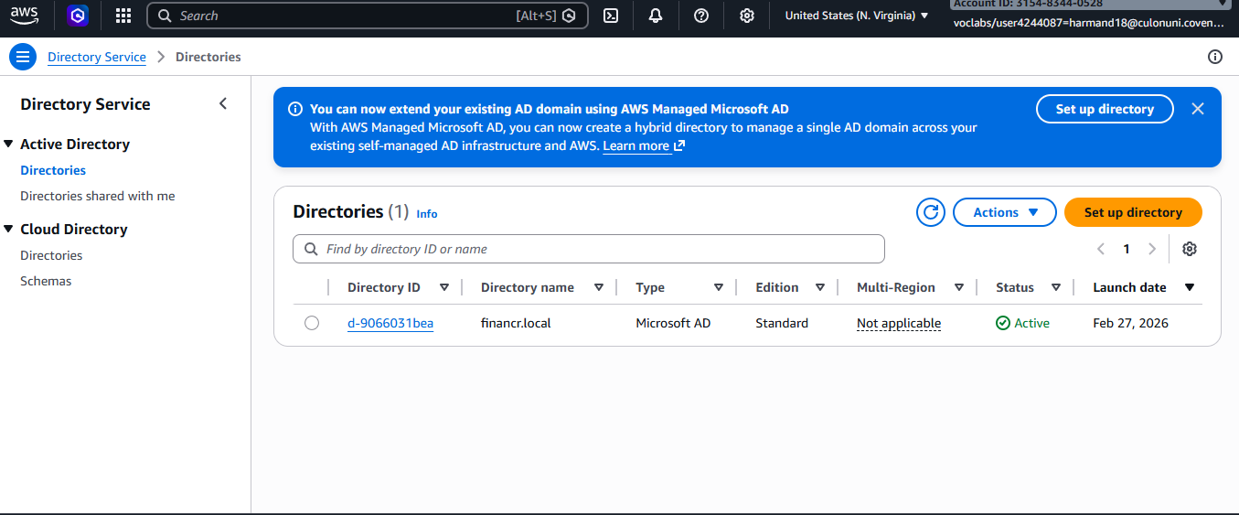
Governance: Active Directory Groups and GPO
Specific groups manage DevOps admins, data analysts, and support staff.
Group Policy Objects are used to deny the non-administrative users the chance to customize the network settings.
Financr-Users OU is related to the implementation of the GPO (Cherukuri, Chhapola and Kaushik, 2024).
Role-based access control this will make sure that the staff only access the resources needed by the cloud.
Notes:
The governance is enforced with the help of Active Directory and Group Policy Objects. Specific groups deal with DevOps, Analyst and Support staff permissions. The non-admin users will also not be permitted to modify the network settings on the bastion host by a GPO.

Slide 13
High Availability and Disaster Recovery (DR)
Auto Scaling Groups Self-Healing Auto Scaling Groups automatically replace failed server instances.
RDS Multi-AZ failover will minimize downtime in case of a critical database hardware failure.
Regional EFS storage hedges data against catastrophes of data centres (Rakipllari, 2025).
The ALB ensures constant service availability despite individual instance failures.
Notes:
High availability is the nature of this AWS migration. The resilience of the system to data centre failures is due to the allocation of the resources in six zones. Self-healing compute fleets and automated database failover achieve high service levels.

Slide 14
Migration Benefits: On-Premise vs. Cloud
The cloud solution eliminates the expense of the expensive physical hardware.
Operation agility is improved through automated resource deployment and management.
Scalability allows Financr to serve thousands of active financial users at the same time (Thorne and Valdez, 2025).
Security is enhanced with guard services and global standards of adherence.
Notes:
A comparison of the new cloud architecture with the old one reveals that it has much to offer. The startup is no longer investing in non-productive physical servers. They are instead relying on an elastic and pay-as-you-go approach, which is growing with success.

Slide 15
Conclusion and Strategic Recommendations
The AWS migration presents a concrete foundation in user development.
Security and high availability have been guaranteed to all layers.
Managed services can be useful in reducing the burden on the IT team.
NAT Gateways should be used as a part of the future improvement.
Notes:
Lastly, the transformation to AWS has been capable of redefining IT competencies at Financr. Critical weaknesses include the high availability, scalability, and security of the new infrastructure. Strategic recommendations would include the use of NAT Gateways so as to isolate the private instances further. Overall, this architecture provides the necessary reliability and performance to make the industry expansion ambitious.

Slide 16
Technical Summary and Next Steps
Architecture diagrams confirm the successful deployment of a multi-AZ VPC.
Live demonstrations prove that the Load Balancer functions correctly.
The EFS mount provides evidence of a scalable storage solution.
A GPO verification is made to ensure that administrative security policies are operating correctly.
Notes:
The technical prototype is already operational, and it can withstand every requirement. The architecture is demonstrated to be successful based on the demonstrations of the use of load balancer, the shared storage and directory services. The subsequent processes involve the performance load testing to streamline auto-scaling thresholds. This will ensure that the platform is optimised before carrying out live financial transactions.

Slide 17
References
Bhatia, R., 2025. Redefining Finance in the Cloud: Architecture, Intelligence, and Innovation. Journal of Computer Science and Technology Studies, 7(8), pp.181-193.
Boscain, S., 2023. AWS Cloud: Infrastructure, DevOps techniques, State of Art (Doctoral dissertation, Politecnico di Torino).
Cherukuri, H.A.R.S.H.I.T.A., CHHAPOLA, A. and KAUSHIK, D.S., 2024. AWS full stack development for financial services. International Journal of Engineering Development and Research, 12(3), pp.14-25.
Nagraj, A., 2023. Cloud-Native Architectures in Financial Services: Enhancing Scalability and Security with AWS and Kubernetes. Journal of Computer Science and Technology Studies, 5(4), pp.296-308.
RAKIPLLARI, D., 2025. Designing and Implementing a High-Availability Infrastructure for a Web Application on AWS. Editorial Board, p.164.
Thorne, E.J. and Valdez, S.H., 2025. A Systematic Review and Comparative Analysis of Amazon Web Services (AWS) Infrastructure: Architecture, Economic Implications, and Future Research Trajectories. Academic Reseach Library for International Journal of Computer Science & Information System, 10(10), pp.28-37.
Thota, R.C., 2021. Cloud Security in Financial Services: Protecting Sensitive Data with AWS well-Architected Framework. International Journal of Novel Research and Development, 6(4), pp.1-7.

