Slide 1

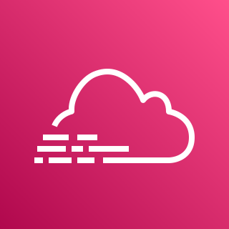










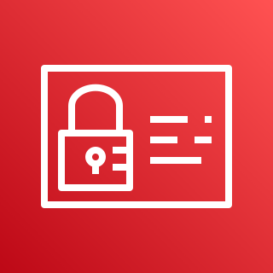
AWS Cloud
Development VPC
AWS CloudTrail
Amazon Simple Storage Service (S3)
Management VPC
Flow logs
***All Flow Logs go to CloudWatch
Amazon CloudWatch
Amazon Simple Storage Service (S3)
NAT gateway
Customer Connectivity
AWS Config
Amazon Simple Storage Service (S3)
AWS Site-to-Site VPN
Internet gateway
Flow logs
AWS Transit Gateway
AWS Direct Connect
Amazon Simple
Notification Service
Production VPC
NAT gateway
AWS Identity & Access Management
Flow logs

