Slide 1

Introduction to Cloud Computing

Slide 2
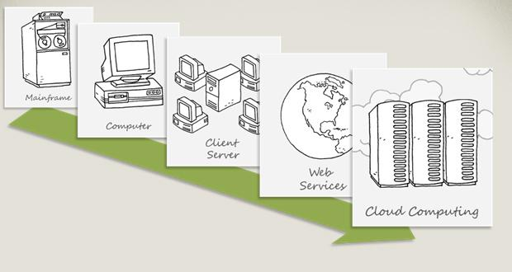
Technology Trends
Technology Trends

Slide 3
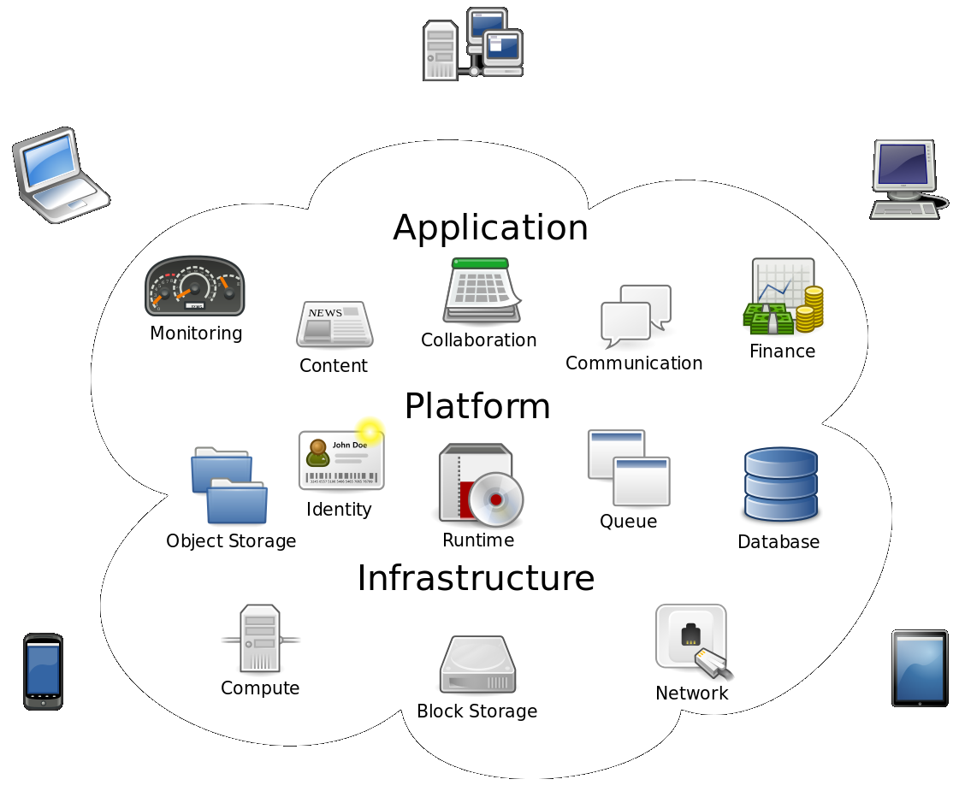
Cloud computing
Cloud computing is a term broadly used to define the on-demand delivery of IT resources like servers, storage, databases, networking, software, and applications over the internet (“the cloud”) with pay-as-you-go pricing.
Cloud computing provides a simple way to access servers, storage, databases and a broad set of application services over the Internet.

Slide 4
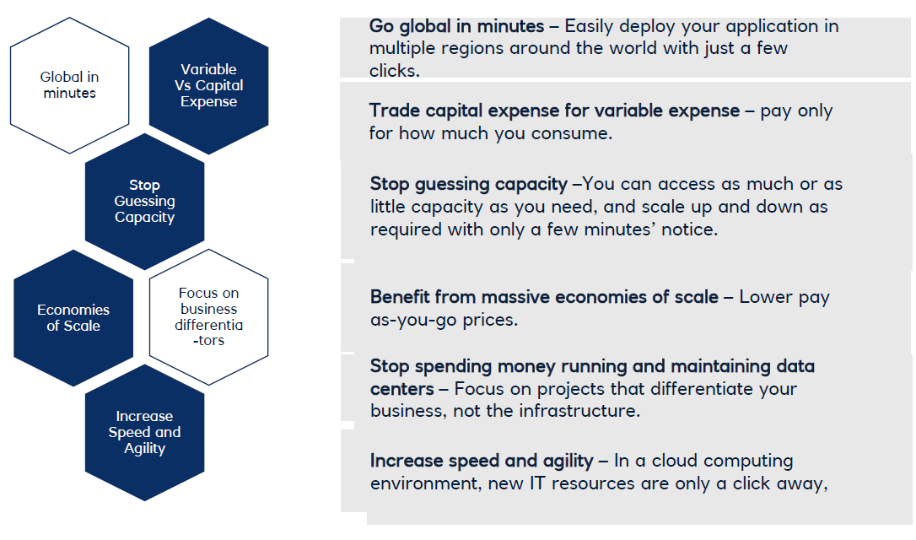
Advantages of Cloud

Slide 5
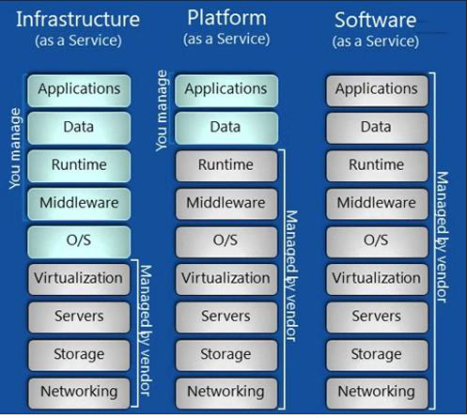
Types of Cloud Computing
Cloud services are broadly categorized as
Infrastructure as a service (IaaS)
Platform as a Service (PaaS)
Software as a Service (SaaS)

Slide 6
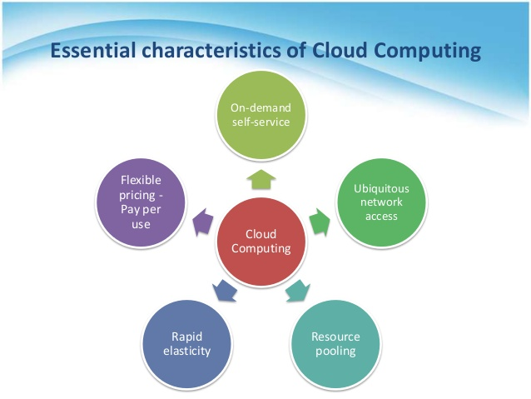
Characteristics of Cloud
Key Cloud Characteristics –
On-Demand Self Service
Broad Network Access
Resource Pooling
Rapid Elasticity
Measured Service

Slide 7
Cloud Deployment Models
According to where the infrastructure for the deployment resides and who has control over that infrastructure, NIST defines four cloud deployment models:
Public clouds
Private clouds
Hybrid clouds
Community clouds
Public Cloud
Public clouds are environments that are entirely managed and serviced by an external service provider.
When most people think about computer clouds, it is public clouds they are thinking about.
The cloud infrastructure is provisioned for open use by the general public. It may be owned, managed, and operated by a business, academic, or government organization, or some combination of them.
Private Cloud [on-prem]
A private cloud consists of computing resources used exclusively by one business or organisation.
The private cloud is physically located at your organisation’s on-site data centre
It may be managed either by the consumer organization or by a third party.

Slide 8
Hybrid Cloud
Often called “the best of both worlds”, hybrid clouds combine on-premises infrastructure, or private clouds, with public clouds so that organisations can reap the advantages of both.
In a hybrid cloud, data and applications can move between private and public clouds for greater flexibility and more deployment options.
In a hybrid cloud, “cloud bursting” is also an option. This is when an application or resource runs in the private cloud until there is a spike in demand (such as a seasonal event like online shopping or tax filing), at which point the organisation can “burst through” to the public cloud to tap into additional computing resources.
Community Cloud
Community clouds aren't used as much as public or private clouds; in fact, they are the least known and least used cloud deployment model. In a community cloud, the cloud is shared by a group of organizations that have a common purpose or goal. The cloud environment is generally built to help them achieve that purpose or goal.

Slide 9
Introduction to Amazon web services

Slide 10
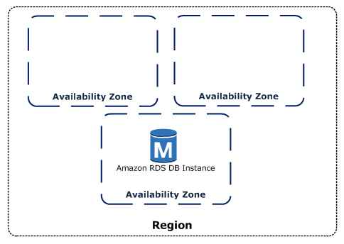
AWS Global Infrastructure
AWS are constantly expanding around the world and currently there are:
• 24 regions
• 76 availability zones
Interactive and up-to-date infrastructure information is available at: infrastructure.aws
AWS Regions
A region is a geographical area, Each region consists of 2 or more availability zones
Each Amazon Region is designed to be completely isolated from the other Amazon Regions
Note that there is a charge for data transfer between regions
Availability Zones (AZs)
Availability Zones are physically separate and isolated
from each other
AZs span one or more data centres and have direct,
low-latency, high throughput and redundant network
connections between each other
An Availability Zone is represented by a region code
followed by a letter identifier; for example, us-east-1a

Slide 11
Introduction to Core services

Slide 12
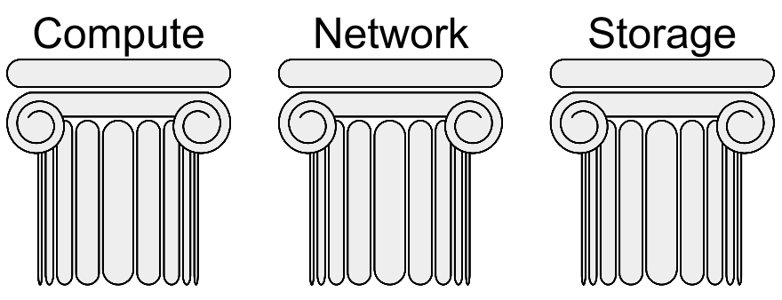
3 Pillars of Cloud Computing
Compute
Storage
Network

Slide 13
AWS EC2 (Elastic Compute Cloud)
Compute is one of the key foundational building blocks of the cloud computing infrastructure layer. "compute" refers to physical servers comprised of the processing, memory, and storage required to run an operating system such as Microsoft Windows or Linux, and some virtualized networking capability.
Amazon EC2 is a web service that provides resizable compute capacity in the cloud.
Amazon EC2 reduces the time required to obtain and boot new server instances to minutes, allowing you to quickly scale capacity, both up and down as computing requirement changes.
You have root access to each of your EC2 instances
You can Stop, Start, Reboot or Terminate your EC2 instances
You can provision your EC2 instances on Shared or dedicated hosts
You need a AMI to launch any EC2 instance.
EC2 instance metadata (from EC2 instances console)
GET (or curl) http://169.254.169.254/latest/meta-data
An Amazon Machine Image (AMI) is a special type of virtual appliance that is used to create a virtual machine within EC2. AMIs come in three main categories:
• Community AMIs – free to use, generally you just select the operating system you want
• AWS Marketplace AMIs – pay to use, generally come packaged with additional, licensed software
• My AMIs – AMIs that you create yourself

Slide 14
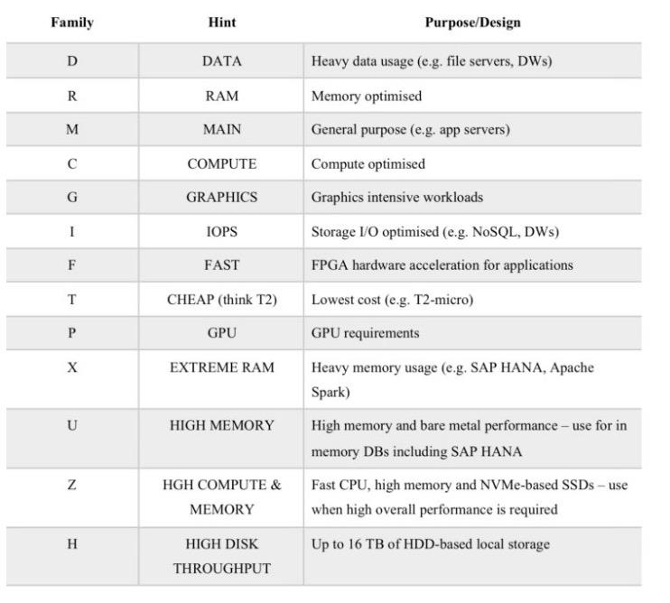
EC2 Families
General purpose
- Balanced memory and CPU
- suitable for most applications
Ex. M3, M4, T2
Compute Optimized
- More CPU than memory
- Compute intensive use
Ex C2, C4
Memory optimized
- More RAM/Memory
- Memory intensive apps, DB, caching
Ex R3, R4
GPU Compute instances
- Graphics Optimized-
- High performance and parallel computing, Ex G2
Storage Optimized
- Very High, Low latency,
- I/O optimized I/O intensive apps, data warehousing, hadoop
Ex I2, D2

Slide 15
EC2 Instance Pricing
On-demand:
• Low cost and flexibility of EC2 without any up-front payment or long term commitment
• Applications with short term, spiky, or unpredictable workloads that cannot be interrupted
Reserved:
• Applications with steady state or predictable usage
• Users can make up-front payments to reduce their total computing costs even further
• Standard Reserved Instances (RIs) provide up to 75% off on-demand price
Spot:
• Applications that can be interrupted or only feasible at very low compute prices
• Users with an urgent need for a large amount of additional compute capacity
• If Amazon terminate your instances you do not pay, if you terminate you pay for the hour
Dedicated hosts:
• Useful for regulatory requirements that may not support multi-tenant virtualization
• Can be purchased on-demand (hourly) or Reserved for up to 70% off the on-demand price
LAB – Create your own EC2 Instance

Slide 16
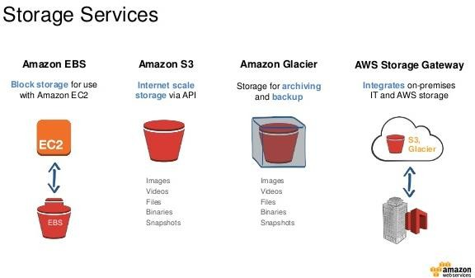
AWS Storage Services
Amazon Simple Storage Service (Amazon S3) – Object based storage
Amazon Glacier – Archival Solution
Amazon Elastic Block Store (Amazon EBS) – block based storage with EC2
Amazon Elastic File System (Amazon EFS) – File storage with EC2
AWS Storage Gateway - hybrid storage between on-premises storage environments and the AWS Cloud
AWS Snowball - Petabyte-scale data transport solution

Slide 17
AWS S3 - Simple Storage Service
Amazon S3 is object storage built to store and retrieve any amount of data from anywhere – web sites and mobile apps, corporate applications, and data from IoT sensors or devices
You can store any type of file in S3
S3 is designed to deliver 99.999999999% durability, and 99.99% availability and stores data for millions of applications used by market leaders in every industry
S3 objects are automatically stored across multiple devices spanning a minimum of three Availability Zones, each separated by miles across an AWS Region.
Buckets are fundamental container in S3
Objects are the entities stored in buckets in Amazon S3. Objects consist of object data
and metadata.
Objects (Files) can be anywhere from 0 bytes to 5 TB
S3 is a universal namespace so bucket names must be unique globally
When you successfully upload a file to S3 you receive a HTTP 200 code
Once data is stored in Amazon S3, it can be automatically tiered into lower cost, longer-term cloud storage classes like Amazon S3 Standard - Infrequent Access and Amazon Glacier for archiving.
Amazon S3 guarantees high-availability by replicating data across many servers and Azs
Read After Write Consistency for Puts of new objects
Eventual consistency for overwrite PUTS and DELETES

Slide 18
AWS S3 - Glacier
Extremely Low-cost, secure, durable storage service for data archiving and long-term backup.
Designed to deliver 11 9’s durability
To archive objects, define archival rules identifying objects and a timeline when you want Amazon S3 to archive these objects to Amazon Glacier.
Set the rules on a bucket using the Amazon S3 console or programmatically using the Amazon S3 API or AWS SDKs.
Retrievals as quick as 1-5 min [Expedited 1-5 min, Standard 3-5 hours, Bulk 5-12 hours]
Unmatched durability and scalability
Most comprehensive Security and Compliance capabilities
Extremely Low cost

Slide 19
Introduction to Security & Compliance

Slide 20
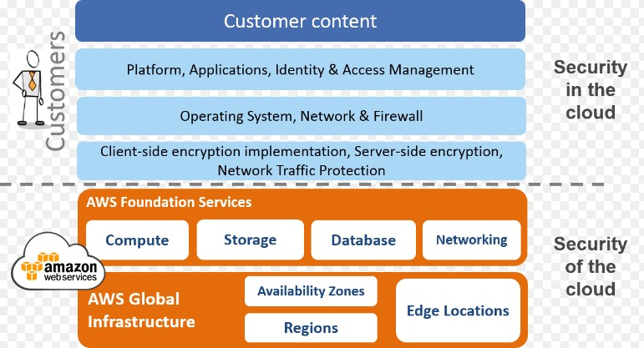
AWS Shared Security Model
‘
Cloud security at AWS is the highest priority. As an AWS customer, you will benefit from a data center and network architecture built to meet the requirements of the most security sensitive organizations.
Security in the cloud is much like security in your on-premises data centers—only without the costs of maintaining facilities and hardware.

Slide 21
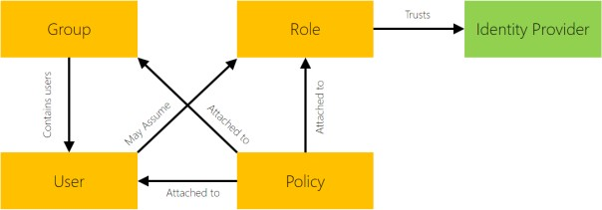
IAM – Identity and Access Management
IAM is a web service that helps you securely control access to AWS resources for
your users. You use IAM to control who can use your AWS resources (authentication) and how they can use resources (authorization).
IAM Features
Shared access to your AWS account
Granular permissions
Multi-factor authentication (MFA)
Identity federation

Slide 22
Introduction to Databases

Slide 23
Databases services
Amazon Relational Database Service (Amazon RDS) is a managed service that makes it easy to setup, operate, and scale a relational database in the cloud RDS is a fully managed service and you do not have access to the underlying EC2 instance (no root access)
Amazon RDS automates common administrative tasks such as performing Backups and Patching the software that
powers your database.
Amazon RDS supports the following database engines:
• SQL Server
• Oracle
• MySQL Server
• PostgreSQL
• Aurora
• MariaDB
AWS Charge for:
• DB instance hours (partial hours are charged as full hours)
• Storage GB/month
• I/O requests/month – for magnetic storage
• Provisioned IOPS/month – for RDS provisioned IOPS SSD
• Egress data transfer
• Backup storage (DB backups and manual snapshots)

Slide 24
Introduction to AI/ML

Slide 25
Machine Learning and AI Services
AWS helps you at every stage of your ML adoption journey with the most comprehensive set of artificial intelligence (AI) and ML services, infrastructure, and implementation resources.
Amazon SageMaker
Amazon Bedrock
Amazon CodeGuru
Amazon CodeWhisperer
Amazon Comprehend
Amazon Lex
Amazon Polly
Amazon Rekognition
Amazon Transcribe
Amazon Translate
Amazon Fraud Detector

Slide 26

THANKS

