Slide 1

AWS skilling & Certification

Slide 2
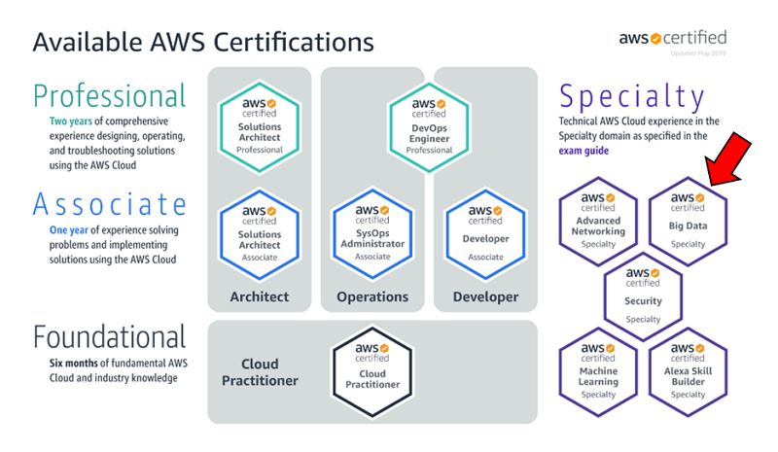

Slide 3
Content Breakdown: Cloud Practitioner
Cloud Practitioner Exam: Content Breakdown
Domain 1: Cloud Concepts (28%)
Domain 2: Security (24%)
Domain 3: Technology (36%)
Domain 4: Billing and Pricing (12%)
Time: 90 min
No.of questions: 65
Passing Score: 700/1000
Fee: $100

Slide 4
Content Breakdown: SAA
AWS Solutions Architect Associate Exam: Content Breakdown
Domain 1: Designing highly available, cost-efficient, fault-tolerant, scalable systems (60%)
Domain 2: Implementation/Deployment (10%)
Domain 3: Data Security (20%)
Domain 4: Troubleshooting (10%)
Time: 130 min
No.of questions: 65
Passing Score: 720/1000
Fee: $150

Slide 5
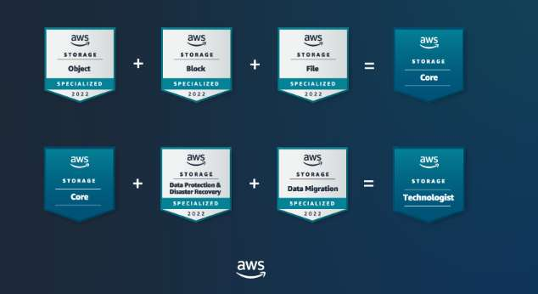
SkillBuilder for Advanced Learners
Explore the tool here
• Earn New Badges for your social profiles
• Access Builder’s Labs with Subscription
• Official Exam Prep material for certifications
• Access AWS Jams – for gamified learning
• Access Industry Quests for deeper knowledge

Slide 6
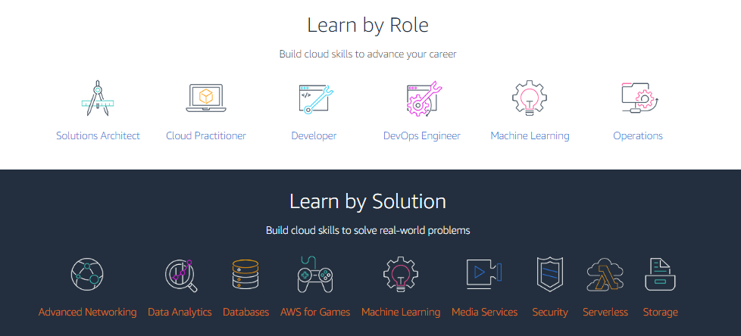
Learn by Role or Solution
Explore it here

Slide 7
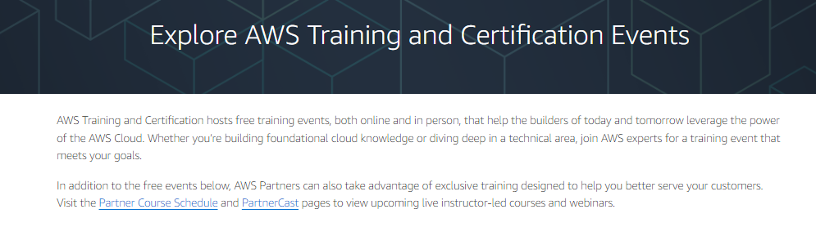
Training & Certification Events
Explore it here

Slide 8
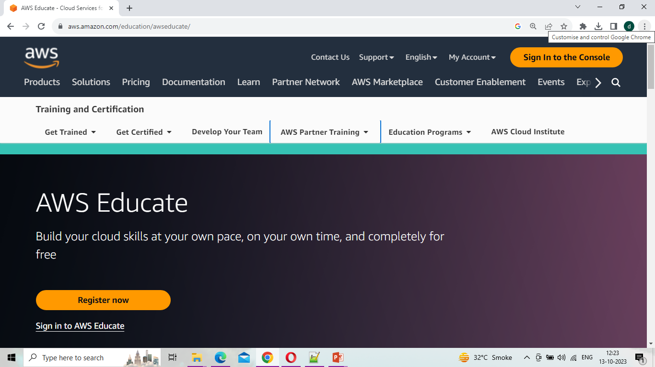
AWS Educate
Explore it here

Slide 9

Learn with AWS Community
Explore reskill here

Slide 10
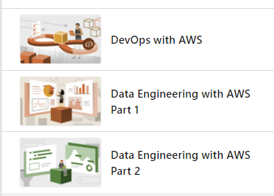
Learn with Dipali…
Devops
Data Engineering Part1
Data Engineering Part2

Slide 11
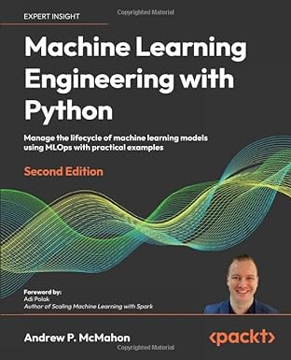
Get expertise on Machine Learning

Slide 12
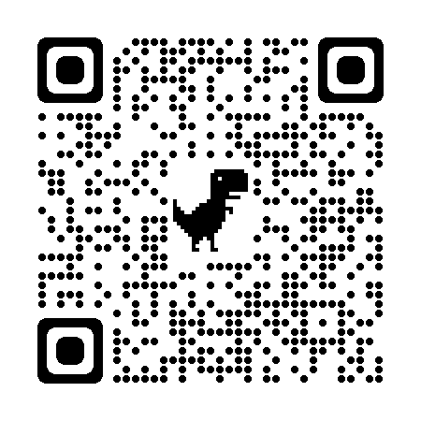

Slide 13
KEEP LEARNING & GROWING.....

