Slide 1

AWS
Cloud
Development
Kit
Dipali
Vice President – Natwest Group
AWS Hero, 3x AWS Certified, AWS UG Leader
Rajat Arora
Vice President – Natwest Group
AWS Community Builder, AWS Certified, AWS UG Leader

Slide 2
AGENDA
OpenSource @ AWS
Challenges in managing multiple Infrastructures
Infrastructure as Code overview
AWS Cloud formation
AWS CDK
Use case Demo – AWS CDK

Slide 3
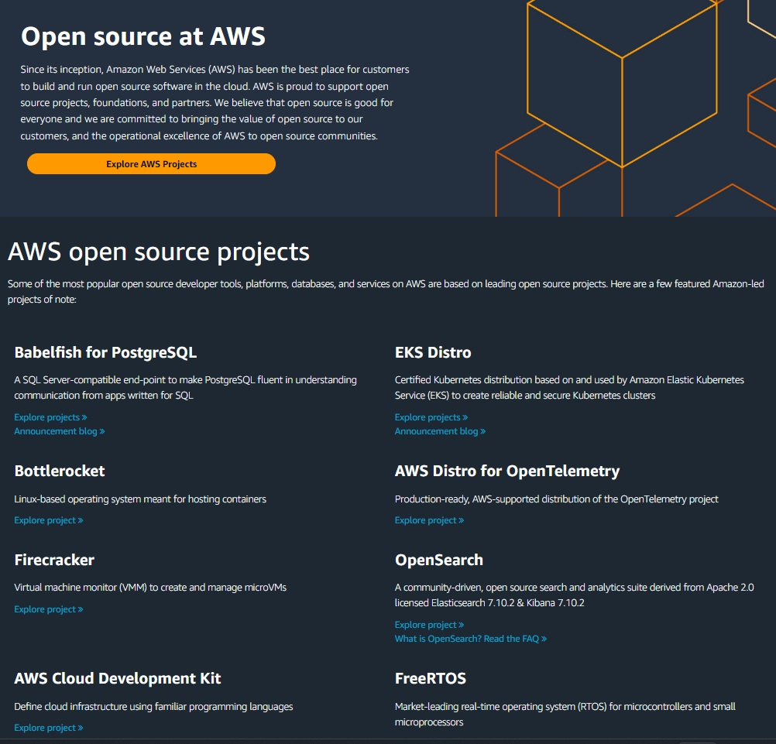
OpenSource @ AWS

Slide 4
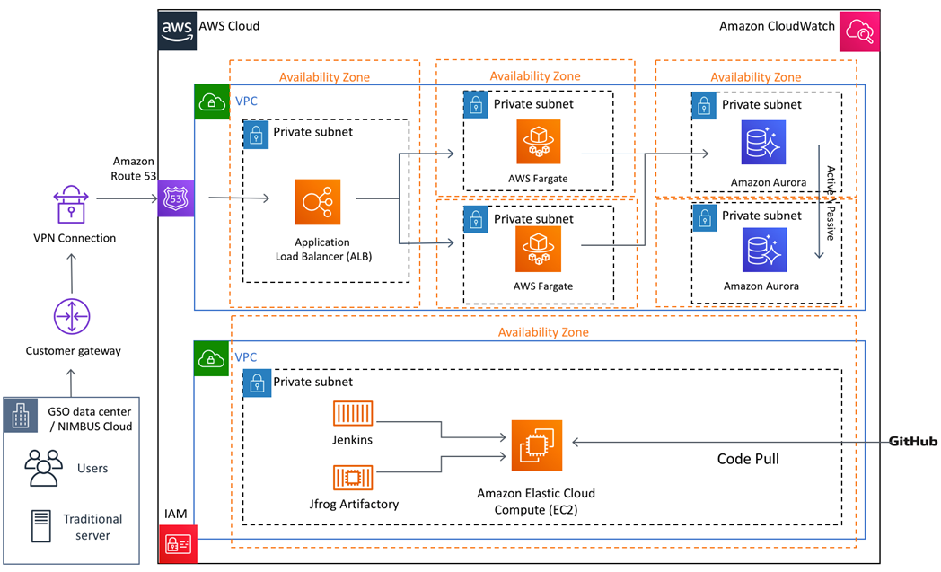
The Problem Statement
With evolution of Cloud Computing, Developers are expected to work on Infrastructure creation as well
Its easy to use the fancy Web Console provided by AWS to define the services, but when it comes to scale and manage multiple different Stacks e.g. Dev, SIT and Prod env it becomes bit tedious to manage the environments.

Slide 5
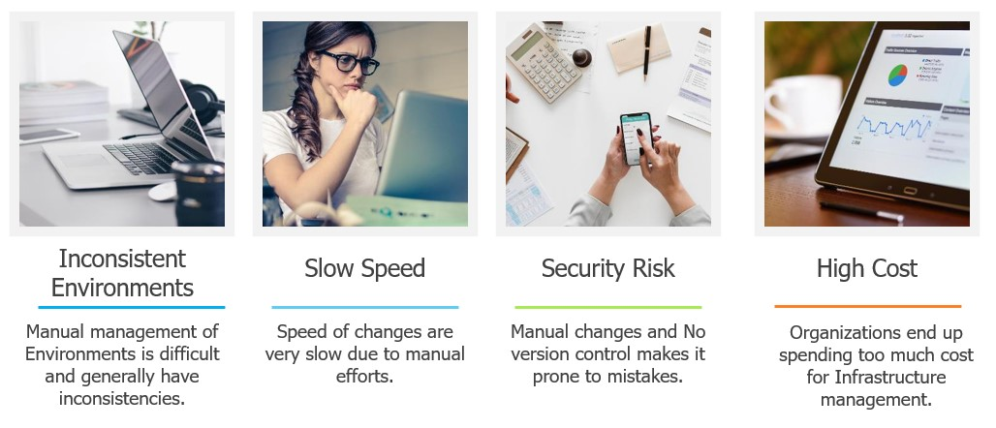
The Problem Statement

Slide 6
Solution – IaC (Infrastructure as Code)
Infrastructure as Code is the process of provisioning and configuring an environment through code instead of manually setting up the required devices and systems. Once code parameters are defined, developers run scripts, and the IaC platform builds the cloud infrastructure automatically.
Such automatic IT setups enable teams to quickly create the desired cloud setting to test and run their software. Infrastructure as Code allows developers to generate any infrastructure component they need, including networks, load balancers, databases, virtual machines, and connection types.

Slide 7
IaC flow
Define Infrastructure
Build Infrastructure
Test Infrastructure
Deploy Infrastructure
Monitor & Maintain
Store Code

Slide 8
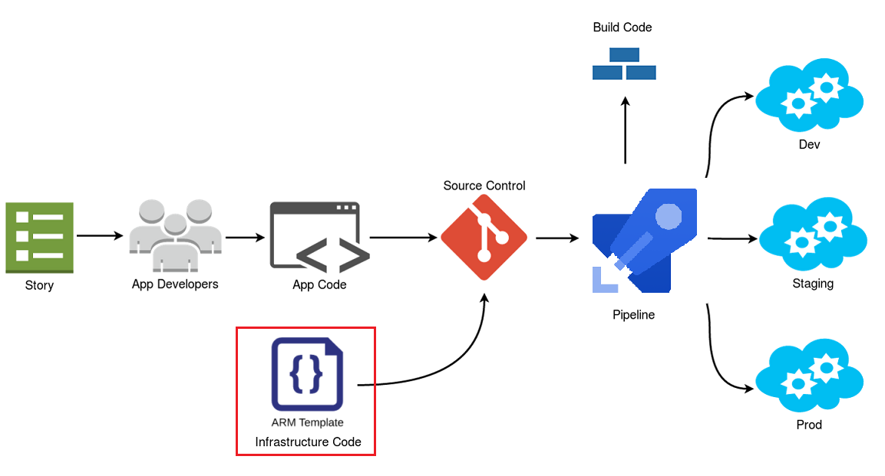
IaC in practice

Slide 9
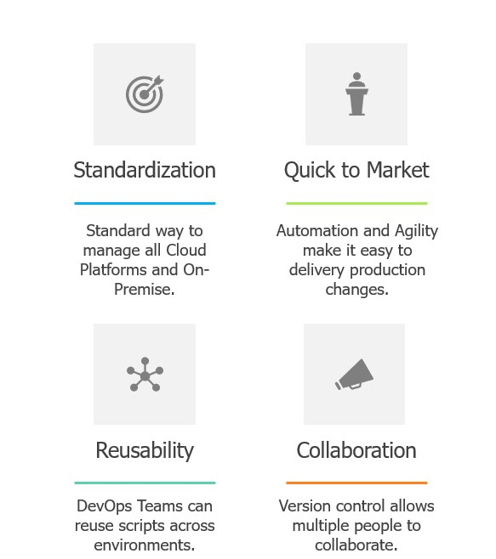
Benefits of IaC

Slide 10
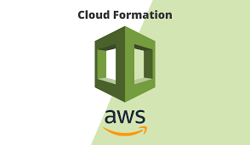
AWS CloudFormation
AWS CloudFormation is an AWS service that uses template
files to automate the setup of AWS resources.
It can also be described as infrastructure automation or Infrastructure-as-Code (IaC) tool and a cloud automation solution because it can automate the setup and deployment of various Infrastructure-as-a-Service (IaaS) offerings on the AWS CloudFormation supports virtually every service that runs in AWS.
You can use CloudFormation to automate the configuration of workloads that run on the most popular AWS services, like the EC2 compute service, the S3 storage service, and the IAM service for configuring access control.
You can also apply CloudFormation templates to AWS services that cater to niche use cases, like Ground Station, the AWS satellite management solution.
It provides full support for packaging and templating using JSON, YAML

Slide 11
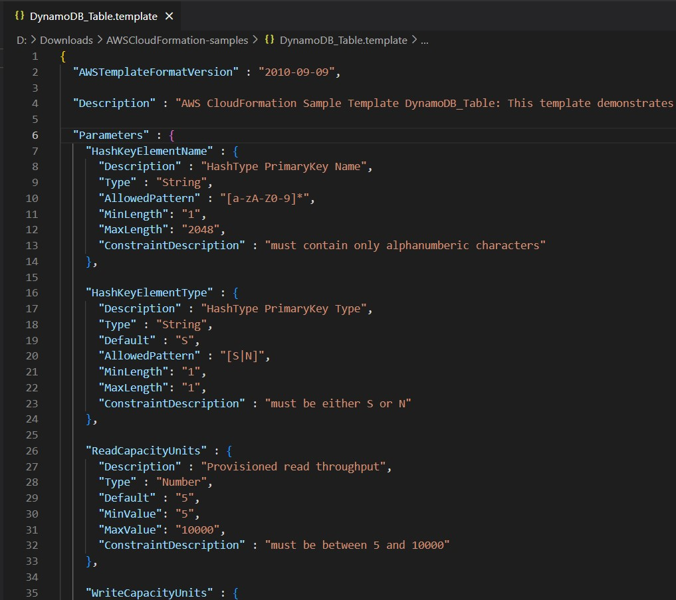



AWS CloudFormation
Template : You can create Templates for the service or application architectures
Stack : CloudFormation use those templates for quick and reliable provisioning of the services or applications (called “stacks”)
ChangeSet : Allows to modify an existing CloudFormation Stack with a new template

Slide 12
AWS CDK
The AWS Cloud Development Kit (AWS CDK) is an open-source software development framework for defining cloud infrastructure as code with modern programming languages and deploying it through AWS CloudFormation.
Brings the power of Programming Languages to you infrastructure.
Cloud
Development
Kit

Slide 13
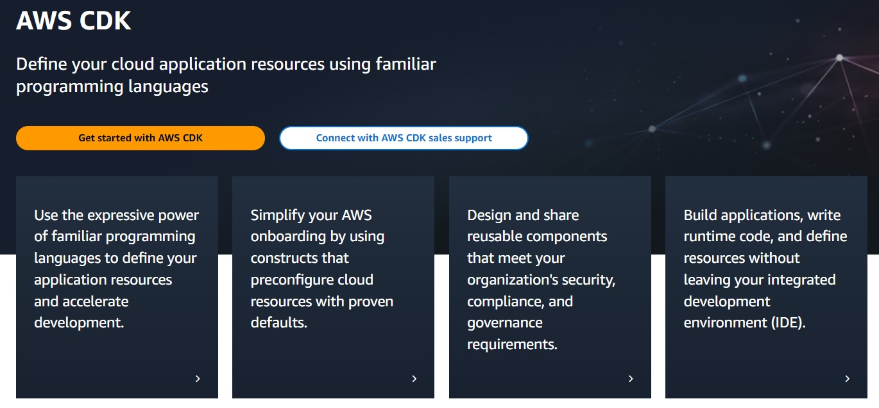
AWS CDK

Slide 14
AWS CDK features
Familiar programming languages: which can help reduce the learning curve and improve productivity.
AWS resource modelling: The CDK provides a library of pre-built AWS resource models, which help reduce the amount of code needed to define resources and improve consistency across projects.
Support for AWS best practices: The CDK includes built-in support for AWS best practices, such as using IAM roles and policies, tagging resources, and configuring VPCs.
Continuous delivery and deployment: The CDK integrates with AWS CodePipeline and other CI/CD tools, making it easy to automate the build, test, and deployment of infrastructure resources.
Open source community: The AWS CDK is an open-source project with a large and growing community of contributors. This community provides support, documentation, and examples to help developers get started with the CDK.

Slide 15
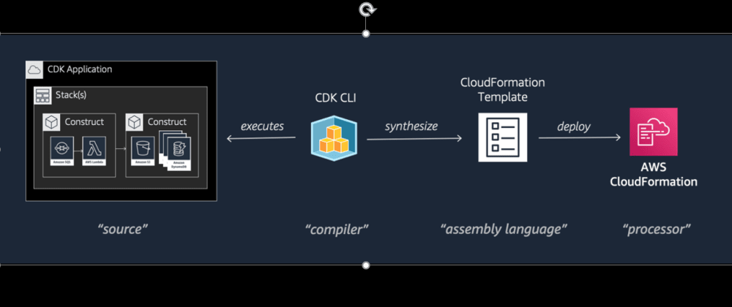
AWS CDK – How it works ?

Slide 16
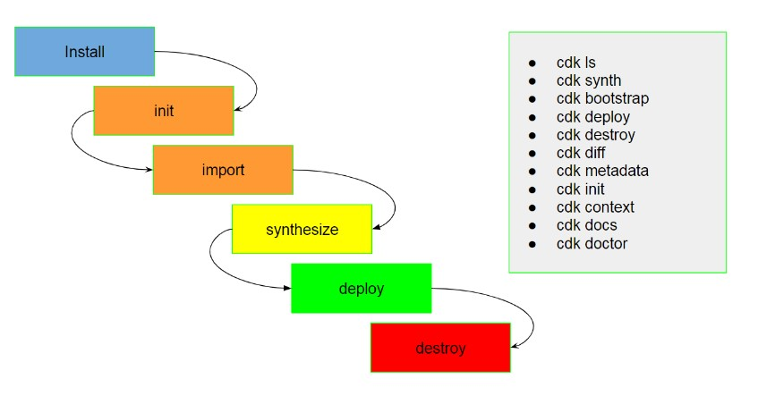
AWS CDK – Lifecycle

Slide 17
DEMO

