Slide 1

AWS skilling & Certification

Slide 2
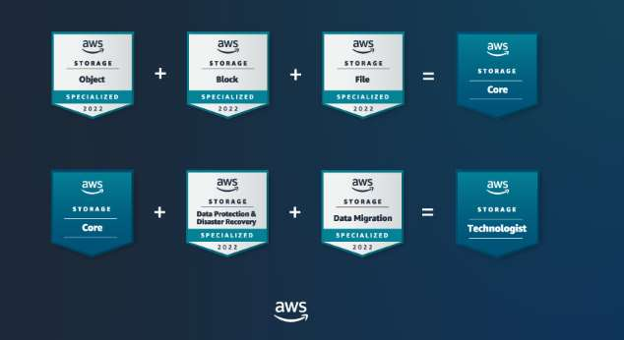
SkillBuilder for Advanced Learners
Explore the tool here
• Earn New Badges for your social profiles
• Access Builder’s Labs with Subscription
• Official Exam Prep material for certifications
• Access AWS Jams – for gamified learning
• Access Industry Quests for deeper knowledge

Slide 3
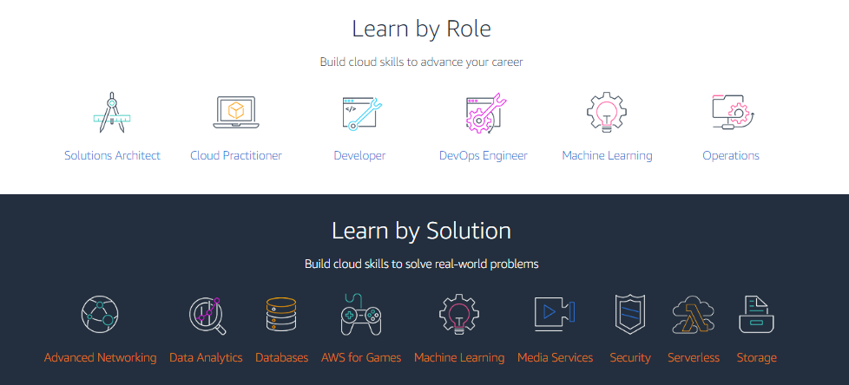
Learn by Role or Solution
Explore it here

Slide 4
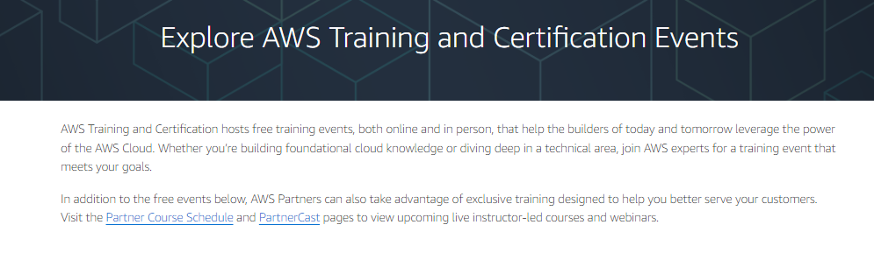
Training & Certification Events
Explore it here

Slide 5

Learn with AWS Community
Explore reskill here

Slide 6
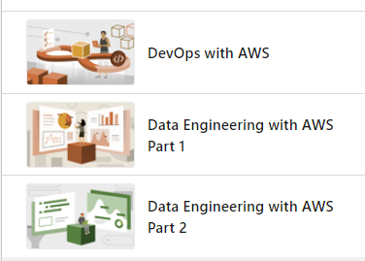
Learn with Dipali…
Devops
Data Engineering Part1
Data Engineering Part2

Slide 7
KEEP LEARNING & GROWING.....

