Slide 1
Containerize with AWS

Slide 2

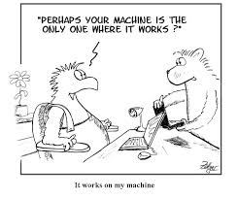
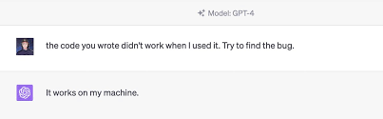
Why Containers?

Slide 3
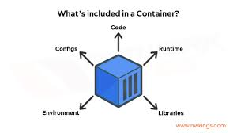
What is Container
A container is an abstraction at the application layer that packages code and dependencies together. Instead of virtualizing the entire physical machine, containers virtualize the host operating system only.

Slide 4
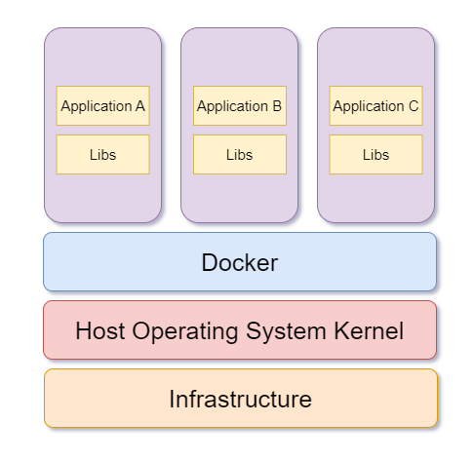
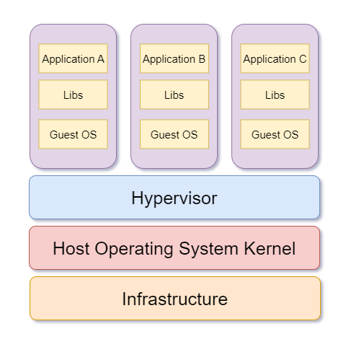
How Docker works?
Containers
Virtual Machines

Slide 5
Benefits of Containerization
Portability
Efficiency
Agility
Faster delivery
Improved security
Faster app startup
Flexibility
Easier management

Slide 6
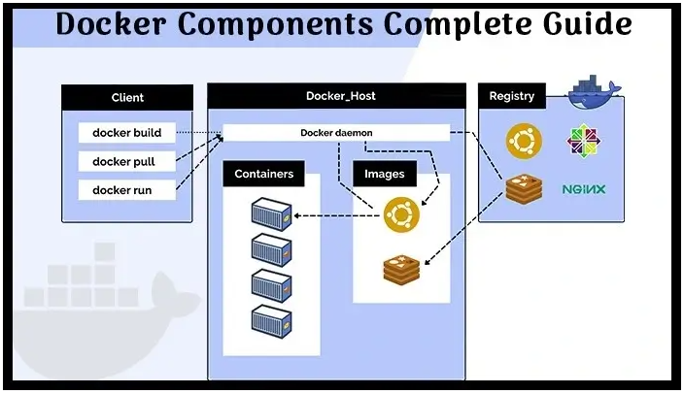
Docker Architecture

Slide 7
Docker Components
Docker Client: The first component of Docker is the client, which allows the users to communicate with Docker. Being a client-server architecture, Docker can connect to the host remotely and locally.
Docker Image: Docker images are used to build containers and hold the entire metadata that elaborates the capabilities of the container. These images are read-only binary templates in YAML and created based on Dockerfile instructions.

Slide 8
Docker Components contd..
Docker Daemon: Docker Daemon is among the most essential components of Docker as it is directly responsible for fulfilling the actions related to containers.
Docker Registry: Docker images require a location where they can be stored and the Docker registry is that location. Docker Hub is the default storage location of images that stores the public registry.

Slide 9
Docker Components contd..
Docker Container: A Docker container is the instance of an image that can be created, started, moved, or deleted through a Docker API.
Docker Compose: Sometimes you want to run multiple containers but as a single service. This task can be accomplished with the help of Docker compose as it is specifically designed for this goal.

Slide 10
Docker Hub - Overview
https://hub.docker.com/
Example: blackicebird/2048
Docker Playground
Docker ps –a
Docker pull blackicebird/2048
Docker images
Docker run –p 80:80 blackicebird/2048
open port 80
https://labs.play-with-docker.com/

Slide 11
Docker Images
Docker images are a lightweight, standalone, executable package of software that includes everything needed to run an application: code, runtime, system tools, system libraries and settings.
Description | Command
Build an Image from a Dockerfile | docker build -t <img_name> .
List local images | docker images
Delete an Image | docker rmi <img_name>
Remove all unused images | docker image prune
Run image in Container | Docker run –p localport:containerport <img_name>
Dockerfile
FROM node:alpine
WORKDIR /app
COPY ./package.json /app
RUN npm install
COPY . /app
CMD ["npm","start"]
FROM directive is to tell Docker that which base image is to take from Docker Hub
WORKDIR sets the working directory
COPY adds files from your Docker client's current directory
RUN directive is calling npm install
CMD command is to execute the actual application script

Slide 12
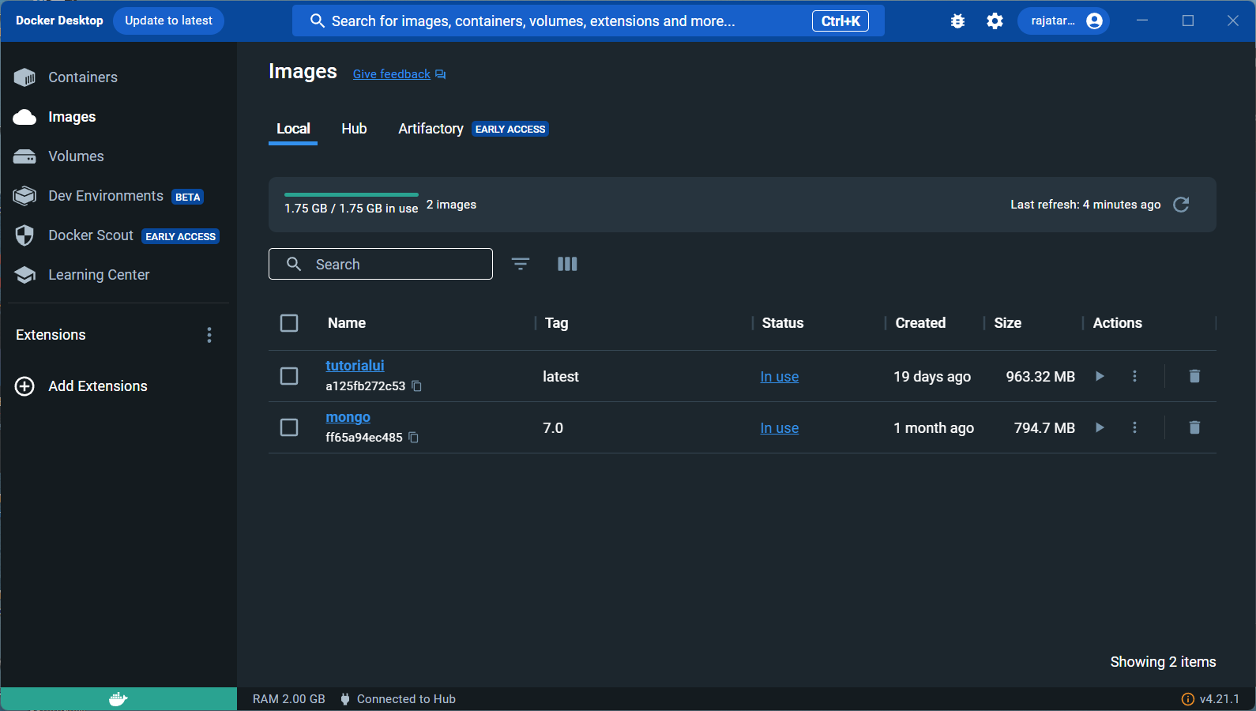
Docker Desktop images

Slide 13
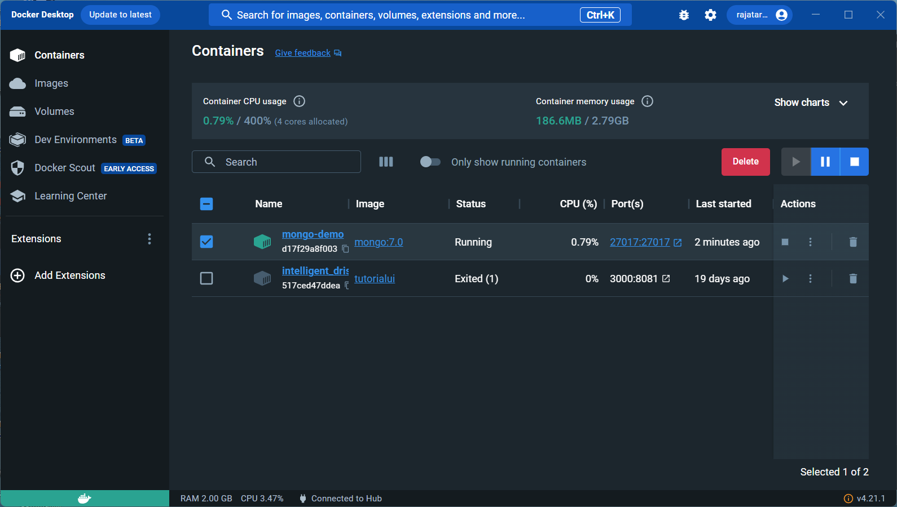
Docker Desktop Containers

Slide 14
Docker setup - installation
Create EC2 machine (Linux t2.small)
Update packages | sudo yum update -y
Install Docker | sudo yum install docker -y
Start Docker deamon | sudo systemctl start docker
Run Hello world container to verify docker installation | sudo docker run hello-world
Enable docker as service | sudo systemctl enable docker
Add Current user to Docker Group | sudo usermod -a -G docker $(whoami)
Switch group | newgrp docker

Slide 15
Running a single container app
Create EC2(linux) atleast t2.small
Putty to Linux server and download myapp.zip from S3 location | wget https://s3.us-west-1.amazonaws.com/awsomedomain.tk/myapp.zip
Unzip files | unzip myapp.zip
Cd to /myapp/frontend
Build docker image | docker build -f Dockerfile.dev -t tutorialreactapp .
Run container image | docker run -it -d -p 3000:8081 tutorialreactapp
Open port 3000 in Security Group

Slide 16
Run Multi-Container app with Docker Compose
Sometimes you want to run multiple containers but as a single service. This task can be accomplished with the help of Docker compose as it is specifically designed for this goal.
sudo curl -L https://github.com/docker/compose/releases/latest/download/docker-compose-$(uname -s)-$(uname -m) -o /usr/local/bin/docker-compose
sudo chmod +x /usr/local/bin/docker-compose
docker-compose version
Edit myapp/frontend/src/services
Cd to /myapp
sudo docker-compose up -d [in myapp folder]
Open port 3000 & 5000 in Security group

