Slide 1
Programming
Week 2

Slide 2
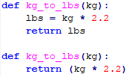
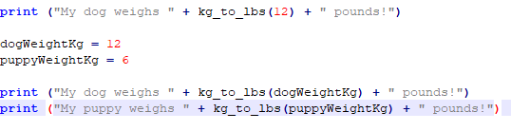
Week 1 review
Functions
When should we create functions?
How do we call our functions?
Parameter names and type

Slide 3
Week 1 review
Conditions
Equals x == y
Not equals x != y
Less than x < y
Less than or equls to x <= y
Greater than x > y
Greater than or equals to x >= y

Slide 4
Objectives for week 2
Review of week 1
Week 1 project demos
Sequences
Arrays / Lists
Tuples
Collections
Sets
Dictionaries
Loops

Slide 5
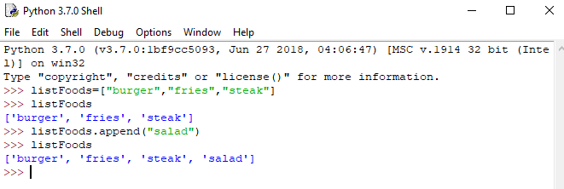
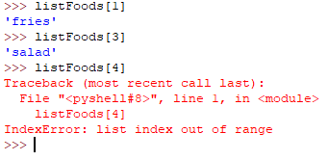
Arrays/Lists/Sequences
Why should we use Arrays?
Arrays are called Lists in Python
This is a sequence/list of a data type
Tuples are lists that are immutable
We declare lists with [ ]
We declare tuples with ( )
Each element of an array are called an index
Indexes always start with 0!

Slide 6
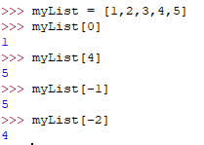

List Indexes
Accessing list items with an index
0 … (n-1)th item
In Python, you can use negative numbers for indexes
Index of -1 refers to the last item
Index of -2 is the second to last item

Slide 7
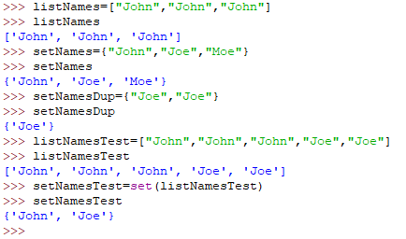

Sets
Sets are a collection of unique items
Sets are declared with { }
Converting from a list to a set
Automatically removes duplicates!

Slide 8
List Functions
append(element) – Add an item to the end of the list
insert(index, element) – Insert an item at the given index
remove(element) – Removes an item from list. Just the first occurrence
clear() – Removes all items from the list
count(element) – Returns the count of the number of items per parameter
len(listName) – This is not a list function, but you will use it all the time. This will return the size of the list.

Slide 9
Other List functions
extend(anotherList) – Adds all items of a list to another list
pop(index) – removes and returns an element at the given index
index(element) – returns the index of the first matched item
sort() – sorts the items in a list in ascending order
reverse() – reverses the order of the items in the list
copy() – returns a shallow copy of the list()

Slide 10
loops
What are loops?
Why do we use loops?
Types of loops in Python
while
for
recursive
Will be covered in the future

Slide 11

While loops
While a condition is true, the loop will run an iteration
The variable that controls the loop condition is called a loop control variable (lcv)

Slide 12
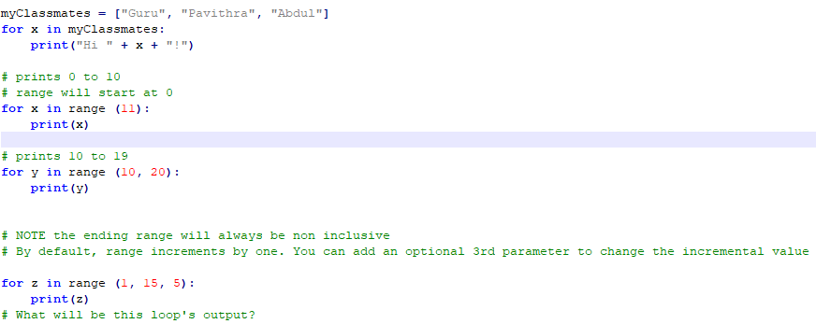
For loop
A loop to iterate over a sequence or range
Can be used for all sequence data types and strings in Python

Slide 13
The break and continue
Mostly not regarded as best practice, similar to goto statements
If they are used at the start of a block, as first checks made, they can act as precautions
Otherwise, if they are embedded in the middle of blocks of code, they could unintentionally break/trap your code, which is bad
All loops can be rewritten to avoid using break and continue statements
break
stops the loop even if the while condition is true
continue
stop the current iteration and continue with the next

Slide 14
Week 2 lab exercise 1
Enhance the first lab
Prompt the user for the number of people to enter
Run the program x number of times based on the previous response
Use the appropriate data type to incorporate these changes
Add error checking for user responses

Slide 15
Week 2 lab exercise 2
FizzBuzz!
Write a program that will prompt the user for two numbers (range)
The second number has to be greater than the first number
Iterate through the range of numbers and print them out as you iterate through
If the number is divisible by 3, print “Fizz” after the number
If the number is divisible by 5, print “Buzz” after the number
If the number is divisible by both 3 and 5, print “FizzBuzz” after the number
Hint: check out the mod function!

Slide 16
Bonus lab – class registration
Class Registration Project
Your program will register students by ID to a class. The class has a maximum size of 30, and a wait list of 30. When you add students to the class, they will automatically be added to class if it is not full. If the class is full, add the student id to the waitlist.
You can remove students from the class or the wait list. Upon exiting the program, the program will print out the list of students in the class and the wait list.
First, plan out how you'd implement this in pseudocode and determine what functions you will need

Slide 17
Bonus lab - continued
Your program will print out the following menu
Students currently registered for class : xx <max of 30>
Students currently on the waitlist: xx <max of 30>
Please enter one of the following options
1. Add a student to the class
2. Remove a student from the class
3. Remove a student from the waitlist
4. Exit program
Enter option: <user enters 1, 2, 3, or 4>

Slide 18
Bonus lab - continued
<If the user enters 1, 2, or 3>
Please enter the student ID: <user enters student ID, and goes back to the main menu>
<If the user selected 1 and the student ID already exists in class or the wait list, print error, and go back to the main menu>
<If the user selected 1 and the class is currently full, they will be added to the waitlist>
<If the user selected 2 and the student ID does not exist, print error, and go back to the main menu>
<If the user selected 3 and the student ID does not exist, print error, and go back to the main menu>
<If the user selected 4, the print the list of students in class and the waitlist and exit the program>

