Slide 1
EBS- Elastic Block Store

Slide 2
Agenda
Agenda
1
2
Introduction to EBS
1
EBS Volume Types
1
3
4
1
Performance Characteristics - IOPS & Throughput
1
Pricing and Service Quota
5
6
1
1
EBS Snapshots
Hands-on EBS Volumes, Mounting, Snaphots, Replication

Slide 3
Introduction to EBS

Slide 4
Elastic Block Store
What is EBS?
Amazon Elastic Block Store (Amazon EBS) provides block level storage volumes for use with EC2 instances.
Raw, unformatted block devices.
You can mount these volumes as devices on your instances.
EBS volumes that are attached to an instance persist independently from the life of the instance.
You can create a file system on top of these volumes.

Slide 5
Elastic Block Store
Amazon EBS volumes
An Amazon EBS volume is a durable, block-level storage device that you can attach to your instances.
After you attach a volume to an instance, you can use it as you would use a physical hard drive.
EBS volumes are flexible.
You can dynamically increase size, modify the provisioned IOPS capacity.
You can change volume type on live production volumes.

Slide 6
Elastic Block Store
Amazon EBS volumes
EBS volumes can be used as primary storage for data that requires frequent updates, such as the system drive for an instance or storage for a database application.
You can also use them for throughput-intensive applications that perform continuous disk scans.
You can attach multiple EBS volumes to a single instance. The volume and instance must be in the same Availability Zone.
Depending on the volume and instance types, you can use Multi-Attach to mount a volume to multiple instances at the same time.

Slide 7
Elastic Block Store
EBS - Volume Types
Amazon EBS provides the following volume types:
SSD Volumes -
General Purpose SSD (gp2 and gp3),
Provisioned IOPS SSD (io1 and io2),
HDD Volumes -
Throughput Optimized HDD (st1),
Cold HDD (sc1)
Previous Generation Volumes -
Magnetic (standard).
They differ in performance characteristics and price, allowing you to tailor your storage performance and cost to the needs of your applications.

Slide 8
Elastic Block Store
EBS - Volume Types
Amazon EBS provides the following volume types:
SSD Volumes -
General Purpose SSD (gp2 and gp3),
Provisioned IOPS SSD (io1 and io2),
HDD Volumes -
Throughput Optimized HDD (st1),
Cold HDD (sc1)
Previous Generation Volumes -
Magnetic (standard).
They differ in performance characteristics and price, allowing you to tailor your storage performance and cost to the needs of your applications.

Slide 9
Elastic Block Store
SSD Volumes
SSD-backed volumes are optimized for frequent read/write operations with small I/O size, where the dominant performance attribute is IOPS.
SSD-backed volume types include:
General Purpose SSD and
Provisioned IOPS SSD

Slide 10
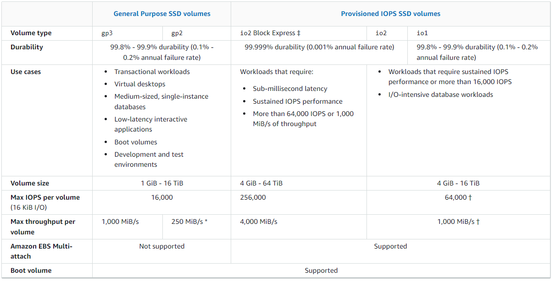
Elastic Block Store

Slide 11
Elastic Block Store
HDD Volumes
SSD-backed volumes are optimized for frequent read/write operations with small I/O size, where the dominant performance attribute is IOPS.
SSD-backed volume types include:
General Purpose SSD and
Provisioned IOPS SSD

Slide 12
Elastic Block Store
SSD Volumes
SSD-backed volumes are optimized for frequent read/write operations with small I/O size, where the dominant performance attribute is IOPS.
SSD-backed volume types include:
General Purpose SSD and
Provisioned IOPS SSD

Slide 13
Elastic Block Store
SSD Volumes
HDD-backed volumes are optimized for large streaming workloads where the dominant performance attribute is throughput.
HDD volume types include:
Throughput Optimized HDD and
Cold HDD

Slide 14
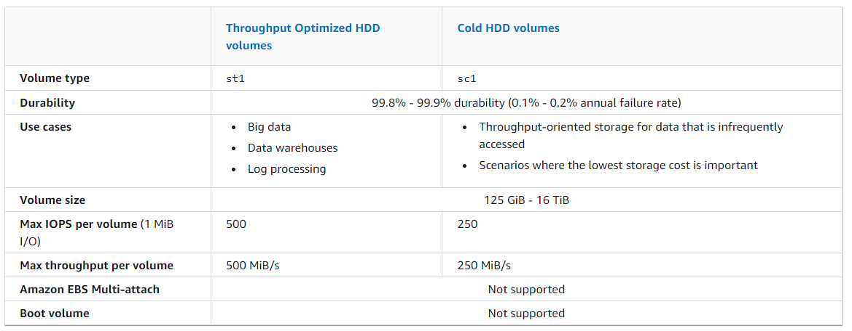
Elastic Block Store

Slide 15

Elastic Block Store
Previous Generation Volumes
Magnetic (standard) volumes are previous generation volumes that are backed by magentic drives.
Suited for small datasets where data is accessed infrequently and performance is not of primary importance.

Slide 16
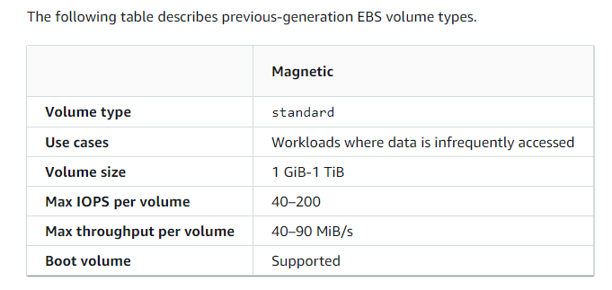
Elastic Block Store

Slide 17
Elastic Block Store
IOPS & Throughput
Throughput and IOPS (Input/Output Operations Per Second) are two different performance metrics used in storage systems.

Slide 18
Elastic Block Store
Throughput
Throughput refers to the amount of data that can be transferred between two points in a given time frame.
It is usually measured in terms of bytes per second (B/s), megabytes per second (MB/s), or gigabytes per second (GB/s).
Throughput is an important metric for applications that require high data transfer rates, such as video streaming, large file transfers, and database applications.

Slide 19
Elastic Block Store
IOPS
IOPS is a measure of the number of input/output operations that can be performed by a storage system in a second.
IOPS is used to measure the random access performance of a storage system, such as hard disk drives (HDDs) or solid-state drives (SSDs).
It is particularly important for applications that require a high level of random access, such as databases or virtualization.

Slide 20
Elastic Block Store
Understanding the difference between Throughput & IOPS
Throughput measures the amount of data that can be transferred in a given time frame, IOPS measures the rate at which input/output operations can be performed.
In other words, IOPS measures the speed at which data can be read or written to storage, while throughput measures the amount of data that can be transferred in that same time frame.

Slide 21
Elastic Block Store
EBS Pricing & Service Quota
With Amazon Elastic Block Store (EBS), you pay only for what you provision.
Volume storage for all EBS volume types is charged by the amount of GB you provision per month until you release the storage.
Costs increase for EBS volumes that support additional input/output operations per second (IOPS) and throughput beyond baseline performance.
IOPS is used to measure the random access performance of a storage system, such as hard disk drives (HDDs) or solid-state drives (SSDs).

Slide 22
Elastic Block Store
EBS Pricing & Service Quota
Free Tier:
AWS Free Tier includes 30 GB of storage, 2 million I/Os, and 1 GB of snapshot storage with Amazon Elastic Block Store (EBS).
You can view Free Tier details here:
https://aws.amazon.com/free/

Slide 23
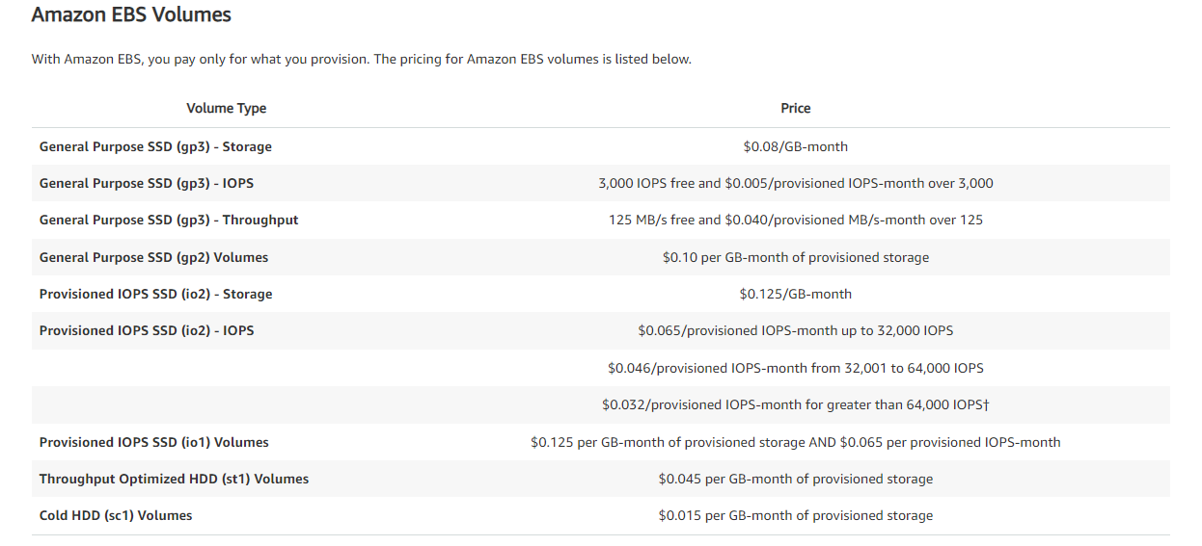
Elastic Block Store

Slide 24
Elastic Block Store
EBS Snapshots
Amazon EBS Snapshots are point-in-time copies of your block data.
EBS Snapshots in the Standard tier are stored incrementally, which means you are billed only for the changed blocks stored.
EBS Snapshots in the Archive tier are full copies of your block data, which means you are billed for all the blocks stored and not just the changed blocks.
Snapshots in the Archive tier have a minimum retention period of 90 days.
Archived snapshots that are deleted or permanently restored to the Standard tier before 90 days will incur a pro-rated charge equal to the storage charge for the remaining days.
Additional charges apply for retrievals from the Archive tier.

Slide 25
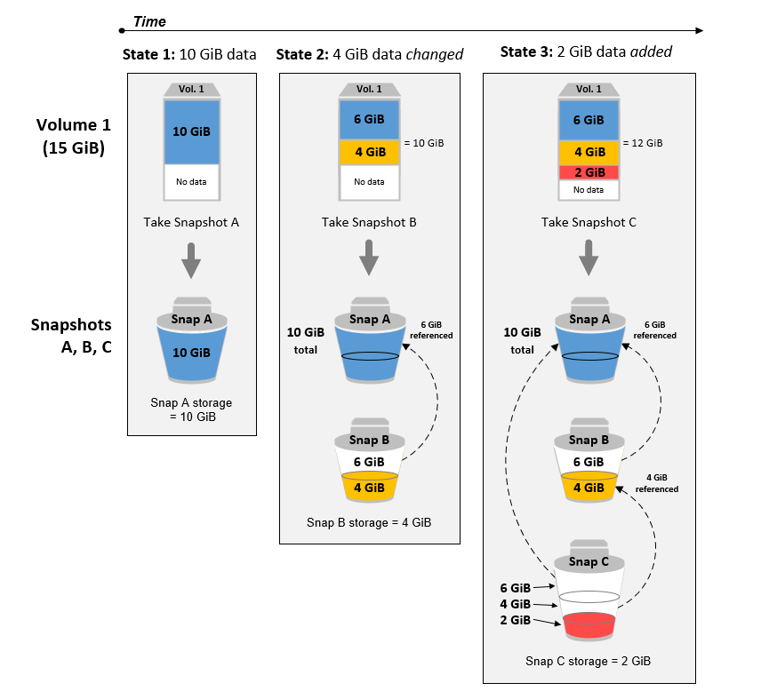
Elastic Block Store
How Snapshot works?

