Slide 1
Polymorphism
Adopted from the Notes provided by the textbook authors

Slide 2
Polymorphism
The term polymorphism literally means "having many forms"
A polymorphic reference is a variable that can refer to different types of objects at different points in time
The method invoked through a polymorphic reference can change from one invocation to the next
All object references in Java are potentially polymorphic
2nd semester, 2016-2017
ELEC2543
polymorphism-<number>

Slide 3
References and Inheritance (1)
An object reference can refer to an object of its class, or to an object of a class related to it by inheritance (subject to some rules)
For example, if the Parent class is used to derive a class called Child, then a Parent reference could be used to point to a Child object
Parent
Parent p;
p = new Child();
Child
2nd semester, 2016-2017
ELEC2543
polymorphism-<number>

Slide 4
References and Inheritance (2)
Assigning a child object to a parent reference is considered to be a widening conversion, and can be performed by simple assignment
Assigning a parent object to a child reference can be done also, but it is considered a narrowing conversion and must be done with a cast (may generate runtime error if not used carefully)
public class Parent {
}
public class Child extends Parent {
}
public class TestParentChild {
public static void main (String[] args) {
Parent parentRef;
Child childRef;
parentRef = new Child(); // fine
childRef = new Parent(); // compilation error
childRef = (Child) new Parent(); // run time error
}
}
2nd semester, 2016-2017
ELEC2543
polymorphism-<number>

Slide 5
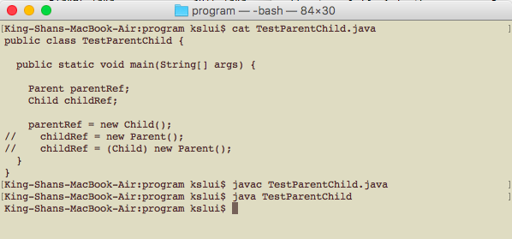
parentRef = new Child(); can be compiled and executed.
javac – compile a program
java – execute a program
2nd semester, 2016-2017
ELEC2543
polymorphism-<number>

Slide 6
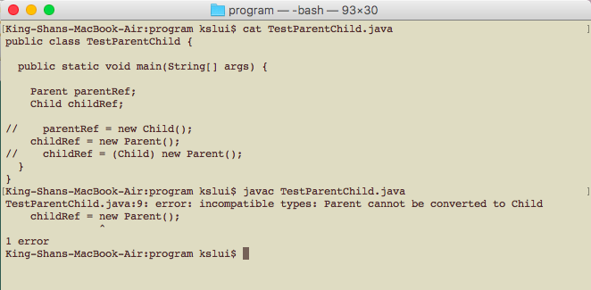
childRef = new Parent(); cannot be compiled.
2nd semester, 2016-2017
ELEC2543
polymorphism-<number>

Slide 7
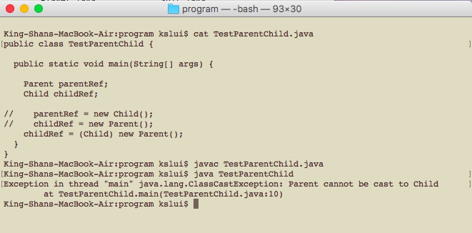
childRef = (Child) new Parent(); can be compiled but not executed.
2nd semester, 2016-2017
ELEC2543
polymorphism-<number>

Slide 8
Polymorphism via Inheritance
It is the type of the object being referenced, not the reference type, that determines which method is invoked
StaffMember
Volunteer
Employee
pay = 0
pay = basic salary
Executive
Clerk
pay = basic salary + bonus
pay = basic salary + rate per hour * number of overtime hours
2nd semester, 2016-2017
ELEC2543
polymorphism-<number>

Slide 9
Parent and Child classes
public class Volunteer extends StaffMember
{
public Volunteer (String eName) {
super (eName);
}
public double pay() {
return 0.0;
}
}
public class Employee extends StaffMember
{
protected double basicSalary;
public Employee (String eName, double salary)
{
super (eName);
basicSalary = salary;
}
public String toString()
{
return super.toString();
}
public double pay()
{
return basicSalary;
}
}
public abstract class StaffMember
{
protected String name;
public StaffMember (String eName)
{
name = eName;
}
public String toString()
{
return "Name: " + name + "\n";
}
//-----------------------------------------------------------------
// Derived classes must define the pay method for each type of
// employee.
//-----------------------------------------------------------------
public abstract double pay();
}
2nd semester, 2016-2017
ELEC2543
polymorphism-<number>

Slide 10
Child Classes
public class Clerk extends Employee
{
private int hoursWorked;
private double rate;
public Clerk (String eName, double basicSalary, double rate) {
super (eName, basicSalary);
this.rate = rate;
hoursWorked = 0;
}
public void addHours (int moreHours) {
hoursWorked += moreHours;
}
public double pay() {
double payment = rate * hoursWorked;
hoursWorked = 0;
return super.pay() + payment;
}
public String toString() {
String result = super.toString();
result += "\nCurrent hours: " + hoursWorked;
return result;
}
}
public class Executive extends Employee
{
private double bonus;
public Executive (String eName, double basicSalary)
{
super (eName, basicSalary);
bonus = 0; // bonus has yet to be awarded
}
public void awardBonus (double execBonus) {
bonus = execBonus;
}
public double pay()
{
double payment = super.pay() + bonus;
bonus = 0;
return payment;
}
}
2nd semester, 2016-2017
ELEC2543
polymorphism-<number>

Slide 11
public class Firm {
public static void main(String[] args) {
StaffMember[] staffList = new StaffMember[4];
staffList[0] = new Executive ("Sam", 2423.07);
staffList[1] = new Clerk ("Diane", 1246.15, 10.55);
staffList[2] = new Volunteer ("Norm");
staffList[3] = new Volunteer ("Cliff");
((Executive)staffList[0]).awardBonus (500.00);
((Clerk)staffList[1]).addHours (40);
double amount;
for (int count=0; count < staffList.length; count++)
{
System.out.println (staffList[count]);
amount = staffList[count].pay(); // polymorphic
System.out.println ("Paid: " + amount);
System.out.println ("-----------------------------------");
}
}
OUTPUT:
Name: Sam
Paid: 2923.07
-----------------------------------
Name: Diane
Current hours: 40
Paid: 1668.15
-----------------------------------
Name: Norm
Paid: 0.0
-----------------------------------
Name: Cliff
Paid: 0.0
-----------------------------------
Note that you need to typecast the ancestor reference to invoke a method in a child class
2nd semester, 2016-2017
ELEC2543
polymorphism-<number>

Slide 12
Polymorphism via Interfaces
Interface name can be used to declare an object reference variable
public interface Hello {
public String sayHello();
}
public class Chinese2 implements Hello {
public String sayHello() {
return "Ni Hao";
}
public String sayBye() {
return "Zai Jian";
}
}
public class TestSayHello2 {
public static void main (String[] args) {
Hello person;
person = new English();
System.out.println(person.sayHello());
person = new Chinese2();
System.out.println(person.sayHello());
System.out.println(
((Chinese2)person).sayBye());
}
}
2nd semester, 2016-2017
ELEC2543
polymorphism-<number>

