Slide 1
Exceptions
Adopted from the Notes provided by the textbook authors

Slide 2
Exceptions
An exception is an object that describes an unusual or erroneous situation at run time
  Divided by zero
  Array index out of bound
  Follow a null reference
  File cannot be opened
Options to deal with exceptions
  Not handle it at all
  Handle the exception when it occurs
  Handle the exception at another point in the program
2nd semester, 2016-2017
ELEC2543
Exception -<number>

Slide 3
Uncaught Exceptions
If an exception is ignored by the program, the program will terminate abnormally and produce an appropriate message
The message includes a call stack trace that:
  indicates the line on which the exception occurred
  shows the method call trail that leads to the attempted execution of the offending line
public class Zero
{
public static void main (String[] args)
{
int numerator = 10;
int denominator = 0;
System.out.println (numerator / denominator);
System.out.println ("This text will not be printed.");
}
}
Output:
Exception in thread "main" java.lang.ArithmeticException: / by zero
at Zero.main(Zero.java:17)
2nd semester, 2016-2017
ELEC2543
Exception -<number>

Slide 4
The try Statement
To handle an exception in a program, the line that generates the exception is executed within a try block
A try block is followed by one or more catch clauses
Each catch clause has an associated exception type and is called an exception handler
When an exception occurs, processing continues at the first catch clause that matches the exception type
2nd semester, 2016-2017
ELEC2543
Exception -<number>

Slide 5
Zero2.java
public class Zero2
{
public static void main (String[] args)
{
int numerator = 10;
int denominator = 0;
try {
System.out.println (numerator / denominator);
} catch (ArithmeticException e) {
System.out.println("denominator is zero");
}
System.out.println ("This text WILL BE printed :-)");
}
}
Output:
denominator is zero
This text WILL BE printed :-)
2nd semester, 2016-2017
ELEC2543
Exception -<number>

Slide 6
The finally Clause
A try statement can have an optional clause following the catch clauses, designated by the reserved word finally
The statements in the finally clause are always executed
If no exception is generated, the statements in the finally clause are executed after the statements in the try block complete
If an exception is generated, the statements in the finally clause are executed after the statements in the appropriate catch clause complete
See DemoCatch.java
2nd semester, 2016-2017
ELEC2543
Exception -<number>

Slide 7
public class DemoCatch
{
public static void main (String[] args)
{
Scanner scan;
try {
scan = new Scanner(new File("test.txt"));
scan.nextInt();
} catch (FileNotFoundException e) {
System.out.println("test.txt does not exist.");
} catch (InputMismatchException e) {
System.out.println("IO exception");
}
finally {
System.out.println("finally");
}
System.out.println ("This text WILL BE printed :-)");
}
}
test.txt does not exist
test.txt does not exist.
finally
This text WILL BE printed :-)
test.txt exists but contains ‘a’
IO exception
finally
This text WILL BE printed :-)
test.txt exists and contains ‘1’
finally
This text WILL BE printed :-)
2nd semester, 2016-2017
ELEC2543
Exception-<number>

Slide 8
Exception Propagation
When an exception is not handled when it occurs, the control is returned back to the method that called the method
This behavior is called exception propagation
Exceptions propagate up through the method calling hierarchy until they are caught and handled or until they reach the level of the main method
2nd semester, 2016-2017
ELEC2543
Exception -<number>

Slide 9
Propagation.java
public class ExceptionScope
{
public void level1()
{
System.out.println("Level 1 beginning.");
try
{
level2();
}
catch (ArithmeticException problem)
{
System.out.println ();
System.out.println ("The exception message is: " + problem.getMessage());
System.out.println ();
System.out.println ("The call stack trace:");
problem.printStackTrace();
System.out.println ();
}
System.out.println("Level 1 ending.");
}
public void level2()
{
System.out.println("Level 2 beginning.");
level3 ();
System.out.println("Level 2 ending.");
}
public void level3 ()
{
int numerator = 10, denominator = 0;
System.out.println("Level 3 beginning.");
int result = numerator / denominator;
System.out.println("Level 3 ending.");
}
}
public class Propagation
{
static public void main (String[] args)
{
ExceptionScope demo = new ExceptionScope();
System.out.println("Program beginning.");
demo.level1();
System.out.println("Program ending.");
}
}
Output:
Program beginning.
Level 1 beginning.
Level 2 beginning.
Level 3 beginning.
The exception message is: / by zero
The call stack trace:
java.lang.ArithmeticException: / by zero
at ExceptionScope.level3(ExceptionScope.java:54)
at ExceptionScope.level2(ExceptionScope.java:41)
at ExceptionScope.level1(ExceptionScope.java:18)
at Propagation.main(Propagation.java:17)
Level 1 ending.
Program ending.
(Note that the interleaving between normal output and error output
may be different at different runs.)
2nd semester, 2016-2017
ELEC2543
Exception-<number>

Slide 10
The Exception Class Hierarchy
Throwable
Error
Exception
IOException
RuntimeException
Classes that define exceptions are related by inheritance, forming an exception class hierarchy
All error and exception classes are descendants of the Throwable class
IndexOutOfBoundsException
ArithmeticException
ArrayIndexOutOfBoundsException
2nd semester, 2016-2017
ELEC2543
Exception-<number>

Slide 11
Checked Exceptions
An exception is either checked or unchecked
A checked exception either must be caught by a method, or must be listed in the throws clause of any method that may throw or propagate it
  E.g. IOException is checked
A throws clause is appended to the method header
The compiler will issue an error if a checked exception is not caught or asserted in a throws clause
See DemoChecked.java
2nd semester, 2016-2017
ELEC2543
Exception-<number>

Slide 12
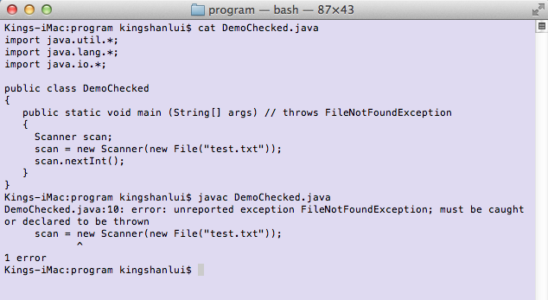
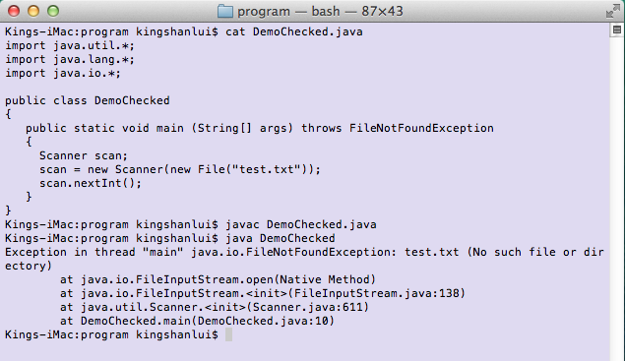
2nd semester, 2016-2017
ELEC2543
Chapter 11-<number>

Slide 13
Unchecked Exceptions
An unchecked exception does not require explicit handling, though it could be processed that way
The only unchecked exceptions in Java are objects of type RuntimeException or any of its descendants
ArithmeticException and ArrayIndexOutOfBoundsException need not be caught or thrown
2nd semester, 2016-2017
ELEC2543
Exception-<number>

Slide 14
Define An Exception
A programmer can define an exception by extending the Exception class or one of its descendants
public class OutOfRangeException extends Exception
{
OutOfRangeException (String message)
{
super (message);
}
}
Output
Enter an integer value between 25 and 40, inclusive: 45
Exception in thread "main" OutOfRangeException: Input value is out of range.
at CreatingExceptions.main(CreatingExceptions.java:20)
import java.util.Scanner;
public class CreatingExceptions
{
public static void main (String[] args) throws OutOfRangeException
{
final int MIN = 25, MAX = 40;
Scanner scan = new Scanner (System.in);
OutOfRangeException problem =
new OutOfRangeException ("Input value is out of range.");
System.out.print ("Enter an integer value between " + MIN +
" and " + MAX + ", inclusive: ");
int value = scan.nextInt();
// Determine if the exception should be thrown
if (value < MIN || value > MAX)
throw problem;
System.out.println ("End of main method."); // may never reach
}
}
2nd semester, 2016-2017
ELEC2543
Exception-<number>

Slide 15
import java.util.Scanner;
public class MakeSureInputCorrect {
final static int MIN = 25, MAX = 40;
public static int userInput() throws OutOfRangeException {
Scanner scan = new Scanner (System.in);
OutOfRangeException problem =
new OutOfRangeException ("Input value is out of range.");
System.out.print ("Enter an integer value between " + MIN + " and " + MAX + ", inclusive: ");
int value = scan.nextInt();
if (value < MIN || value > MAX)
throw problem;
else
return value;
}
public static void main (String[] args)
{
int value;
boolean done = false;
while (!done) {
try {
value = userInput();
done = true;
}
catch (OutOfRangeException e) {
System.out.println("The input was invalid");
}
}
System.out.println ("End of main method.");
}
}
MakeSureInputCorrect.java
2nd semester, 2016-2017
ELEC2543
Chapter 11-<number>

