Slide 1
An Application of Large Language Models and Generative Agents to Compare Quality and Quantity Learning Processes and Performance
Workshop 1 presentation for the project Advanced Web Technologies on the topic of Large Language Models for Education: Generative Agents
Mohammad Ferdous Safi | Jasmin Hübler | Siar-Remzi Akbayin
Notes:
Hello everyone, today we are presenting our project, ’An Application of Large Language Models and Generative Agents to compare quality and quantity of learning processes and performance' It is based on our overarching topic Large Language Models for Education: Generative Agents.

Slide 2
AGENDA
AGENDA
Problem statement
Use case
Expected outcome
Approach
Technology stack
Roadmap & next Steps
Notes:
First, I'll explain our problem statement that has placed our entire project in it’s context. We'll also explore it’s theoretical framework, needed definitions and the key questions at play. Following that, Jasmin will guide you through our detailed use case as well as the expected outcome of our project. Lastly, Siar will lead us through our approached implementation and technology stack. He will also present a roadmap with our next steps.

Slide 3
PROBLEM STATEMENT
The importance of quality vs. quantity in learning
Implications of quality & quantity for human learning
Central question: If we could only focus on one,
should quality or quantity be of more Importance?
PROBLEM STATEMENT > USE CASE > EXPECTED OUTCOME > APPROACH > TECHNOLOGY STACK > ROADMAP & NEXT STEPS
Notes:
Our Problem Statement consists of 3 Point:
The Importance of Quality vs. Quantity in Learning
Implications of Quality & Quantity for Human Learning
Central Question: If We Could Only Focus On One,
Should Quality or Quantity Be Of More Importance?

Slide 4



PROBLEM STATEMENT
Importance of Quality vs. Quantity in Learning
Quality approach
Quantity approach
PROBLEM STATEMENT > USE CASE > EXPECTED OUTCOME > APPROACH > TECHNOLOGY STACK > ROADMAP & NEXT STEPS
Notes:
Consider the scenario of a student preparing for an exam. Should they focus on deeply understanding, through time limited, a set of topics (quality) or cover a broader range but with less depth (quantity)? The quality approach involves thorough comprehension and critical thinking, aiming for a deep-seated understanding of some concepts. while, the quantity approach emphasizes covering more material, possibly leading to a wider but shallower knowledge base.

Slide 5





PROBLEM STATEMENT
Implications of Quality & Quantity for Human Learning - Concepts
Depth of processing
Elaboration
PROBLEM STATEMENT > USE CASE > EXPECTED OUTCOME > APPROACH > TECHNOLOGY STACK > ROADMAP & NEXT STEPS
Notes:
These definitions are based in the psychological studies of human learning, and give us the concepts of ‘depth of processing’, which means that the more the meaning of the material is processed, the better the memory, and the concept of ‘elaboration’, which means that the enrichment of new material through already known information improves memory.

Slide 6
PROBLEM STATEMENT
Implications of Quality & Quantity for Human Learning - Definition
Qualitative Learning
High depth of processing
High elaboration
Few repetitions
Quantitative Learning
Low depth of processing
Low elaboration
Many repetitions
PROBLEM STATEMENT > USE CASE > EXPECTED OUTCOME > APPROACH > TECHNOLOGY STACK > ROADMAP & NEXT STEPS
Notes:
On one hand qualitative learning has a high depth of processing and elaboration with few repetitions of already learned material while on the other hand, a quantitative learning process has a lower depth of processing and elaboration, but has more repetitions of the material to help memorize it.

Slide 7


PROBLEM STATEMENT
Implications of Quality & Quantity for Human Learning - Trade-off
High processing effort
More time
High memory performance
PROBLEM STATEMENT > USE CASE > EXPECTED OUTCOME > APPROACH > TECHNOLOGY STACK > ROADMAP & NEXT STEPS
Notes:
The trade-off in Psychology is produced by the fact that a better depth of processing and elaboration have a higher processing effort and require more time while making a higher memory performance possible.

Slide 8


PROBLEM STATEMENT
Central Question: If We Could Only Focus On One,
Should Quality or Quantity Be Of More Importance?
PROBLEM STATEMENT > USE CASE > EXPECTED OUTCOME > APPROACH > TECHNOLOGY STACK > ROADMAP & NEXT STEPS
Notes:
if we can only focus on one, should quality or quantity be of more importance - This central question supported by psychological definitions guides our project. Our aim is to explore and provide insights into which approach might be more beneficial or effective in a simulated learning scenario.
Having set the foundation of our problem statement, focusing on the significance of quality versus quantity in learning, I will now pass the presentation to Jasmine. She will delve into our project's use case, elaborating on the methodologies employed and the expected outcomes from each approach.

Slide 9

USE CASE
A
Quantity
Learning process A
Evaluation & Discussion
Learning process B
B
Exam
Quality
Notes:
Let us now explore the use case we developed to simulate an answer to the described problem statement.
We will simulate two spatially separate groups of two student-agents each, where one group engages in a qualitative, the other in a quantitative learning process. They should prepare for an exam and then be evaluated by their performance.
To ensure transferability, reconstructability and objectivity we opted for a standardized test and selected Section I Part A of the AP US History exam.

Slide 10
USE CASE
Exam: AP US History
Section I | Part A | 55 multiple-choice questions
 | Part B | three short-answer questions
Section II | Part A | Document-based
 | Part B | Essay
nine periods:
1491 - today
PROBLEM STATEMENT > USE CASE > EXPECTED OUTCOME > APPROACH > TECHNOLOGY STACK > ROADMAP & NEXT STEPS
Notes:
The AP US History exam is offered by the College Board as part of the Advanced Placement Program. Each year, over 400,000 students take the exam, so there is plenty of practice material available online.
It is divided into two sections with two parts each. Our selected Section I Part A comprises 55 multiple-choice questions and is responsible for 40% of the whole exam, while Part B has three questions that call for short answers. Section II Part A is a document-based examination and Part B is a lengthy essay. All questions span over nine periods, from 1491 to today.
The large multiple-choice part structured over the periods is likely to be the most effective for our use case, because it makes it easier to distinguish and design the two learning processes as well as evaluate their performance reliably.

Slide 11


USE CASE
A
Lists of practice questions
memorize, interrogate
Quantity
B
Information about the nine periods
analyse and summarize material, generate questions, identify knowledge gaps, work together
Quality
PROBLEM STATEMENT > USE CASE > EXPECTED OUTCOME > APPROACH > TECHNOLOGY STACK > ROADMAP & NEXT STEPS
Notes:
Our two-agent group which adheres to a quantitative learning process, now known as group A, will receive lists of practice questions and should memorize these questions and their answers. They should also help each other by asking questions that they have already learned to support their memory.
Our two-agent group which adheres to a qualitative learning process, now known as group B, should in general research, discuss and understand the nine periods. To achieve this, they will be expected to, among other things, summarize texts, attempt to answer practice questions themselves, generate new questions for each other and identify gaps in their knowledge as well as work actively together and teach each other the material.
So while group A will simply memorize existing material, group B should understand the material, underlying concepts and knowledge, including being able to generate new information and teach all of it.

Slide 12
USE CASE
Discuss: challenges, confidence, score
A
Quantity
Take Exams
A
Quantity
Take Exams
B
B
Quality
Quality
Evaluate performance
PROBLEM STATEMENT > USE CASE > EXPECTED OUTCOME > APPROACH > TECHNOLOGY STACK > ROADMAP & NEXT STEPS
Notes:
After some time, both groups will take a few identical unknown exams. After they finish, all four agents will be allowed to communicate with one another. The points they should discuss include what their challenges were in the preparation and exam, how confident they were in their answers and how much they struggled to choose an option. They should also provide a prediction regarding their score. The exams are then evaluated and should hopefully indicate a rift between the performance of both groups – thus giving a simulated answer to our question regarding the importance of quality or quantity.

Slide 13

EXPECTED OUTCOME
Performance
Confidence
Many repetitions
No additional context
Depth of processing
Elaboration
Deep understanding
A
Group B
(Quality)
Quantity
B
Group A
(Quantity)
Quality
PROBLEM STATEMENT > USE CASE > EXPECTED OUTCOME > APPROACH > TECHNOLOGY STACK > ROADMAP & NEXT STEPS
Notes:
We believe that group B will outperform group A just as the proverb “quality over quantity” suggests. They will have had a higher depth of processing and elaboration, as well as a deeper understanding of the material. They should therefore be able to answer the questions either directly through or be able to deduct it from their knowledge. Group A however, just has many repetitions of their memorized questions without any additional context.

Slide 14
EXPECTED OUTCOME
Performance
Confidence
Very familiar
Recognition
Less familiar
Missed information
B
Group A
(Quantity)
A
Quality
Group B
(Quality)
Quantity
PROBLEM STATEMENT > USE CASE > EXPECTED OUTCOME > APPROACH > TECHNOLOGY STACK > ROADMAP & NEXT STEPS
Notes:
However, we do expect group A to be more confident in their answers, progress and score because they will be familiar with the type and format of the questions they had to answer. If they could recognize identical or very similar questions or eliminate answers because they knew that those belong to other questions, they should be even more optimistic. Group B on the other hand is less familiar with the multiple-choice questions and may have missed important information for very specific questions.

Slide 15

EXPECTED OUTCOME
Performance
Confidence
B
A
Quality
Quantity
PROBLEM STATEMENT > USE CASE > EXPECTED OUTCOME > APPROACH > TECHNOLOGY STACK > ROADMAP & NEXT STEPS
Notes:
In the end, we anticipate that our simulated answer will indicate a greater importance of a qualitative learning process, but a higher sense of confidence if a quantitative learning process is used.

Slide 16
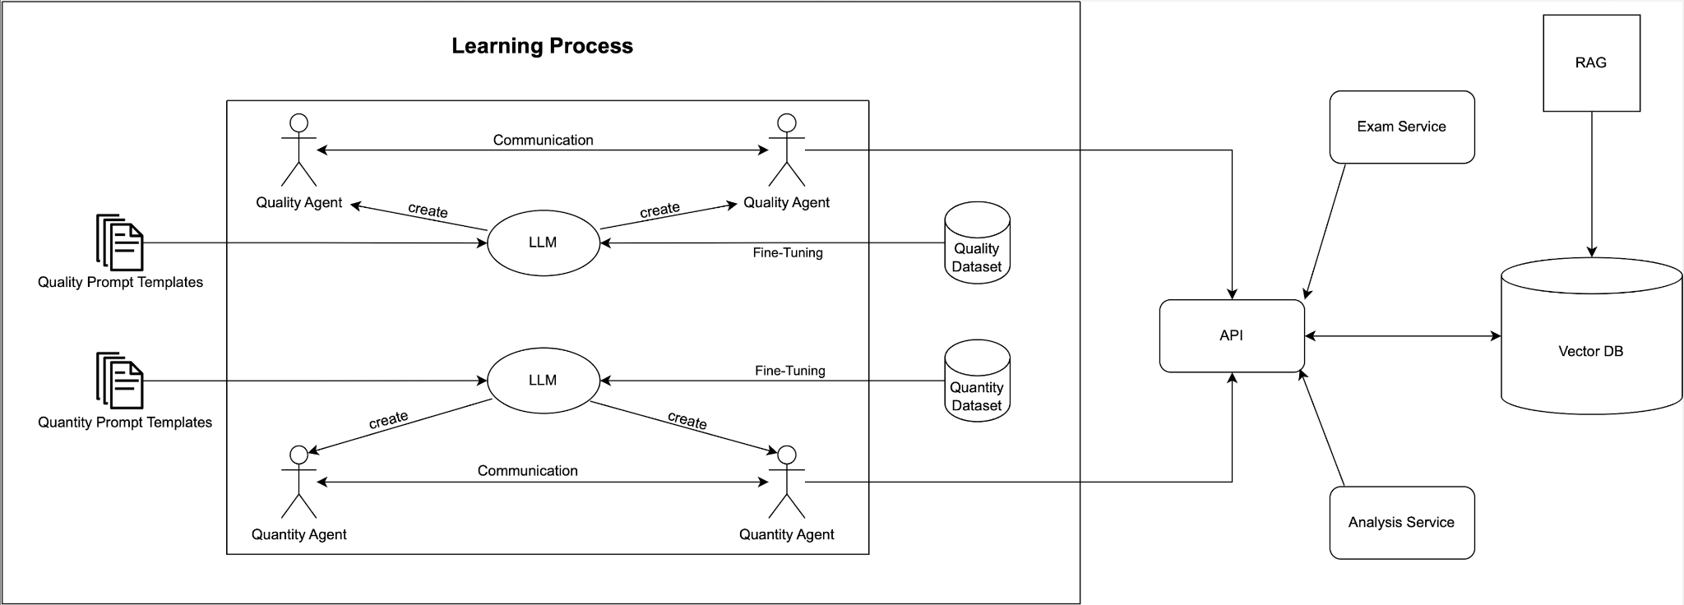
APPROACH
PROBLEM STATEMENT > USE CASE > EXPECTED OUTCOME > APPROACH > TECHNOLOGY STACK > ROADMAP & NEXT STEPS
Notes:
Our general approach is illustrated here. We will use an LLM to create the agents from both groups based on specialized prompt templates. One LLM will be fine-tuned with a qualitative dataset for the quality group which could contain historical books or articles, for instance. Additionally, we will fine-tune the quantitative group with a dataset mainly consisting of questions and answers from old exams. The answer from one agent will be the prompt for the other agent. After the learning process is done, all agents will take an exam which can be retrieved from an API. The API gets the data from our Vector database which was filled with a Retrieval Augmented Generation approach. We will also implement an exam service which supports operations on the API by the agents and also saves the results in the database through the API. Our analysis service helps to evaluate the performance of our agents. The discussion round after taking the exam is not illustrated but still planned.

Slide 17
TECHNOLOGY STACK
Prerequisites
Open source solutions
Model which is already fine-tuned for conversations
Model should be runnable locally
Database should be suitable for LLM use cases
Mature programming language and API
PROBLEM STATEMENT > USE CASE > EXPECTED OUTCOME > APPROACH > TECHNOLOGY STACK > ROADMAP & NEXT STEPS
Notes:
The prerequisites of our technology choice are that we only want to use open source solution and a model that is already fine-tuned for conversations. Furthermore, we want a solution which is runnable locally. Moreover, our database should of course be suitable for LLM use cases and finally, we only want to use mature programming languages and APIs.

Slide 18
TECHNOLOGY STACK
Model: Llama 2-Chat → fine-tuned for conversations [1]
Variation: 13b
Programming language: Python
API: REST
RAG: LlamaIndex
Database: Chroma
Local setup: llama.cpp
PROBLEM STATEMENT > USE CASE > EXPECTED OUTCOME > APPROACH > TECHNOLOGY STACK > ROADMAP & NEXT STEPS
Notes:
Taking into account the prerequisites, we decided on the following technologies. Our LLM is Llama 2-Chat since it is already fine-tuned for conversation scenarios. It provides three models: 7b, 13b and 70b. The 13b model is most suitable for our use case since the other two would disadvantage the other group. Our programming language of choice is Python since it is very mature and commonly used within the LLM area. Furthermore, we will use a RESTful API since our use case for it is very simple and, therefore, GraphQL, for instance, is not necessary. For the Retrieval Augmented Generation process, we will use LlamaIndex since it fits our stack well, is open source and popular. Our database will be Chroma, since it is pretty straightforward and compatible with LlamaIndex and in general, graph-based databases are most suitable for LLM. Since we have M2 MacBook users among us, we are relying on the llama.cpp project which helped us to run Llama 2 locally on MacOS with 4-bit integer quantization and also supports other platforms like Linux or Windows.

Slide 19
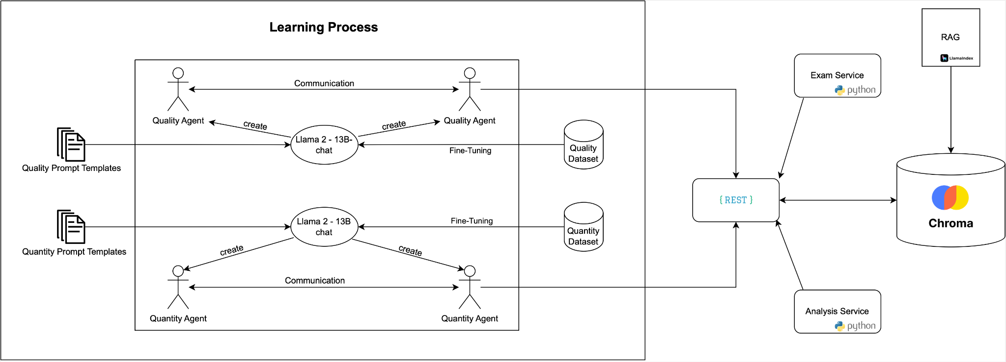
TECHNOLOGY STACK
PROBLEM STATEMENT > USE CASE > EXPECTED OUTCOME > APPROACH > TECHNOLOGY STACK > ROADMAP & NEXT STEPS
Notes:
This slide shows our approach with the described technologies.

Slide 20


ROADMAP
Final Submission: 29.02.2024
Research and skill acquisition
Minimum viable product
Working prototype
Workshop 1: 16.11.23
Workshop 2: 21.12.2023
Workshop 3: 15.02.2024
PROBLEM STATEMENT > USE CASE > EXPECTED OUTCOME > APPROACH > TECHNOLOGY STACK > ROADMAP & NEXT STEPS
Notes:
The roadmap illustrated here shows our milestones for the coming workshops. Since we are new to the field of LLMs, our first milestone objective is to acquire skills for implementation in this field and also gain more theoretical knowledge by reading important papers. The second milestone objective is to have a minimum viable product until the third workshop. And, finally, we want to submit a working prototype in the end.

Slide 21

ROADMAP - NEXT STEPS
Setup the Llama 2 - 13b Chat model locally with llama.cpp
Find and review related work
Try different configurations to get familiar with the model
Create different datasets for quality and quantity fine-tuning
Create prompt templates for the agents
Get AP US History exams, remove the parts which are not MC
Set up Chroma - LlamaIndex stack
Try first embedding process
PROBLEM STATEMENT > USE CASE > EXPECTED OUTCOME > APPROACH > TECHNOLOGY STACK > ROADMAP & NEXT STEPS
Notes:
We already set up the Llama 2 -13b Chat model locally with llama.cpp and ran our first experiments with example prompt templates of the llama.cpp project. Our next steps will be to find related work for our use case and approach. Afterwards, we need to try out different configurations and investigate features provided by llama.cpp, for instance. We will also need to download old exams and other learning sources and create datasets with them for the fine-tuning. The data format is not clear yet. We will also need to create prompt templates for different agents and we will need to try different templates to check which produces our intended outcome. Furthermore, we need to set up our Chroma-LlamaIndex stack and try first embedding processes.

Slide 22
References
[1] Hugo Touvron et al., Llama 2: Open Foundation and Fine-Tuned Chat Models.
https://doi.org/10.48550/arXiv.2307.09288

