Slide 1
An Application of Large Language Models and Generative Agents to Compare Quality and Quantity Learning Processes and Performance
Workshop 3 presentation for the project Advanced Web Technologies on the topic of Large Language Models for Education: Generative Agents
Mohammad Ferdous Safi | Jasmin Hübler | Siar-Remzi Akbayin
Notes:
Welcome to our third and final presentation of our Project „An Application of Large Language Models and Generative Agents to Compare Quality and Quantity Learning Processes and Performance“

Slide 2
AGENDA
AGENDA
Recap: Problem statement & Use Case
Implementation Details
Results & Evaluation
Roadmap & final steps
Notes:
First, I will present you with a brief recap and update on our problem statement and use case in order to establish the context of the presentation. Afterwards Siar will demonstrate our progress while providing details about our Implementation as well as our results and our evaluation process. In the end, Ehsan will conclude our presentation with our roadmap and the final steps we need to take.

Slide 3
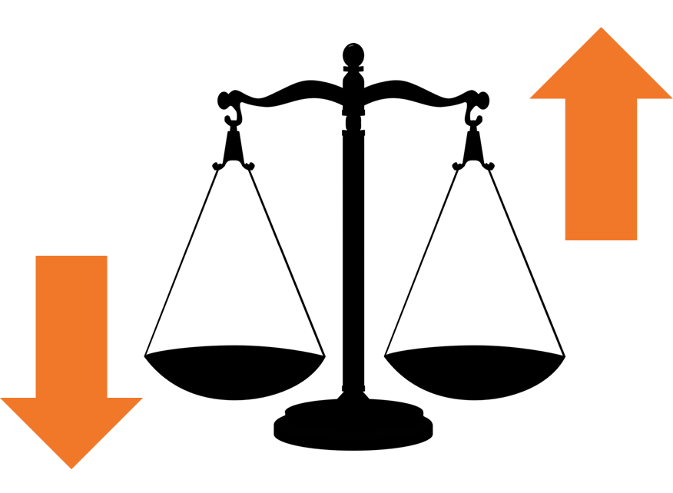
RECAP: PROBLEM STATEMENT
Quality or Quantity?
PROBLEM STATEMENT & USE CASE > IMPLEMENTATION DETAILS > RESULTS & EVALUATION > ROADMAP & FINAL STEPS
Notes:
Let us now look back at our problem statement. It was centered around whether quality or quantity should be more important, if we were forced to chose between them. In order to answer this hypothetical, we placed it in the context of a student studying for an exam.

Slide 4


RECAP: USE CASE
A
Quantity
Quantitative learning process
A
Evaluation
B
Exam
B
Qualitative learning process
Quality
Notes:
This led us to our use case where we have two groups of student-agents - one following a qualitative learning process and one following a quantitative one. Each process aims to prepare one student-agent for a multiple choice history exam.The discussion in the quantitative process focuses on pre-formulated multiple-choice questions, while the discussions in the qualitative process are based on history textbooks. After the exam, we evaluate their answers in order to draw a conclusion about our hypothesis. Siar will now demonstrate you what we have achieved so far and how we accomplished it.

Slide 5
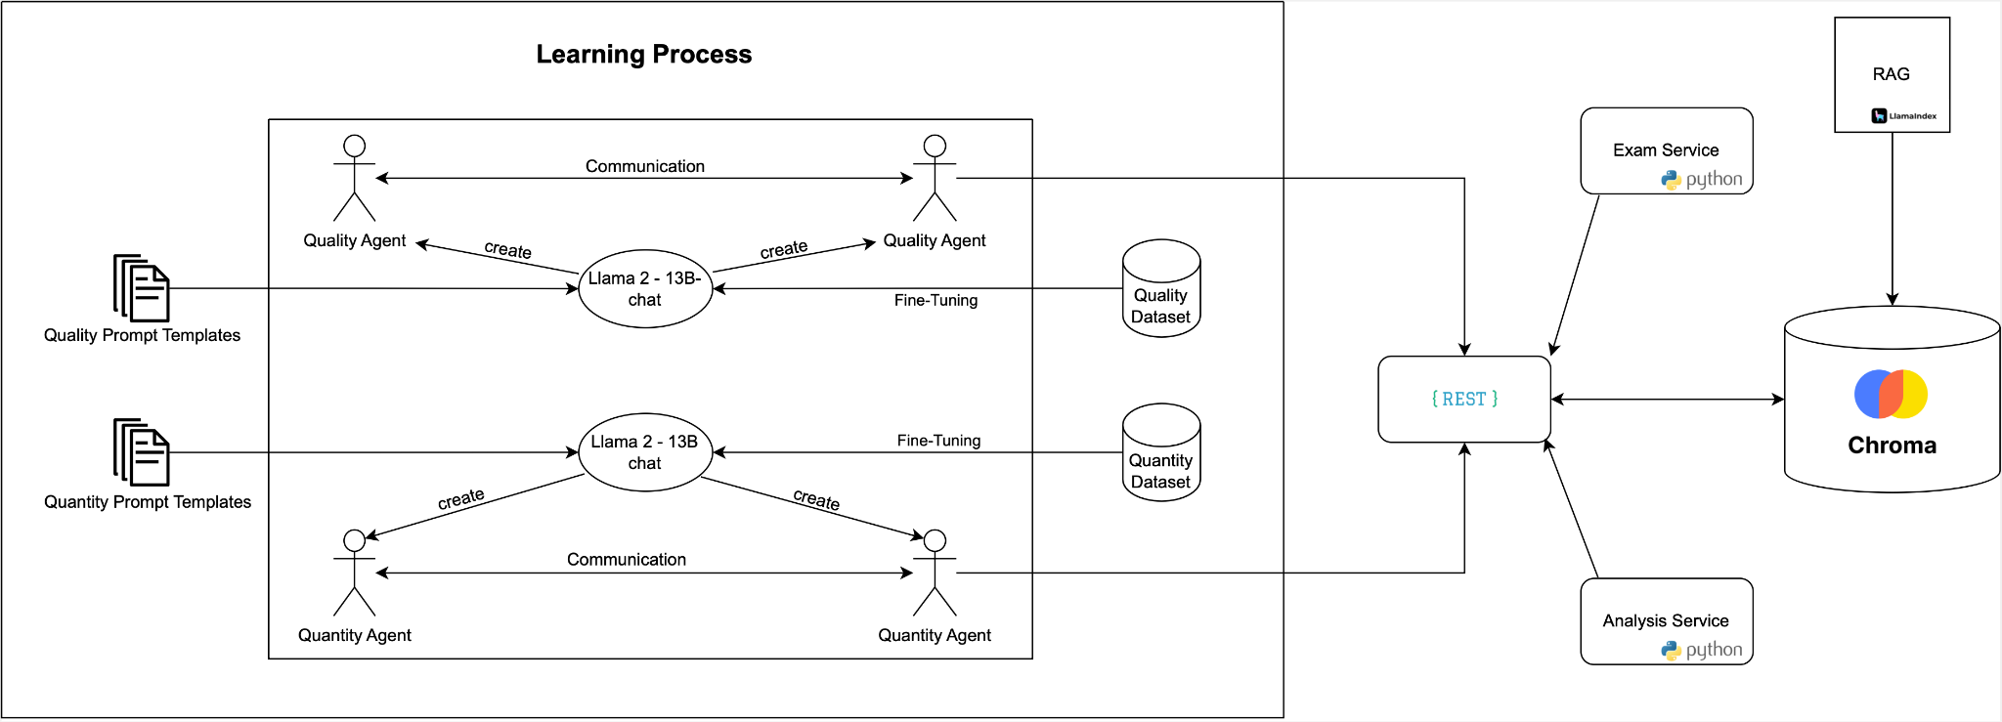
INITIAL IDEA

Slide 6
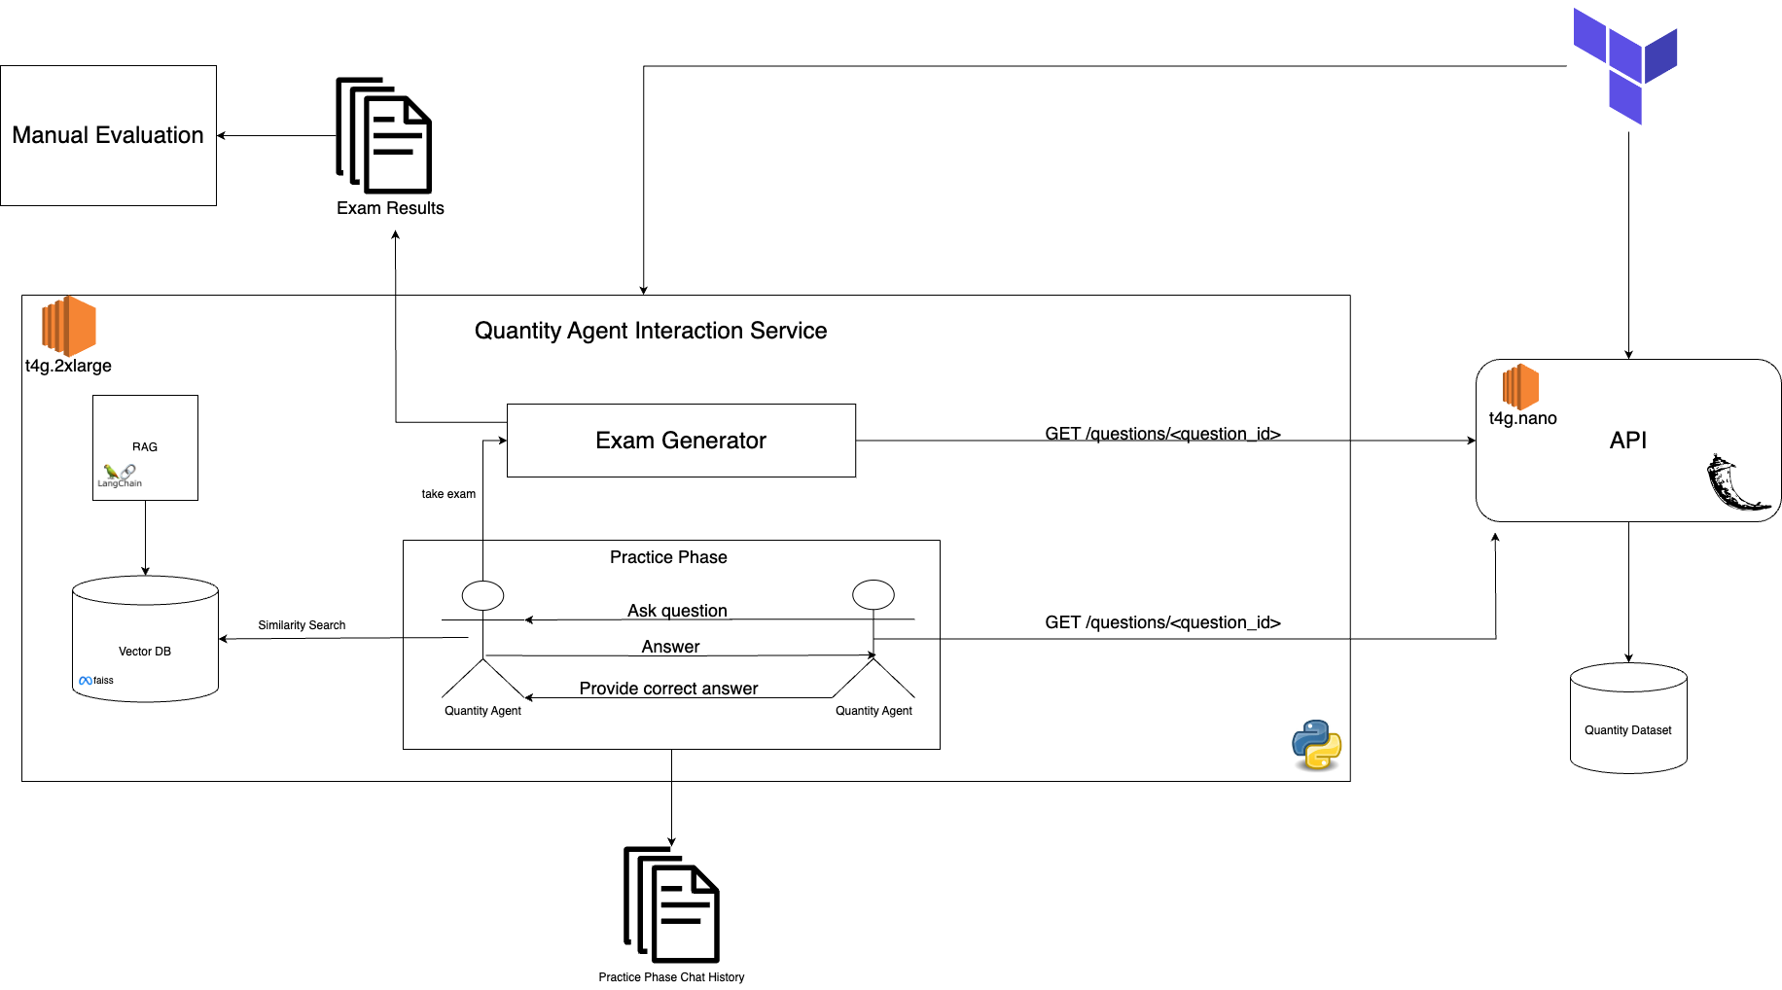
IMPLEMENTATION DETAILS

Slide 7
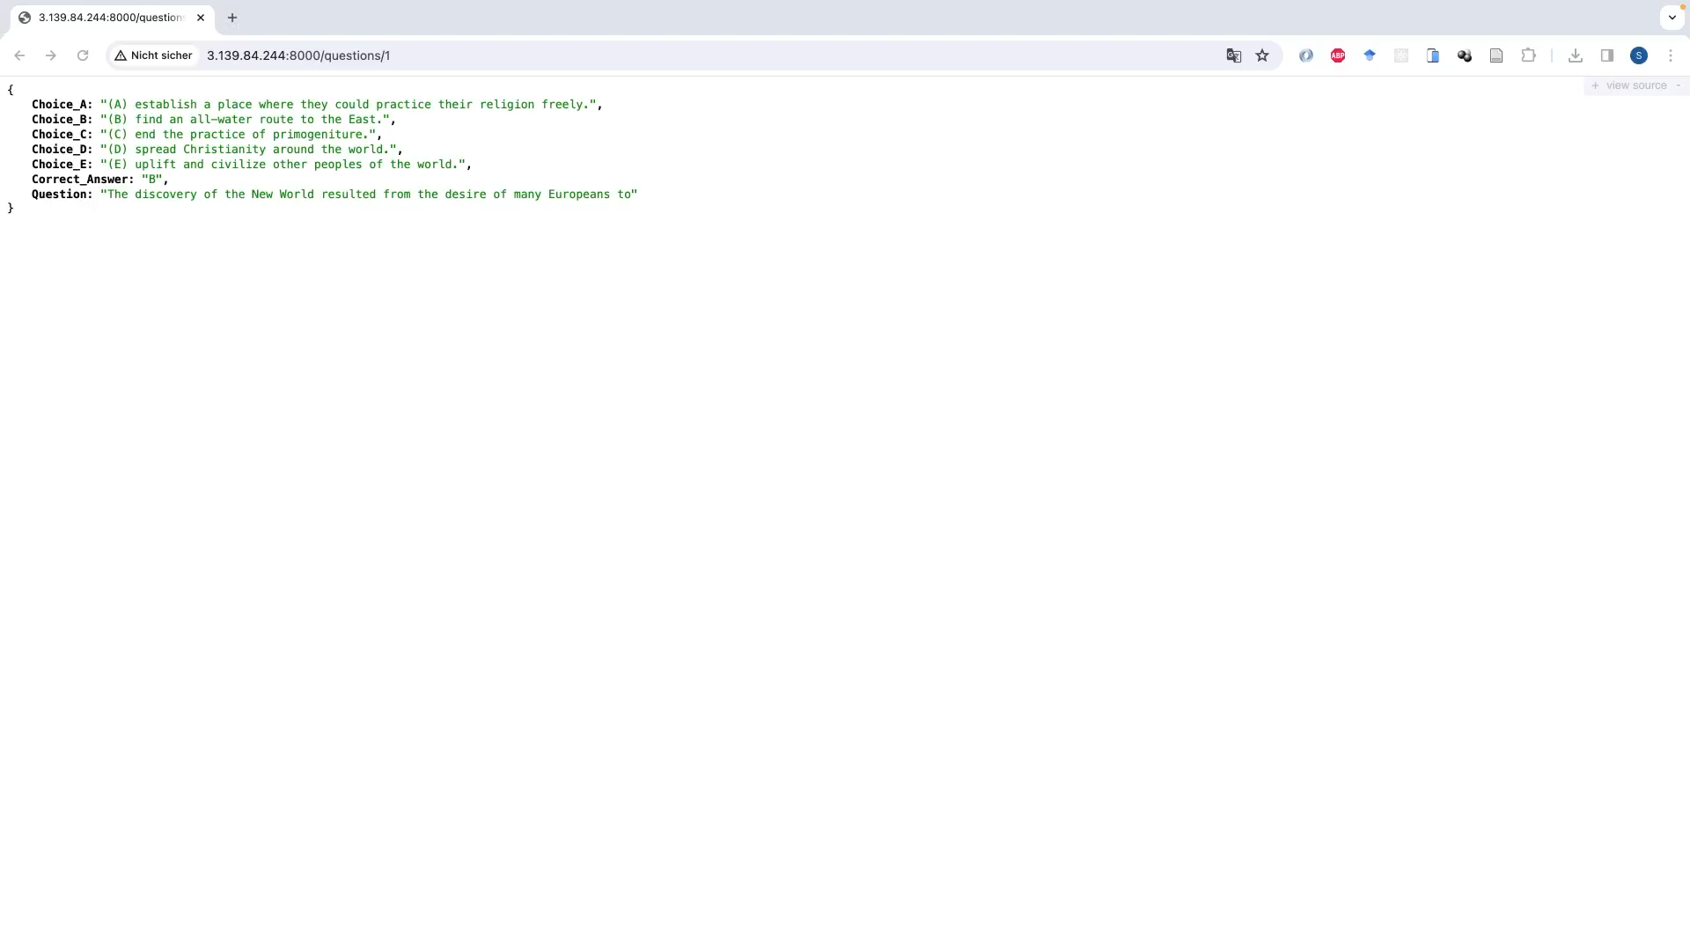
DEMO

Slide 8



ROADMAP
Final Submission: 29.02.2024
Research, skill acquisition & start coding
Minimum viable product & start paper
Working prototype & finished paper
Workshop 1: 16.11.23
Workshop 2: 21.12.2023
Workshop 3: 15.02.2024
PROBLEM STATEMENT & USE CASE > IMPLEMENTATION DETAILS > RESULTS & EVALUATION > ROADMAP & FINAL STEPS
Notes:
Let's review our project's strategic roadmap. We began with Workshop 1 on November 16, 2023, focusing on research and skill acquisition. By Workshop 2 on December 21, 2023, we initiated some coding and aimed for a minimum viable product. Moving to Workshop 3 on February 15, 2024, we prepared a working model for the showcase, unfortunately we faced numerous challenges at the end along the way, especially in implementation, but of course we will overcome these issue before final submission. This phase is crucial for demonstrating our project's practicality and innovation. Our goal is to have all components ready by February 29, 2024, for the final Submission along with the academic paper Submission.

Slide 9







ROADMAP - FINAL STEPS
Implementation of quality group
Implementing evaluation service
Developing a ChatBot GUI
Finish paper
Final check
PROBLEM STATEMENT & USE CASE > IMPLEMENTATION DETAILS > RESULTS & EVALUATION > ROADMAP & FINAL STEPS
Notes:
Moving on to the final steps of our project, we've got some important tasks to complete. First, after implementing the quantity group we’re going to set up the quality group.
Secondly, we're also going to upgrade our manual Evaluation to an automatic Evaluation in our project, which will evaluate the outcome of the Exams of both Quality and Quantity Groups. This is like a test to see how well the 2 groups performs.
Last key step is also to develop a ChatBot GUI, which will show the interaction of our Generative Agents.
And finally, we'll finish our paper, which explains everything about our project. We'll do one last check before our final submission date to make sure we didn't miss anything.
Thank YOU!

