Slide 1



baseball-da
View in Power BI
Last data refresh:
12/10/2024 5:24:31 AM UTC
Downloaded at:
12/11/2024 3:23:55 AM UTC

Slide 2
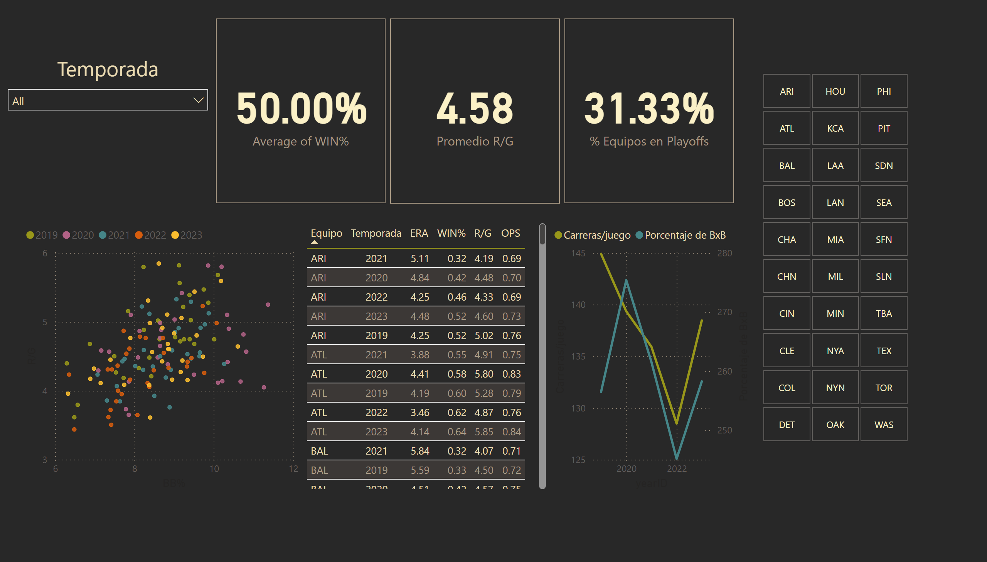
Overview
Notes:
card
No alt text provided
card
No alt text provided
card
Porcentaje de victorias.
Temporada
No alt text provided
lineChart
No alt text provided
tableEx
No alt text provided
scatterChart
No alt text provided
slicer
No alt text provided

Slide 3
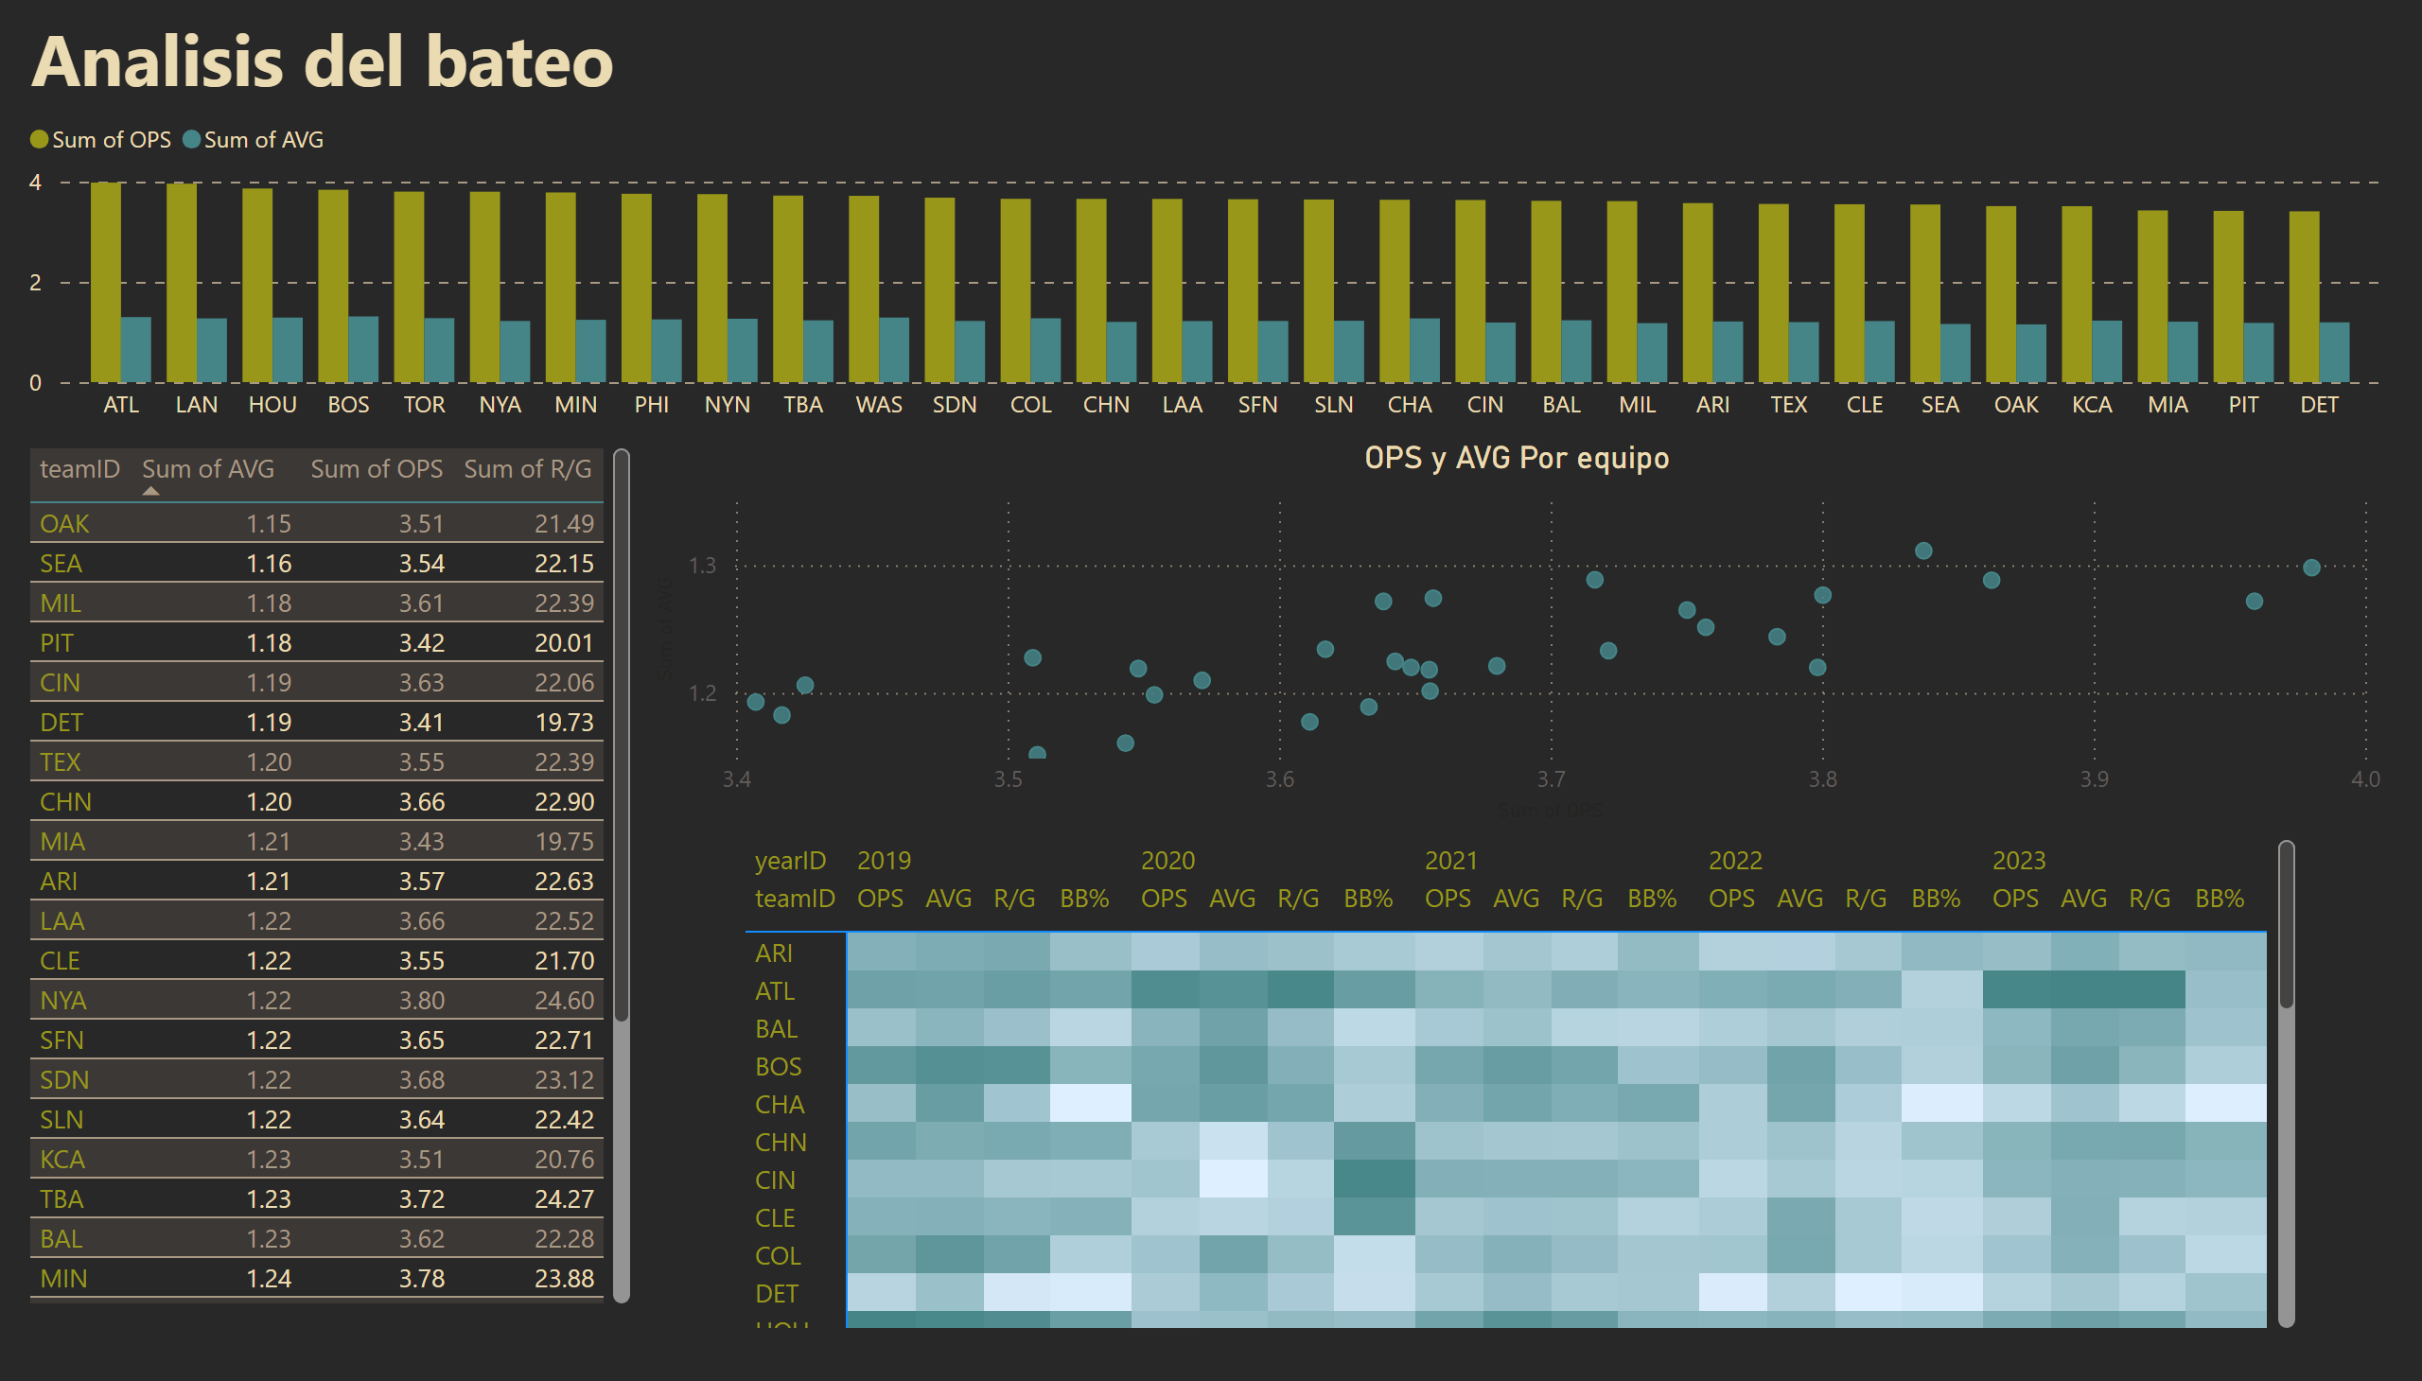
Batting Analysis
Notes:
tableEx
No alt text provided
OPS y AVG Por equipo
No alt text provided
clusteredColumnChart
No alt text provided
textbox
No alt text provided
pivotTable
No alt text provided
slicer
No alt text provided

Slide 4
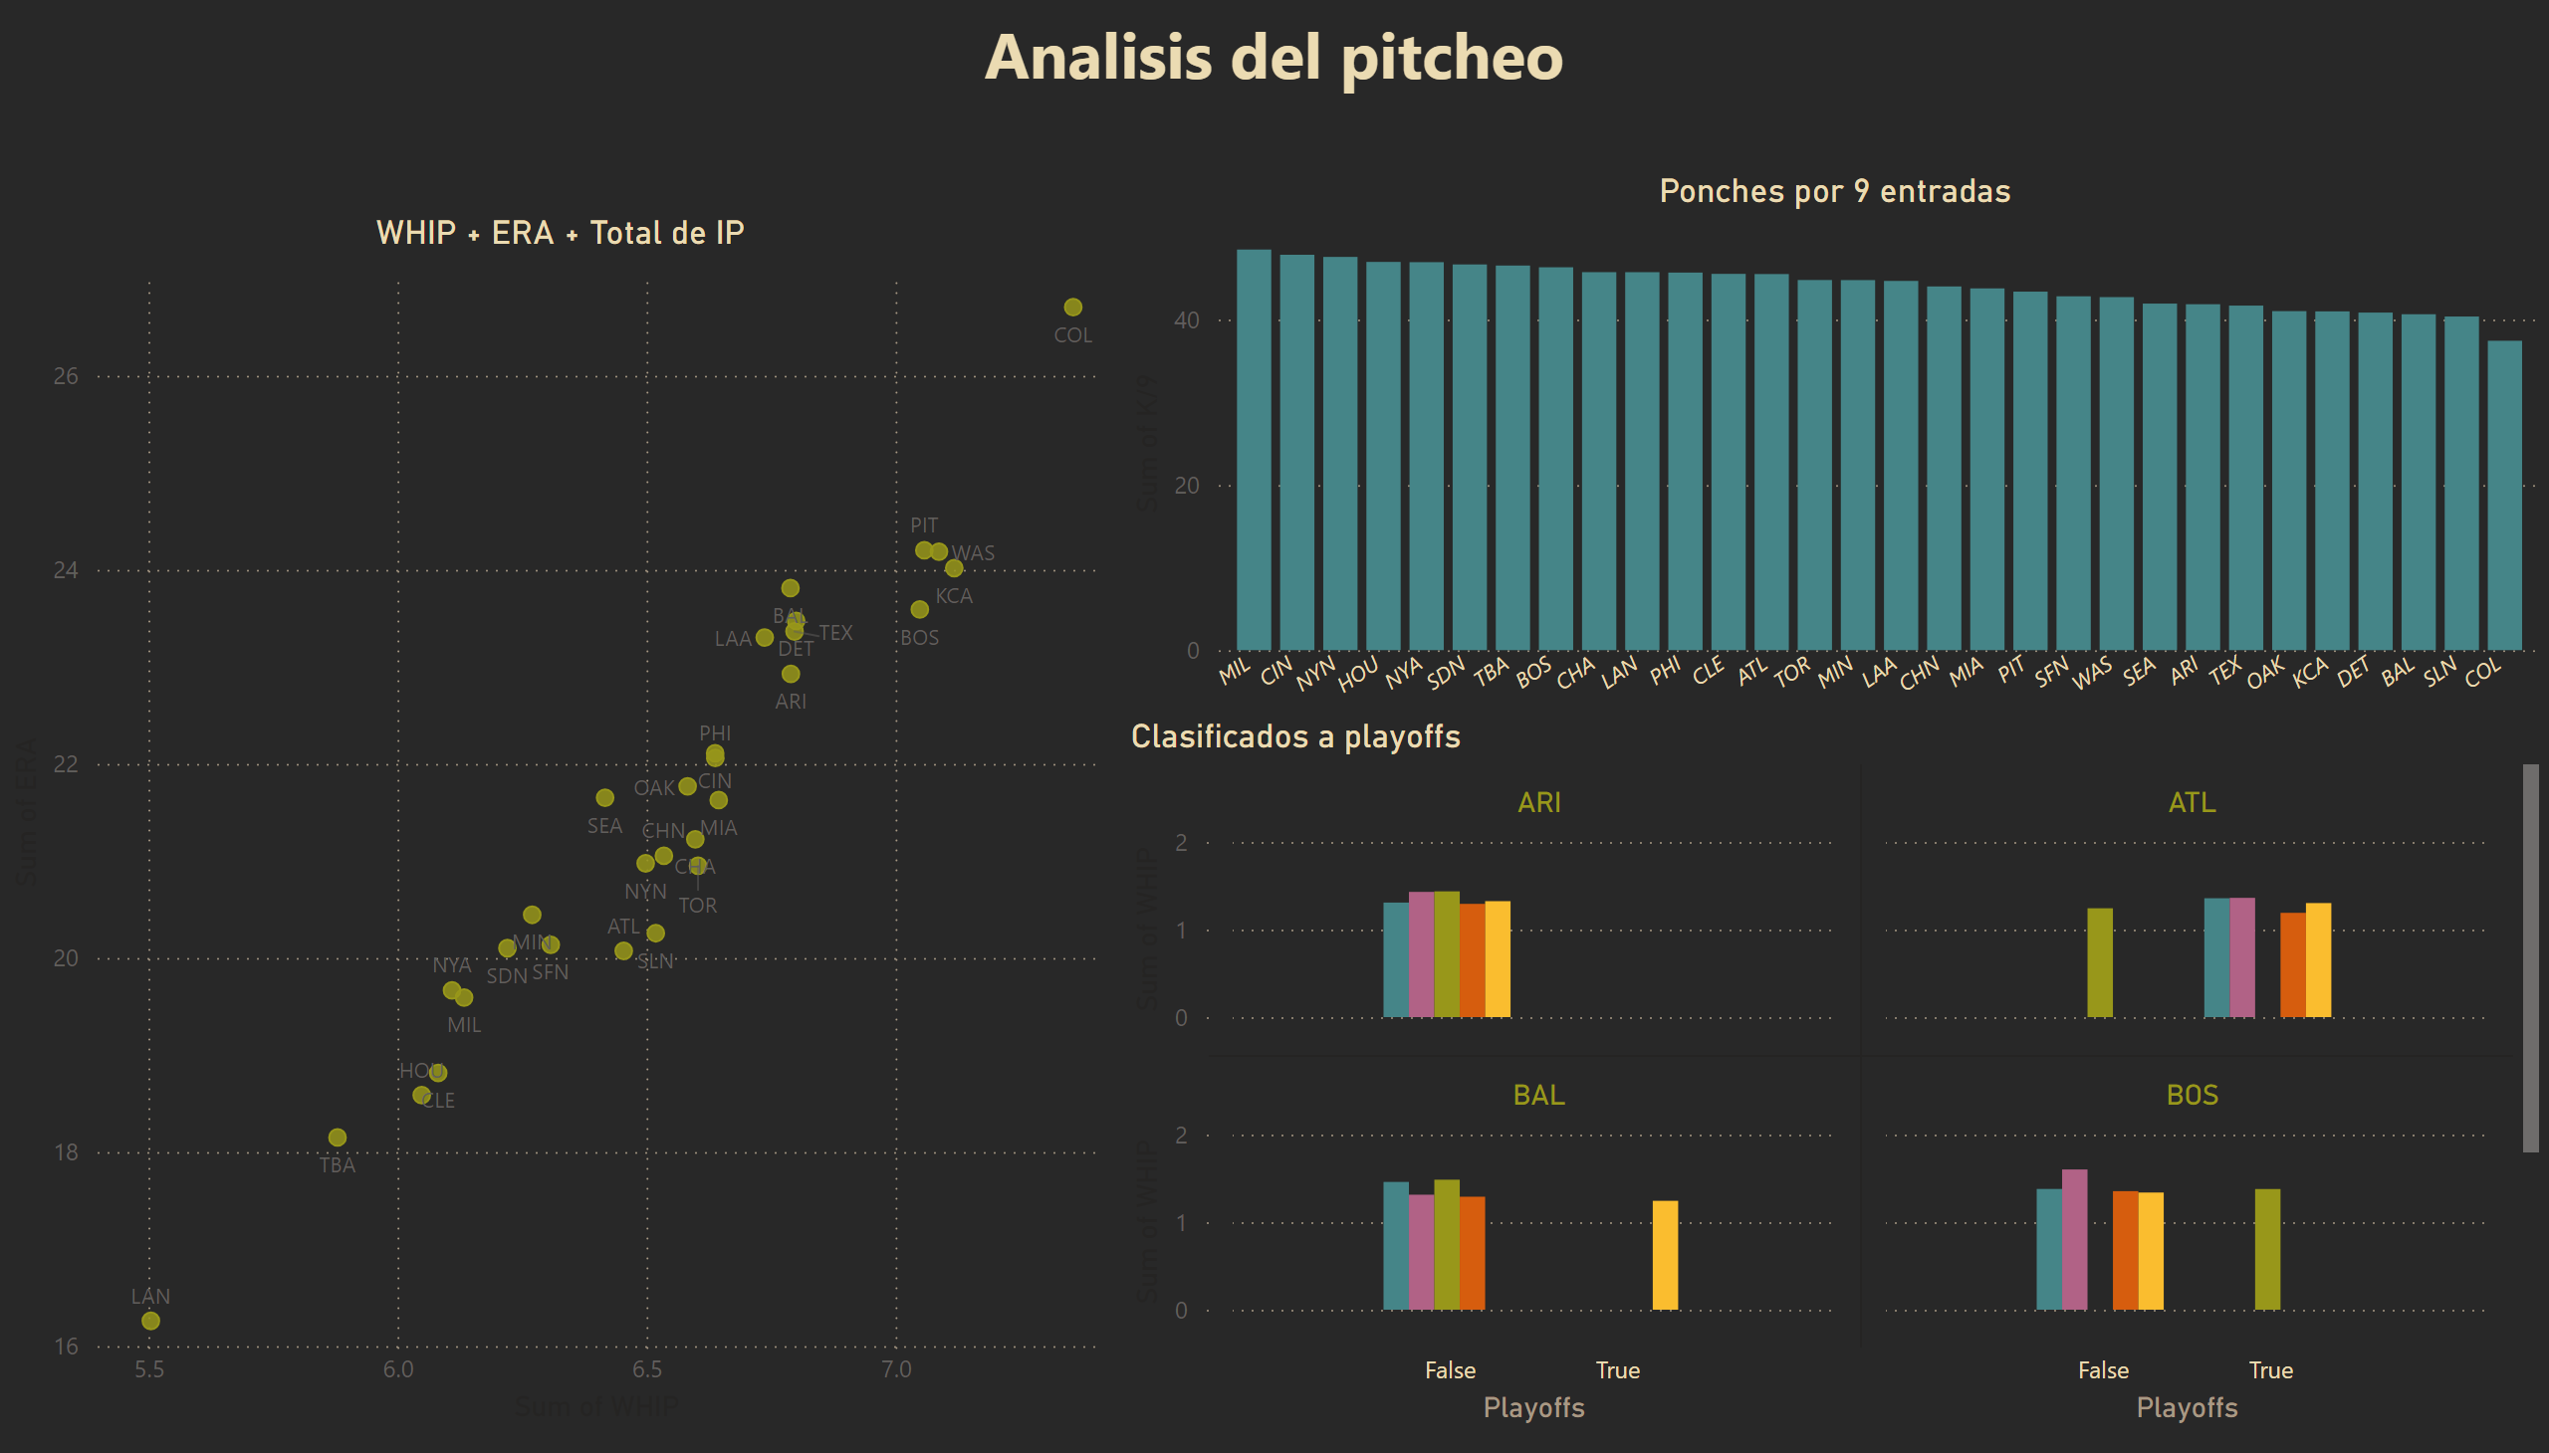
Pitching & Defense
Notes:
WHIP + ERA + Total de IP
No alt text provided
textbox
No alt text provided
Clasificados a playoffs
No alt text provided
Ponches por 9 entradas
No alt text provided
slicer
No alt text provided

