Slide 1
CSYS/MATH 300: PoCS Term Project The Connectedness of Places
Austin Thomas
Fall 2015

Slide 2
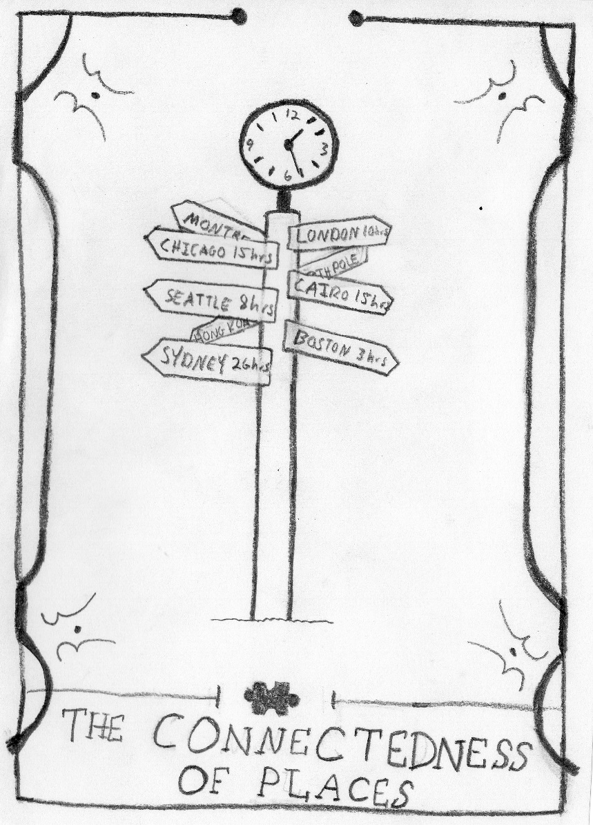
CSYS/MATH 300: PoCS Term Project
Austin Thomas
Fall 2015

Slide 3
Project Idea
Traditional mapping: Point A to point B spans X distance
Real-word practice: ‘Oh yeah, XYZville is half an hour away.’
Project goal: Describe travel in terms of time → Connectedness!
Connectedness: ability to reach more places in X amount of time.

Slide 4
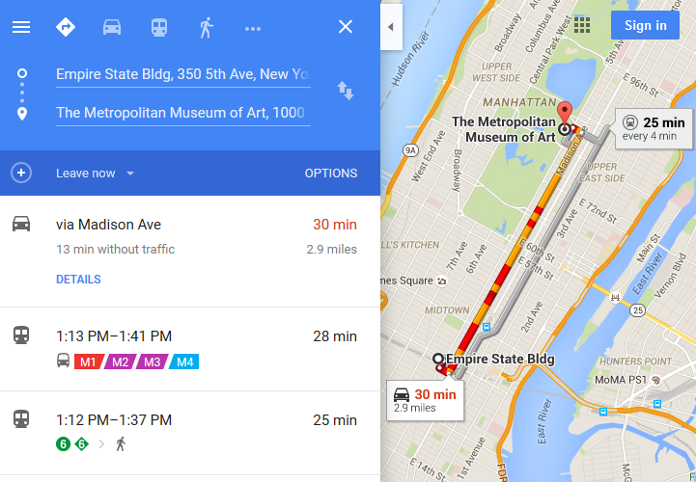
Project Plan
Use Google Maps Distance Matrix data to map travel times between ZIP codes or postcodes
Repeat for various modes of transport
Car, bicycle, on foot, metro, bus, ferry, etc.
Hopping on a train, plane, ferry, etc. usually allows greater mobility
Map locations reached vs. time and compare
Index of Connectedness?
Test bed: Vermont and New York City

