Slide 1
Alumni Tracker with Job Matching using AI Integration
Eduard Rino Q. Carton
Bacolod Four Leaf Clover

Slide 2
This study aims to develop an Alumni Tracker with Job Matching using AI Integration.
General Objectives

Slide 3
1. Design a system that will manage the following data of NONESCOST Alumni: a. Education b. Work Experience c. Skills d. Job Preferences
Specific Objectives

Slide 4
Specific Objectives
2. Design a system that will integrate Artificial Intelligence in the following aspects:
a. Job Matching algorithm that can analyze data and provide personalized job recommendations. b. Natural Language Processing (NLP) algorithm to analyze text and provide suggestions for improving grammar, punctuation, style, tone and clarity

Slide 5
Specific Objectives
3. Generate the following reports: a. Alumni Report
b. Employer Report
c. Employment Rate Report
d. Job Posting Report
4. Determine the quality of the developed system based on ISO/IEC 25010:2011 Systems and Software Quality Requirements and Evaluation (SQuaRE) Quality Model

Slide 6
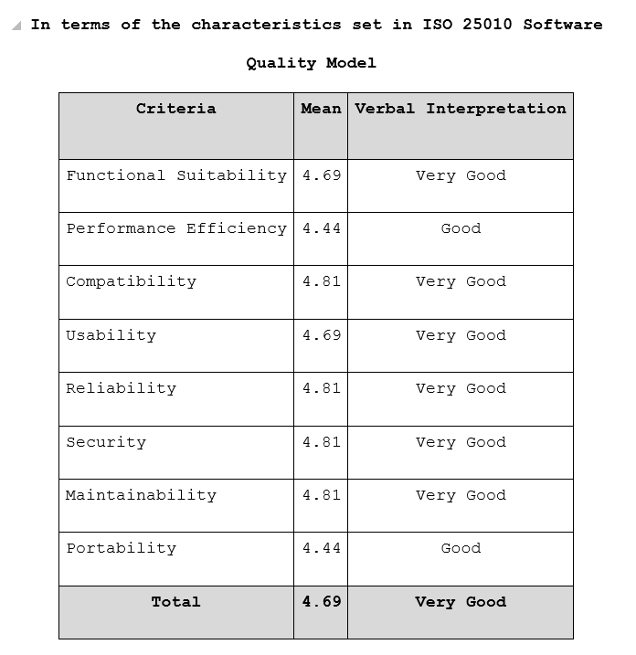
Results
Table shows the result of the IT Experts' feedback in determining the quality of the NONESCOST Alumni Tracker with Job Matching using AI Integration based on the characteristics set in the ISO 25010 Software Quality Model.

Slide 7
Thank you.

Slide 8
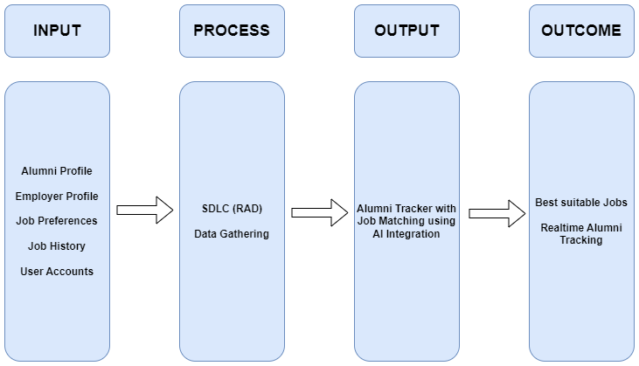
Conceptual Framework

Slide 9
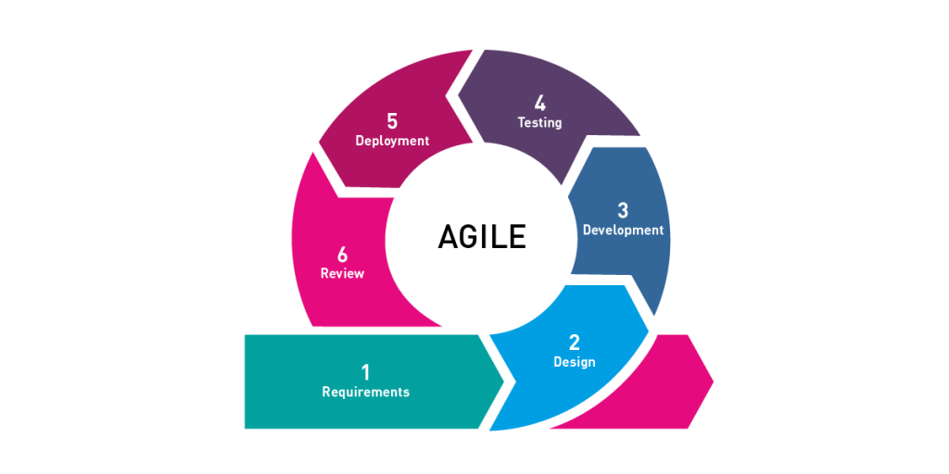
Methodology
The Agile methodology is a software development approach that emphasizes collaboration, flexibility, and continuous improvement. It focuses on delivering value to end-users through rapid iteration and incremental development. The Agile methodology is based on the Agile Manifesto, a set of values and principles for software development that prioritize individuals and interactions, working software, customer collaboration, and responding to change.

Slide 10
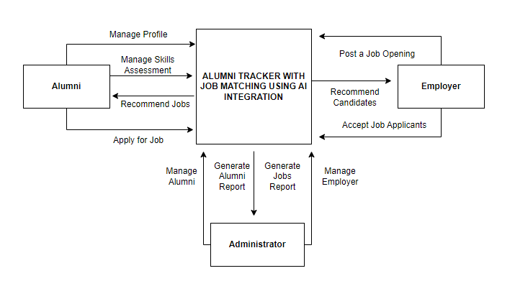
Context Flow Diagram
Figure shows how the researcher maps out on how the entire features and components of the system will work together according to its purpose.

Slide 11
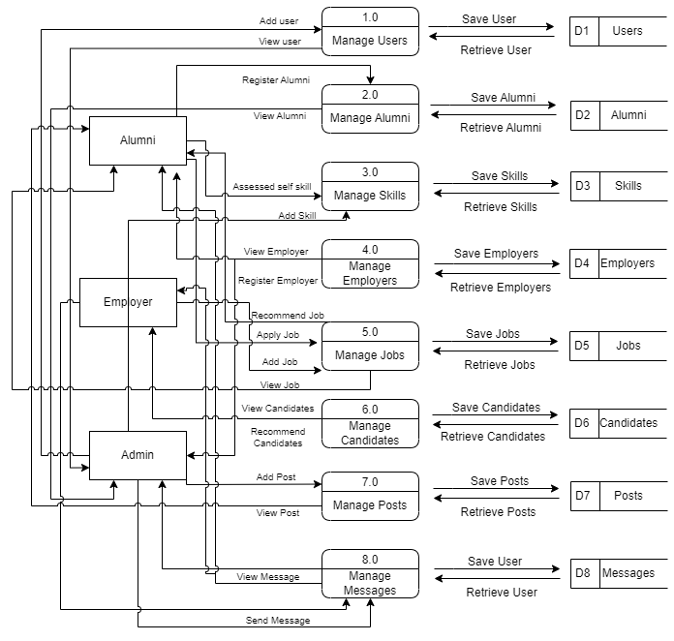
Data Flow Diagram
The figure illustrates how information is processed within the system, including where it comes from, how it is transformed, and where it is stored. The purpose of the Data Flow Diagram is to depict the system's scope and boundaries, and it can be used as a tool for communication between the systems analyst and stakeholders involved in the system's redesign.

Slide 12
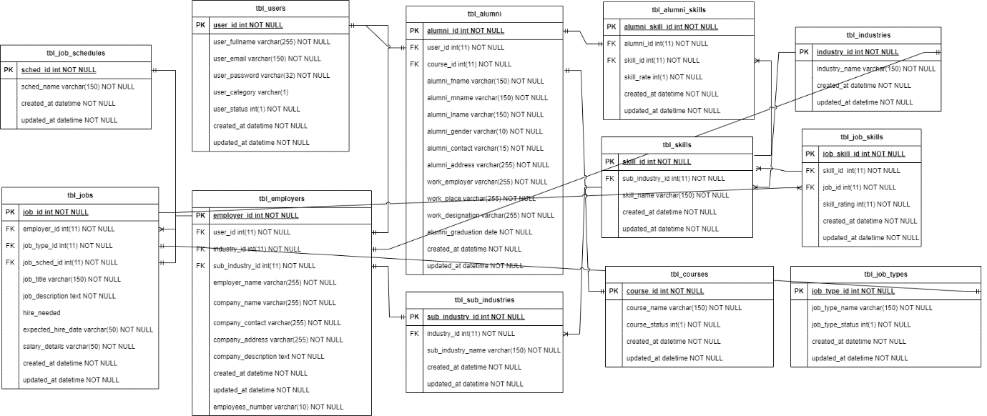
Entity Relationship Diagram

Slide 13
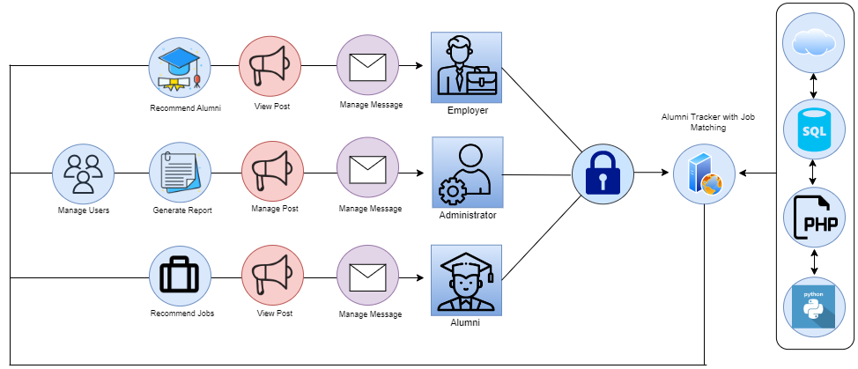
Application Architecture

Slide 14
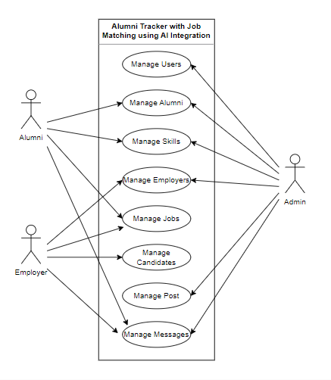
Use-Case Diagram

