Slide 1
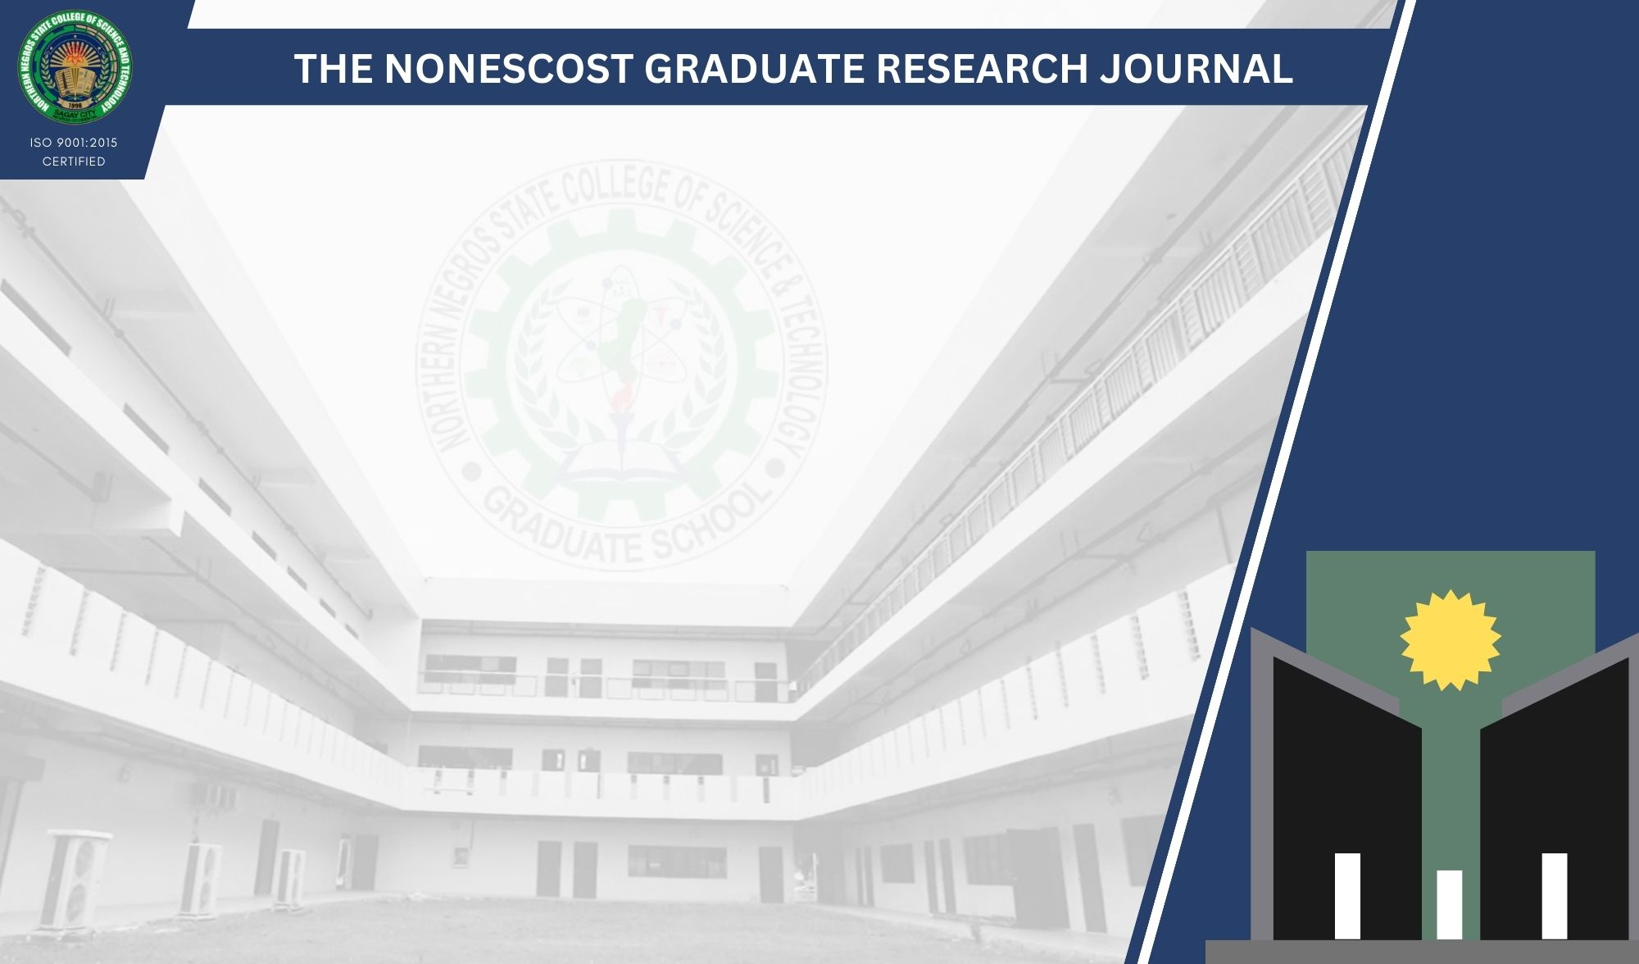
ALUMNI TRACKER WITH JOB MATCHING USING AI INTEGRATION
EDUARD RINO Q. CARTON
Master in Information Technology
MAY 21, 2023

Slide 2
Specific Objectives
Alumni Data Management
AI Integration
Generate Report
ISO/IEC 25010:2011

Slide 3
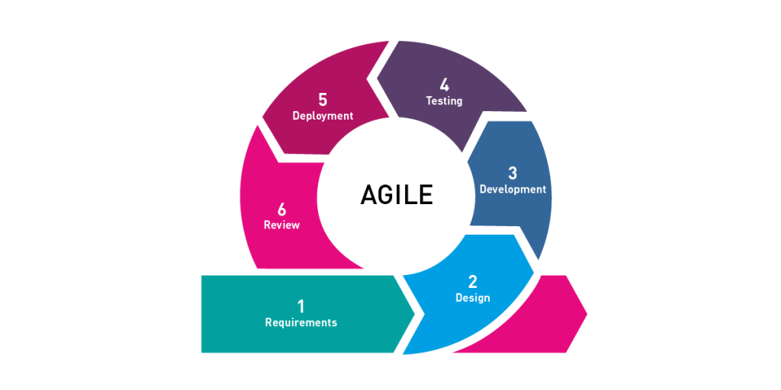
Methodology
Requirements Gathering
Design
Development
Testing
Deployment
Review
Notes:
The Agile methodology is a software development approach that emphasizes collaboration, flexibility, and continuous improvement. It focuses on delivering value to end-users through rapid iteration and incremental development. The Agile methodology is based on the Agile Manifesto, a set of values and principles for software development that prioritize individuals and interactions, working software, customer collaboration, and responding to change.

Slide 4
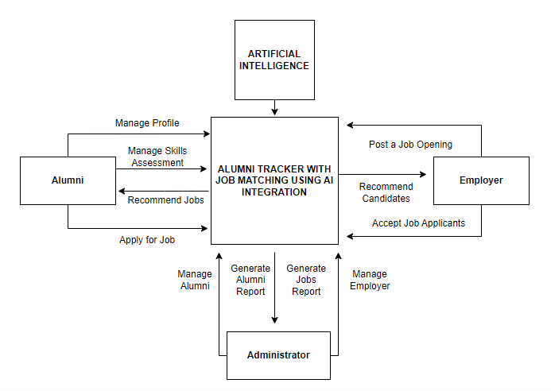
Context Flow Diagram
The figure illustrates the how the complete features and components of the system will collaborate in alignment with its intended function.

Slide 5
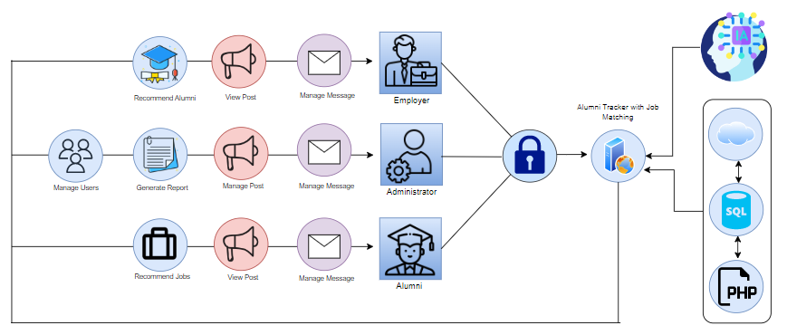
Application Architecture
Figure showcases the operational dynamics of the system when utilized by registered users.

Slide 6
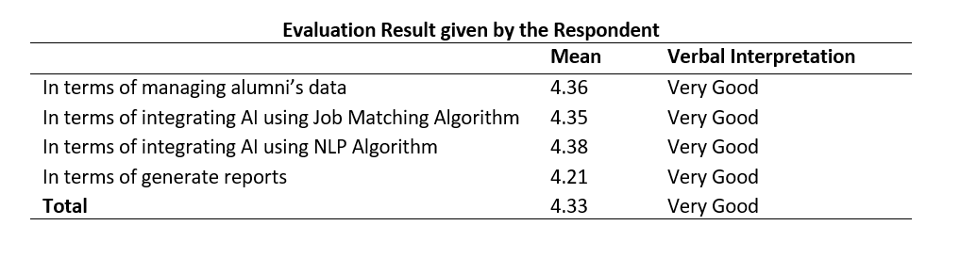
Results and Discussion
Table showed that the developed system is efficient in integrating AI in Alumni Tracker with Job Matching.

Slide 7
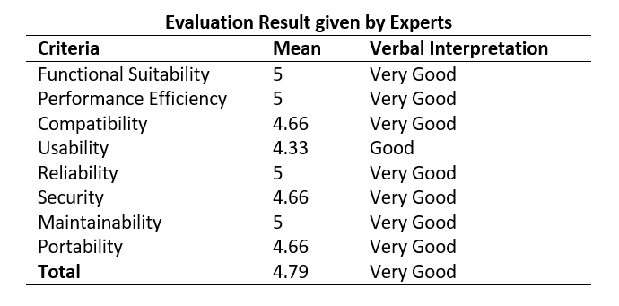
Table presents the feedback from experts, evaluating the quality of the system based on the characteristics defined in the ISO 25010 Software Quality Model.

Slide 8
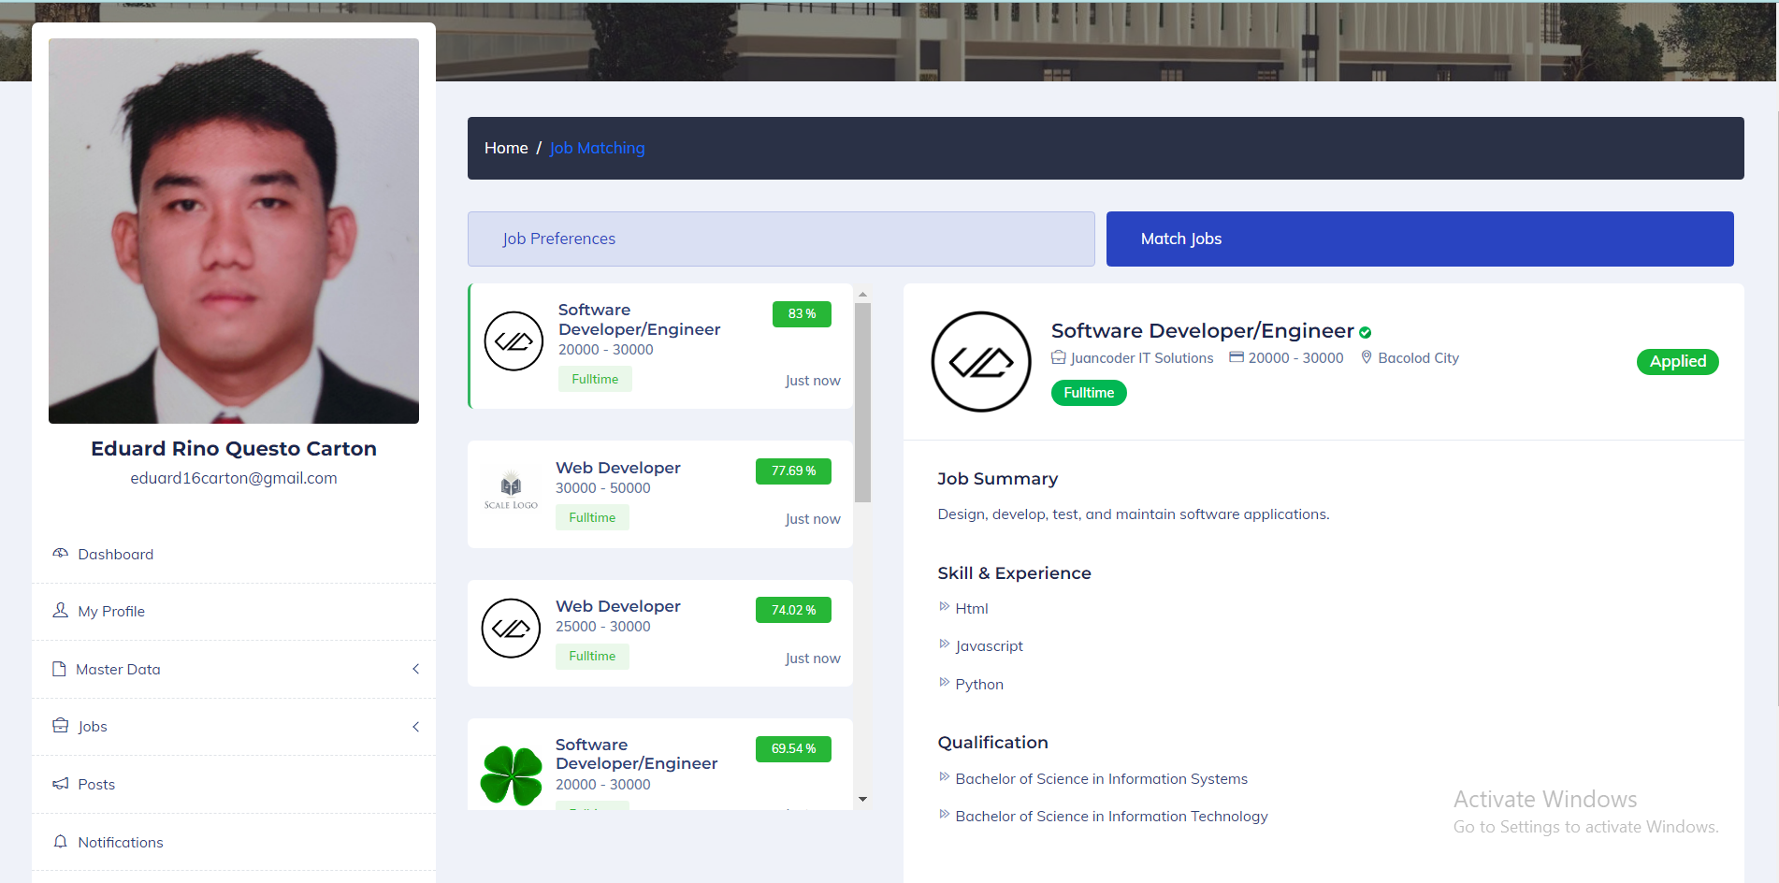
Job Matching Algorithm

Slide 9
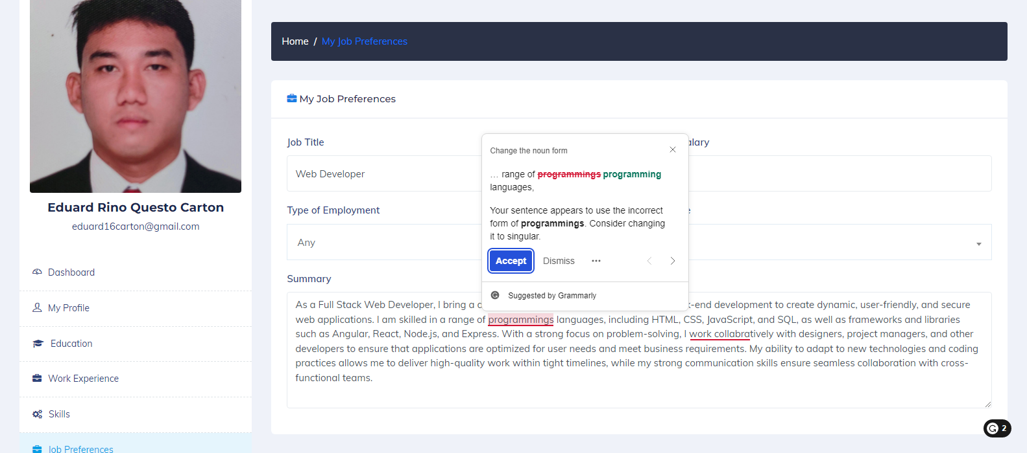
NLP Algorithm

Slide 10
Conclusion
In conclusion, the study's findings indicate that the incorporation of AI into the Alumni Tracker system has demonstrated remarkable effectiveness and significant benefits.

Slide 11
Recommendations
Implement in other educational institution
Improve notification mechanism
Conduct similar study

