Slide 1
Optimizing Reasoning Models for Standardized Test Performance
Akshat Iyer, Andrew Wu, Eugene Kim, Sebastian Perez, Will Noonan

Slide 2
Problem Statement & Motivation
We are optimizing reasoning models to perform well on standardized test practice (SAT, ACT, etc.)
Studying for standardized tests is difficult when students don’t understand the reasoning behind the correct answer. We aim to train a reasoning model to provide the correct answer and reasoning for test questions.
We will start with mathematical questions, but may expand to English in the future.
English carries with it its own challenges, as generally SAT English questions are grouped and need a passage for context.

Slide 3
Methodology
Group Relative Policy Optimization (GRPO), a policy gradient method that improves the model’s reasoning ability via reinforcement learning (RL).
Handles long-horizon reasoning (multiple steps).
Uses reward-based updates to reinforce better reasoning chains.
Gradually improves response distribution through sampled trials.
Load our dataset and use Unsloth’s technology to help fine-tune the model.
Aiming to get LLM to process the word problem into an annotated formula (present in our data).
Develop a regex-based parser to change formula into symbolic representation.
Use SymPy to get a final answer.
Formulation: Θ* = argmax_{Θ} EP_{Θ} R(S, A) + Human Input.
Maximize reasoning clarity and accuracy.

Slide 4
Technical Approach
Setup
Download all required libraries from notebook
Tokenize Reasoning-based questions from tests
Unsloth TINYLLAMA Baseline
A100 GPU - 100 GB VRAM
Data
SAT-like dataset from Kaggle
~30,000 examples
Data Cleaning needed
Formatting with spaces
Combine question and options into prompt
Extract numerical answer

Slide 5
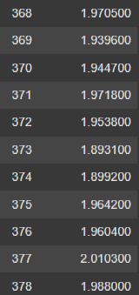
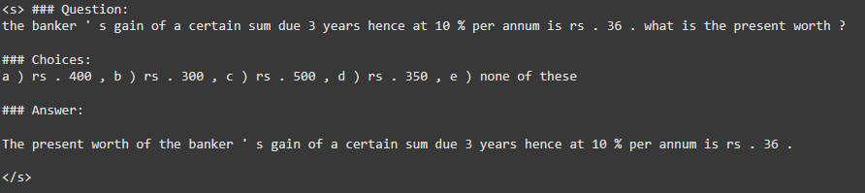
Initial Results
Dataset processed and cleaned.
Loss is still high.
Training starts around L = 4 and progresses towards L = 2.
Responses are not coherent and mostly incorrect.
Refine responses and provide justifications for the responses.

Slide 6
Literature Review
InstructGPT
Tuning LLMs for human preferences and tasks.
Separate loss/reward function based on human-labeled pairs.
DeepSeek-R1
Ranks a sampled set of completions.
This innovation uses adaptive rank reweighting.
Toolformer
LLM outputs to symbolic or code based environments exhibit greater performance.
Allows greater interpretability as well, especially for human-focused tasks.
LoRA
Low-rank adaptations for LLMs.
Restricts updates to low-rank matrices for use in transformers (reduces overhead).

Slide 7
Future Processes
Reduce Loss
Make sure it is actually doing math.
Check for accurate formula generation.
Look into different data sources
Scraping?
Other pre-formed sets.

