Slide 1
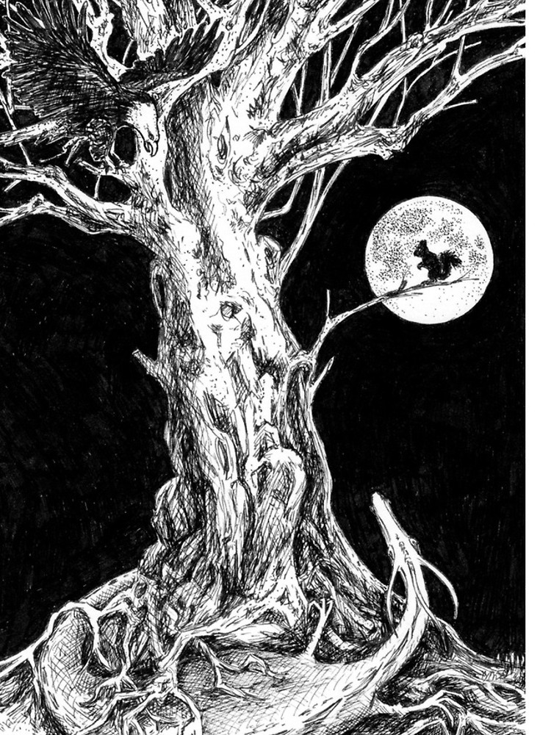
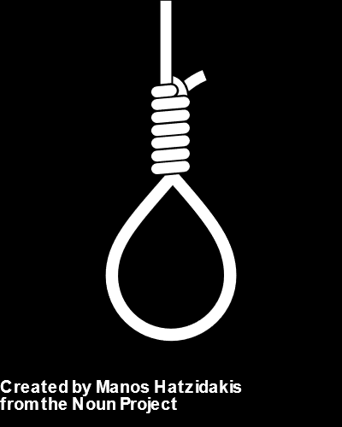
“For knowledge of runes and for power he sacrificed himself to himself. He hung from the world tree Yggdrasil…
- Neil Gaiman, Norse Mythology
D
A
L
Type a letter to guess the word
Letters Guessed:
A B C D E F G H I J K L M
N O P Q R S T U V W X Y Z
ATTEMPTS:
10
8
2
Notes:
Animate correct letters with a glow/fade when they appear in the answer box
Animate Letters guessed with a glow
Shift text color of attempts as they increment up from white to red. Maybe increase font-size?

Slide 2
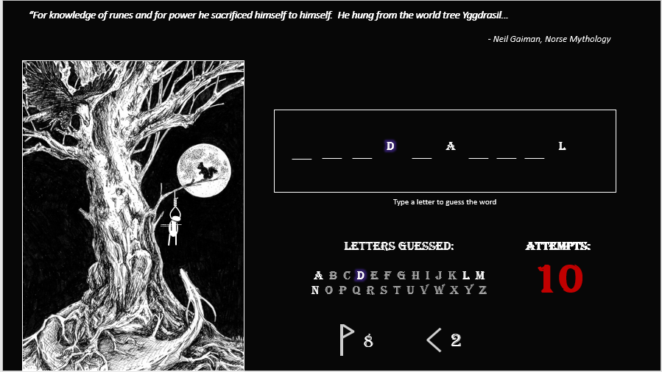

Slide 3
