Slide 1
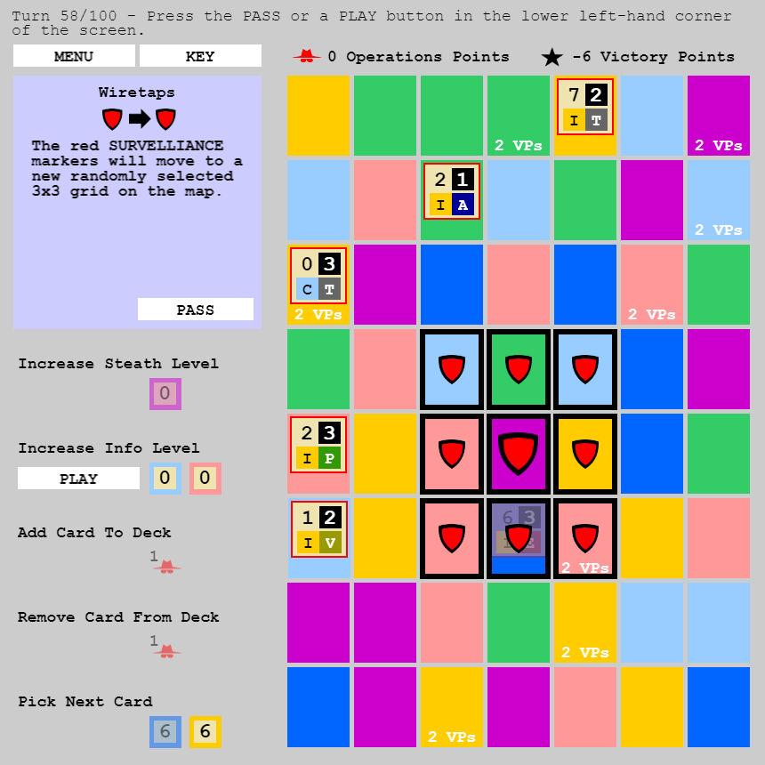
You spend operations points to add or remove cards from the deck
Stealth
Value
Information
Value
If you there is an agent present in this box at the end of the game, you earn 2 victory points
The card’s effect will happen automatically after you press a PLAY or PASS button
Information
Agent Characteristics
Stealth
Value
You need an agent in one of each of these box types to play this action
These boxes are under surveillance. You cannot place agents in these boxes or add stealth and info points

Slide 2
You spend operations points to add or remove cards from the deck
Stealth
Value
Information
Value
If there is an agent present in this box at the end of the game, you earn 2 victory points
The card’s effect will happen automatically after you press a PLAY or PASS button
Agent Characteristics
You need an agent in one of each of these box types to play this action
These boxes are under surveillance. You cannot place agents in these boxes or add stealth and info points. When an agent is under surveillance, card effects do not apply to the agent, and the agent cannot enable actions

Slide 4

0=C=0

