Slide 1
DC PM Podcast Software A generic event podcasting solution
Zachary Zebrowski ; zaz@mitre.org
The author’s affiliation with the MITRE Corporation is provided for identification purposes only and is not intended to convey or imply MITRE’s concurrence with, or support for, the positions opinions or viewpoints expressed by the author.
Date of release: June 15, 2012
Approved for Public Release 12-2665. Distribution Unlimited.
© 2012 The MITRE Corporation. All Rights Reserved

Slide 2
What is this talk about?
Why we wrote the software
Various technical key features of the implementation
Recommendations for others interesting in using the software
How to use the software
Code repository location

Slide 3
Why did you write the software?
A few of our Perl mongers (Perl user group members) can’t attend our monthly meeting. We want to share the content to our members.
We wanted to capture both the audio portion, and screen captures of the presentors screen.
We want to minimize the amount of editing / producing the website of the content.
Realizing this is a generic problem, I decided we could share this code back to the community at large.

Slide 4
What alternatives have you considered?
Youtube
It is possible, but a lot of manual effort is involved
Video segments of 15 minutes or less
Large amount of audio & video to upload, would take a lot of time to process.
Especially since video of slides may not be interesting.
A dial in meeting
http://www.freeaudioconferencing.com/ or similar
But no easy way to store it to convert it to a podcast
Also, may not be able to use in various meetings
Manual process using audacity
Too much time to produce, prefer an automated solution.

Slide 5
Key Feature: Screen Capturing
We like seeing screen captures of presenters screens
Particularly for ad hoc meetings, where there was no good topic defined, we want to be able to selectively share the presenters screen.
We use VNC to record a snap shot of the user’s screen.
VNC has clients for multiple OS’s.

Slide 6
Key Feature: Screen Capturing Continued.
Before a presentor presents, we have them connect to the podcasting box.
We present them with a presentor agreement to let them know that we will be recording their screen.
They hit submit, and we verify that they have a valid VNC connection.
We check that we can connect to VNC
We check that the screen is correct (everyone using the same endiness), by presenting a bar code one the screen.

Slide 7
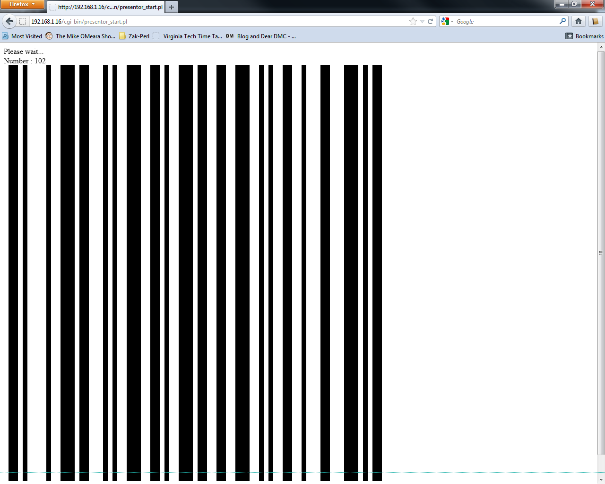
Example Screen Capture Barcode

Slide 8
Key Feature: Screen Capturing Continued.
They hit submit, and we verify that they have a valid VNC connection.
We check that we can connect to VNC
We check that the screen is correct (everyone using the same endiness), by presenting a bar code one the screen and decoding it.
We check that we can connect a second time, as we do not maintain a VNC connection throughout the recording.
If all goes well, they see a success message. If not, they’re given a list of things to check.

Slide 9
Key Feature: Screen Capturing Continued
The person recording the conference, then can select which screens to capture, by simply selecting a number associated with the user (1..4)

Slide 10
Key Feature: Topics
There can be multiple topics during a month’s meeting, and the recording need not be stopped.
The person recording can enter a new topic, and a new podcast entry will be created, automatically.

Slide 11
Key Feature: Ease of production
After the audio has been recorded, to update the website with recent content, two unix commands are used.
Audio files, are converted to mp3s.
Screen shots, attachments (if any), are automatically uploaded to the website..

Slide 12
Recommendation: Use external audio adapter
Our first podcasts were recorded using the onboard audio adapter.
A lot of background noise was recorded.
A lot of keyboard noises were recorded.
It wasn’t directional – it was hard to pick up the speaker.
Using dedicated audio equipment & mics (about $175), these problems were fixed.
Amazon: http://amzn.com/B000PARIZU

Slide 13
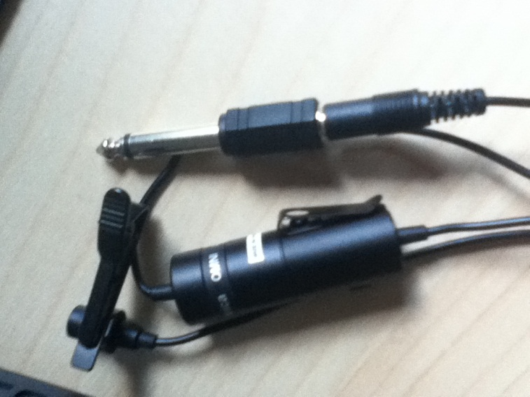
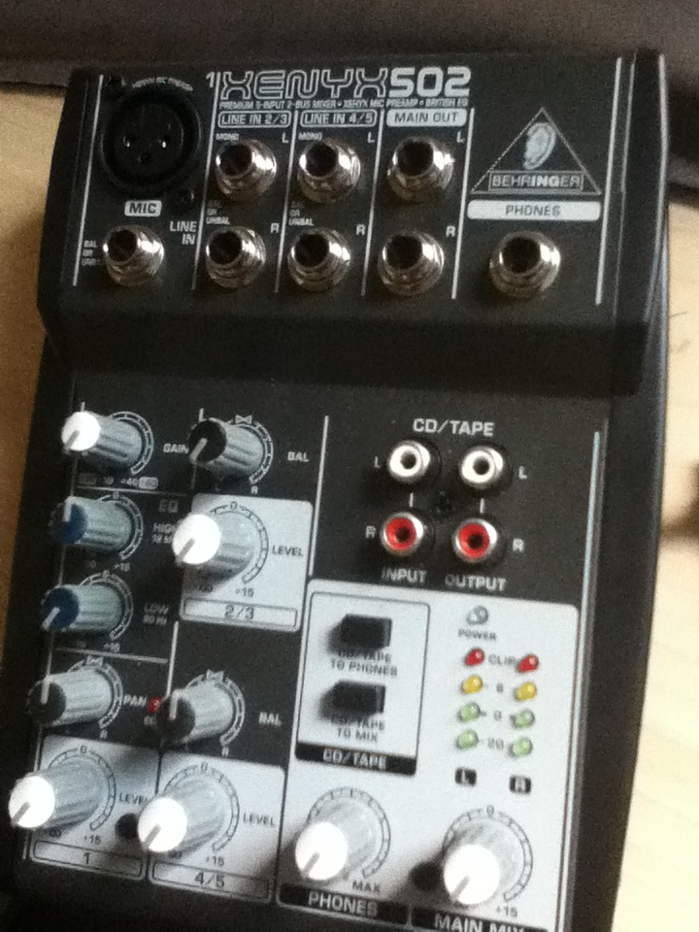
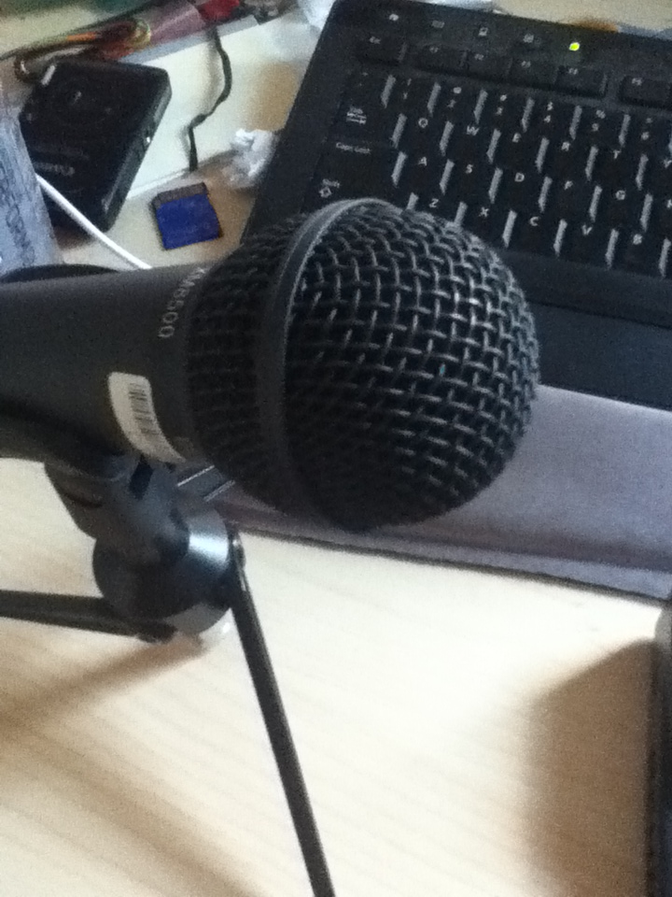
Mixer & Mics used.

Slide 14
Recommendation: Pre-agree on privacy
Be sure within your group to agree on privacy agreements.
The primary thing is making sure that the presenter is comfortable with recording.

Slide 15
Linux Libraries Used
Mysql-server (database)
Zbar-tools (barcode scanner)
Rsync
Boa (simple web server)
Flite (text to speech library)
Lame (wav -> mp3)
Libimlib2-dev
Libimlib2 (Used by vnc client)
Sox (audio recording)

Slide 16
Perl Libraries Used
Core
Strict
CGI
File::Copy
File::Find
Non-Core
File::Path
Image::Dot (used for ajax like things)
MP3::ID3v1Tag (sets mp3 attributes)

Slide 17
Perl Libraries Continued
Net::Address::IP::Local – determines your local IP Address
Net::VNC – Perl vnc client
Proc::Background – Runs processes in background space
URL::Encode
URI::Escape

Slide 18
Installing
Download code from github
https://github.com/japharl
Read & Follow INSTALL document.

Slide 19
Future Work
Update code to use SQLite instead of MySQL (less dependencies than mysql)
Plugins
Audio Transcription (via speech recognizer software?)
A “mod voice” for when speakers don’t wish to be identified.
Capture usb / other camera.
Call in capability

Slide 20
Demo

Slide 21
Questions?

Slide 22
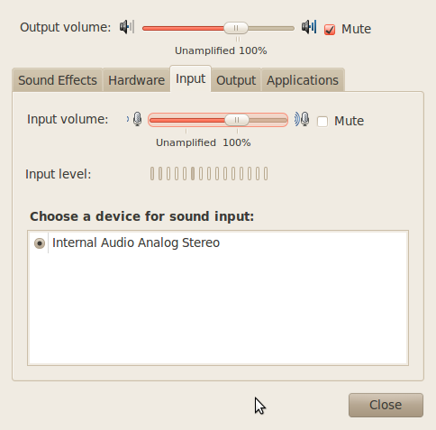
Things to avoid

