Slide 1
Insurance Customer Response Prediction
Using Machine Learning
Capstone Project | End-to-End Machine Learning Workflow

Slide 2
Agenda
1. Business problem and project objective
2. Dataset understanding and exploratory data analysis
3. Data preprocessing and feature engineering
4. Model building: Logistic Regression, Decision Tree and Random Forest
5. Model evaluation and handling class imbalance
6. Random Forest hyperparameter tuning
7. Model saving, prediction workflow and deployment
8. Key findings, limitations and conclusion
2

Slide 3
1. Business Problem & Objective
Insurance companies want to identify customers who are likely to respond positively to a vehicle insurance offer.
The project treats customer response as a binary classification problem: Response = 1 (Yes) or 0 (No).
Goal: build a machine-learning model that estimates response probability from customer and policy attributes.
The model can support more targeted outreach by prioritizing customers with higher predicted response probability.
Target variable
Response: 0 = No response, 1 = Positive response
3

Slide 4
2. Dataset Overview
Dataset size: 381,109 customer records and 12 original columns.
Features include demographic, vehicle, insurance-history and policy-related attributes.
Original columns: id, Gender, Age, Driving_License, Region_Code, Previously_Insured, Vehicle_Age, Vehicle_Damage, Annual_Premium, Policy_Sales_Channel, Vintage and Response.
Data types: 6 integer, 3 float and 3 categorical/object columns.
Dataset scale
381,109 rows
12 original columns
Target
Response is the prediction label
4

Slide 5
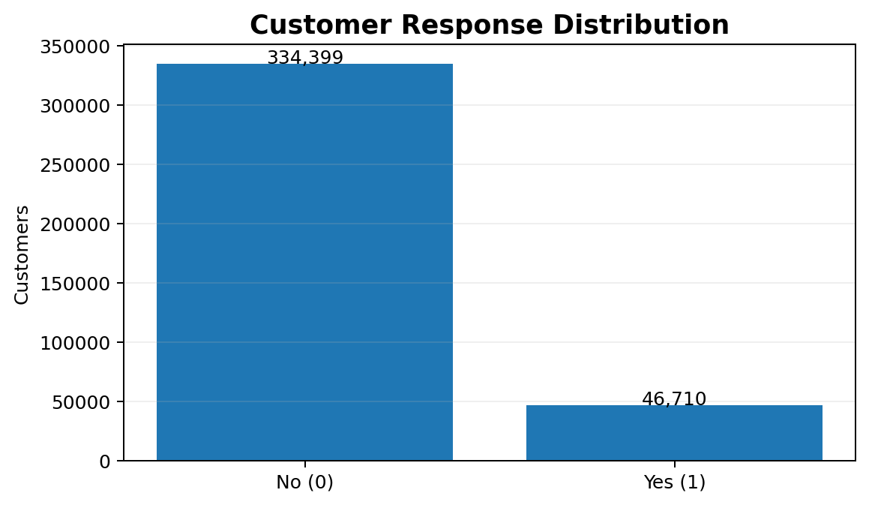
3. Data Quality & Class Imbalance
Missing-value check: 0 missing values across all 12 columns.
Duplicate-row check: 0 duplicate rows.
Response distribution is highly imbalanced: 334,399 customers (87.74%) are class 0 and 46,710 (12.26%) are class 1.
Because the positive class is relatively rare, accuracy alone is not sufficient for evaluating the model.
class_weight="balanced" was used for the classification models to give more importance to the minority class.
Key implication:
Focus on Precision, Recall, F1 and ROC-AUC in addition to Accuracy.
5

Slide 6
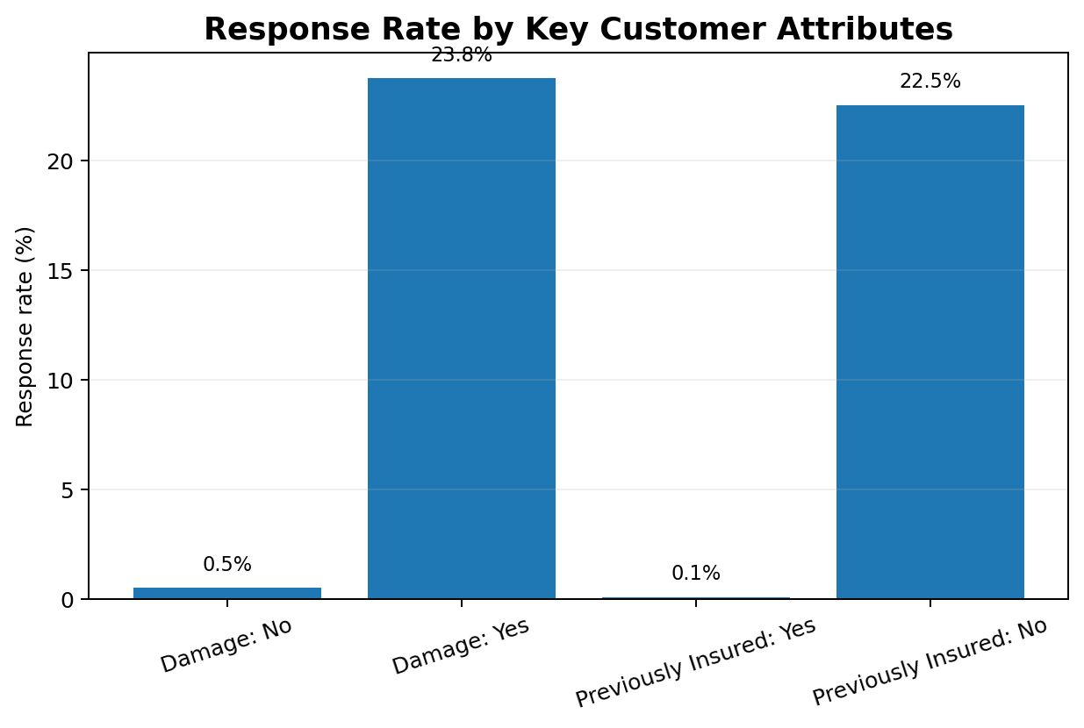
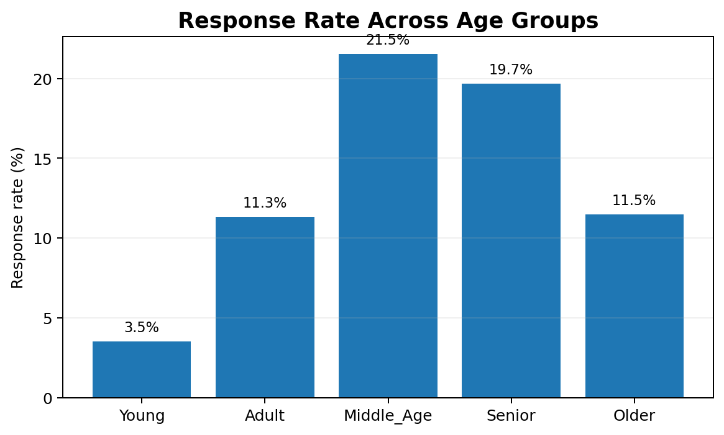
4. Exploratory Data Analysis — Key Findings
Vehicle damage
Previous insurance
Age pattern
Response rate is ~23.8% when damage = Yes vs ~0.5% when damage = No.
Response rate is ~22.5% when not previously insured vs ~0.09% when
previously insured.
Middle-age and senior groups show higher response rates than the youngest group.
6

Slide 7
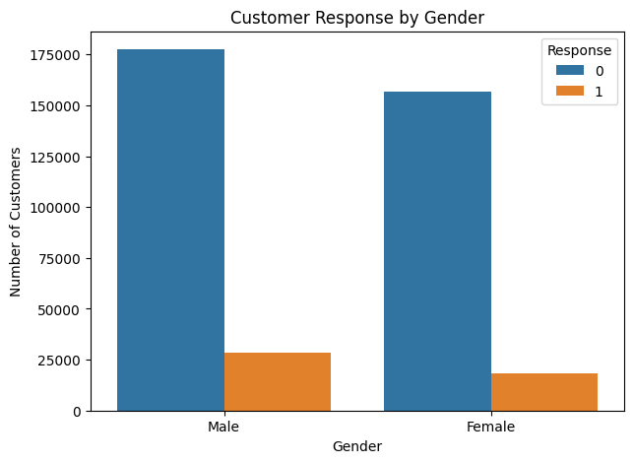
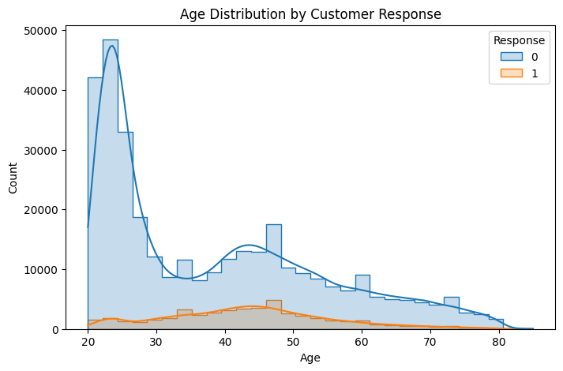
EDA Visualization

Slide 8
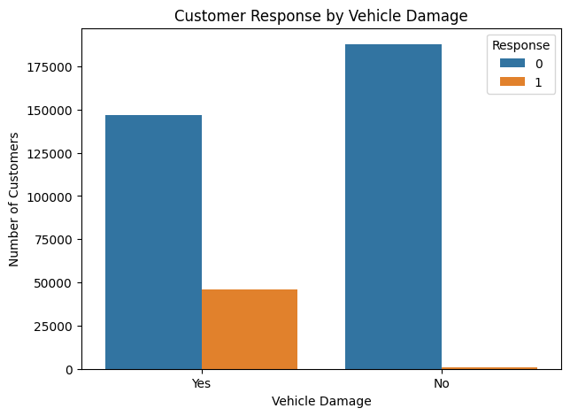
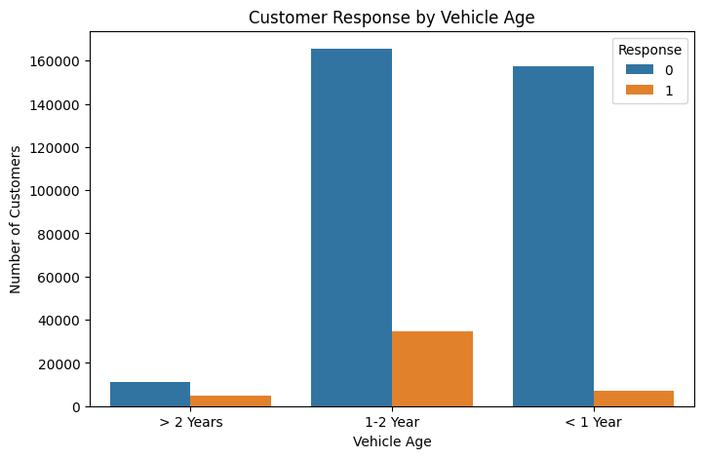
EDA Visualization

Slide 9
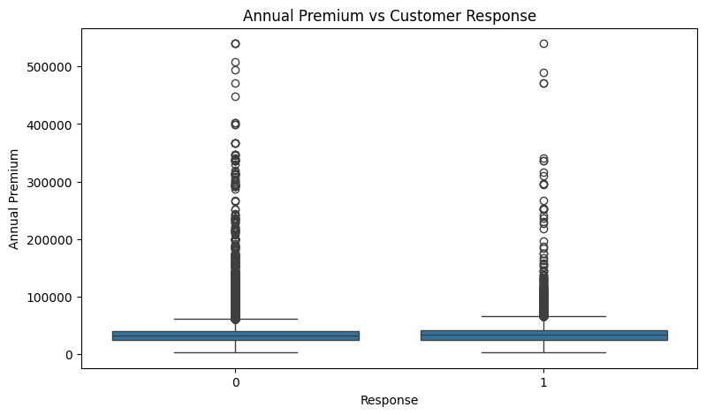
EDA Visualization
This box plot compares annual premium between customers who responded and those who did not. The median premium is slightly higher for responding customers, but the distributions overlap significantly. We can also see many high-premium outliers, indicating that the annual premium distribution is highly right-skewed. Therefore, annual premium alone is not sufficient to distinguish customer response, but it can still contribute to the machine-learning model along with other features.

Slide 10
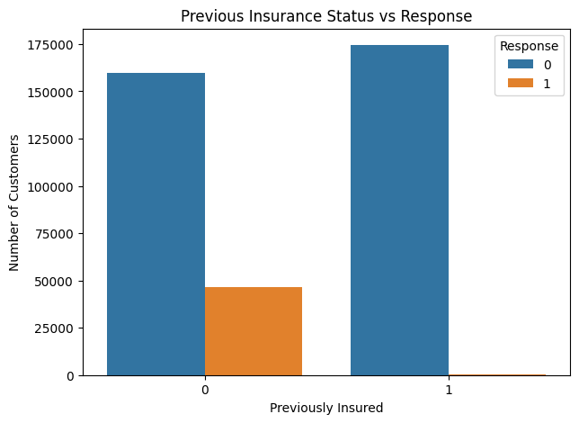
EDA Visualization

Slide 11
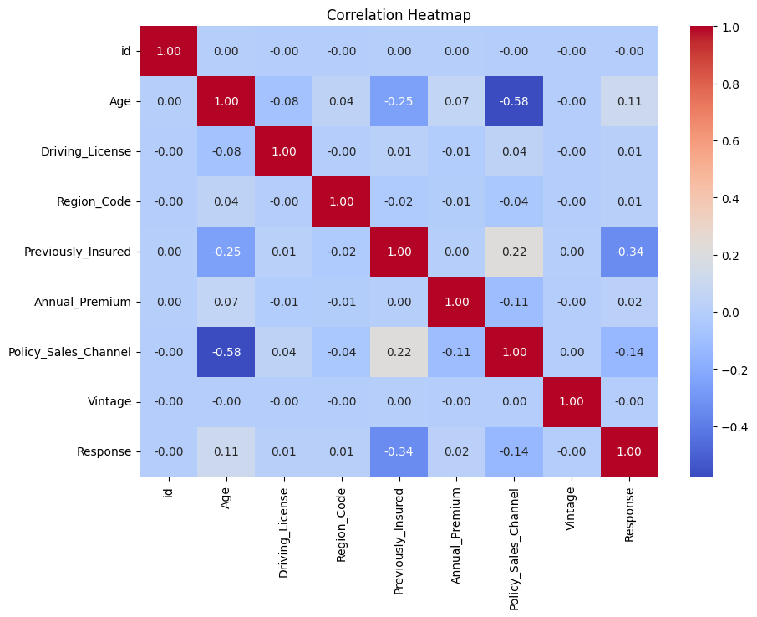
Correlation Matrix Heatmap

Slide 12
Random Forest feature-importance analysis
Rank | Feature | Importance
1 | Vehicle_Damage_Yes | 0.1540
2 | Vehicle_Damage_No | 0.1440
3 | Previously_Insured | 0.1423
4 | Vintage | 0.1360
5 | Annual_Premium | 0.1153
6 | Age | 0.0812
7 | Region_Code | 0.0809
8 | Policy_Sales_Channel | 0.0639
9 | Vehicle_Age_< 1 Year | 0.0214
10 | Vehicle_Age_Years | 0.0202
11 | Age_Group_Young | 0.0146

Slide 13
5. Data Preprocessing
Removed the identifier column (id) because it is not a meaningful predictive feature.
Split the data into 80% training and 20% testing sets using random_state=42 and stratify=y.
Numerical features were standardized using StandardScaler.
Categorical features were one-hot encoded using OneHotEncoder(handle_unknown="ignore").
All preprocessing steps were placed inside a scikit-learn ColumnTransformer and Pipeline to keep training and prediction consistent.
Preprocessing pipeline
Numeric → StandardScaler
Categorical → OneHotEncoder
7

Slide 14
6. Feature Engineering
Created Vehicle_Age_Years by mapping vehicle-age categories to approximate numeric values: <1 Year → 0.5, 1–2 Year → 1.5, >2 Years → 3.
Created Age_Group using bins: Young, Adult, Middle_Age, Senior and Older.
These engineered features provide additional numerical and grouped representations of customer characteristics.
The engineered features were included in the same preprocessing/model pipeline.
Vehicle_Age_Years
Age_Group
<1 → 0.5 | 1–2 → 1.5 | >2 → 3
Young → Adult → Middle_Age → Senior → Older
8

Slide 15
7. End-to-End Machine Learning Workflow
Raw Data
Preprocess
Train
Tune
381,109 records
Scale + encode
3 ML models
RandomizedSearchCV
EDA
Features
Evaluate
Deploy
Quality + patterns
Vehicle age + age group
Accuracy + Precision + Recall + F1 + ROC-AUC
Save .pkl + predict.py / app
The same preprocessing pipeline is retained when generating predictions on new customer data.
9

Slide 16
8. Model Building
Logistic Regression — baseline linear classification model; class_weight="balanced" and max_iter=1000.
Decision Tree — captures non-linear rules and interactions between features; class_weight="balanced".
Random Forest — ensemble of decision trees; 500 trees, max_depth=15, class_weight="balanced", n_jobs=-1.
For each model, predicted class labels and response probabilities were generated for evaluation.
Why three models?
Compare a linear baseline, a single tree and an ensemble model under the same preprocessing framework.
10

Slide 17
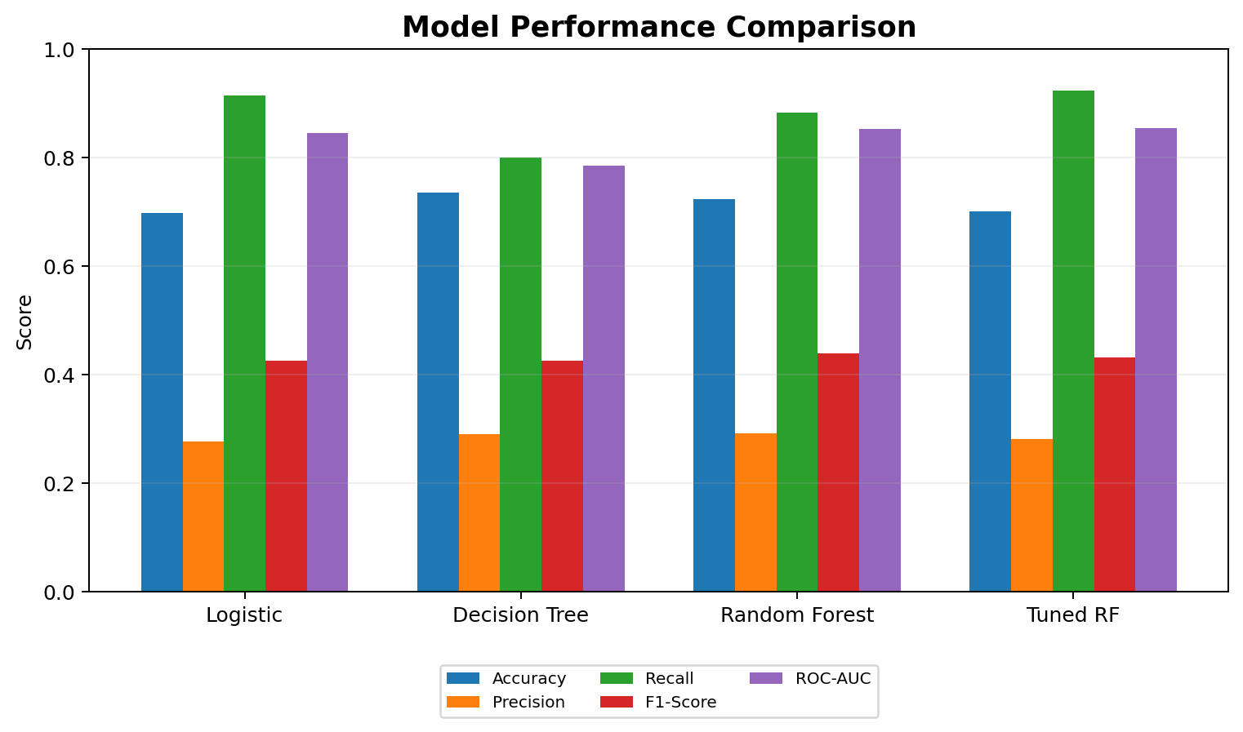
9. Model Evaluation — Comparison
Model | Acc. | Prec. | Recall | F1 | AUC
Logistic | 69.75% | 27.73% | 91.42% | 42.56% | 84.45%
Decision Tree | 73.53% | 28.98% | 79.93% | 42.54% | 78.55%
Random Forest | 72.33% | 29.20% | 88.26% | 43.88% | 85.29%
Tuned RF | 70.10% | 28.10% | 92.36% | 43.09% | 85.44%
The tuning objective was ROC-AUC; the tuned Random Forest achieved test ROC-AUC 0.8544.
11

Slide 18
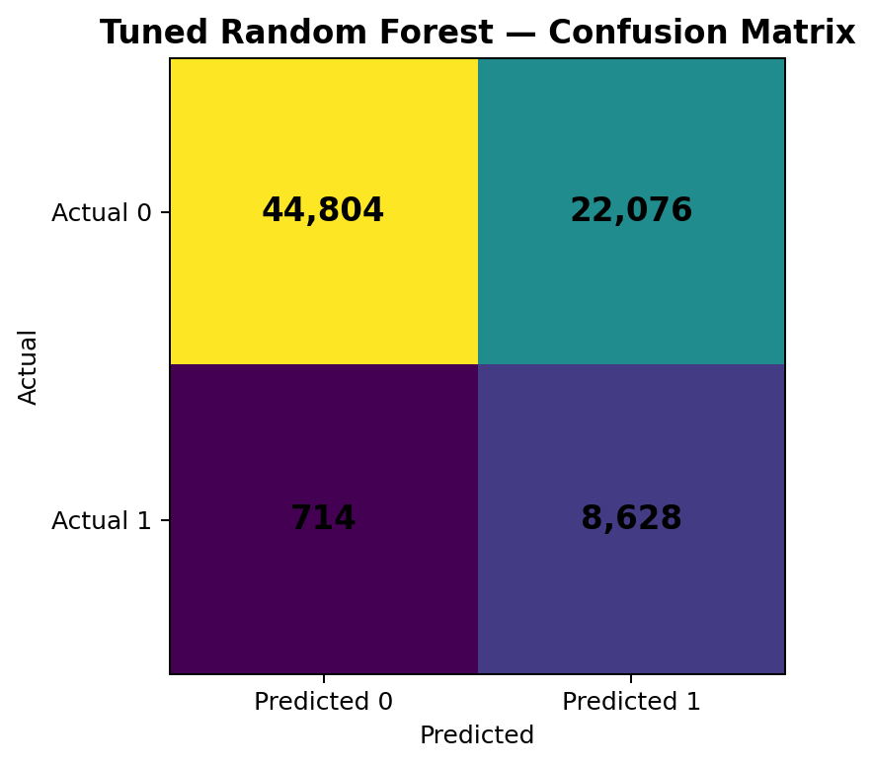
10. Evaluation Deep Dive — Class Imbalance
Recall = 92.36%
The tuned model identified most of the actual responders in the test set.
Precision = 28.10%
Many customers predicted as responders were actually non-responders.
Why this trade-off matters
For outreach use cases, missing a real responder can be costly; however, false positives also create extra campaign effort.
Accuracy can look lower because the model is intentionally identifying more of the minority class.
12

Slide 19
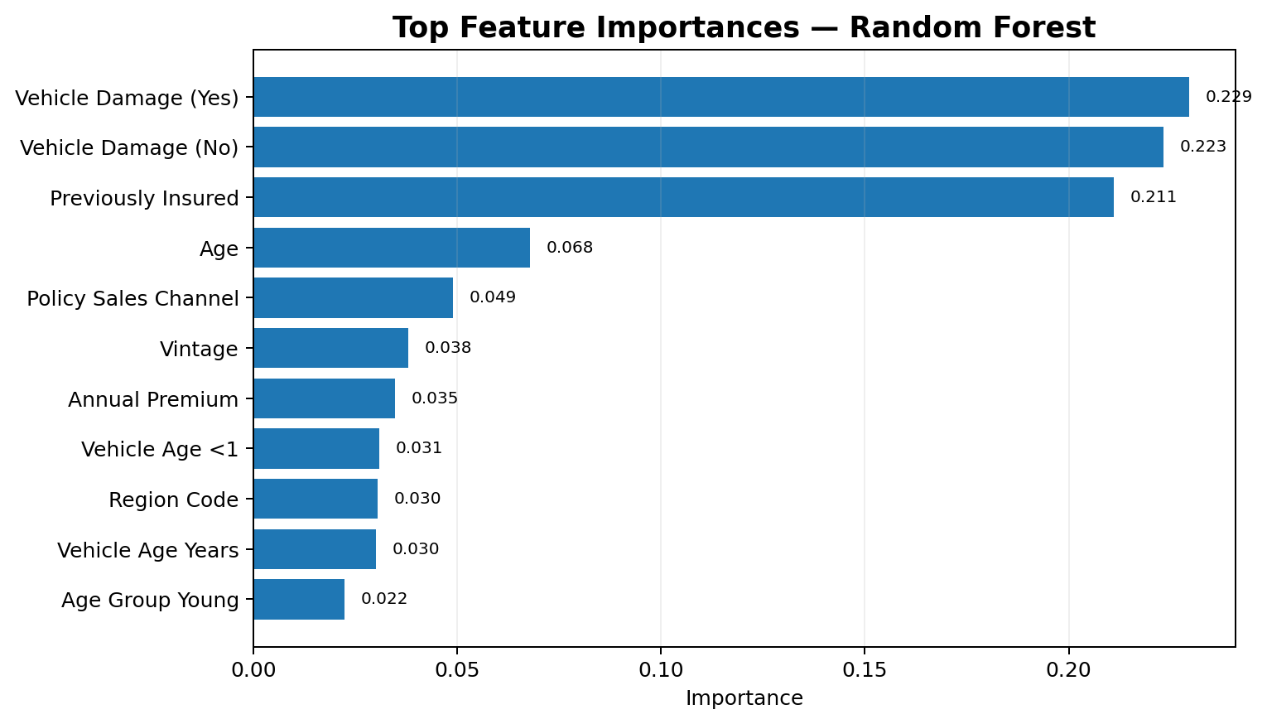
11. Feature Importance — Random Forest
- Vehicle damage indicators contributed strongly to the Random Forest predictions.
- Previously_Insured was another major contributor.
- Age, policy sales channel, vintage and annual premium also contributed.
- Feature importance describes model contribution; it does not establish causation.
Top three groups:
Vehicle Damage • Previously Insured • Age
13

Slide 20
12. Random Forest Hyperparameter Tuning
Used RandomizedSearchCV with 10 parameter combinations and 3-fold StratifiedKFold cross-validation.
Tuned: n_estimators, max_depth, min_samples_split, min_samples_leaf and max_features.
Scoring metric: ROC-AUC, which is suitable for evaluating ranking/discrimination under class imbalance.
Best parameters: n_estimators=200, max_depth=12, min_samples_split=10, min_samples_leaf=1, max_features="sqrt".
Best cross-validation ROC-AUC: 0.8534; tuned test ROC-AUC: 0.8544.
Tuning result
Higher test ROC-AUC than the original Random Forest, with recall increasing to 92.36%.
14

Slide 21
13. Model Saving & Prediction Workflow
The final tuned Random Forest pipeline was saved as: model/insurance_response_model.pkl.
The saved pipeline contains both preprocessing and the trained classifier, so new inputs go through the same transformations.
predict.py collects customer inputs, creates Vehicle_Age_Years and Age_Group, and calls predict_proba().
At the default classification threshold of 0.50, the probability is converted into a Yes/No response prediction.
A Streamlit interface was also prepared to provide an interactive front end for the prediction workflow.
Example test run
Predicted Response: YES
Estimated probability: 82.55%
Threshold: 0.50
15

Slide 22
14. Deployment Architecture
User Inputs
Feature Engineering
Saved Pipeline
Prediction
Gender, Age,
Vehicle & policy data
Vehicle_Age_Years
Age_Group
Scaler + OneHotEncoder
+ Tuned Random Forest
Probability +
YES / NO response
This makes the project usable beyond the notebook: the trained model can be loaded and applied to new customer records.
16

Slide 23
15. Limitations & Future Improvements
The dataset is strongly imbalanced, so precision remains relatively low while recall is high.
The current threshold of 0.50 is a default operating point; threshold tuning can be used to balance campaign volume and missed responders.
Additional evaluation such as Precision-Recall AUC, calibration and business-cost analysis would provide deeper insight.
Future work could test more algorithms, class-imbalance techniques applied only to training data, and explainability methods such as SHAP.
Production deployment would also require monitoring for data drift, model performance and changing customer behavior.
17

Slide 24
16. Conclusion
Built an end-to-end binary classification solution for insurance customer response prediction.
Performed data validation, EDA, preprocessing and feature engineering on 381,109 records.
Compared Logistic Regression, Decision Tree and Random Forest models using multiple evaluation metrics.
Used RandomizedSearchCV to tune the Random Forest with ROC-AUC as the optimization metric.
Saved the final model as a reusable .pkl pipeline and created a prediction workflow for new customers.
Key learning: for imbalanced classification, model evaluation should consider the business objective rather than accuracy alone.
Final test ROC-AUC
0.8544
Tuned Random Forest
18

Slide 25
Try this test customer on Streamlit
Gender: Male
Age: 35
Driving License: 1
Region Code: 28
Previously Insured: 0
Vehicle Age: 1-2 Year
Vehicle Damage: Yes
Annual Premium: 35000
Policy Sales Channel: 26
Vintage: 150

Slide 26
Questions?
I am happy to explain the data, model, evaluation, tuning or deployment workflow.
19

Slide 27
Thank You!
Insurance Customer Response Prediction Using Machine Learning

