Slide 1

Self-driving labs: sense or nonsense?
September 3, 2026

Slide 2
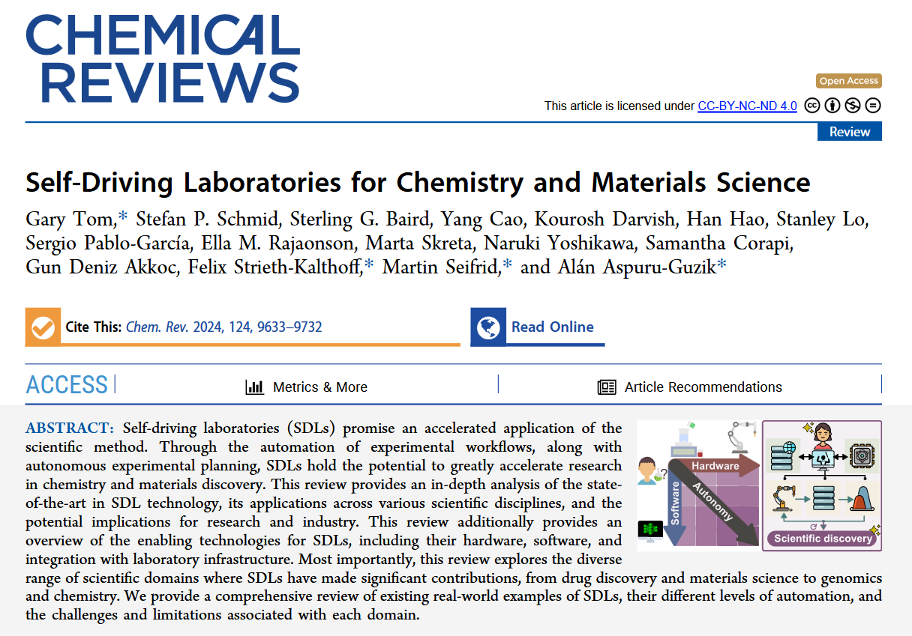
Comprehensive review paper
Extensive discussion
Today: not even attempting a summary
Use this paper as a starting point
Long history
Laboratory automation
Design of experiments
High throughput experimentation
Now: cheap hardware, powerful computing possible
https://doi.org/10.1021/acs.chemrev.4c00055

Slide 3
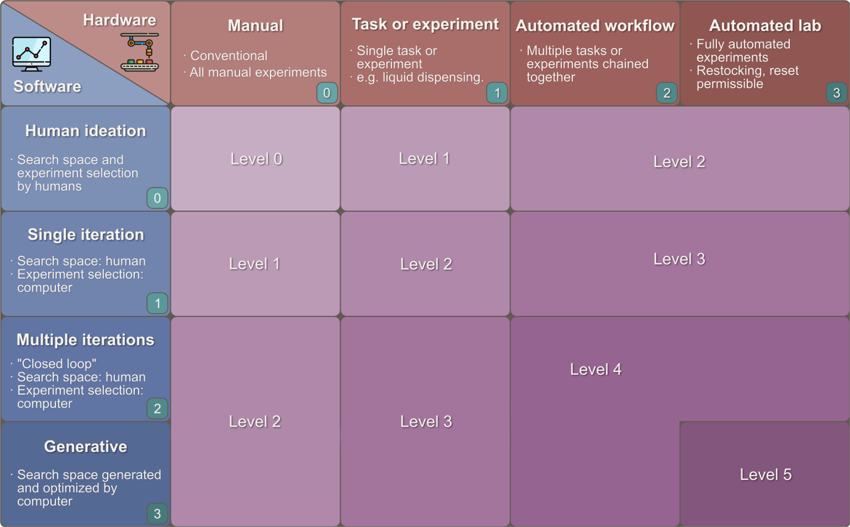
Key idea: 2 axes for self-driving-readiness

Slide 4
Key idea: 2 axes for self-driving-readiness
Software axis again lumps 2 ideas
Experiment selection
Search space definition

Slide 5

Closing the loop as a milestone (level 3?)
Repeatedly executing an experiment
Different conditions
Without human intervention
It is not known beforehand which experiments will be executed next
Mostly software decisions
Choice of hyperparameters is often overlooked!
Software
Consider data
Decide on next experiment
Hardware
Carry out experiment

Slide 6
Several use cases
Analytical chemistry
Drug Discovery
Structural materials
Optoelectronics
Energy Storage materials
Optimize “yield”/property
Reaction discovery
Multi-objective optimization

Slide 7
Summary
2 axes for a self-driving lab: Hardware and software
“Closing the loop” as a milestone
Different fields

Slide 8
Discussion points
What is the goal of research?
Optimization versus discovery
Who sets these goals? (computer, researcher, company, funding agency…)
What are bottlenecks in your research?
Synthesis
Characterization
Thinking (?)
Is it easier to build an SDL in some fields?
If yes, how do you describe/define these fields

