Slide 1


Smoothing experimental data
May 4, 2026

Slide 2
Overview
When (not) to smooth your data?
Know your noise
Different smoothers
Window methods: Convolution, Savitzky Golay
Total variation methods (e.g. Whitaker-Eilers)
Discussion

Slide 3
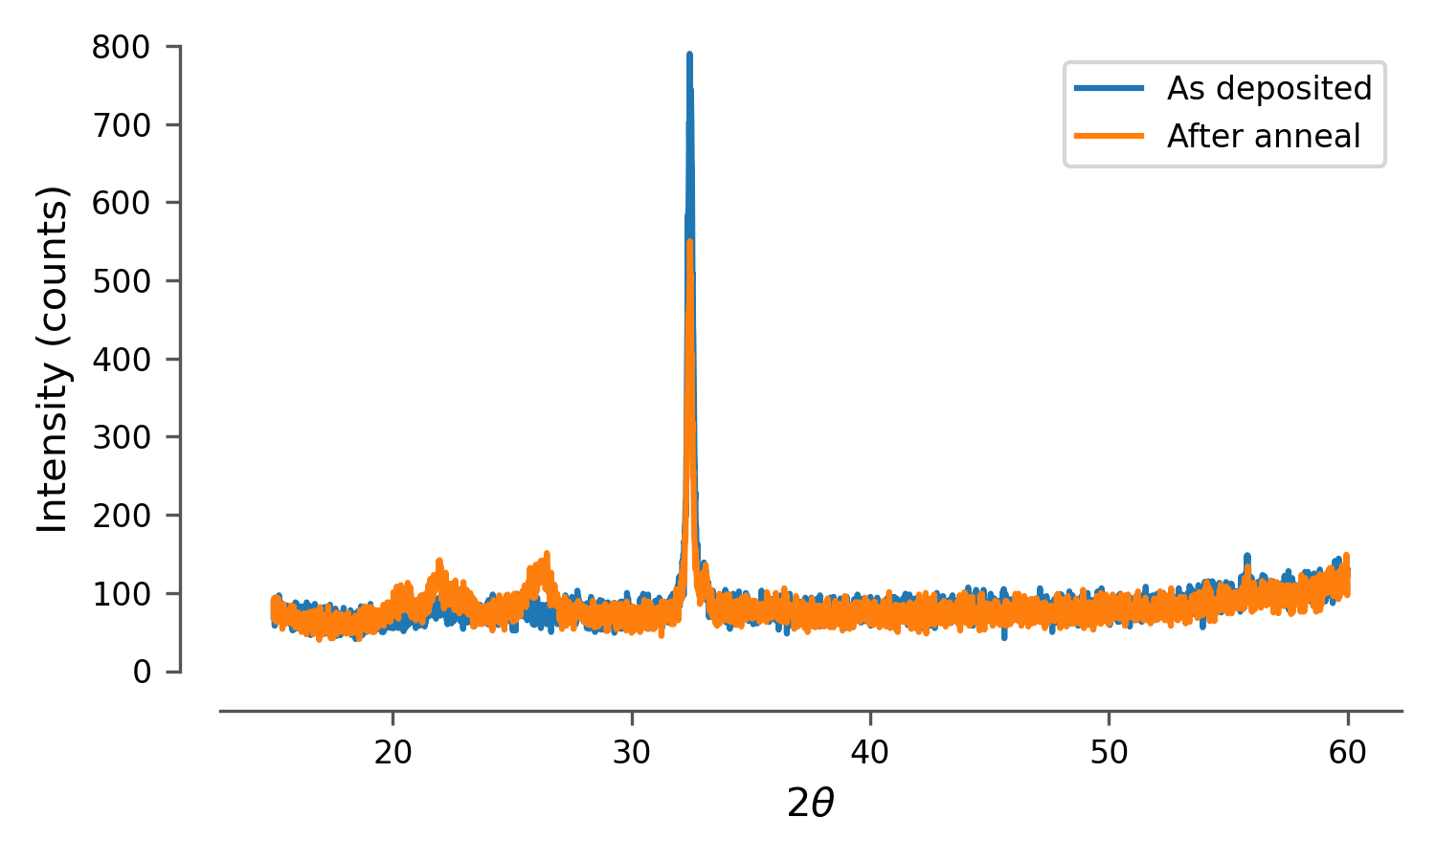
When (not) to smooth your data
NO: direct interpretation or fitting
You may miss features because of (excessive) smoothing
You may see features that are not there because of smoothing of an outlier
YES: Further transformation
Fourier transformation
Derivative
Presentation?
Would you smooth these XRD spectra?

Slide 4
Know your noise
Gaussian noise: additive
observation = signal + noise(standard deviation)
Poisson noise (counts): applied
Observation = noise(signal)
Low counts: low noise
High counts: higher noise (but lower fraction!)
Converges to gaussian noise
Effect of binning / integrating longer!!

Slide 5
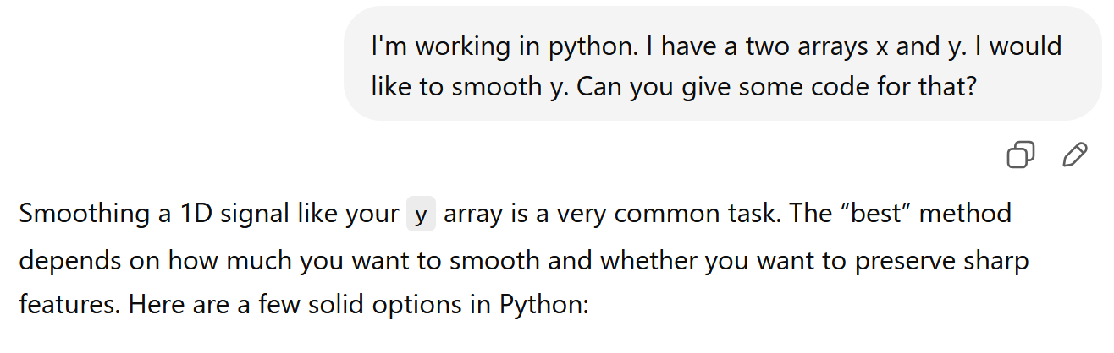
Convolution
First answer of ChatGPT
def moving_average(y, window_size=5):
return np.convolve(y, np.ones(window_size)/window_size, mode='valid')
y_smooth = moving_average(y, window_size=5)
x_smooth = x[:len(y_smooth)] # adjust x accordingly

Slide 6
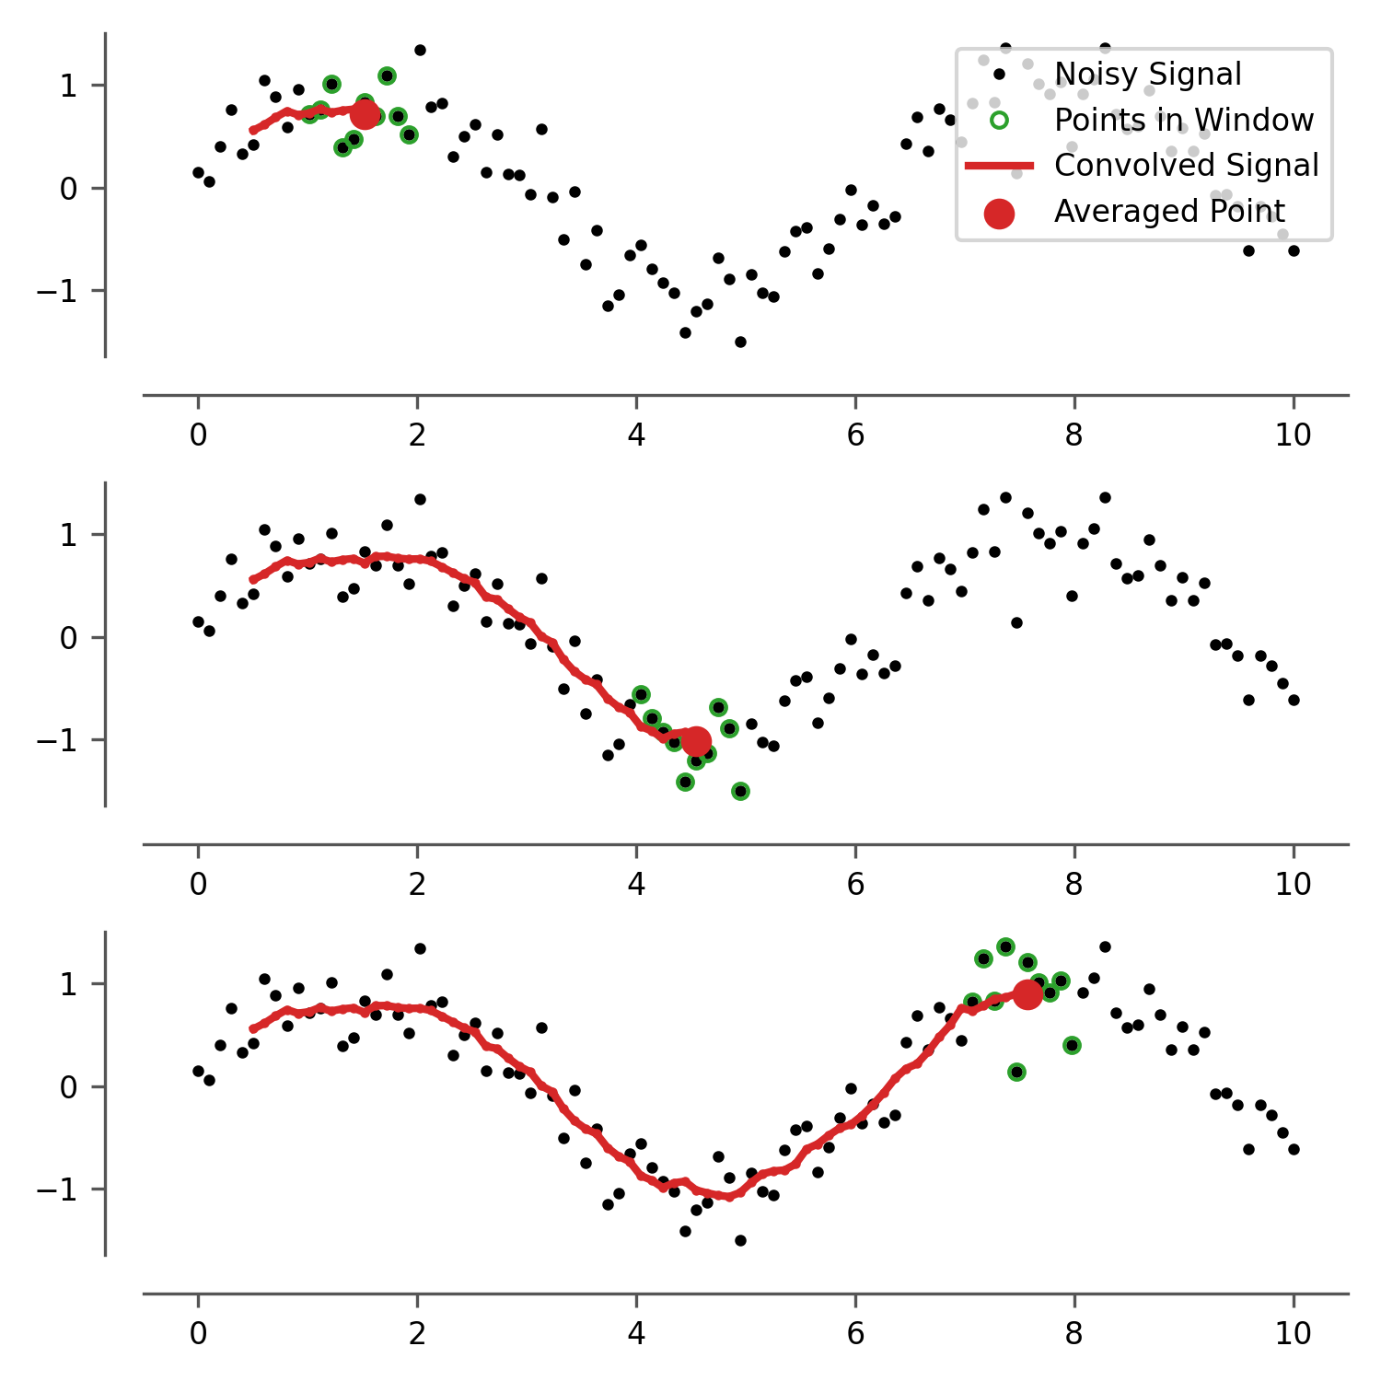
Convolution

Slide 7
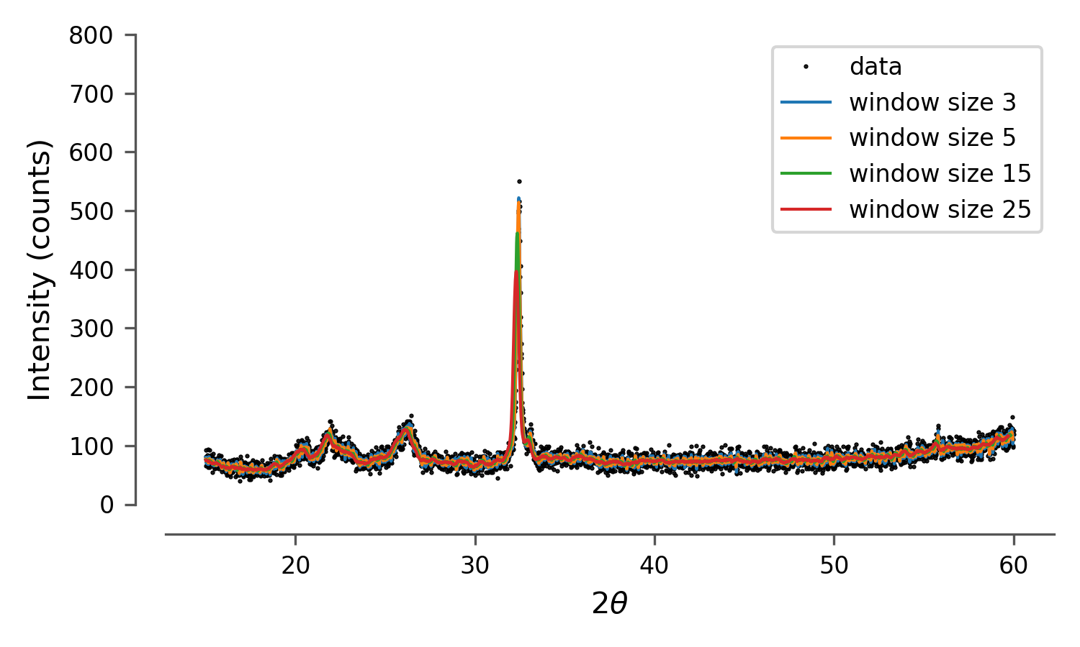
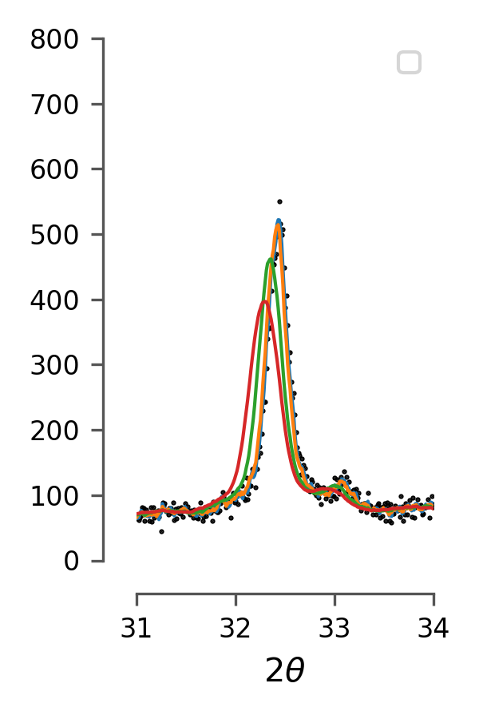
Convolution
First answer of ChatGPT
def moving_average(y, window_size=5):
return np.convolve(y, np.ones(window_size)/window_size, mode='valid')
y_smooth = moving_average(y, window_size=5)
x_smooth = x[:len(y_smooth)] # adjust x accordingly

Slide 8
Convolution
First answer of ChatGPT
Benefits: simple, same number of points (?)
Problems: edges, window size estimation, shifting (?)
Other suggestions in the answer
Savitzky-Golay (also window method: next slide)
Gaussian smoothing (also convolution!)
Locally weighted regression (I didn’t know this one…)
Other thought: binning (from ~ 3000 points to about 1000 points)
As long as features are larger than 1 point, this seems like a legit method…
The statistics are more transparent (in case you want that)

Slide 9
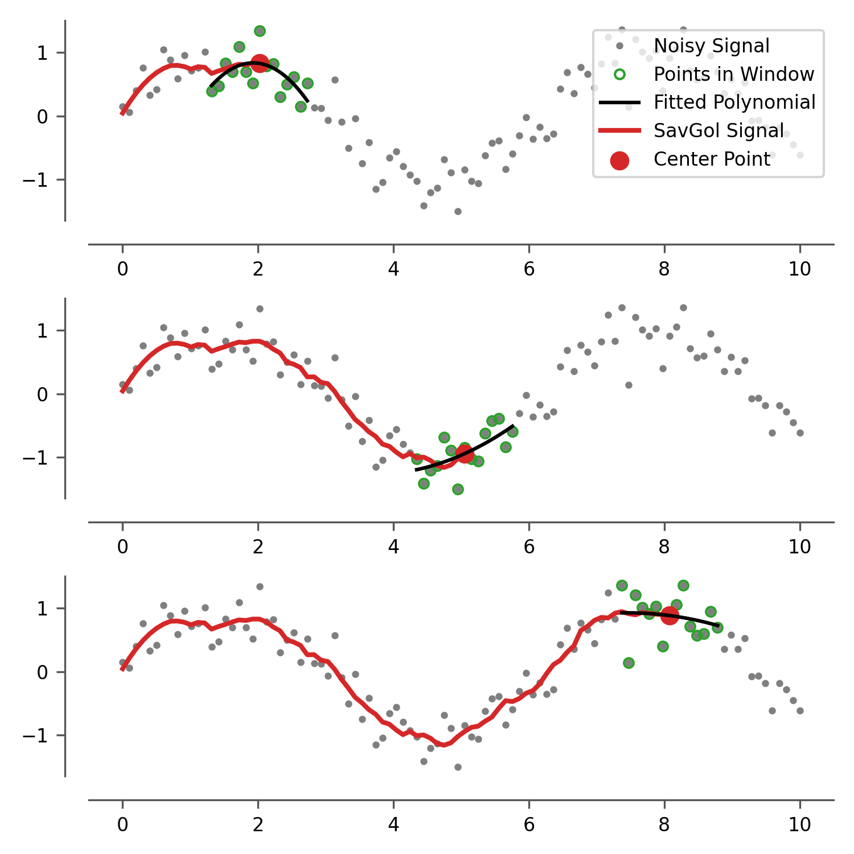
Savitzky - Golay
Instead of taking the average of points in window, fit a polynomial.
Benefits
very commonly used
Problems?
window size estimation
degree of polynomial
Computationally intensive

Slide 10
Total Variation methods
Underlying idea
Noise is statistically independent
Signal will be correlated with its neighbors
Allow for ‘sharp edges’ ( = ‘preservation of peaks’)
Our brain does this automagically
Observation(x) = signal(x) + noise(standard deviation)
Note: periodic noise!!!

Slide 11
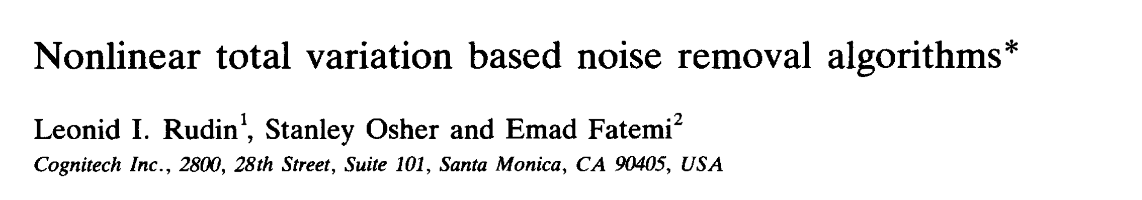
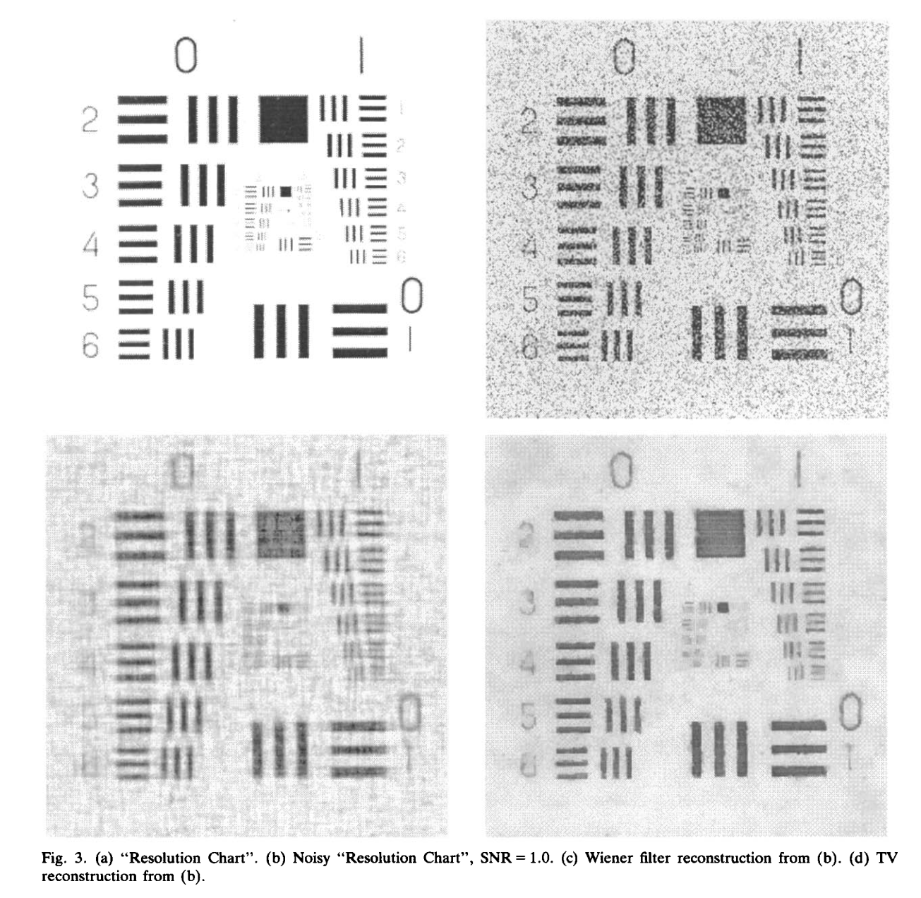
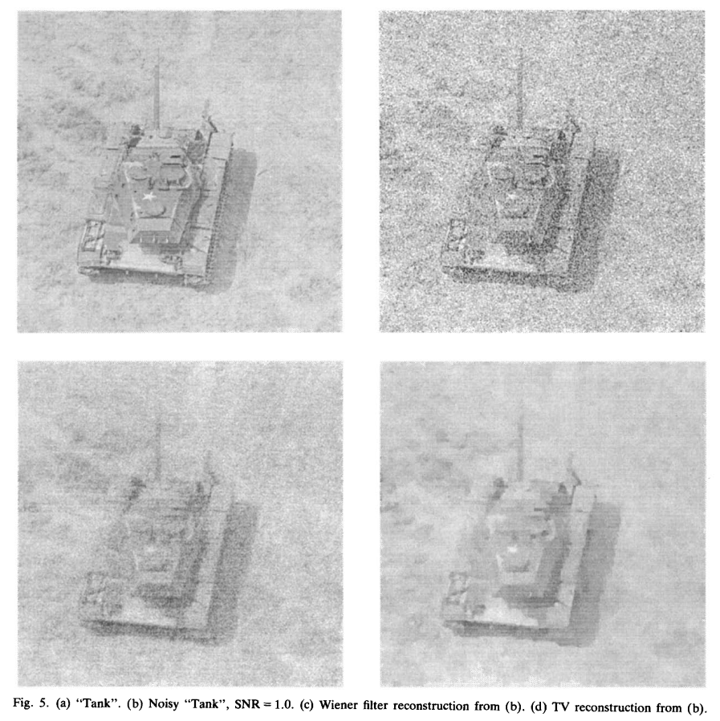
Total Variation methods
For images: you want to preserve edges
1992: Post cold-war, declassified!

Slide 12
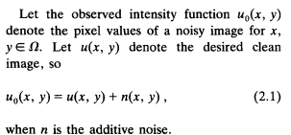
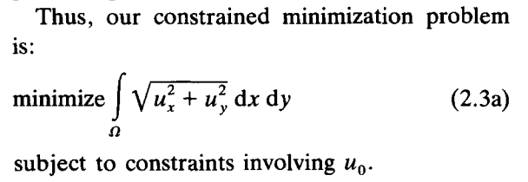
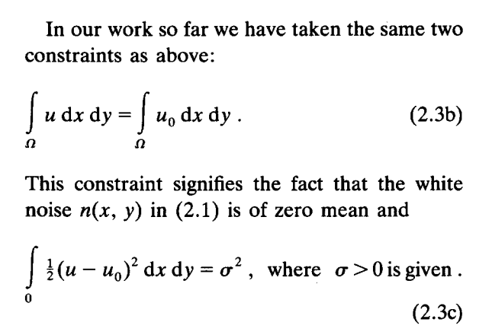
Total Variation methods

Slide 13
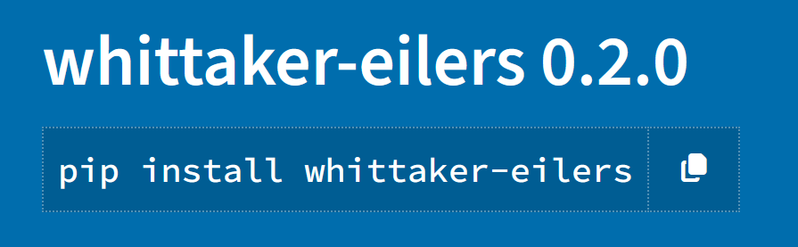
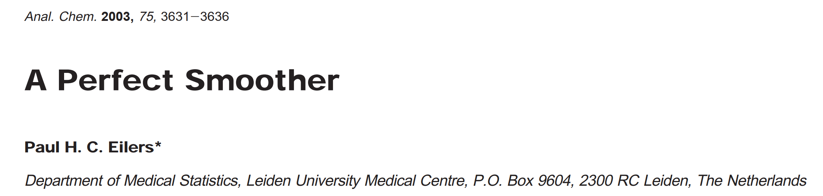
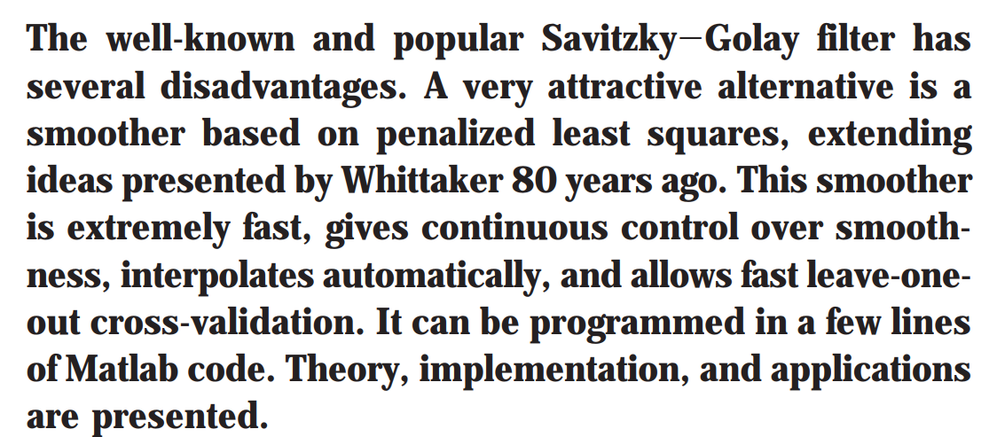
Whittaker-Eilers
Apparently, Whittaker had this idea (‘total variation regularization’) earlier
Extended by Eilers in 2004
Here: matrix formalism for fast computation

Slide 14
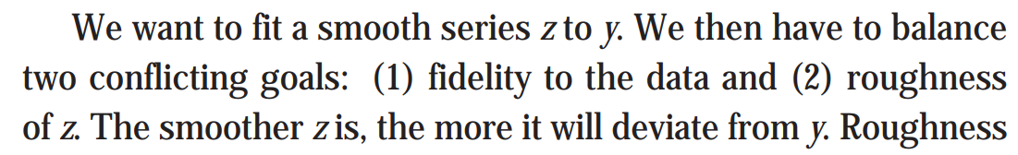
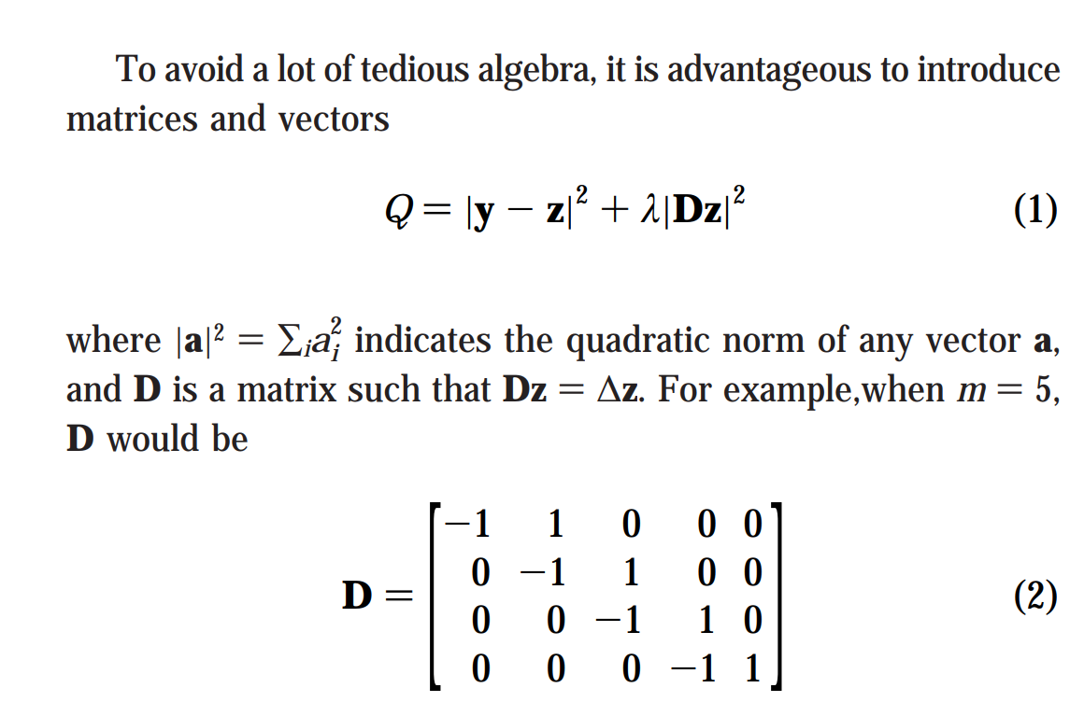
Whittaker-Eilers
Note: parameter lambda
Note: single point derivative, can also take multipoint derivative

Slide 15
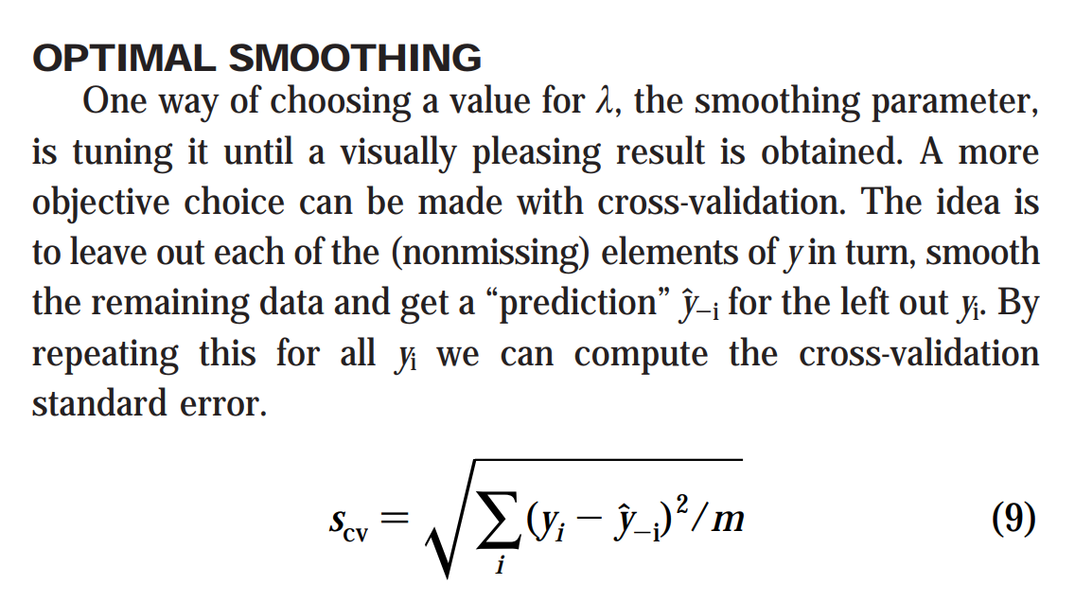
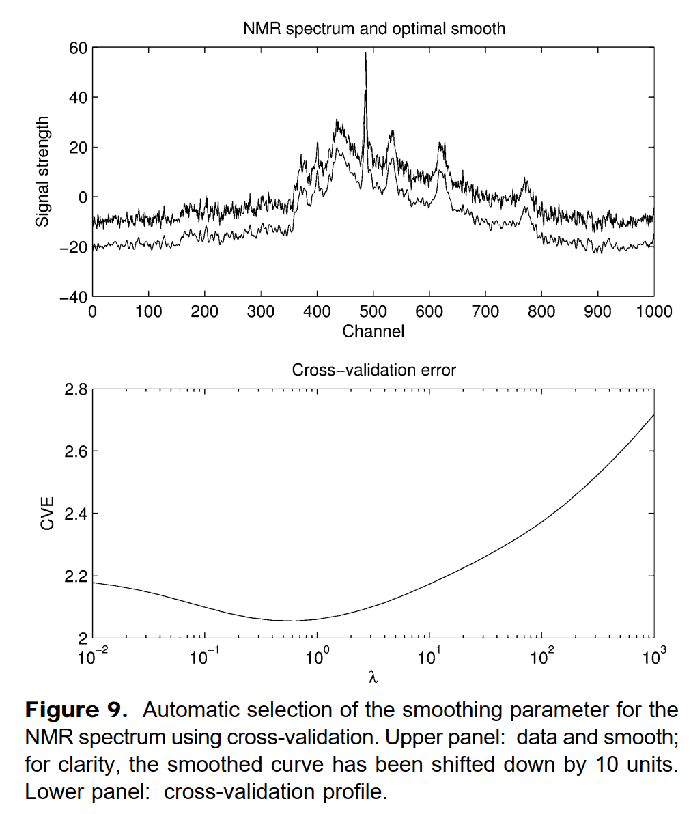
Whittaker-Eilers
Note: this is a way to objective determine the value lambda!
The paper then goes into some depth about how to efficiently calculate S_{CV}

Slide 16
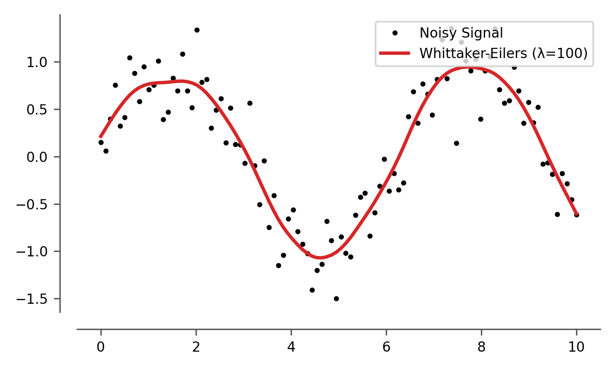
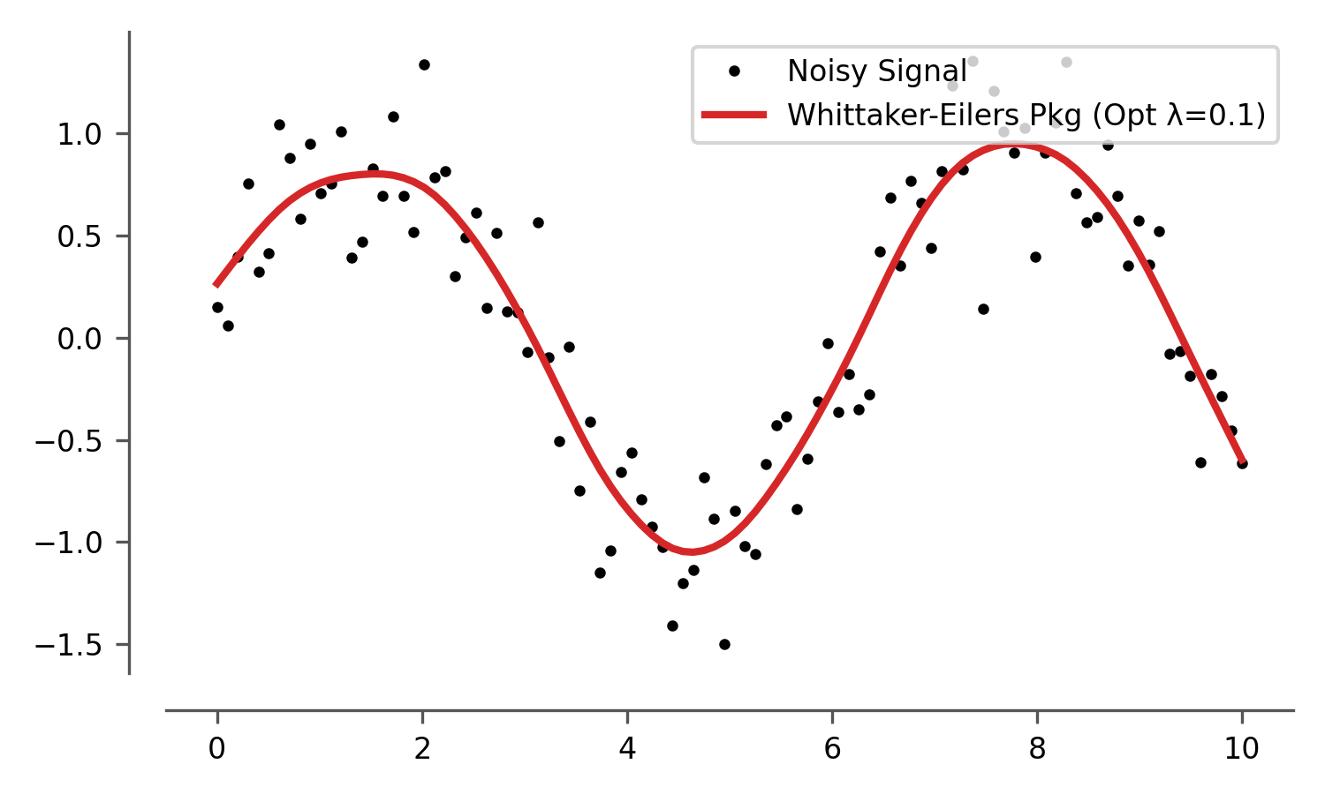
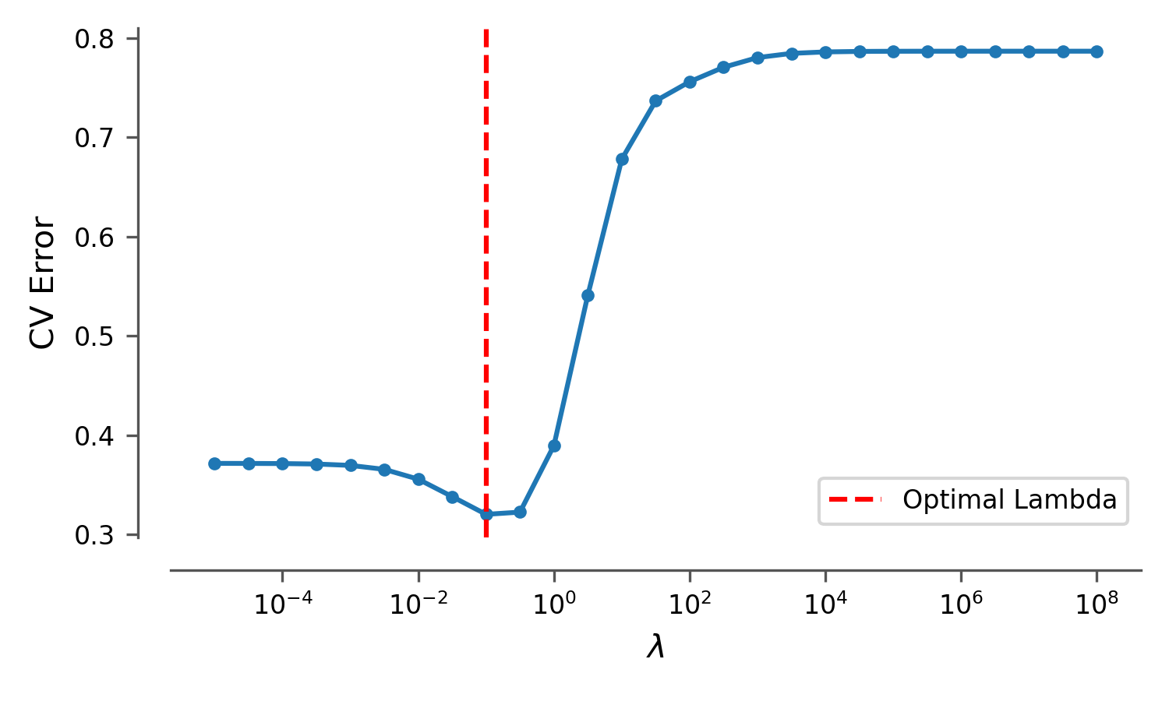
Whittaker-Eilers on our datasets

Slide 17
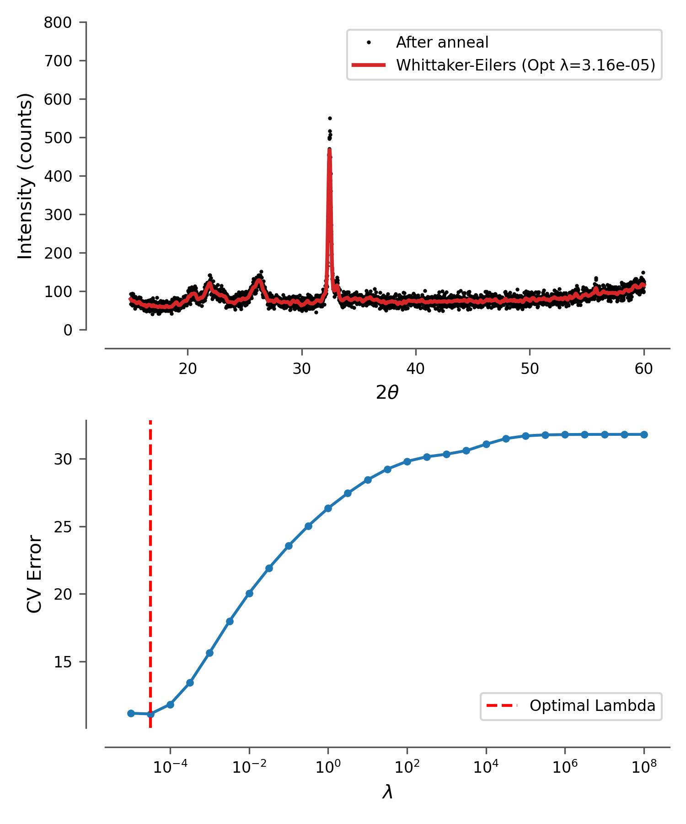
Whittaker-Eilers on our datasets
Note: NO parameters,
objective smoother…

Slide 18
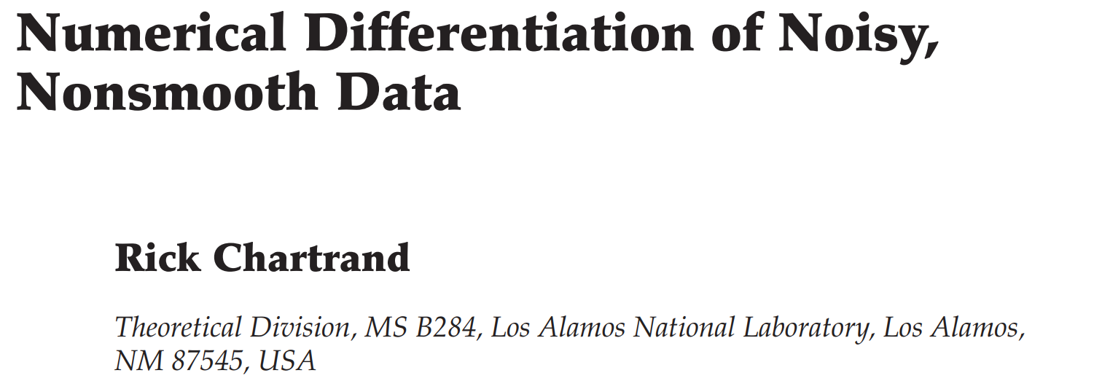
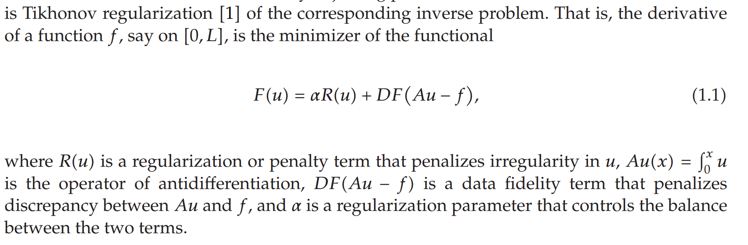
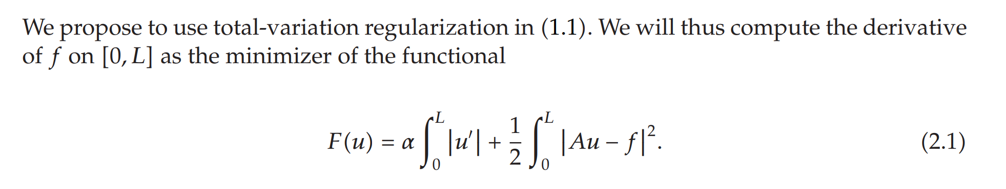
Bonus: Chartrand
u is the derivative of noisy signal f you want to compute.
So you use the integral Au and the derivative u’ of u

Slide 19
Discussion
Experiences with smoothing?
Other metrics beyond ‘visually pleasing’?
In which situations?
Other methods?
Would you smooth?
SEM images
XRD spectra
FTIR spectra

