Slide 1
Asymmetrically reweighted penalized least squares smoothing
The baseline correction algorithm you didn’t know you needed
Jorden De Bolle

Slide 2
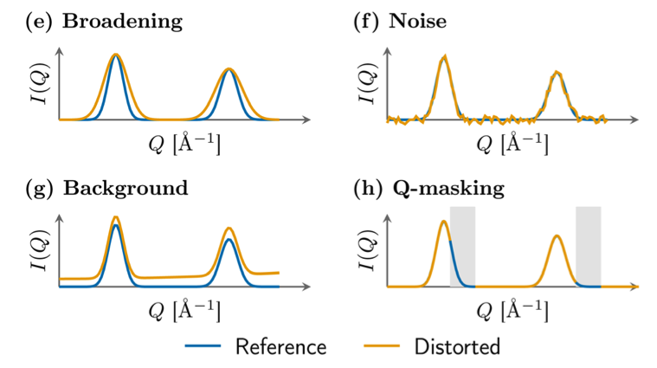
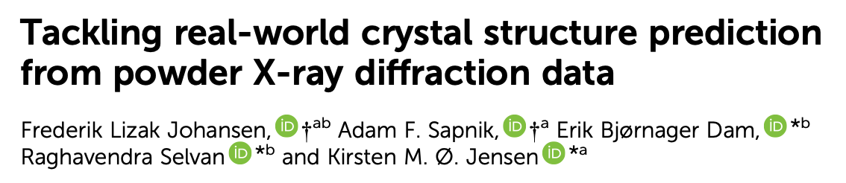
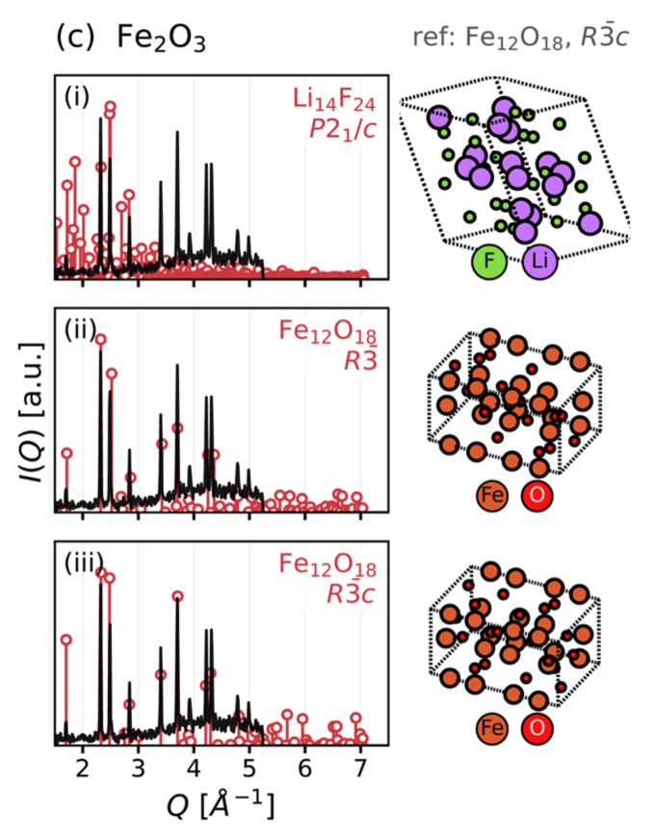
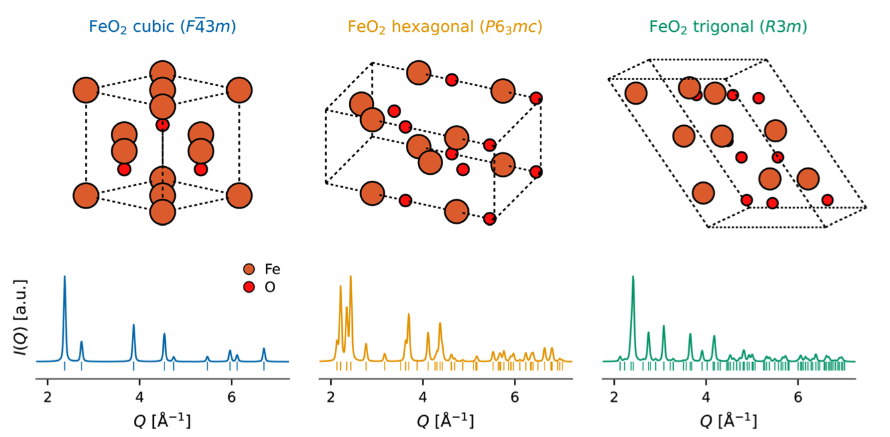
Remember two weeks ago…

Slide 3
Remember two weeks ago…
→ How often do you come across a situation where you have to subtract a background?

Slide 4
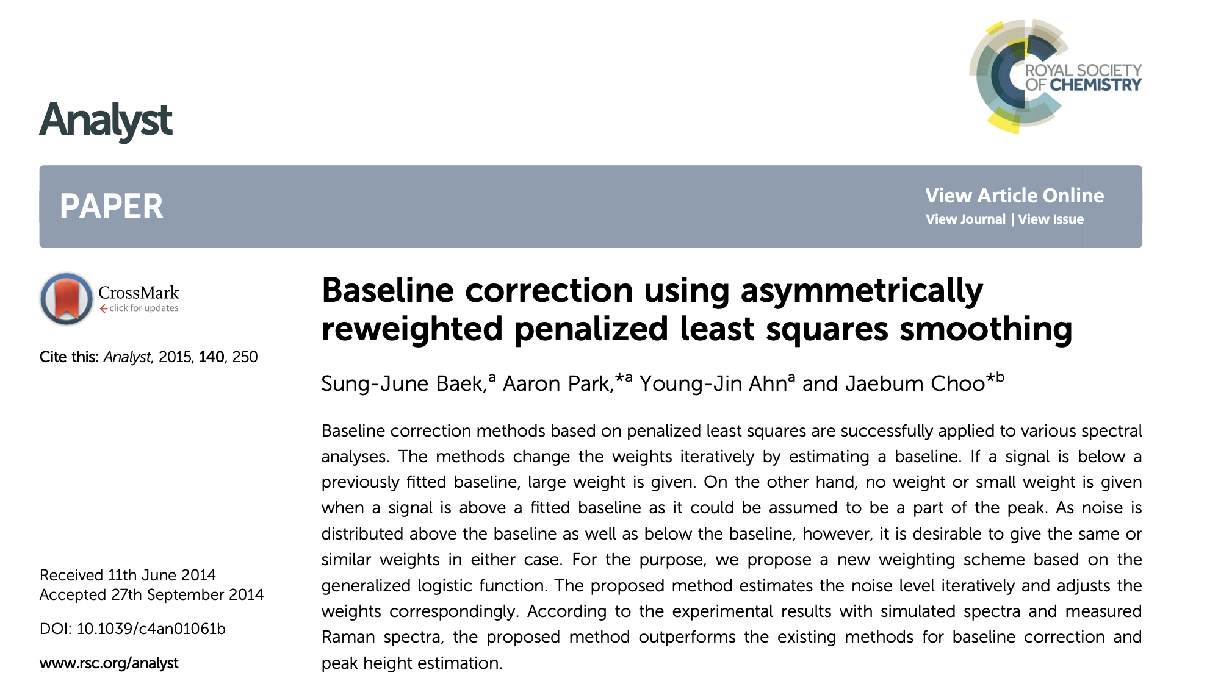

Slide 5
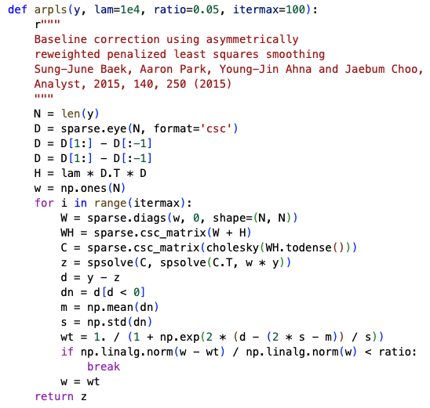
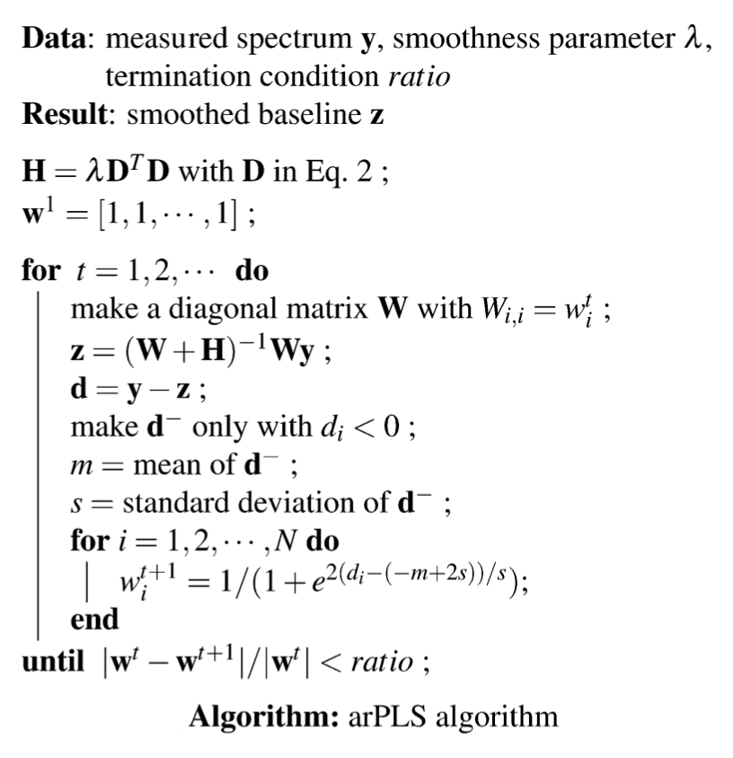
Asymmetrically reweighted penalized least squares smoothing

Slide 6

How it works
Least squares smoothing
Least squares: try to find a function z that minimises the error between z and y
Penalty term if second derivative of z is large: smoothness
Weights matrix: where there is a peak in y, the weight becomes 0

Slide 7
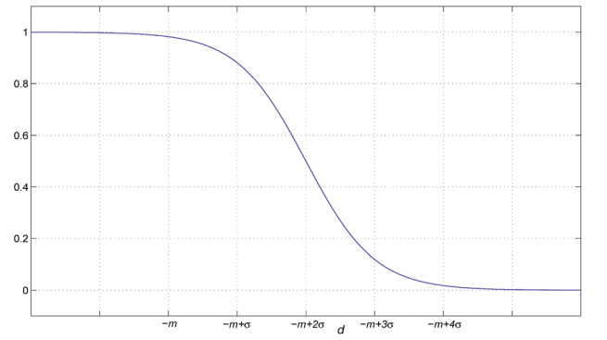
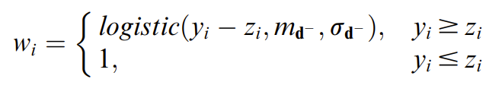
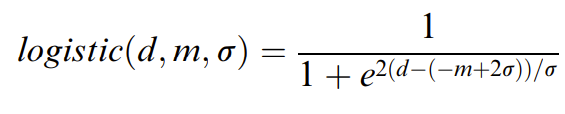
How it works
Weights matrix: where there is a peak in y, the weight becomes 0
→ How to assign the weights?
ARPLS:

Slide 8
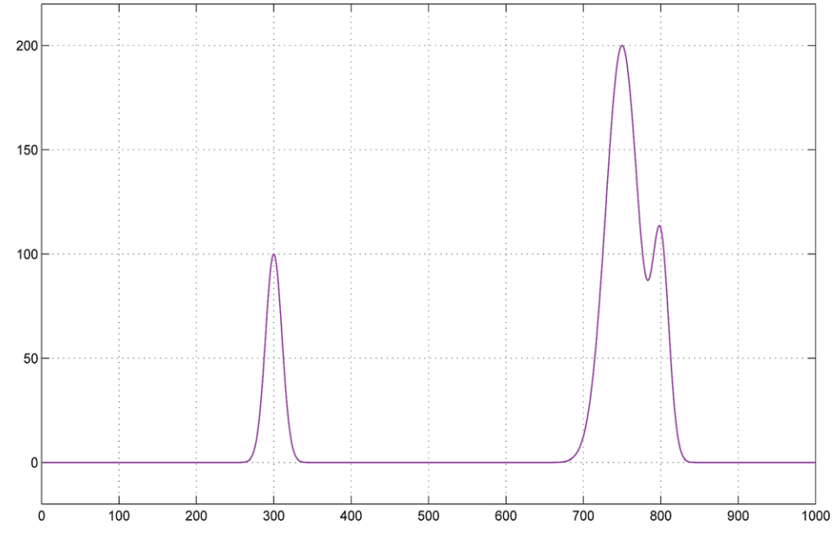
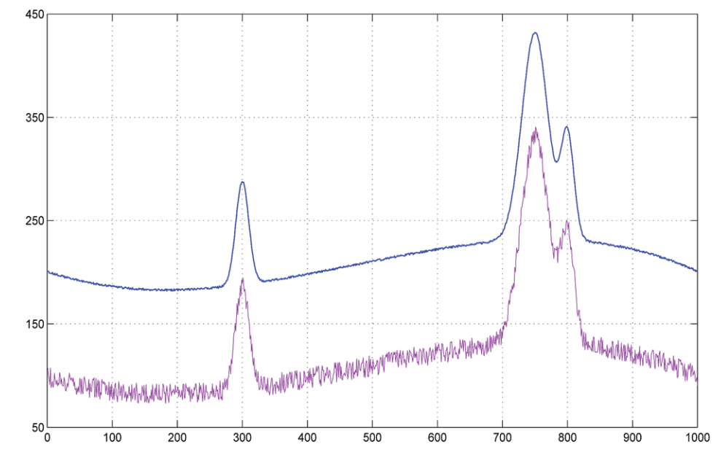
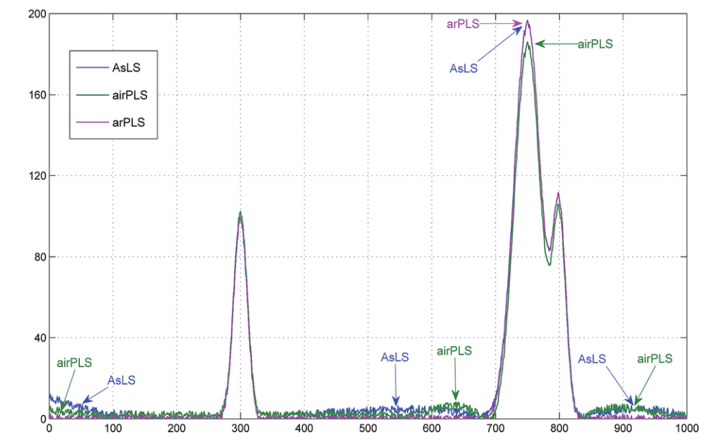
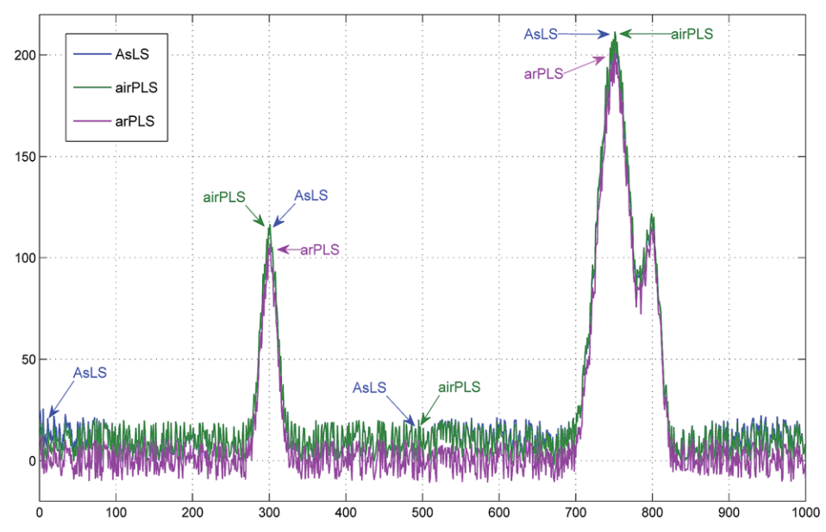
Some examples (from the paper)
Simulated signal
Simulated signal
+ noise + background
Baseline
correected
Baseline
correected

Slide 9
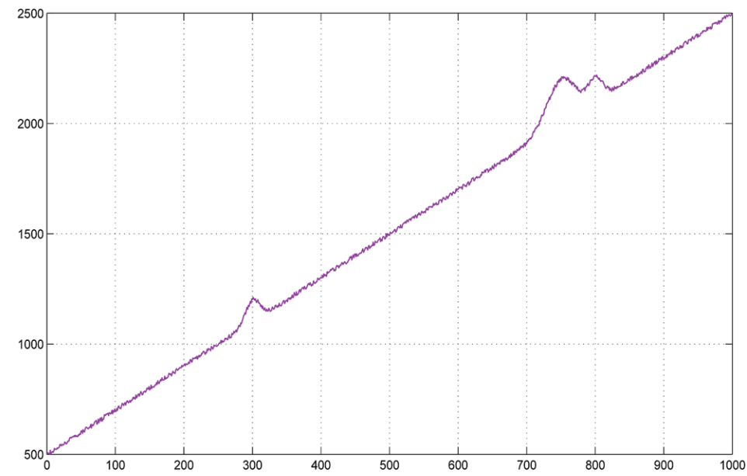
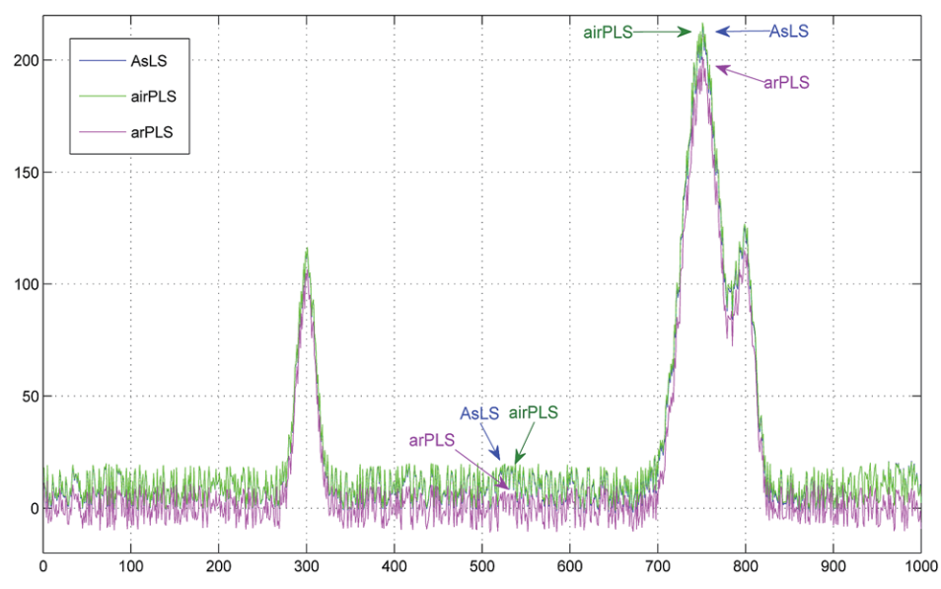
Some examples (from the paper)

Slide 10
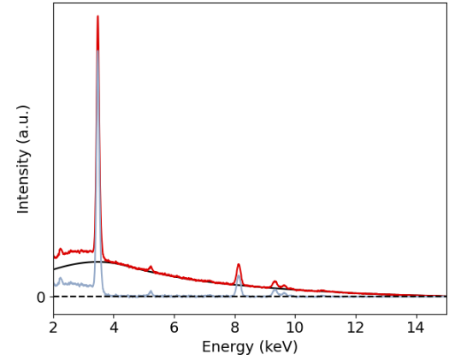
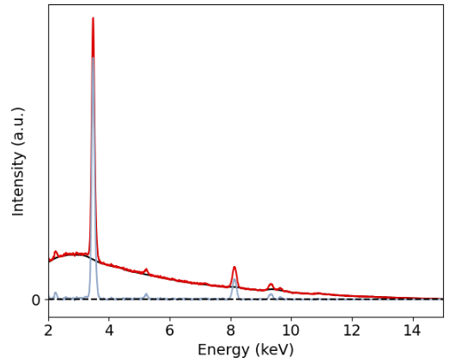
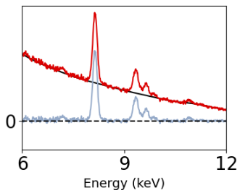
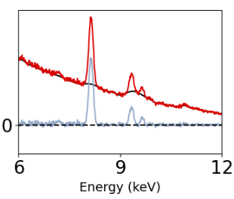
Some examples (from the real world): EDX
λ=1x10⁵
λ=1x10³

Slide 11
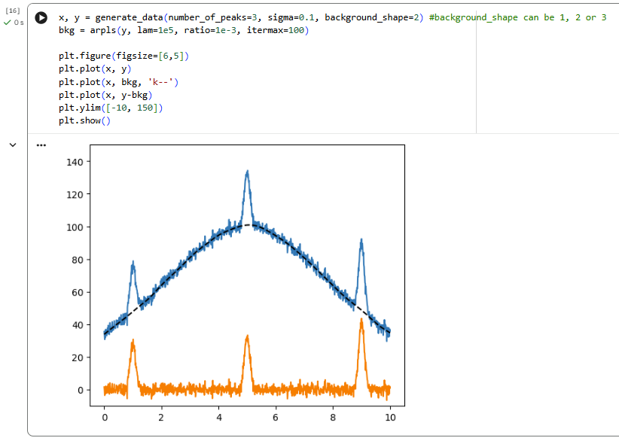
Now it’s your turn
https://colab.research.google.com/drive/1BqKSirKvoHp3z57vtKybTcNx90dYF7sK?usp=sharing
Download notebook and open in google colab (https://colab.research.google.com/)

Slide 12


