Slide 1

RetailMind: Autonomous Retail Research Agent
An AI-powered system that automates retail industry research through intelligent multi-agent collaboration

Slide 2

What is RetailMind?
RetailMind is a full-stack AI-powered web application that transforms how retail professionals conduct market research. Simply enter a natural language query, and the system autonomously generates a comprehensive, professional research report.
The platform combines generative AI, agentic systems, and modern DevOps practices to deliver real-time insights without manual intervention.

Slide 3



Three AI Technologies Powering the System
Generative AI
Agentic AI
DevOps
Google Gemini API generates structured reports, extracts insights, and produces professional documentation from raw data
CrewAI orchestrates autonomous agents that collaborate, make decisions, and execute research tasks independently
Automated CI/CD pipelines, containerization, and cloud deployment ensure reliable, scalable production infrastructure

Slide 4



Three AI Agents Working in Harmony
Researcher Agent
Analyst Agent
Writer Agent
Collects real-time data from the web using Tavily Search API
Processes information and extracts meaningful insights
Generates structured professional reports
These agents work autonomously, communicating and collaborating to deliver comprehensive research results without human intervention.

Slide 5
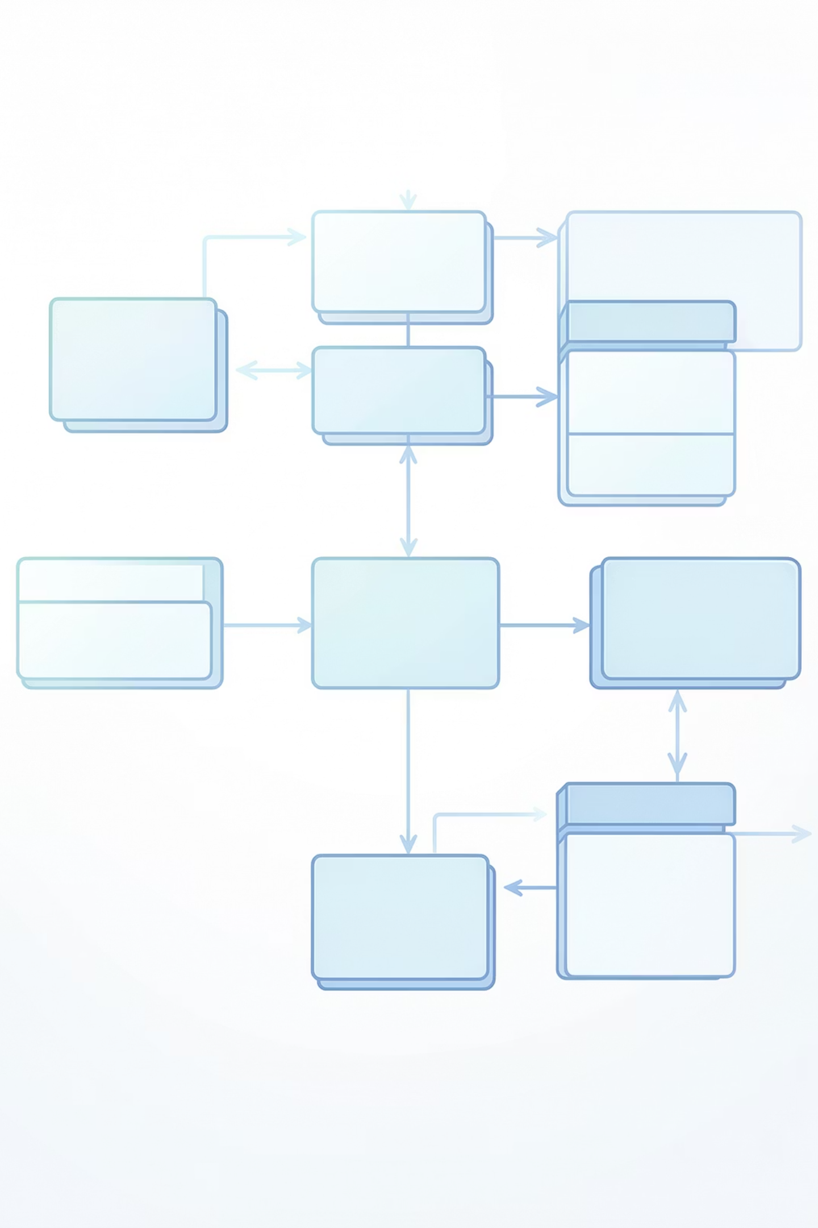
System Architecture
01
Frontend Layer
React UI with Tailwind CSS provides intuitive user interface
02
Backend Layer
FastAPI handles requests and coordinates AI agents
03
Data Layer
ChromaDB enables semantic search over vector embeddings
04
Storage Layer
Text files provide backup and retrieval capability

Slide 6

Technology Stack
Backend
Frontend
Data Storage
Python programming language
FastAPI framework
CrewAI for agent orchestration
Google Gemini API
Tavily Search API
React component library
Tailwind CSS framework
Server-Sent Events (SSE)
ChromaDB vector database
Text file backup system

Slide 7
Key Features
Autonomous Research
Real-Time Progress
Complete research execution without human intervention from query to report generation
Server-Sent Events (SSE) stream updates with low latency as research progresses
Semantic Search
Dual Storage
Query past reports using natural language with vector-based similarity matching
Vector database for semantic search plus text files for reliable backup and retrieval

Slide 8
DevOps Implementation
AWS EC2
CI/CD Pipeline
Production deployment on scalable cloud infrastructure with rollback capabilities
Containerization
GitHub Actions automates testing and deployment with SHA-based versioning
Docker packages application and dependencies for consistent deployment across environments

Slide 9

Performance & Benefits
Performance
Advantages
Real-time updates with minimal latency
Automated deployment within minutes
Production-ready infrastructure
Significantly reduces time and cost of manual research
Enhanced accuracy through real-time data
Scalable and maintainable architecture

Slide 10


Future Roadmap
1
User Authentication
Secure user accounts with role-based access control and data privacy
2
Export Capabilities
Generate PDF and Word document formats for sharing and presentations
3
Customization
Industry-specific research templates and tailored data sources
4
Monitoring
Kubernetes orchestration with comprehensive logging and alerting systems

