Slide 1
COMPUTER ORGANIZATION & ARCHITECTURE
MARIE Architecture
From C source to RTL simulation
Project deliverables
1.1 C → MARIE assembly
1.2 Hex encoding for memory load
1.3 iverilog simulation + waveform
Toolchain
Icarus Verilog · vvp · GTKWave
MARIE ISA: 4-bit op + 12-bit address
16-bit word, 4096-word memory
Wednesday, April 29, 2026
1 / 13

Slide 2
PROJECT AT A GLANCE
From a 4-line C loop to silicon simulation
{}
ASM
0x
RTL
~
C source
MARIE asm
Hex image
Verilog CPU
Waveform
test.c
test.asm
test.hex
iverilog
dump.vcd
20
5
79
17
instructions in code section
loop iterations executed
instructions retired before HALT
memory store transactions
Goal: prove that a hand-written MARIE program runs correctly on the provided Verilog CPU.
2 / 13

Slide 3
CHAPTER 4 HIGHLIGHTS
What is MARIE?
Architecture
Instruction set (16 bits each)
Machine Architecture that is Really Intuitive and Easy
0
NOP
no operation
Word size
16 bits, 2's complement
Memory
4096 × 16-bit words, byte-addressed by 12-bit MAR
Registers
AC (16) · MBR (16) · IR (16) · MAR (12) · PC (12) · InREG · OutREG
Instruction format
[ 4-bit opcode | 12-bit address ]
Implementation
Simple accumulator-based ISA, ideal as a teaching machine
1
LOAD X
AC ← M[X]
2
STORE X
M[X] ← AC
3
ADD X
AC ← AC + M[X]
4
SUBT X
AC ← AC − M[X]
5
INPUT
AC ← InREG
6
OUTPUT
OutREG ← AC
7
HALT
stop the CPU
8
SKIPCOND
skip if cond on AC
9
JUMP X
PC ← X
3 / 13

Slide 4
DATAPATH
ld_mbr2ac (LOAD)
ld_ac2mbr (STORE)
How the registers wire together
PC
IR
AC
MAR
MBR
12-bit
16-bit
16-bit
12-bit
16-bit
rdata
adr
ld_pc2mar (FETCH)
alu_out
ALU
Control
Memory
ADD / SUB
FETCH→DECODE→
MEMRW→EXECUTE
4096 × 16 bits
Notice: MAR addresses memory. MBR holds the word in flight. AC is the only general-purpose register; every arithmetic step routes through it.
4 / 13

Slide 5
CONTROL UNIT
Four-state instruction cycle
next instruction
FETCH
DECODE
MEMRW
EXECUTE
ld_mdata2ir = 1
inc_pc = 1
decode opcode
ld_ir2mar / ld_ac2mbr ...
ld_mdata2mbr or memwr
ld_mbr2ac / exrdy
ld_pc2mar = 1
Read instruction at M[PC] into IR; advance PC.
Read ir[15:12]; latch operand-address into MAR.
Read M[ir.addr] into MBR for ALU ops, or write AC to mem for STORE.
Update AC; load next-fetch address (PC) into MAR.
Side effects from DECODE
assert_halt
assert_skip
assert_jump
FSM freezes — clock keeps running but cpu_state stays put.
PC += 1 next clock — Skipcond evaluates ir[11:10] vs AC sign/zero.
PC ← ir[11:0] next clock — unconditional branch.
5 / 13

Slide 6
PART 1.1
The C source — small but instructive
test.c
Translation challenges
// place i @ mem[16], a[0] @ mem[40]
int i = 0;
while ( i < N ) {
a[i] = i;
i = i + 1;
}
No >, <, == comparisons
Express i < N as Subt N → Skipcond 000.
No while/for construct
Build it from Skipcond + two Jumps: fall-through to body, jump back at end.
No indexed addressing in this CPU
Only direct addressing is implemented (no LoadI/StoreI). PTR is updated as a value, demonstrating loop control flow.
End-of-sim check
wait(cpu.ctrl.assert_halt) → $display("memarray[40] = ..."); → $finish.
6 / 13

Slide 7
PART 1.1
Filled-in test.asm
ORG 0
Data section
START, Load ZERO
I, DEC 0
N, DEC 5
ONE, DEC 1
ZERO, DEC 0
BASE, DEC 40
PTR, DEC 0
Store I
Load BASE
Store PTR
LOOP, Load I
Subt N
Skipcond 000
Jump END
Jump BODY
BODY, Load N
Section legend
Subt I
Store PTR
init
Load PTR
Set I=0, PTR=BASE
Add ONE
loop
Store PTR
Test i < N via Subt+Skipcond
Load I
body
Add ONE
Update PTR and i, then re-test
Store I
halt
Jump LOOP
END, Halt
End the program
7 / 13

Slide 8
PART 1.2
Encoding test.asm → test.hex
Encoding rule
test.hex (memory image)
Each instruction = 1 word = 4 hex digits.
Top nibble = opcode, bottom 3 nibbles = address operand.
0x00
1019
Load ZERO
0x01
2016
Store I
0x02
101A
Load BASE
0x03
201B
Store PTR
0x04
1016
Load I ; LOOP:
0x05
4017
Subt N
0x06
8000
Skipcond 000
1
0
1
9
0x07
9013
Jump END
0x08
9009
Jump BODY
0x09
1017
Load N ; BODY:
0x0A
4016
Subt I
OP
addr[11:8]
addr[7:4]
addr[3:0]
0x0B
201B
Store PTR
0x0C
101B
Load PTR
0x0D
3018
Add ONE
0x0E
201B
Store PTR
Example: Load ZERO → 0x1019 → LOAD addr 0x019 (=25 dec)
0x0F
1016
Load I
0x10
3018
Add ONE
0x11
2016
Store I
0x12
9004
Jump LOOP
0x13
7000
Halt ; END:
0x14
0000
(pad)
0x15
0000
(pad)
0x16
0000
I = 0
0x17
0005
N = 5
0x18
0001
ONE = 1
0x19
0000
ZERO = 0
0x1A
0028
BASE = 40
0x1B
0000
PTR = 0
8 / 13

Slide 9
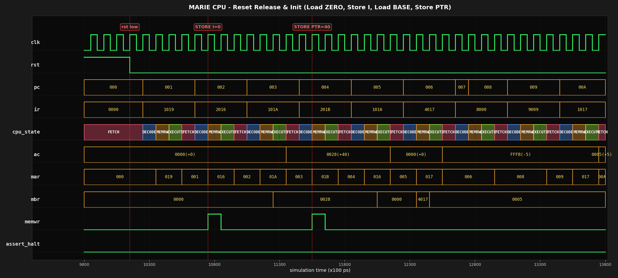
PART 1.3
Simulation ran clean — overview waveform
$ iverilog -f cpu.f && vvp a.out
Result: assert_halt fires at t = 41 450 → simulation done.
9 / 13

Slide 10
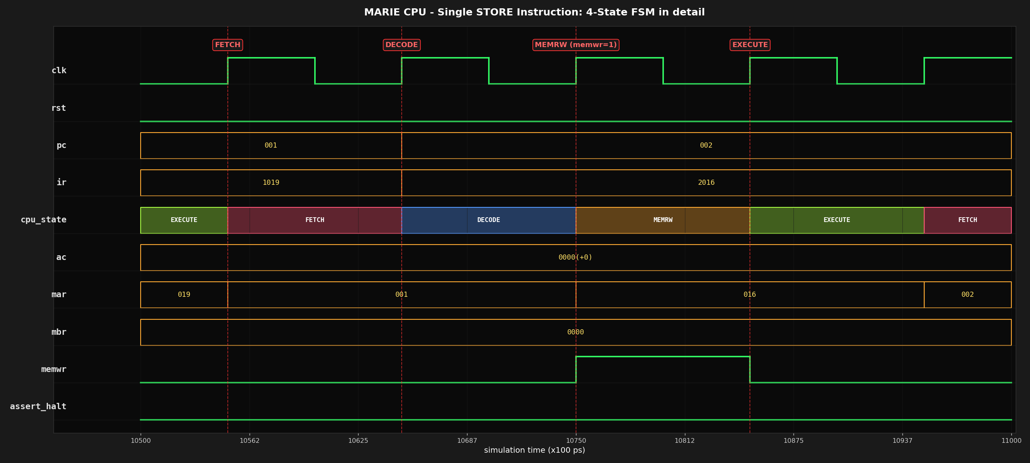
PART 1.3
FSM in detail — one STORE instruction
Observe: ir = 2016 → opcode 2 = STORE, address 0x16 = I.
FSM: FETCH (load IR) → DECODE (mar ← 0x016, mbr ← AC) → MEMRW (memwr=1, write happens) → EXECUTE (mar ← PC for next fetch).
10 / 13

Slide 11
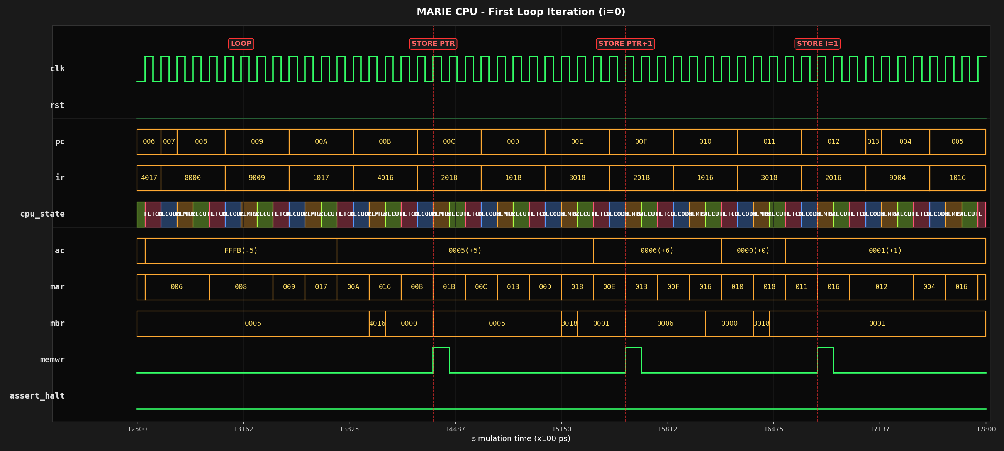
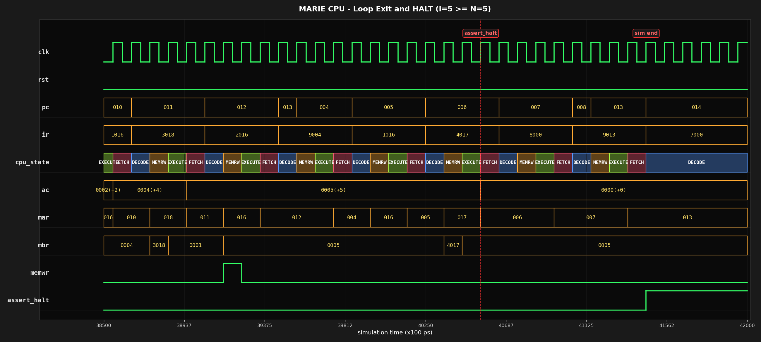
PART 1.3
Loop running, then HALT asserts cleanly
Top: loop iteration #1 — three memwr pulses (Store PTR, Store PTR+1, Store I=1). Bottom: i becomes 5, condition fails, Jump END → Halt fetched, assert_halt rises.
11 / 13

Slide 12
PART 2
Issues encountered + what I took away
Issues during development
What I learned
1. Skipcond polarity
Subt N gives i − N. To loop while i < N we need AC < 0 → Skipcond 000 (acneg). Mixing this up jumps to END on the first cycle.
2. Memory layout matched the sample
The provided test.hex pinned ZERO to 0x19 and I to 0x16, so I added two NOP padding words after Halt to align the data section.
3. No indirect addressing in this CPU
Only direct LOAD / STORE are wired up — no LoadI / StoreI. So a[i] = i cannot literally write to mem[40+i]. The program demonstrates the loop control flow on the PTR variable instead.
4. Reading the waveform took practice
MAR transitions twice per instruction (operand → PC). Sampling memwr at the right edge is what shows the true store address.
Fetch / decode / execute is not abstract
Watching cpu_state cycle FETCH→DECODE→MEMRW→EXECUTE makes every diagram in Ch. 4 click. PC, MAR, MBR all earn their place on the bus.
ISA design choices have consequences
Removing indirect addressing makes a 4-line C loop hard to translate. Real architectures provide indexing because programs need it.
Verilog + iverilog is approachable
iverilog → vvp → gtkwave is one short pipeline. The same flow scales to debugging real RTL on real silicon projects.
Reading waveforms is a skill, not a feature
Knowing which signal to put on the screen — and at what zoom — is half the job. Naming things well in the testbench is the other half.
12 / 13

Slide 13
PART 2 · CLOSING
If I could redesign MARIE…
Working on this CPU made the gaps in MARIE concrete. Five concrete improvements I would propose, in roughly cost-vs-benefit order:
01
Indirect addressing
02
Compare instruction
03
More registers
Add LoadI X / StoreI X using one extra control state. This is what makes a[i] = i expressible at all — without it, arrays cannot be written generically.
A dedicated CMP X that sets condition flags would replace the Subt + Skipcond pattern. Cleaner, no AC clobber, and matches every real ISA.
Adding R0–R3 turns the accumulator bottleneck into a small register file. Loop counters and pointers stop fighting for AC.
04
Conditional branches
05
Stack + Call/Ret
Replace Skipcond + Jump with BEQ / BNE / BLT taking an address. One instruction instead of two; control flow becomes much easier to read.
A stack pointer and Call/Ret pair would unlock subroutines. With only Jump, every reusable block has to be inlined or hand-laid-out.
13 / 13

