Slide 1
Chapter 4 MARIE: An Introduction to a Simple Computer Chapter 5 (Addressing modes)

Slide 2
Lecture Overview
Introduction to this Lecture's activities
In this lecture, you will learn how computer components work, and how they fit together to create useful computer systems. This lecture illustrates basic computer organization and introduces many fundamental concepts, including the fetch-decode-execute cycle, the data path, clocks and buses, register transfer notation, and of course, the CPU.
In addition, you will learn how the Instruction Set Architecture (ISA) plays the role of an interface between the software and Hardware. Mainly, you will have a look at MARIE, which has a very simple, yet powerful, instruction set.
Moreover, you will have a detailed look at different instruction formats, operand types, and memory access methods. Although addressing is an instruction design issue, there are many aspects to consider, the most important of which is addressing modes.

Slide 3
Lecture Overview
After completing the lecture, you will be able to:
Identify the components common to every modern computer system.
Explain how each component contributes to program execution.
Develop a simple architecture to illuminate the basic concepts that relate to some real architectures.
Describe how the program assembly process works.
Identify different memory addressing modes.

Slide 4
Lecture Overview
Introduction
CPU Basics and Organization
The Bus
Clocks
The Input/Output Subsystem
Memory Organization and Addressing
Interrupts
Marie
Instruction processing
A simple program
Extending our ISA
Addressing Modes ( Ch. 5)

Slide 5
Introduction
From Chapter 1, 2 and 3 we learned about:
Computer systems and components
How data is stored and manipulated inside different computer systems.
The fundamental components of digital circuits.
From now on, we will be interested in:
How computer components work?
and how they fit together to create useful computer systems?

Slide 6
The Von Neumann model
The Von Neumann architecture is shown in Figure 1.4
It satisfies at least the following characteristics
Consists of three hardware systems
A central processing unit (CPU) with a control unit, an arithmetic logic unit (ALU), registers (small storage areas), and a program counter;
a main-memory system, which holds programs that control the computer’s operation;
and an I/O system.
Capacity to carry out sequential instruction processing
Contains a single path, between the main memory system and the control unit of the CPU

Slide 7
The Von Neumann model
The Von Neumann architecture is shown in Figure 1.4
It satisfies at least the following characteristics
Consists of three hardware systems
A central processing unit (CPU) with a control unit, an arithmetic logic unit (ALU), registers (small storage areas), and a program counter;
a main-memory system, which holds programs that control the computer’s operation;
and an I/O system.
Capacity to carry out sequential instruction processing
Contains a single path, between the main memory system and the control unit of the CPU

Slide 8
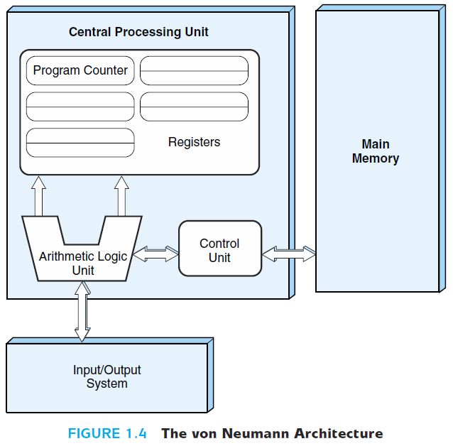
The Von Neumann model
A Memory stores both data and program instructions (both binary!)
The CPU fetches, decodes, and executes program instructions sequentially

Slide 9
The Von Neumann model
Program instructions are stored inside the main memory
The machine runs the programs sequentially (instruction per instruction – machine instruction)
Each machine instruction is fetched, decoded and executed during one cycle known as the von Neumann execution cycle (also called the fetch-decode-execute cycle)
One iteration of the cycle is as follows:
1. The control unit fetches the next program instruction from the memory, using the program counter to determine where the instruction is located.
2. The instruction is decoded into a language the ALU can understand.
3. Any data operands required to execute the instruction are fetched from memory and placed into registers within the CPU.
4. The ALU executes the instruction and places the results in registers or memory.

Slide 10
The Von Neumann model
Fetch
PC indicates the iteration number
CU fill the instruction register
Instruction 1
Instruction 2
Instruction 3
Instruction 3
Data 1
Data 2
Instruction 4
…
2. Decode
what ALU should do (add, multiply, …)?
Fill registers with needed data
…
…
Instruction N

Slide 11
The Von Neumann model
3. Execute
Execute the instruction
Place the results in registers or memory
Instruction 1
Instruction 2
Instruction 3
Instruction 3
Data 1
Data 2
Instruction 4
Result
…
…
…
Instruction N

Slide 12
CPU Basics and Organization
What is inside the Box?
The central processing unit (CPU) is responsible for fetching program instructions, decoding each instruction that is fetched, and performing the indicated sequence on the correct data.
The computer’s CPU or Processor
Fetches the program instructions,
Decodes each instruction that is fetched , and
Executes the indicated sequence of operations on the data
To introduce the simple architecture in the next section, we first examine, in general, the microarchitecture that exists at the control level of modern computers.

Slide 13
CPU Basics and Organization
The two principal parts of the CPU are the Datapath and the Control unit.
Datapath - consists of an arithmetic-logic unit (ALU) and network of storage units (registers) that are interconnected by a data bus that is also connected to main memory.
Control Unit - responsible for sequencing the operations and making sure the correct data is in the correct place at the correct time.
Registers hold data that can be readily accessed by the CPU. They are places to store a wide variety of data (Numerical data, Addresses, Control information,..). They are located on the processor so information can be accessed very quickly
The control unit directly accesses data inside the registers

Slide 14
CPU Basics and Organization
“General Purpose registers” are registers available to the programmer.
“Special Purpose registers” always stores the same type of data
Examples: Index registers, status registers, etc.
Registers can be implemented using D flip-flops (recall that A D flip-flop could be used as a storage element).
For example, a 32-bit register requires 32 D flip-flops.
The size of the registers fixes the “word size”
The arithmetic-logic unit (ALU) carries out logical and arithmetic operations as directed by the control unit.
The control unit (CU) determines which actions to carry out according to the values in a program counter register and a status register.
It fetches and decodes sequentially the instructions stocked in the main memory.
It also monitors the execution of these instructions and the transfer of all information.

Slide 15
Computer Buses and Clocks
The CPU communicates with the other components via a Bus. Moreover, and in order to maintain synchronization of the activities, the computer contains at least one clock.
Buses:
A Bus is a set of wires that simultaneously convey a single bit along each line (parallel movement). It connects multiple subsystems within the system.
A Bus could be “Point-to-Point” or “Multipoint” (also referred to as “Common Pathway”)

Slide 16
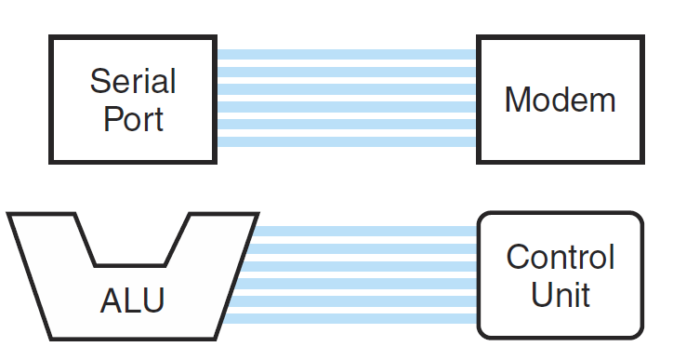
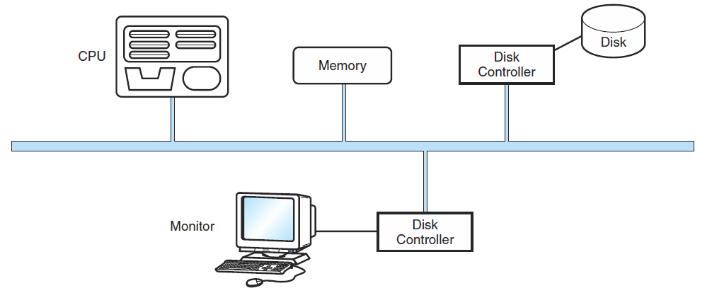
Computer Buses and Clocks
A point-to-point bus connects two specific components
Figure ‎4.1: Point-to-point bus
A multipoint bus is shared by several devices
Bus protocols are used to manage the bus access by these devices
Multipoint Bus
Figure 4.2: Multipoint bus

Slide 17
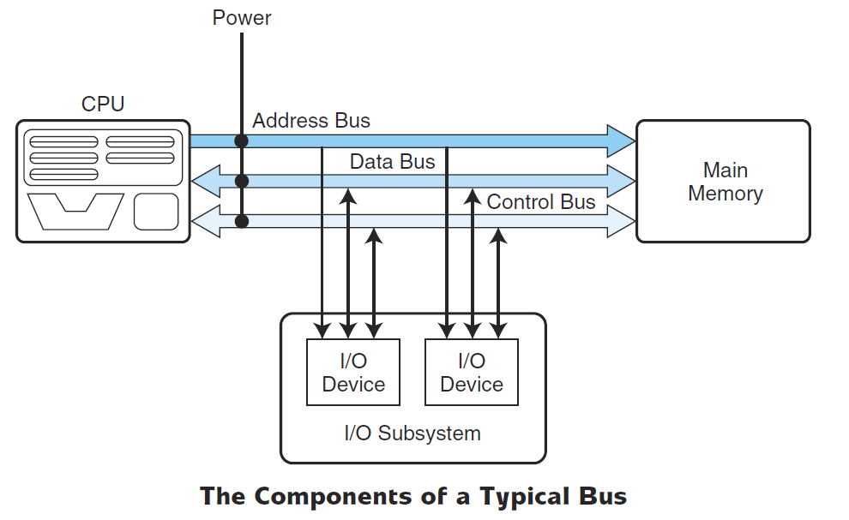
Computer Buses and Clocks
A typical bus consists of three main components
Data lines: are dedicated to moving data (the actual information that must be moved).
Control lines: indicate which device has permission to use the bus and for what purpose (reading or writing from memory or from an I/O device, …)
Address lines: indicate the location (in memory, for example) that the data should be either read from or written to.
Power lines are also required to provide the electrical power necessary
Figure ‎4.3: Components of a typical Bus

Slide 18
Computer Buses and Clocks
Clocks:
Every computer contains at least one clock that synchronizes the activities of its components.
The CPU requires a fixed number of clock ticks to execute each instruction.
Moreover, instruction performance is often measured in clock cycles instead of seconds.
The clock frequency, measured in megahertz or gigahertz, determines the speed with which all operations are carried out.
Clock cycle time is the reciprocal of clock frequency: T= 1/F
Example 1: An 800 MHz clock has a cycle time of 1/(800x 10⁶) seconds = 1.25 ns.
Example 2: If a machine has a 2ns cycle time, then it is a 500MHz machine.

Slide 19
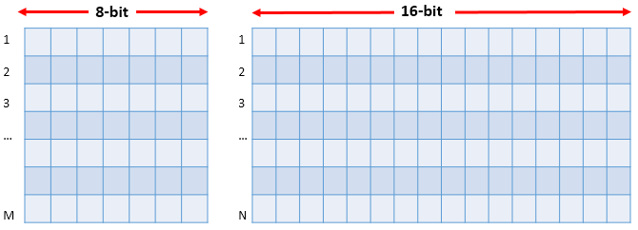
Memory Addressing and Organization
Computer memory consists of a linear array of addressable storage cells that are similar to registers. It can be seen as a matrix of bits, with each row having a length typically equivalent to the word size of the machine (figure 4.4).
Figure ‎4.4: M 8-bit and N 16-bit Memory locations

Slide 20
Memory Addressing and Organization
Memory Addressing
Memory can be byte-addressable, or word-addressable, where a word typically consists of two or more bytes.
Byte addressable: Each byte has its own address (each memory row contains 8 bits only)
Word addressable: Each word has a unique address (each memory row contains one word that can be larger than 8 bits).
Now, how many addresses, and how many address bits do we have in a given memory?

Slide 21
Memory Addressing and Organization
To answer this question, you should be aware of:
The type of addressing, whether word addressable or byte addressable.
The word size. For example, 8, 16, 32, 64 bits.
The storage capacity of the memory. Memory is often referred to using the notation L x W (length x Width). For example, 4M x 16 means the memory is 4M long (number of words) and it is 16 bits wide (word size)
Example 1: How is a 4M x 16 word addressable memory organized?
The word size is 16 bits.
4M means that we have 4 x 2²⁰ = 2² x 2²⁰ = 2²² different words.
These 2²² words are numbered from 0 to 2²² -1; each number represents the address of only one word.
So, each address is represented with at least 22 bits

Slide 22
Memory Addressing and Organization
Example 2: How many bits would you need to address a 2M × 32 memory if:
The memory is byte-addressable?
The memory is word-addressable?
Solution:
There are 2M × 4 bytes (recall that 32 bits =4 bytes), which equals 2¹ * 2²⁰* 2² bytes = 2²³ bytes. Hence, 23 bits are needed for an address.
There are 2M words (32 bits are considered as 1 word, since the memory is word addressable), which equals 2¹ × 2²⁰ words = 2²¹ words. Hence, 21 bits are required for an address.

Slide 23
Memory Addressing and Organization
Memory Organization
Usually, computers’ physical Memory (RAM) is not made from a single high capacity chip, but a group of lower capacities chips.
Access is more efficient when memory is organized into banks of chips with the addresses interleaved across the chips.
The best way to explain how memory is organized, is found in the following example.
Example: How to build a 32Kx16 word addressable RAM memory with only 2Kx8 RAM chips.
A 32Kx16 word addressable RAM memory can be created with 32 different 2Kx8 RAM chips. You could connect 16 rows and 2 columns of chips together as shown in figure 4.5.

Slide 24
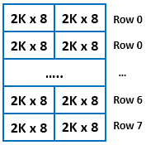
Memory Addressing and Organization
Figure ‎4.5: Building 32kx16 module from 2kx8 chips
The word size is now: 8x2=16 bits
The number of addresses (rows) is now: 2Kx16= 32K.
Therefore, what we have now is a memory module that has the size of 32Kx16.

Slide 25
Lecture Overview
Introduction
MARIE
Introduction
The Architecture
Registers and Buses
The Instruction Set Architecture
Register Transfer Notation
Instruction processing
A simple program
Extending our ISA
Addressing Modes ( Ch. 5)

Slide 26
MARIE – Introduction
We are now familiar with computer components but how these are connected together? How these work together?
Leonardo Da Vinci once said:
“When you wish to produce a result by means of an instrument, do not allow yourself to complicate it”
In this part we will use a MARIE, A Machine Architecture that is Really Intuitive and Easy.
A very simple architecture, MARIE, and its ISA are presented to allow you to gain a full understanding of the basic architectural organization involved in program execution.
MARIE exhibits the classical von Neumann design and includes a program counter, an accumulator, an instruction register, 4096 bytes of memory, and two addressing modes. Assembly language programming is introduced to reinforce the concepts of instruction format, instruction mode, data format, and control that are presented earlier.

Slide 27
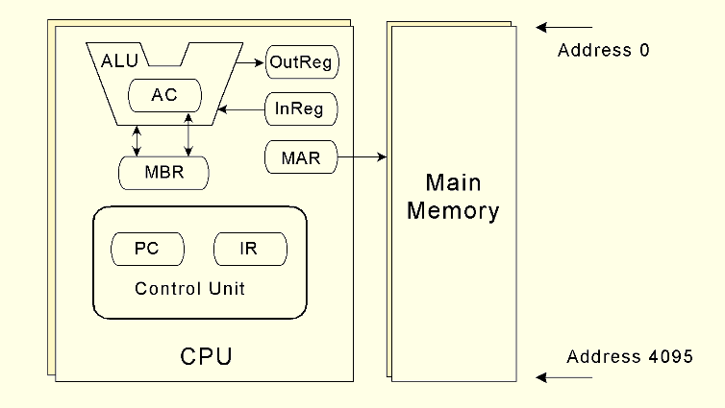
MARIE – Architecture, Registers, and Buses
Architecture
The MARIE architecture is shown in the figure below:
Figure 4.6: MARIE architecture
The MARIE architecture has the following characteristics:
Binary, two's complement data representation.
Stored program, fixed word length data and instructions.
4K x 16 word-addressable main memory.
16-bit instructions: 4 bits for the opcode, 12 bits for the address.
A 16-bit arithmetic logic unit (ALU).
Seven registers for control and data movement.

Slide 28
MARIE – Architecture, Registers, and Buses
Registers
As you already know, registers are storage locations within the CPU (as illustrated in the figure above).
The ALU portion of the CPU performs all the processing (arithmetic operations, logic decisions, etc.).The registers are used for very specific purposes when programs are executing.

Slide 29
MARIE – Architecture, Registers, and Buses
Buses
MARIE cannot transfer data or instructions into or out of registers without a bus.
In MARIE, we assume a common bus scheme
The registers are interconnected. They are also connected with main memory through a common data bus.
A unique number that is set on the control lines whenever that device is required to carry out an operation identifies each device on the bus.

Slide 30
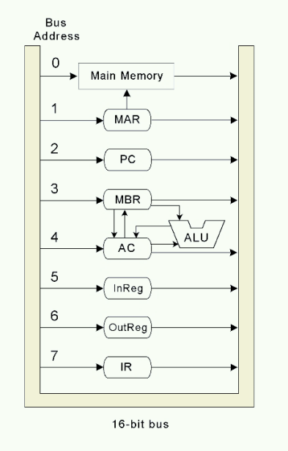
MARIE – Architecture, Registers, and Buses
Separate connections are also provided between the accumulator and the memory buffer register, between the ALU and the accumulator and memory buffer register. This permits data transfer between these devices without use of the main data bus.
The Data path in MARIE is shown in figure 4.7.
Note that a data word (that is an instruction) in the main memory travels a relatively long path before achieving the IR!
Figure ‎4.7: Data path in MARIE

Slide 31

The Instruction Set Architecture (ISA)
MARIE has a very simple, yet powerful, instruction set.
The Instruction Set Architecture (ISA) specifies the format of its instructions and the primitive operations that the machine can perform.
The ISA is an interface between a computer’s hardware and its software.
Some ISAs include hundreds of different instructions for processing data and controlling program execution.
For MARIE, each instruction consists of 16 bits
These bits are organized as follows:
Opcode: 4 bits (bits 12 to 15), specifies the instruction to be executed (which allows for a total of 2⁴=16 instructions, but only 13 are used)
Address: 12-bits (bits 0 to 11), forms an address.
Figure ‎4.8: Format of the MARIE instruction

Slide 32
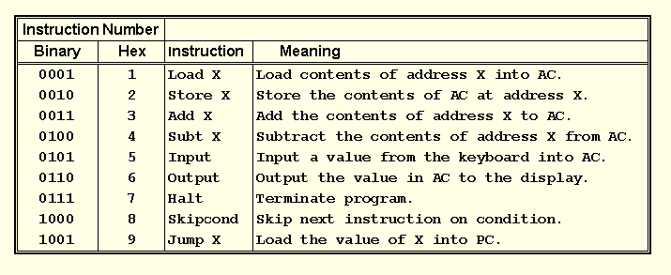
The Instruction Set Architecture (ISA)
The fundamental MARIE instructions are:
Table 4.1: Fundamental MARIE instructions

Slide 33
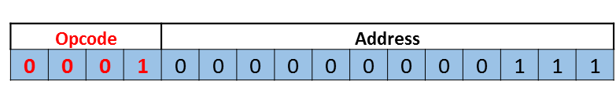
The Instruction Set Architecture (ISA)
To understand how things work, let us examine the instruction format used in MARIE.
Suppose that we have the following 16-bit instruction:
Figure ‎4.9: Load 007 instruction format
The leftmost 4 bits indicate the opcode or the instruction to be executed.
0001 is binary for 1, which represents the Load instruction. The remaining 12 bits indicate the address of the value we are loading, which is the address 7 in main memory.
This instructions causes the data found in address 7 in main memory to be copied to the accumulator, AC.
Note that the value of address 7 in main memory remains there, as we have only taken a copy of it.
However, any previous data found in the AC will be overwritten when we use the Load instruction.

Slide 34
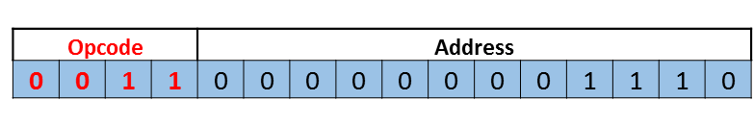
The Instruction Set Architecture (ISA)
Let us have another example:
Suppose that we have the following 16-bit instruction:
Figure ‎4.10: ADD 00E instruction format
The leftmost four bits, 0011, are equal to 3, which is the Add instruction.
The address bits indicate address 00E in hex (or 14 in decimal). This means that the order will be given to go to main memory, get the data value at address 00E, and add this value to the AC.
The new value in the AC would then be the sum of the old value of the AC and the data fetched from address 00E.

Slide 35
The Instruction Set Architecture (ISA)
One important instruction is “Skipcond”
When the Skipcond instruction is executed, the value stored in the AC must be inspected:
The next instruction is skipped, if the condition tested is True.
The next instruction is not skipped, if the condition tested is False.
Bits 11 and 10 (say b₁₁b₁₀) in the address field specify the condition to be tested:
b₁₁b₁₀ = 00: The CPU tests if AC < 0
b₁₁b₁₀ = 01: The CPU tests if AC = 0
b₁₁b₁₀ = 10: The CPU tests if AC > 0

Slide 36

The Instruction Set Architecture (ISA)
Example: Figure 4.11 is a bit pattern for a SKIPCOND instruction, as it would appear in the IR:
Figure ‎4.11: Skipcond 400 instruction format
In figure 4.11, we see that the opcode is 8 and b₁₁b₁₀ (bits 11 and 10)are 01, meaning that the next instruction will be skipped if the value in the AC is equal to zero.
In general, we use:
SKIPCOND 000 which means skip the next instruction if the AC <0.
SKIPCOND 400 which means skip the next instruction if the AC =0.
SKIPCOND 800 which means skip the next instruction if the AC >0.
Note that 000, 400 and 800 are in base 16. They are equivalent to 12 bits (Address part).

Slide 37
Register Transfer Notation
MARIE instruction appears to be very simplistic.
Actually, at the component level, each instruction involves multiple operations called “micro-operations”
Register Transfer Language (RTL), or Register Transfer Notation (RTN) specifies the exact sequence of micro-operations that are carried out by an instruction.
In the MARIE RTL, we will use the following notations:
M[X]: to indicate the actual data value stored in memory location X
←: to indicate the transfer of bytes to a register or memory location
We will present the RTL for each of the instructions in the ISA for MARIE.

Slide 38
Register Transfer Notation
Load X (loads the contents of memory location X into the AC)
MAR← X Place the address X in MAR;
MBR← M[MAR] The data M[MAR] at location address MAR
is moved into the MBR;
AC← MBR The content of MBR is placed in the AC.
Store X (stores the contents of AC into the memory location X)
MAR← X Place the address X in MAR;
MBR← AC Place the content of AC in MBR
M[MAR]← MBR Place the content of MBR in the memory
location MAR (M[MAR] is replaced by MBR)

Slide 39
Register Transfer Notation
Add X (The data value stored at address X is added to the AC).
MAR← X Place the address X in MAR;
MBR← M[MAR] Place the data M[MAR] at location address
MAR in MBR;
AC← AC + MBR Place the sum AC + MBR in AC
Subt X (The data value stored at address X is subtracted from AC).
MAR← X Place the address X in MAR;
MBR← M[MAR] Place the data M[MAR] at location address
MAR in MBR;
AC← AC - MBR Place AC - MBR in AC

Slide 40
Register Transfer Notation
Input (Inputs a value from the keyboard into AC)
AC← InREG Place the content of InREG (contains the input) in the
AC.
Output (Output the value in AC to the display)
OutREG← AC Place the content of AC (contains the output) in the
OutREG (to sent data to the display)
Halt (Terminate the program)
no need for any RTL!
Jump X (unconditional branch to the given address, X)
PC← X Load X into the PC

Slide 41
Register Transfer Notation
Skipcond
if IR[11–10] = 00 then {if bits 10 and 11 in the IR are both 0}
if AC < 0 then PC ← PC+1
else if IR[11–10] = 01 then {if bit 11 = 0 and bit 10 = 1}
if AC = 0 then PC ← PC + 1
else if IR[11–10] = 10 then {if bit 11 = 1 and bit 10 = 0}
if AC > 0 then PC ← PC + 1

Slide 42
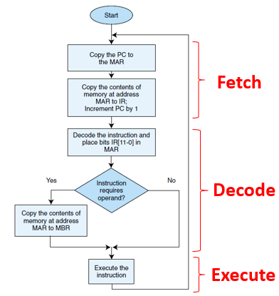
Register Transfer Notation
Machine Cycle
It is worth mentioning that MARIE, like any other computer architecture, follows the basic machine cycle: the fetch, decode, and execute cycle.
The fetch-decode-execute cycle is the series of steps that a computer carries out when it runs a program.
We first have to fetch an instruction from memory, and place it into the IR.
Once in the IR, it is decoded to determine what needs to be done next.
If a memory value (operand) is involved in the operation, it is retrieved and placed into the MBR.
With everything in place, the instruction is executed.

Slide 43
Lecture Overview
Introduction
MARIE
Instruction processing
A simple program
Extending our ISA
Addressing Modes ( Ch. 5)

Slide 44
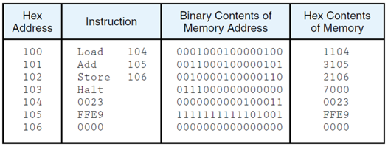
A simple program
The table below shows a program written in assembly language for MARIE
What does this program do?
Table ‎4.2: A program To Add Two Numbers
This program simply adds to numbers and stores the result in the main memory.
It loads the value stored at the location address 104₁₆ into AC (the value is 0023₁₆ = 35₁₀)
It adds this value to the value stored at the location address 105₁₆ (the value is FFE9₁₆ = (-23)₁₀)
Stores the sum into the location address 106₁₆.
So, what will be stored in the location address 106₁₆?

Slide 45
A simple program
This program simply adds to numbers and stores the result in the main memory.
It loads the value stored at the location address 104₁₆ into AC (the value is 0023₁₆ = 35₁₀)
It adds this value to the value stored at the location address 105₁₆ (the value is FFE9₁₆ = (-23)₁₀)
Stores the sum into the location address 106₁₆.
So what will be stored in the location address 106₁₆?
Now let us discover what happens during each “Fetch, decode, execute” cycle.

Slide 46
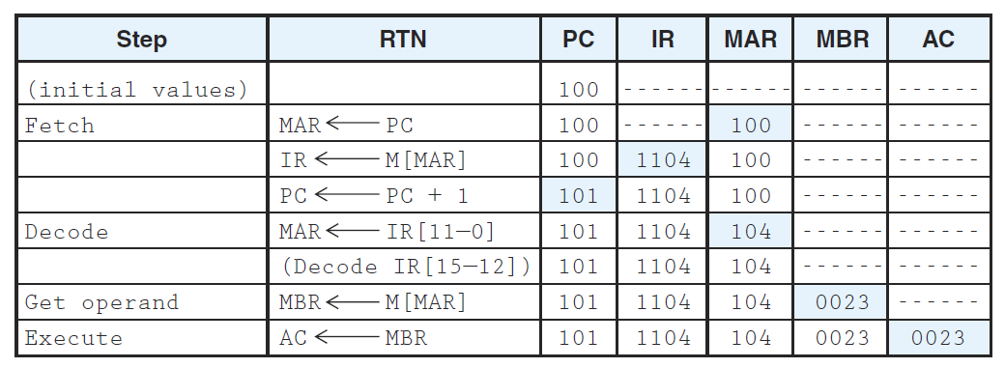
A simple program
Now, let us discover what happens during each “Fetch, decode, execute” cycle.
The tables below show the effect of each instruction on the registers:
Load 104:
Table 4.3: Fetch-decode-execute cycle of Load 104

Slide 47
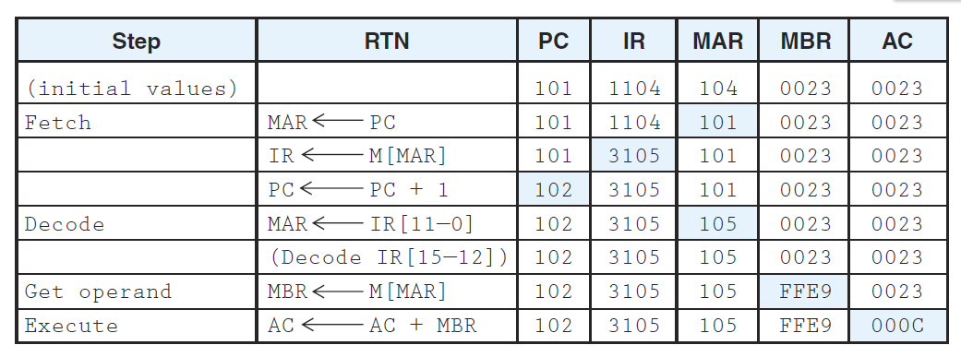
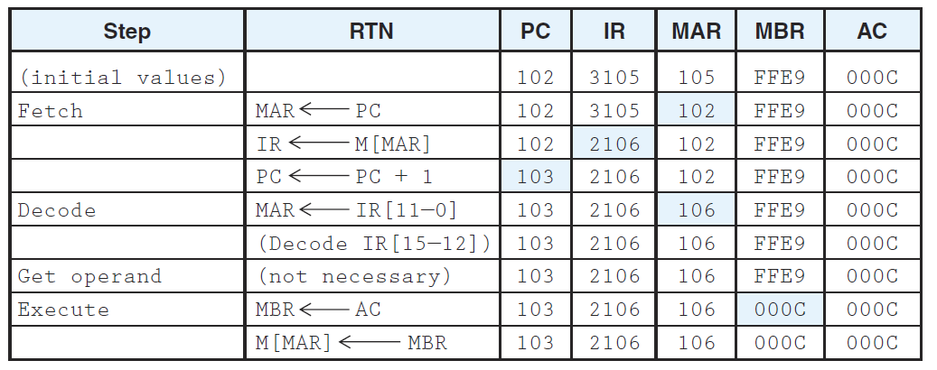
A simple program
Add 105:
Store 106:
Table 4.4: Fetch-decode-execute cycle of Add 105
Table ‎4.5: Fetch-decode-execute cycle of Store 106

Slide 48
A simple program
Directives and Labels
An assembler directive is an instruction that is not supposed to be translated into machine code.
There are four directives that the MARIE assembler recognizes:
The first of these is the origination directive, ORG. The ORG directive controls the starting address of your program. If you do not include an ORG directive in your code, the first address of your program is automatically 000h.
The other three directives enable you to put constants in your program as decimal (DEC), octal (OCT), and hexadecimal (HEX) numbers.
In assembly language, we can also use labels in order to clarify the program.
Substituting simple alphanumeric names for the opcodes makes programming much easier. We can also substitute labels (simple names) to identify or name particular memory addresses, making the task of writing assembly programs even simpler.

Slide 49
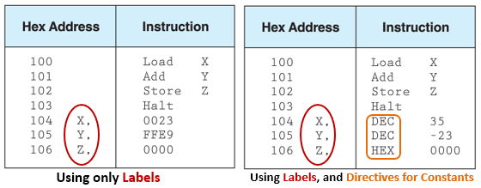
A simple program
For example, in our program to add two numbers, we can use labels to indicate the memory addresses, thus making it unnecessary to know the exact memory address of the operands for instructions.
Table 4.6 shows how labels and directives could be used:
Table ‎4.6: Using Labels and Directives in MARIE

Slide 50
Lecture Overview
Introduction
MARIE
Instruction processing
A simple program
Extending our ISA
Addressing Modes ( Ch. 5)

Slide 51
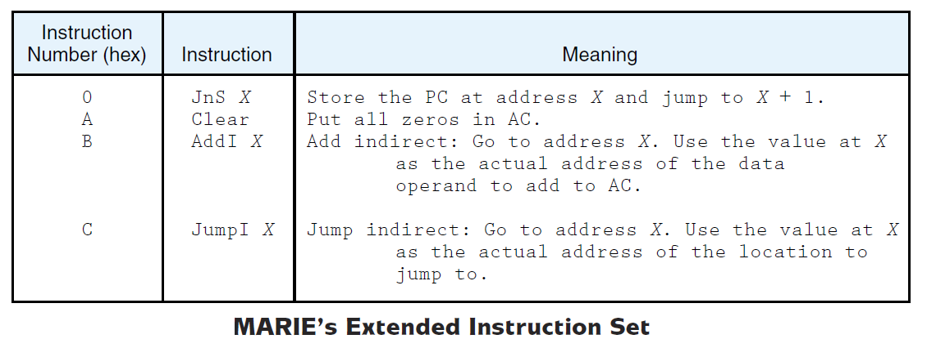
Extending our instruction set
For MARIE, we have seen only 9 instructions while we have 4 bits, so we can have 16 different instructions.
We will now extend our ISA by adding 4 new instructions: JnS, Clear, AddI and JumpI

Slide 52
Extending our instruction set
JnS: Jump-and-Store instruction
Allows us to store a pointer and then proceeds to set the PC to a different instruction
This enables us to call procedures and other subroutines, and then return to the calling point in our code once the subroutine has finished.
Clear:
This instruction moves all zeros into the accumulator.
This saves the machine cycles that would otherwise be expended in loading a 0 operand from memory.
JnS RTL | Clear RTL
MBR ← PC MAR ← X M[MAR] ← MBR MBR ← X AC ← 1 AC ← AC + MBR PC ← AC | AC ← 0

Slide 53
Extending our instruction set
So far, all of the MARIE instructions that we have discussed use a direct addressing mode.
This means that the address (not the value!) of the operand is explicitly stated in the instruction.
It is often useful to employ an indirect addressing:
The address of the address of the operand is given in the instruction.
This means that the content of the given address is the address of the needed value.

Slide 54
Extending our instruction set
JumpI and AddI use indirect addressing
Their RTL are shown in the table below
JumpI RTL | AddI RTL
MAR ← X MBR ← M[MAR] PC ← MBR | MAR ← X MBR ← M[MAR] MAR ← MBR MBR ← M[MAR] AC ← AC + MBR

Slide 55
FOR NEXT LECTURE (1/1)
Exercise:
Write a program that calculates 2X + Y - Z where X, Y, Z are three different numbers in three different memory locations. Store the result in the main memory and display it.
Implement your code in MARIE simulator.
Check if you have errors.
Correct your errors and run your program.

Slide 56
Lecture Overview
Introduction
MARIE
Instruction processing
A simple program
Extending our ISA
Addressing Modes ( Ch. 5)

Slide 57
Addressing Modes
We saw in the previous sections, while discussing the MARIE’s Instructions, that the 12 bits in the operand field can be interpreted in two different ways: the 12 bits represents either the memory address of the operand (direct addressing) or a pointer to a physical memory address ( indirect addressing).
Addressing modes allow us to specify where the operands are located. An addressing mode can specify a constant, a register, or a location in memory. Certain modes allow shorter addresses, and some allow us to determine the location of the actual operand, often called the effective address of the operand, dynamically.
In this section, we will investigate the most basic addressing modes.

Slide 58
Addressing - Introduction
Addressing modes specify where an operand is located.
They can specify a constant, a register, or a memory location.
The actual location of an operand is its effective address.
Certain addressing modes allow us to determine the address of an operand dynamically.
Although there are other different addressing modes, we will focus on four modes:
Immediate Addressing.
Direct Addressing.
Indirect Addressing.
Indexed Addressing.

Slide 59
Addressing Modes
Immediate addressing: where the data is part of the instruction.
Example: If we have the instruction Load 008, the numeric value 8 is loaded into the AC.
Direct addressing: where the address of the data is given in the instruction.
Example: For the instruction Load 008, the data value found at memory address 008 is loaded into the AC.

Slide 60
Addressing Modes
Indirect addressing: Gives the address of the address of the data in the instruction.
Example: Consider the instruction Load 008.
The data value found at memory address 008 is actually the effective address of the desired operand.
Now, suppose we find the value 2A0 stored in location 008.
2A0 is the “real” address of the value we want.
Then, the value found at location 2A0 is loaded into the AC.
Indexed addressing: uses a register (implicitly or explicitly) as an offset, which is added to the address in the operand to determine the effective address of the data.
Example: Suppose that we have the instruction Load X.
The index register holds the value 100.
The effective address of the operand in actually X + 100.
The value found at location X+100 will then be loaded into the AC.

Slide 61
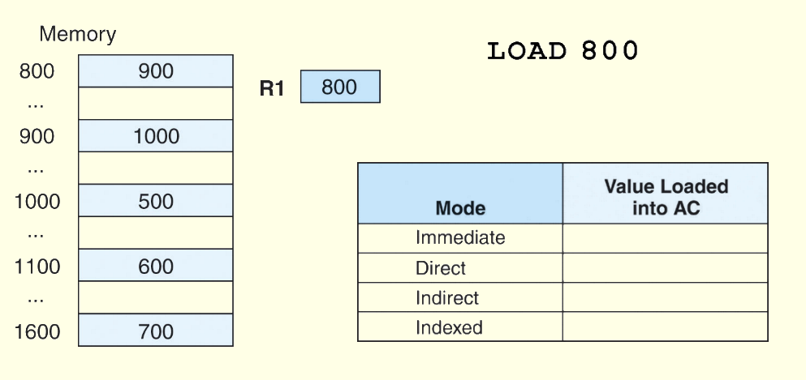
Addressing Modes
Example: For the instruction shown, what value is loaded into the accumulator for each addressing mode?
800

Slide 62
Addressing Modes
Example: For the instruction shown, what value is loaded into the accumulator for each addressing mode?
800
900

Slide 63
Addressing Modes
Example: For the instruction shown, what value is loaded into the accumulator for each addressing mode?
800
900
1000

Slide 64
Addressing Modes
Example: For the instruction shown, what value is loaded into the accumulator for each addressing mode?
800 + 800 = 1600
800
900
1000
700

Slide 65
End of chapters 4 & 5 (addressing modes) Try to solve all exercises related to chapter 4 and the exercises related to addressing modes in chapter 5 Download MARIE Simulator Use the simulator to write and run your own assembly programs!

