Slide 1
RSPCA Australia
An Examination of Animals in Care and Their Outcomes

Slide 2

What they do
Established 1981
Unifying body for state societies that go back to the 1870s
8 constituents:
Victoria
New South Wales
Queensland
Tasmania
South Australia
Western Australia
Darwin
Capital Territory (ACT)
Services and Shelters
Rescue and rehabilitation
Advocacy
Animal welfare lobbying
Law Enforcement
Fines
Prosecutions
Notes:
Established 1981.
Unifying organisation for bodies that go back to the 1870s
8 constituents making up the 6 states and two Territories
The northern territories is represented exclusively by an office in Darwin and runs one shelter. The role there is performed more broadly by an Animal Welfare Authority.
What they do –
Rescue and rehabilitation of stray, injured, and/or abused animals
Political advocacy around animal welfare and animal cruelty, lobbying governments for legislation around protections and public outreach on the same issues
Law Enforcement:
enter property;
seize animals;
seize evidence of animal cruelty offences;
issue animal welfare directions/notices;
issue on-the-spot fines; and
initiate prosecutions under animal welfare legislation.

Slide 3
What are we looking at?
What animals are being cared for?
What outcomes can be expected from their care?
How is this changing?

Slide 4
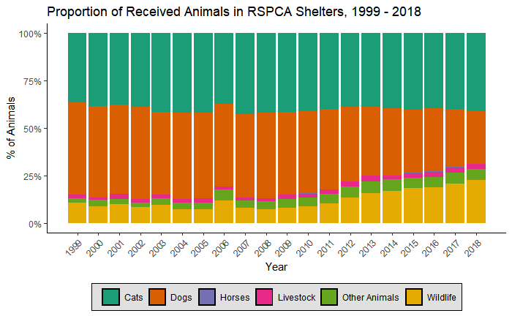
Animals Cared For
Total Animals in 2018
33,863 Dogs
51,170 Cats
479 Horses
3,309 Livestock
28,183 Wildlife
7,142 Other
Wildlife
Native birds
Lizards
Possums
Turtles
Koalas
Kangaroos & Wallabies
Etc.
Other
Budgies
Doves
Ferrets
Guinea Pigs
Mice
Rabbits
Etc.
Notes:
124,146 animals
Predominately cats and dogs, as you might expect
Livestock any kind of animal in the agriculture industry – cows, pigs, sheep etc. If kept as pets they don’t qualify!
Wildlife – any non-pet
Other – all the other weird and wonderful pets
The proportion of wildlife has increased a lot in the last decade, and we’ll touch on that later

Slide 5
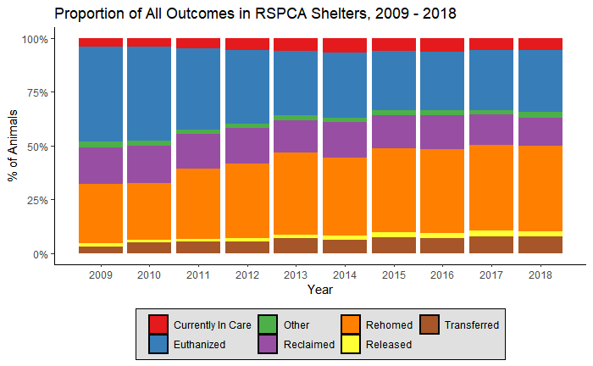
Outcomes
Notes:
Graph showing the proportions of the various recorded outcomes
Transferred: animals transferred to another RSPCA facility or non-RSPCA facility such as pound,welfare or rescue group
Other includes animals dead on arrival, escaped, or none of the above categories
Blue bar euthanasia sticks out – sadly reality is that a huge proportion of animals in shelters are put down.
Orange and purple Rehome/Reclaim is good news!
It’s worth nothing the gradual growth in transfers – the ability to hand off animals for longer care or more focused adoption efforts will greatly enhance the likelihood of a better outcome for any given animal.

Slide 6
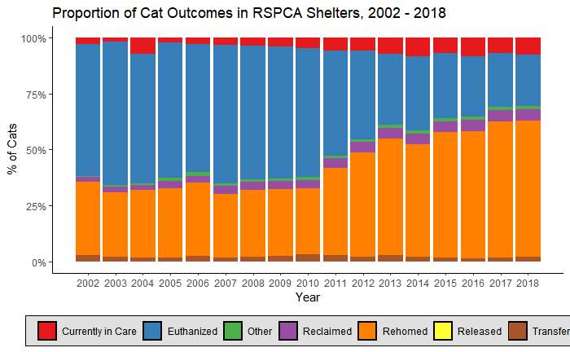
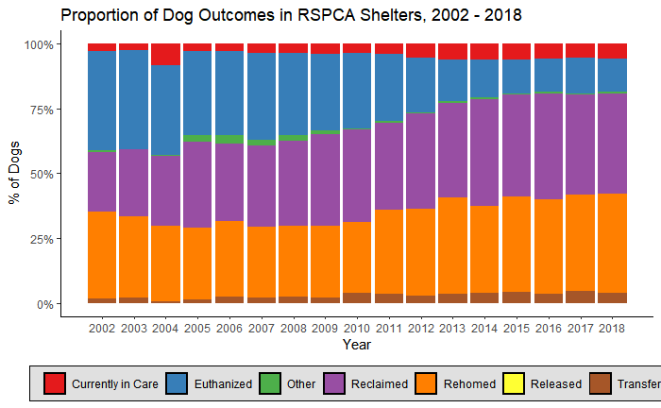
Outcomes – Cats & Dogs
Notes:
Wild difference in outcomes for cats and dogs.
Cats are extremely unlikely to be reclaimed if they end up in shelters. A depressing fact is that a lot of shelters put down unwanted animals at a depressingly high rate, and this is reflected in the front half of the reporting.
Dogs are a lot more fortunate – they are often reclaimed, and this makes a striking difference in their outcomes.

Slide 7
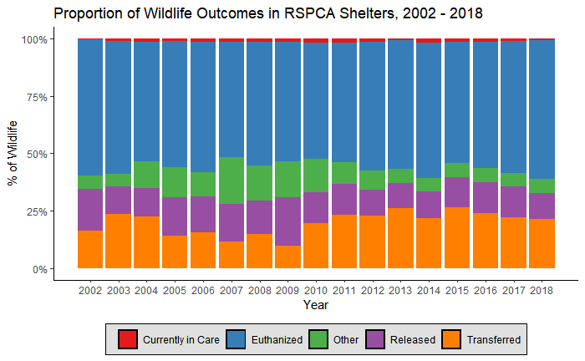
Outcomes – Wildlife
Notes:
Usually, wild animals (native and introduced) are presented to the RSPCA by members of the community and private veterinary clinics because the animals have been injured or orphaned.
Unfortunately, many of the animals’ injuries can cause significant pain and suffering and/or compromise their survival in the wild.
Therefore, the RSPCA performs a difficult but valuable role relieving the suffering of injured wildlife through euthanasia.

Slide 8
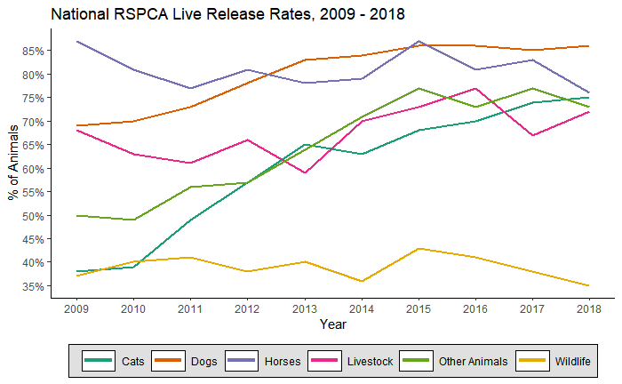
Live Release Rates
The LRR is the percentage of animals who were rehomed, reclaimed by their owner or transferred to a rescue group or other non-RSPCA facility as a percentage of the total number of animals received
(not including those currently in care or categorised as “other”)
Notes:
Basically “percentage of animals that lived”
The LRR is the percentage of animals who were rehomed, reclaimed by their owner or transferred to a rescue group or other non-RSPCA facility as a percentage of the total number of animals received
(not including those currently in care or categorised as “other”)
Notice the positive trend in everything bar wildlife.

Slide 9
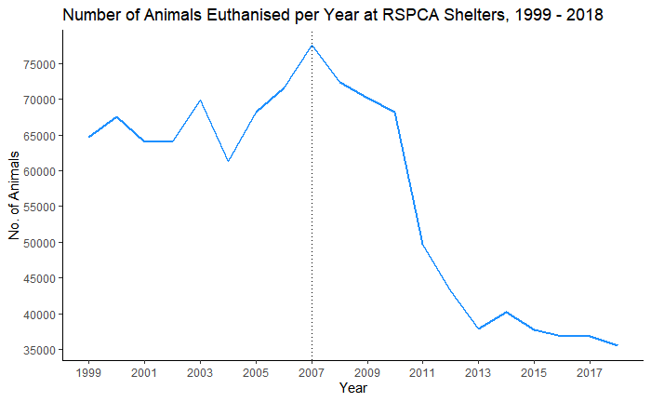
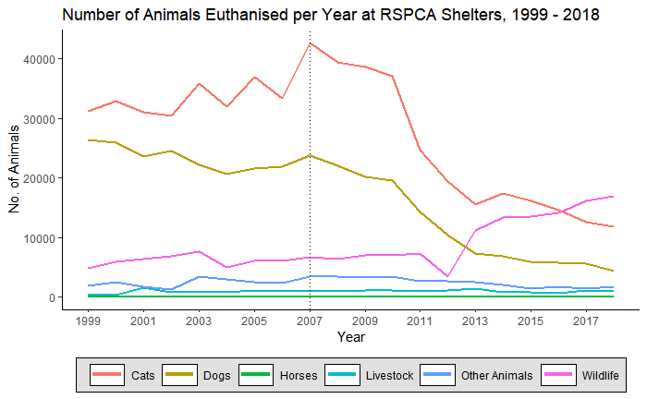
Euthanisation
Notes:
2007 dip!
Euthanasia in dogs – mostly behavioural or infections, some legal
Euthanasia in cats – Broadly all 3 infectious, medical and behavioural, but a giant “Other” amount which they don’t specify reasoning for, which I expect is overpopulation.

Slide 10
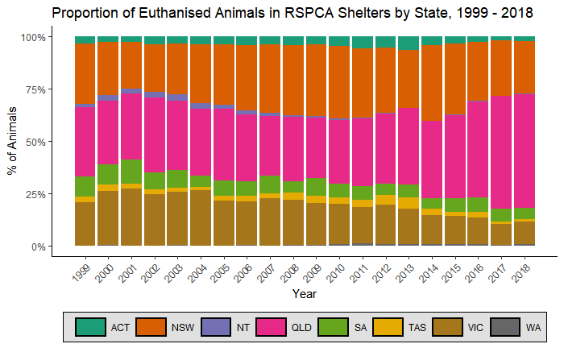
Euthanisation
Notes:
Big 3 states are Queensland, New South Wales, Victoria. No surprises as biggest states in Australia

Slide 11
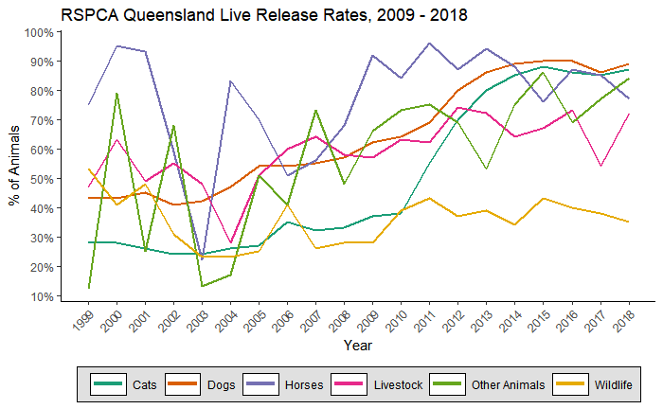
Queensland
Total animals received in 2018:
11,517 Dogs
13,648 Cats
125 Horses
1,597 Livestock
25,385 Wildlife
2,236 Other
Notes:
54,508 animals!
Little over 46.5% of them are wildlife!!

Slide 12
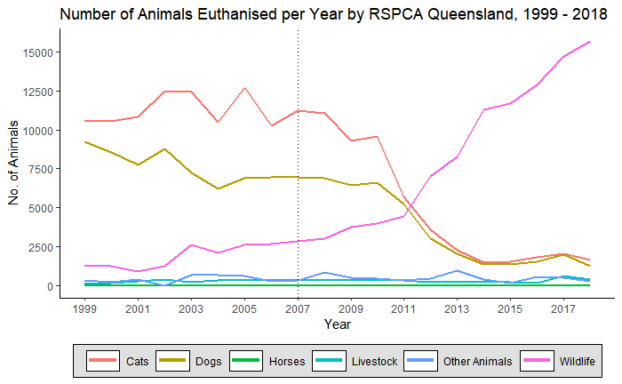
Queensland
15,690 wildlife euthanised in 2018
-- more than 92% of the recorded total for the entirety of Australia!
RSPCA Queensland operates specialist wildlife clinics to treat, rehabilitate and re-release wildlife.
Unfortunately, many of the animals injuries can cause significant pain and suffering or compromise their survival in the wild.
The RSPCA performs a difficult but valuable role in relieving the suffering of injured wildlife.
Notes:
Big stats!!!
Note the fact the graph is raw number of animals, so we can pivot to positive…

Slide 13
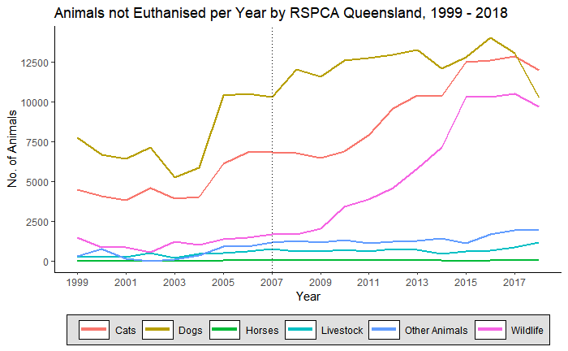
Queensland
Notes:
Number of animals being processed without euthanisation also climbing drastically

Slide 14
Conclusions
Bit of a bummer, really
Things are getting better. Much better!
More of a bad outcome isn’t always a signifier of only bad things
Notes:
Things are better for a variety of reasons –
Much better promotion of pet adoption through the internet and social media.
Working with smaller rescue groups to extend reach
Services to help reunite pets
Expanding foster care networks
Dedicated behavioural trainers
Advances in veterinary care

Slide 15
Challenges Encountered
Data scraped from published PDFs rather than released as a spreadsheet or .CSV
- Parsing errors
I trusted the brief knew the data
Would have liked more depth to the published statistics
Worked on a whole set of data about a totally different topic simultaneously…
What Next?
Integrate more data
- Euthanasia reasons
- Cruelty complaints and prosecutions
Notes:
Data scraped rather than CSV – parsing errors!!!
Brief: sample questions looking at trend in injuries By Region, different peaks of times of year per region?
Brief was interested in injuries, when none of the data is specific like this – the RSPCA reporting doesn’t specify the condition of animals coming into care, and on top of that it doesn’t break my specifically than by year.
Worked on data about complaint calls in a couple of Queensland cities, but it didn’t integrate with this presentation in any meaningful way and I decided it was best to just focus on the RSPCA.
What next?
First step would be to add data on euthanasia reasons, since it is recorded in ever report but wasn’t scraped.
Afterwards would be cruelty complaints and prosecutions, which was also covered
W

Slide 16

Questions?

