Slide 1
Animals and Australia
An Examination of RSPCA Australia Reporting
&
Municipal Complaints in Queensland Cities

Slide 2
RSPCA

Slide 3
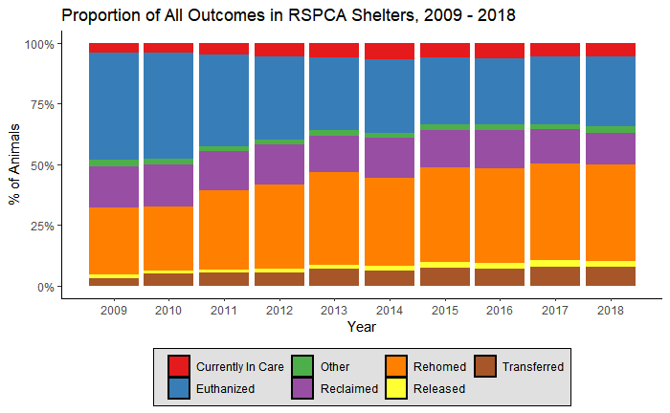
Outcomes

Slide 4
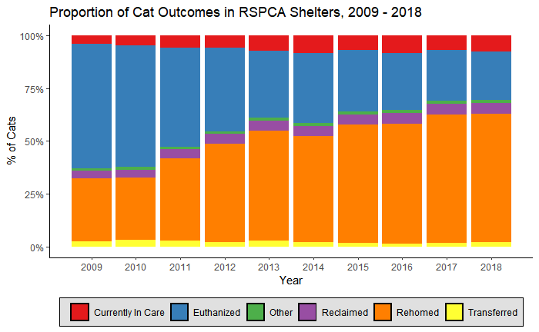
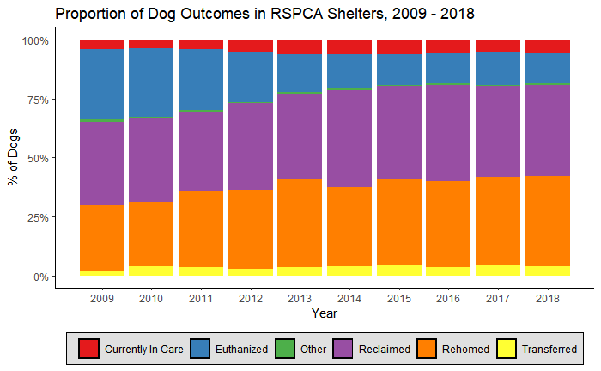
Outcomes – Cats & Dogs

Slide 5
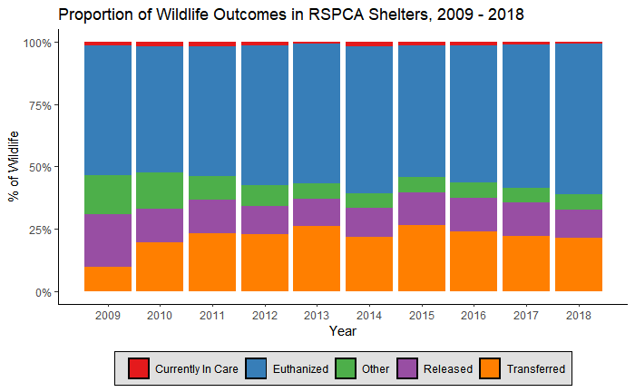
Outcomes – Wildlife

Slide 6
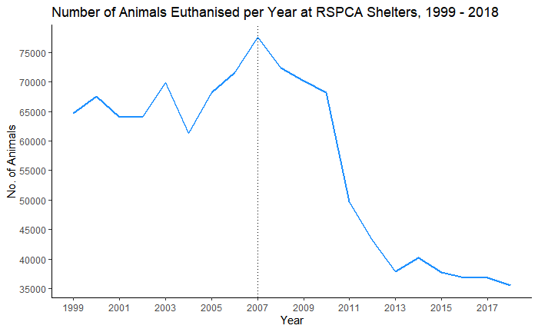
Euthanisation

Slide 7
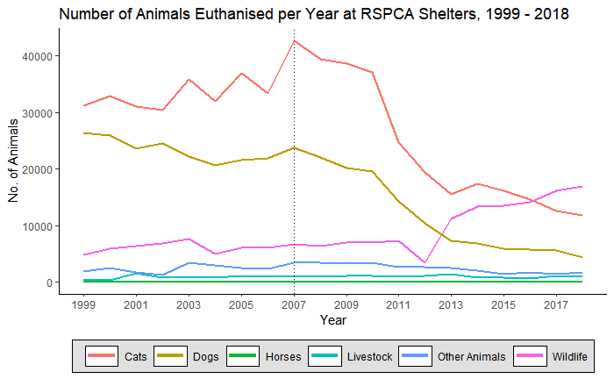
Euthanisation

