Slide 1
Animals and Australia
An Examination of RSPCA Australia Reporting
&
Municipal Complaints in Queensland Cities

Slide 2


Slide 3
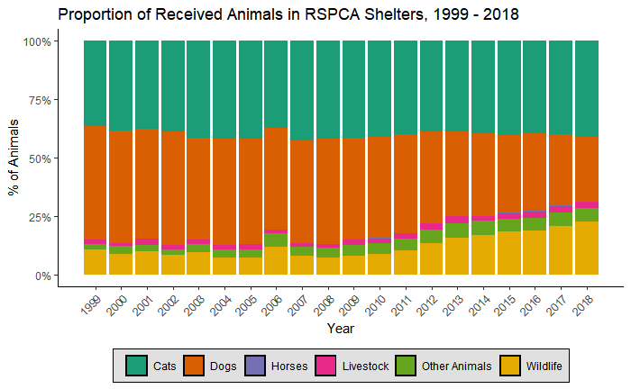
Animals Cared For
Total Animals in 2018
33,863 Dogs
51,170 Cats
479 Horses
3,309 Livestock
28,183 Wildlife
7,142 Other
Wildlife
Native birds
Lizards
Possums
Turtles
Koalas
Kangaroos & Wallabies
Etc.
Other
Budgies
Doves
Ferrets
Guinea Pigs
Mice
Rabbits
Etc.

Slide 4
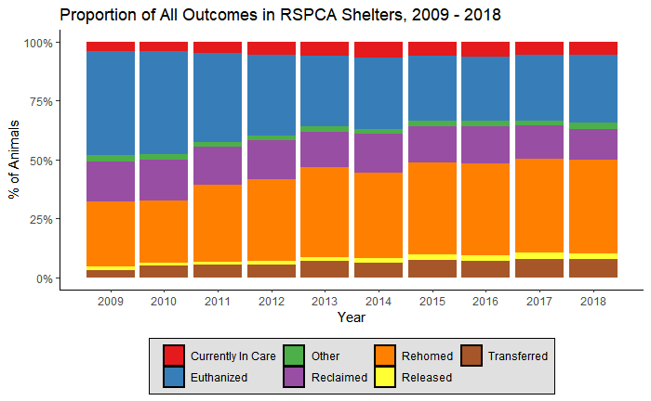
Outcomes

Slide 5
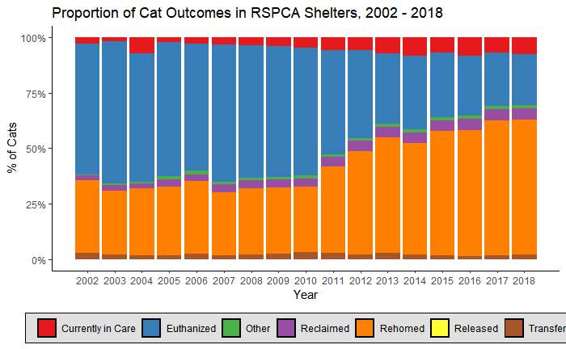
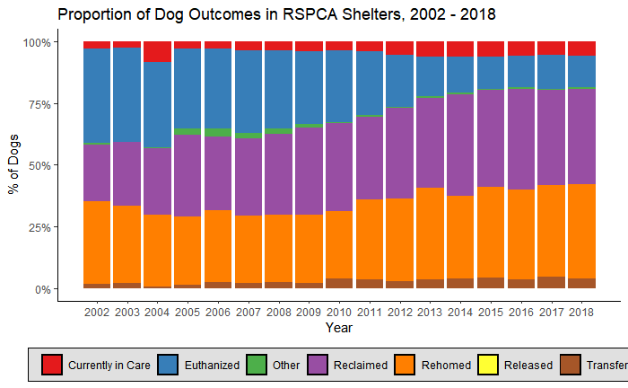
Outcomes – Cats & Dogs

Slide 6
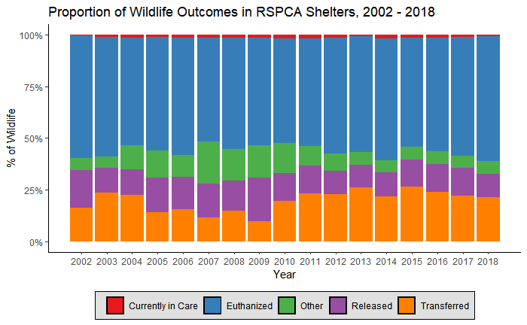
Outcomes – Wildlife

Slide 7
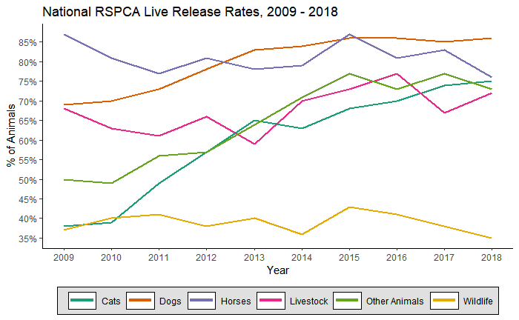
Live Release Rates
Total animals received in 2018:
33,863 Dogs
51,170 Cats
479 Horses
3,309 Livestock
28,183 Wildlife
7,142 Other
The LRR is the percentage of animals who were rehomed, reclaimed by their owner or transferred to a rescue group or other non-RSPCA facility as a percentage of the total number of animals received
(not including those currently in care or categorised as “other”)

Slide 8
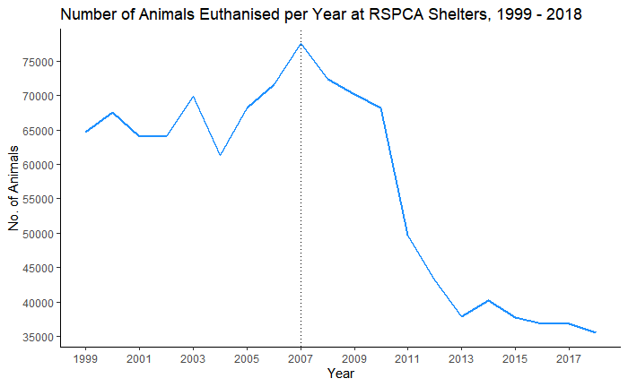
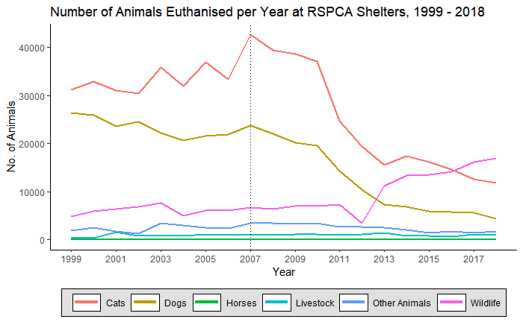
Euthanisation

Slide 9
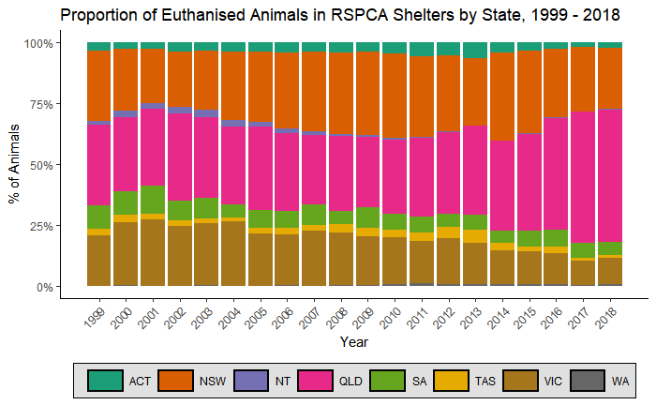
Euthanisation
Notes:
Western Australia big year in 2006 – total reported animals is up more than 38% on the previous year

Slide 10
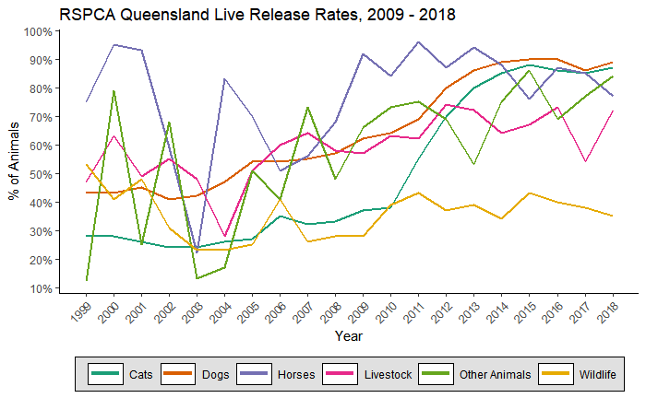
Queensland
Total animals received in 2018:
11,517 Dogs
13,648 Cats
125 Horses
1,597 Livestock
25,385 Wildlife
2,236 Other

Slide 11
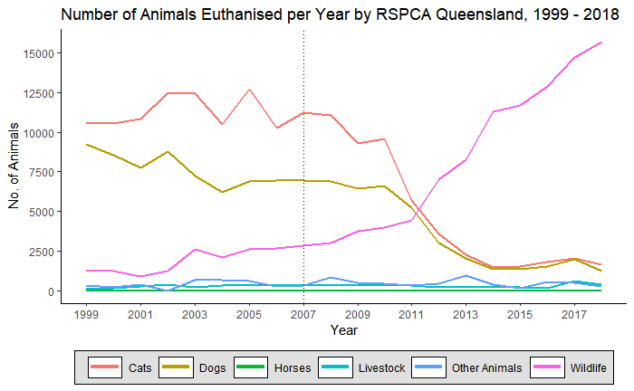
Queensland
15,690 wildlife euthanised in 2018
-- more than 92% of the recorded total for the entirety of Australia!
RSPCA Queensland operates specialist wildlife clinics to treat, rehabilitate and re-release wildlife.
Unfortunately, many of the animals injuries can cause significant pain and suffering or compromise their survival in the wild.
The RSPCA performs a difficult but valuable role in relieving the suffering of injured wildlife.

