Slide 1

Digital Forensics
An Introduction and the
Ethics of Evidence

Slide 2
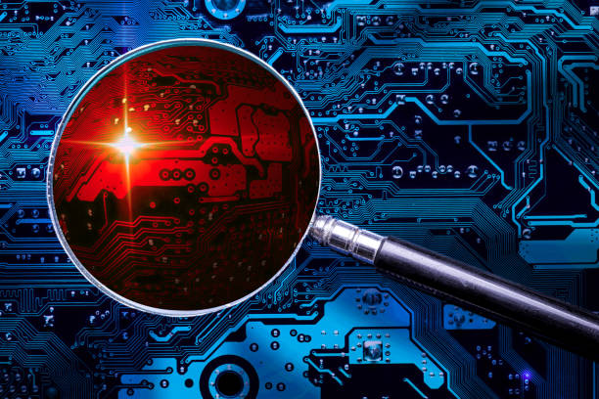
What is
Digital Forensics?
“A branch of forensic science that focuses on identifying, acquiring, processing, analysing, and reporting on data stored electronically”
Notes:
Thank Interpol for the definition.
Data a part of basically everything we do.
Working on our computers.
Texting people. Calling people!
Coming to class.
Crimes included.

Slide 3



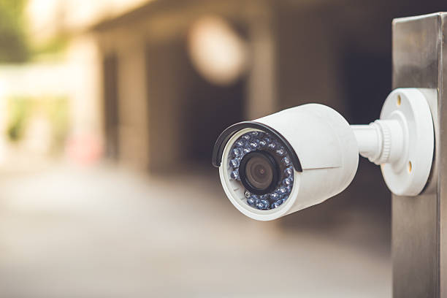
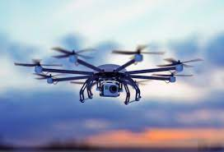

Where is the evidence?
Everywhere!
Notes:
CLICK Everywhere!
evidence collected from –
CLICK computers, smartphones, remote storage
drones, CCTV, aircraft telemetry.
Goal is to extract data, analyse it, turn it into useful information

Slide 4
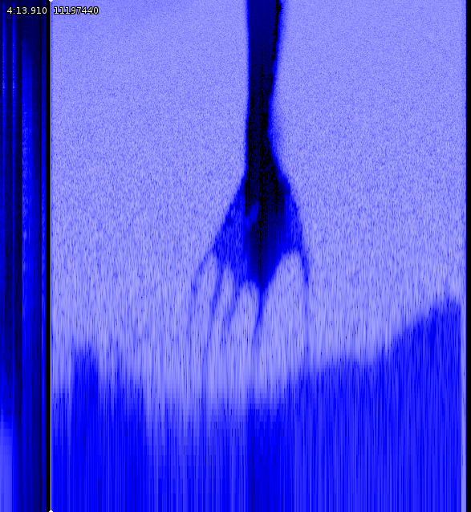
What does it involve?
Too much to cover here!
Analysis
Techniques
Who?
What?
When?
How?
Live analysis
Recovering deleted files
Reverse Steganography
Lots more!
I’m secret!!!!
Notes:
Involve?
CLICK – Too much to cover here!
Basics comes down to Analysis CLICK
Your basic questions CLICK
Who made these files?
What are these files?
When were they edited? When were they last accessed?
How are they stored? Are they structured in some way?
Is it software? How does it work?
Steganography is putting information within other information or physical objects so that you can’t immediately see it by examining it.
You might have seen stuff where applying different colour filters to a picture reveals different things.
In computing, put simply it’s concealing stuff inside files that shouldn’t be there. You can do cool stuff like leave pictures in sound, or leave messages not in pictures but at the end of picture files.

Slide 5


Tools for… good?
Notes:
Wireshark.
Pack analyser. Network troubleshooting, analysis, development, and spying.
Autopsy and the Sleuth Kit.
Digital forensics toolkits for studying hard drives. Autopsy is the front-end in the same way Github Desktop is to Git.
Brings all sorts of information about the drive into one helpful tool.
Internet browser bookmarks, history, cookies, search history, the lot.
Information about all the files, including deleted ones.
Emails stored locally? It’ll grab those. Contact lists and the like will be grabbed and catalogued too.
BOTH ARE FREE AND OPEN-SOURCE

Slide 6
Ethics!
What do consumers want?
Privacy & Confidentiality
Notes:
What do consumers want? CLICK
PRIVACY AND CONFIDENTIALITY!
You don’t want people to read your stuff!
Online? Don’t want people necessarily to know who you are. Where you live.
Right to privacy. Right to anonymity. Right to confidentiality.
Silly personal details up to your bank statements, tax records, medical information.

Slide 7
Ethics!
What does forensics hate?
Privacy & Confidentiality
“There should be a technology that will provide a backdoor for digital forensics investigators to gain access to the most securely encrypted disk drives.
However, there will have to be a restriction to the distribution of such technology when it comes to existence. This is to avoid its abuse by non-law enforcement practitioners (and potential computer criminals) to illegally access target data.”
Notes:
What does forensics hate? CLICK
Privacy & Confidentiality for all of the reasons I just said.
Here’s an insane paragraph from a paper published by two guys at Derby University.

Slide 8
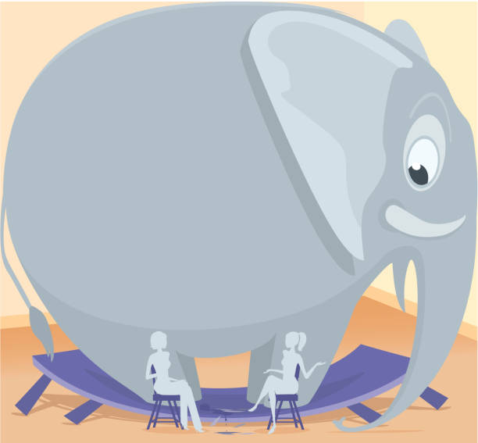
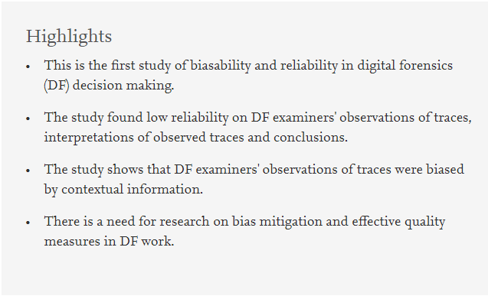
How do we trust them?
Recognised professional body
Code of Ethics
Training
Accreditation – ISO 17025 in UK
Notes:
So the good guys need CLICK
A recognised professional body with a code of ethics.
Proper, consistent training and accreditation.
ISO 17025 in 2017
Broad standard around Testing and calibrating laboratories to prove their output is consistent
Forensic Science Regulator code of practice
This stuff is the lynchpin on a lot of legal cases. It is super important that the court be able to implicitly trust the capabilities of someone doing this job and that the information presented is correct and accurate, just like any other profession.
Forensic Science International 2021
Study presented 53 experts mostly from Norway but also from the UK, Europe and a few other places
Same 3GB of data
given different types of contextual information either strongly indicating
guilt, containing ambiguous and weak indications of guilt, or else indicating innocence.
Other experts only received the scenario and no contextual information.
purpose was to better understand how such information impacted the judgment of experts.
The group provided with the context suggesting innocence made the smallest number of observations ‘indicating that they were biased to find less evidence’; and, by contrast, the group presented with information suggesting guilt found the highest number of observations ‘indicating they were biased to find more evidence’ – with the ‘weak guilt’ group finding ‘significantly more’ observations of guilt.
We’re making progress on this. Chartered Society of Forensics Sciences got a royal charter in 2014 and is the de facto body in the UK. US is a mess and has a whole bunch, making everything a little more shaky.

Slide 9
And we’re done!
Phew!

