Slide 1
JTAG
Ian.Hsieh
1

Slide 2
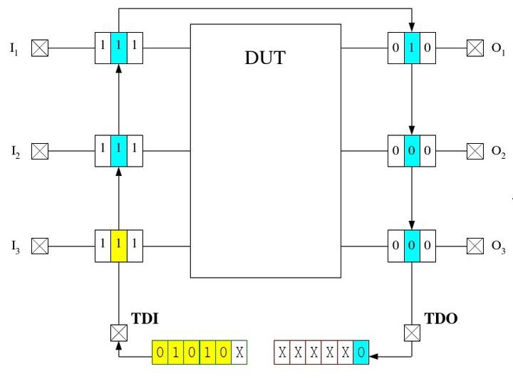
JTAG & DUT
2

Slide 3
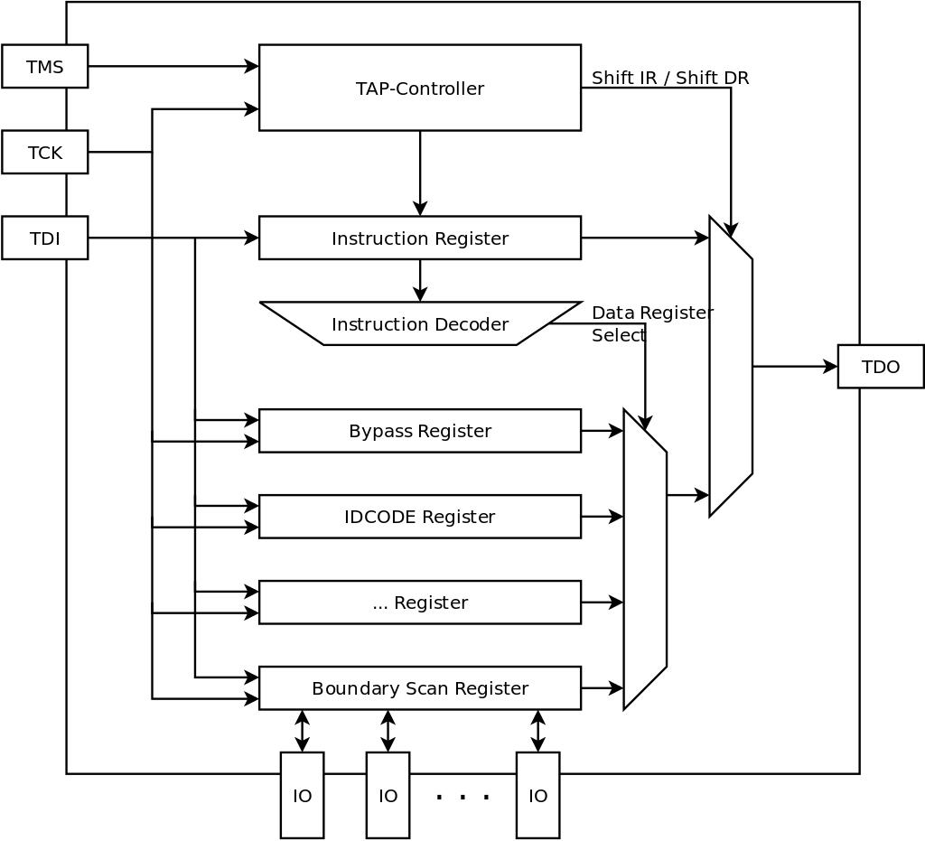
JTAG Overview
Input PIN: TMS、TCK、TDI
Output PIN: TDO
Block:
Boundary Scan Register
TAP Controller
Instruction Register
Instruction Decoder
Bypass Register
3

Slide 4
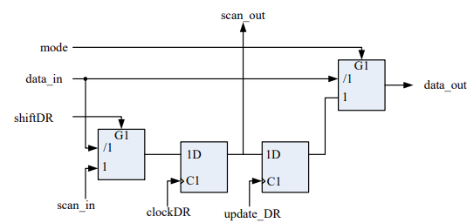
Boundary Scan Cell
Input PIN:
scan_in: from TDI or last cell
data_in: from last block in SoC or SoC input
mode: high when testing, EXTEST or INTEST
ShiftDR, ClockDR, UpdateDR: Controll Signal generated by TAP Controller
Output PIN:
Scan_out: to next cell or TDO
Data_out: to next block in SoC or SoC output
4

Slide 5
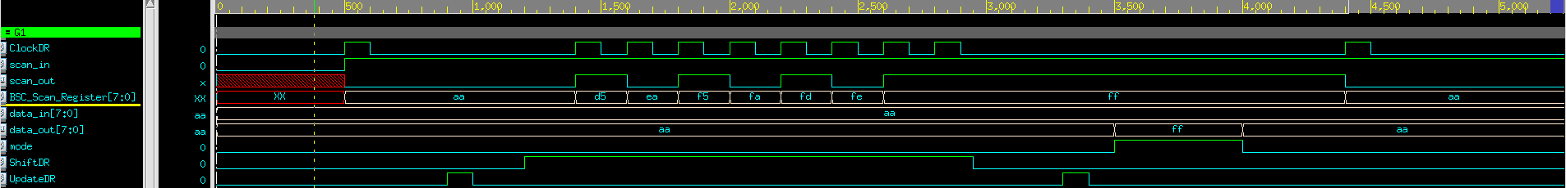
tb Boundary Scan Cell
5

Slide 6
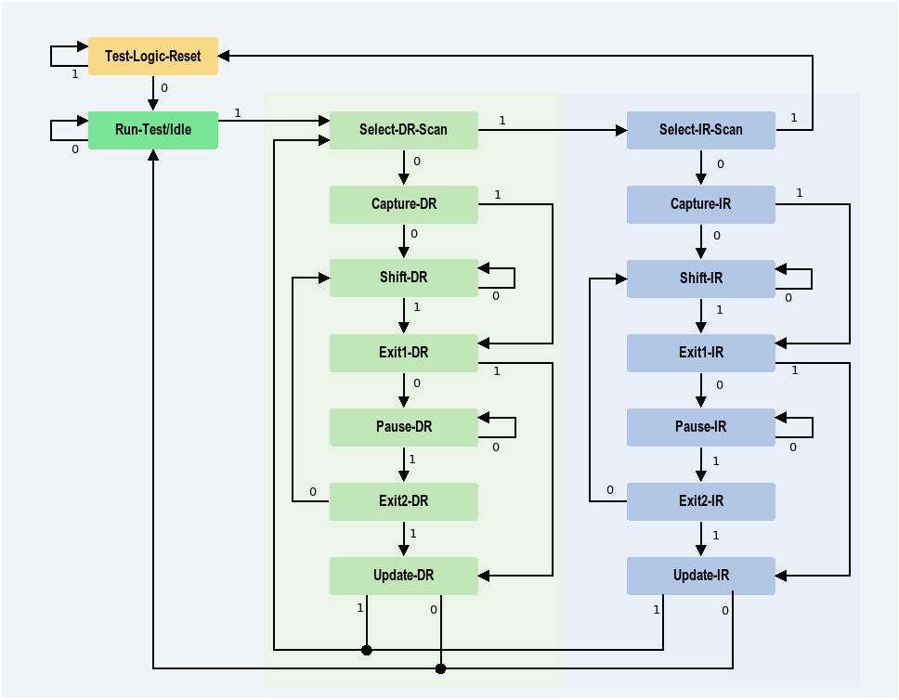
TAP Controller Finite-State Machine
TAP Controller is controlled by TMS
6

Slide 7
Instruction
Code | Instruction
0000 | BYPASS
0001 | SAMPLE_PRELOAD
0010 | INTEST
0011 | RUNBIST
0100 | IDCODE
… | …
1111 | EXTEST
7

Slide 8
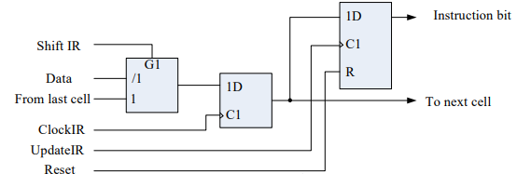
Instruction Register
Input PIN:
scan_in: from TDI or last cell
data_in: from last block in SoC or SoC input
ShiftIR, ClockIR, UpdateIR, Reset: Controll Signal generated by TAP Controller
Output PIN:
Scan_out: to next cell or TDO
Data_out: to next block in SoC or SoC output
8

Slide 9
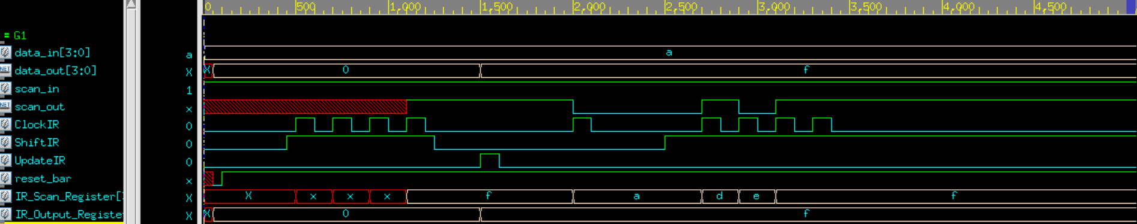
tb Instruction Register
9

Slide 10
Full Adder with JTAG
TAP
A[3:0]
BSC[8:5]
BSC[12:9]
cout
+
B[3:0]
BSC[4:1]
BSC[13]
sum[3:0]
cin
BSC[0]
IR
TDI
TDO
BR
10
TDI Generator

Slide 11
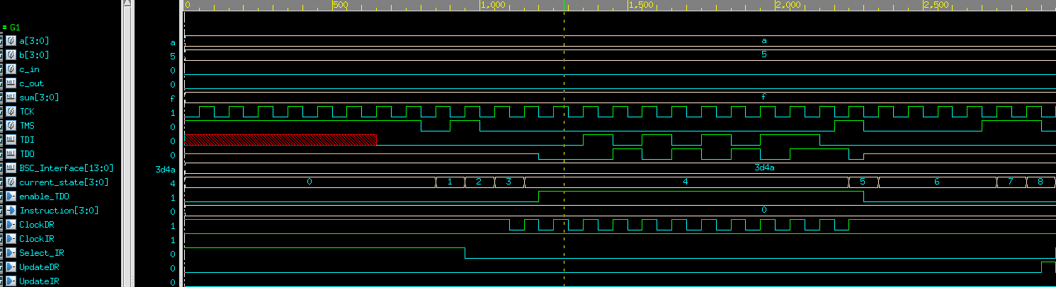
TESE CASE 1
BYPASS & Pause
11

Slide 12
TESE CASE 2
Load Instruction = 2, Pause
12

Slide 13
TESE CASE 3
Boundary Scan In
13

